Slide 1

Select Tracking Method:
Object Tracker
Facial Recognition Tracker
Mouse Tracker
Red:
Hue:
Green:
Saturation:
Blue:
Value:
Camera Feed

Slide 2
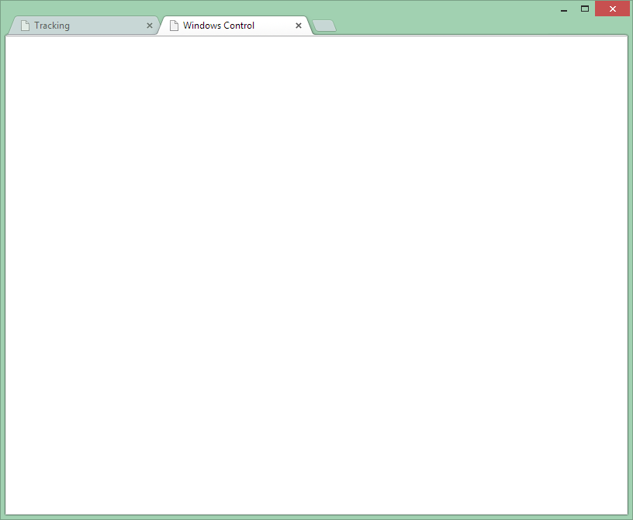

Windows Grid Organizer
Windows Perspective
Sleep Manager
Middle
Top
Left
Right
Bottom
Speed:
Left/Right Width:
%
Top/Bottom Height:
%

