Slide 1
Multi-Modal Deep Learning for Energy Demand Forecasting

Slide 2
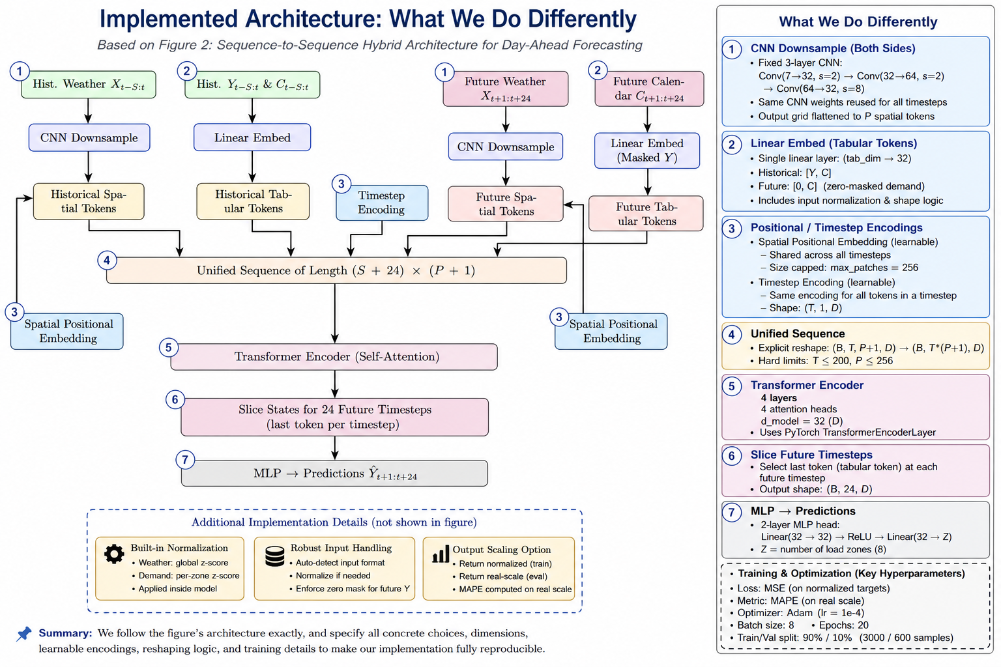
Part 1 - Architecture
Design Choices for Computational Efficiency
CNN Downsampling
Shared Weights
(single CNN encoder across all timesteps)
Small Embedding Dimension
(D = 32)
Lightweight Transformer Configuration
(4 layers, 4 heads, d_model = 32)
Minimal Tabular Token Design
(1 token per timestep, zero-masked future demand)
Efficient Output Slicing
(select last token per timestep for prediction)
Compact Prediction Head
(2-layer MLP: 32 → 32 → Z)

Slide 3
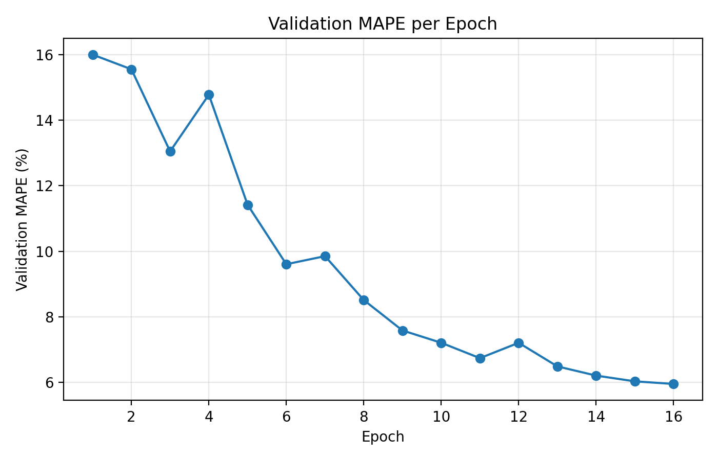
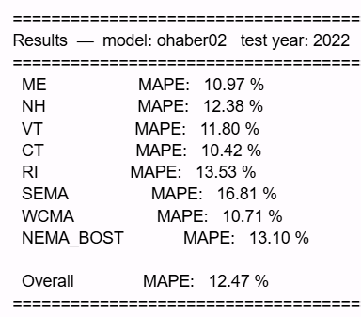
Part 1 - Results

Slide 4
Part 2 - Motivation + Fixes
1
2
3
Spatial-temporal bottleneck
No future demand prior
Limited capacity & training data
Spatial-Temporal Bottleneck
The flat baseline concatenates ALL (S+24)×(P+1) ≈ 2,496 tokens into one sequence.
A single 4-head D=32 Transformer must simultaneously parse weather patterns within each hour AND demand dynamics across time
These two structurally different tasks are competing for the same limited capacity.
Future tabular tokens zero-mask the demand dimension entirely.
ISO-NE demand has a strong weekly cycle: a Tuesday afternoon in December is highly predictable from the same hour one week prior.
The baseline discards this signal, forcing the model to reconstruct it from 168 hours of history.
D=32, 4 layers, 3,000 training samples, 20 epochs represents a small fraction of available capacity and the four-year dataset.
The model was underfitting the multi-year seasonal and geographic patterns visible across all 8 ISO-NE zones.
Fix: factorize into two dedicated stages
Fix: add 168-hour weekly lag as direct input
Fix: scale to D=128, 34,873 samples, 50 epochs
Notes:
Spacial-Temporal bottleneck
The problem is that ISO-NE demand has a very strong weekly cycle. The demand at 6pm on a Tuesday in December is highly predictable from what demand was at 6pm last Tuesday. That signal exists in the data — it's just that the baseline throws it away for future tokens, forcing the transformer to reconstruct the weekly pattern implicitly from the 168-hour historical sequence. That's a much harder learning problem.
The Part 2 fix is to replace the zero-mask with the actual demand from 168 hours prior (the weekly lag):

Slide 5
Part 2 - Architecture
5
Stage 1 — Spatial Transformer (per timestep)
2-layer TransformerEncoder · 8 heads · D=128 · pre-LN · GELU · dropout 0.35
Shape: (B×T, P=25, 128) — time dim folded into batch · mean-pool → 1 weather summary vector/timestep → (B, T=96, 128)
Element-wise add: weather summary + tabular embed + timestep pos. embedding → (B, T=96, D=128)
Stage 2 — Temporal Transformer
4-layer TransformerEncoder · 8 heads · D=128 · pre-LN · GELU · dropout 0.35
Shape: (B, T=96, 128) — one complete hour-level token per timestep
Notes:
The CNN produces P=25 spatial tokens per hour, just like Part 1. But instead of concatenating them across all hours, Stage 1 runs a 2-layer, 8-head Transformer over just those 25 tokens independently for each hour. The time dimension is folded into the batch:
So this Transformer only ever sees the 25 spatial patches from one hour at a time. Its sole job is: given this hour's weather grid, which cells are important? After attention, the 25 tokens are mean-pooled into a single weather summary vector per hour — one 128-dim vector capturing the full spatial context of that timestep.
Temporal:
Now each of the 96 timesteps is represented by a single fused token: the weather summary vector (from Stage 1) added element-wise to the tabular embedding (demand/calendar). A 4-layer, 8-head Transformer then runs over these 96 tokens:
(B, T=96, D=128)
Its sole job is: given 96 hours of complete hour-level summaries, how does demand evolve over time? The 24 future timestep outputs go through an MLP head to produce predictions.

Slide 6
Setting | Part 1 Baseline | Part 2 Hierarchical
Embedding dim D | 32 | 128
Transformer layers | 4 (single flat stage) | 2 spatial + 4 temporal
Attention heads | 4 | 8
Dropout | — | 0.35
Trainable parameters | — | 1,273,608
Historical lookback S | — | 72 h
Spatial grid G | — | 5×5 (P = 25)
Optimizer | Adam, lr=1e-4 | AdamW, lr=3e-4, wd=0.05
LR schedule | None | Cosine annealing to 1e-5
Loss function | MSE (normalized) | MAE (MW)
Batch size | 8 | 16
Epochs | 20 | 50
Training samples | 3,000 | 34,873
Training years | — | 2019, 2020, 2021, 2023
Validation year | 2022 | 2022

Slide 7
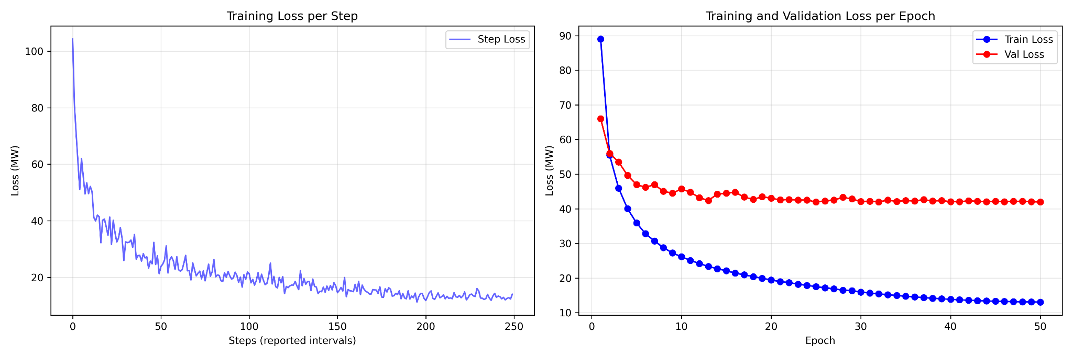
Part 2 - Results
Test year 2022 – best val MAE 41.94 MW
Takeaways:
Factorized attention removes the bottleneck
Weekly lag anchors the forecast
Scale: model + data
MAE loss + cosine annealing
Zone | Part 1 MAPE | Part 2 MAPE | Improvement
ME (Maine) | 10.97 % | 2.79 % | −8.18 pp
NH (New Hampshire) | 12.38 % | 1.86 % | −10.52 pp
VT (Vermont) | 11.80 % | 3.26 % | −8.54 pp
CT (Connecticut) | 10.42 % | 1.97 % | −8.45 pp
RI (Rhode Island) | 13.53 % | 2.24 % | −11.29 pp
SEMA | 16.81 % | 2.39 % | −14.42 pp
WCMA | 10.71 % | 1.60 % | −9.11 pp
NEMA_BOST | 13.10 % | 1.47 % | −11.63 pp
Overall | 12.47 % | 2.20 % | −10.27 pp

Slide 8
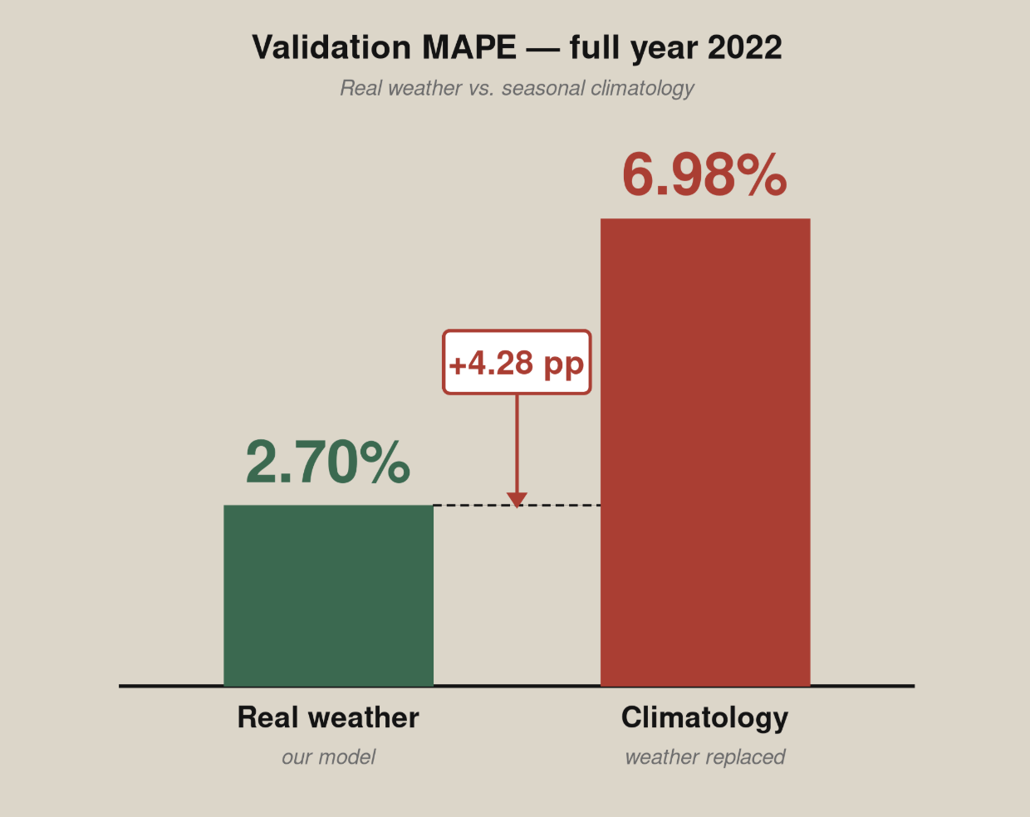
Part 3 - Does weather actually matter?
Hypothesis: the 168-hour weekly lag is doing all the work and weather is noise.
Test: replace real weather inputs with seasonal climatology (per month/day/hour mean) and re-evaluate the same model.
Result: MAPE jumped from 2.70% → 6.98% (+4.28 pp). Effect was strongest at long horizons (t+24: +4.90 pp) and on cold days (+4.67 pp).
Hypothesis rejected — the model is genuinely multi-modal.

Slide 9
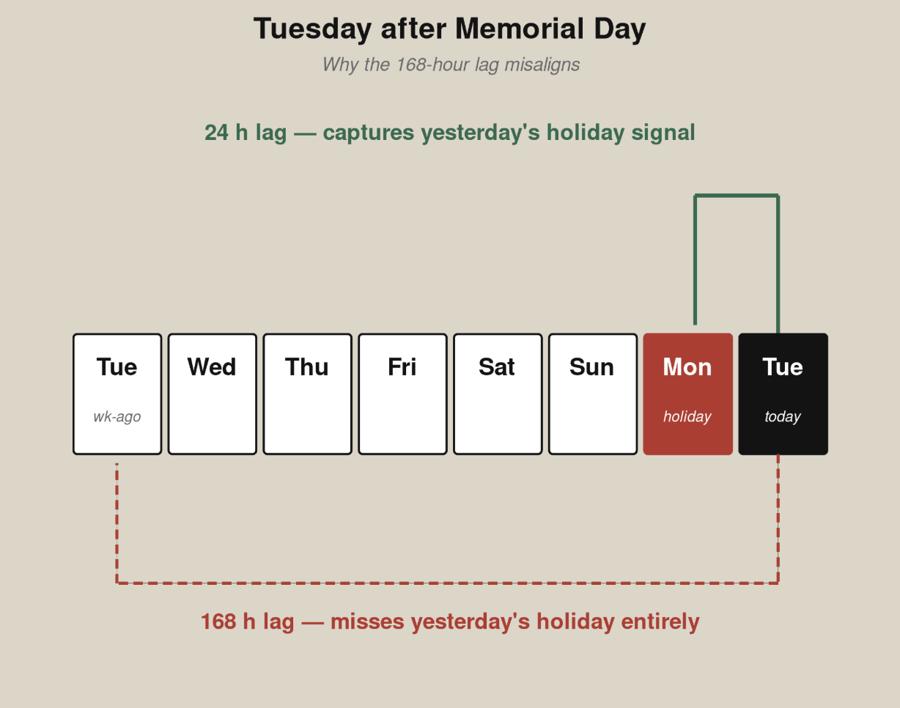
Fixing the worst remaining failure
Diagnosis: highest-error days clustered around holidays. The 168-hour weekly lag misaligns on the Tuesday after Memorial Day — it doesn't reflect that yesterday was a holiday.
Fix: add a 24-hour lag (yesterday-at-this-hour). Always carries the previous day's pattern, holiday or not.
Cost: +1,024 parameters (0.06% of model), same training schedule.
Result: 2.70% → 2.61% MAPE, 6 of 8 zones improved.

