Slide 1
Using MDS to construct global maps
By: Alex Bronstein & Owen Haber

Slide 2
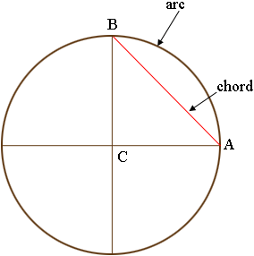
Problem…
You wake up one morning to find that every map of the world has been erased from existence
- no globes
- no gps
All you have is a strange notebook from a very determined traveler, who walked between cities and
recorded his distance (always walking along the surface of the earth, never tunneling or flying).
This is the geodesic distance from walking between 50,000 major global cities

Slide 3
Goal
With only these “arc length” geodesic distances,
can we recreate 3D or 2D global maps using only Multi-Dimensional Scaling and Procrustes alignment.

Slide 4
MDS Review
Want to find nxd matrix P:
Distance Squared Matrix D:
Define matrix J as:
Define matrix X as:
Eigen decomp X:
We can now recover P:
Where each row is just the coordinates of a point
Where D_{ij} = distance(x_{i},x_{j})²
J = I − (1/n) * 1 1ᵀ
X = -½ JDJ where also X = PPᵀ
X = VΛVᵀ where Λ is just a diagonal matrix with the eigenvalues of x
P = VΛ^{1/2}
Notes:
We begin with the matrix of squared distances:
That is the only information we assume we’re given, the travelers notebook
We then define our centering matrix J, which
which subtracts the mean from every column.
We’ll use it to recover inner products from distances
Matrix X is our gram matrix, which
Is a matrix of all the dot products between your points
Captures the distance between points, direction, and dimensionality of space the point cloud lives in (entire geometry of our point cloud)
PSD
We then do the eigen decomp of the gram matrix,
Picking the top k eigenvalues and eigenvectors we get our dimensional space
The eigenvectors give the directions of the embedding, the eigenvalues give the scales, and multiplying them gives us the coordinates.
That final matrix is P, and each row is the recovered coordinates of a city

Slide 5
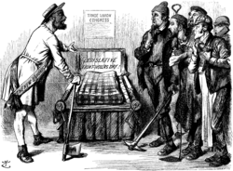
Procrustes alignment
Procrustes alignment takes 2 shapes (2 sets of points) and then finds the best rotation, translation and scaling that minimizes the error between the two
The relation it has to MDS is that if we perfectly reconstruct a set of points, they still may be inconsistent by a rotation.
Inputs: X (the shape we want to align) and Y (the shape we want X to match)
Goal is to minimize: ||Y - (sXR + t)||²_{F} where s is a scaling factor R is a rotation matrix and t is a translation vector (1xd) where each entry of
t is added to every entry of sXR at its respective column.
Notes:
Additionally when we use it to reconstruct the globe based on the continents we can use it to both scale and properly orient our continents relative to each other in order to get the best representation.

Slide 6
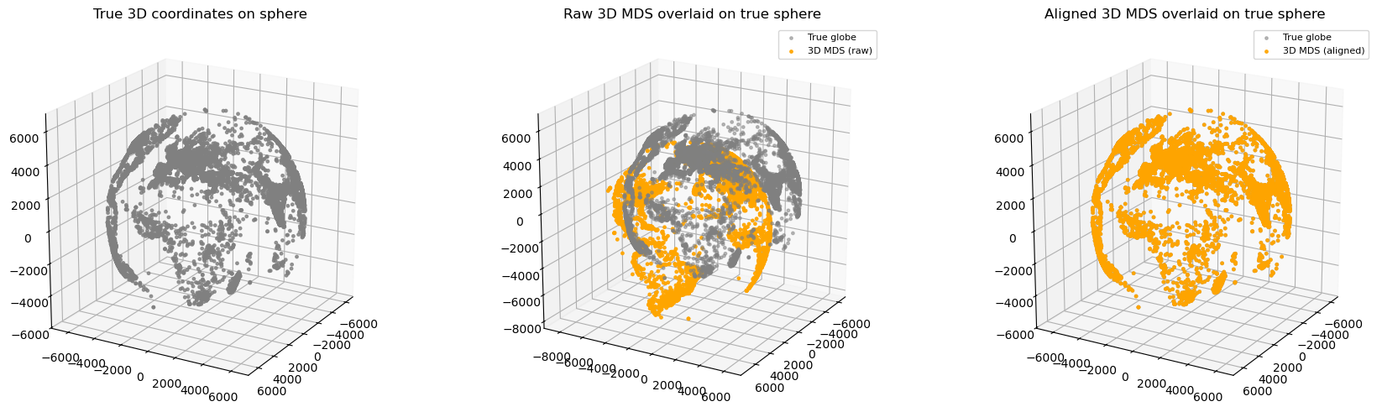
Example
(using 3D Euclidean Coordinates)

Slide 7
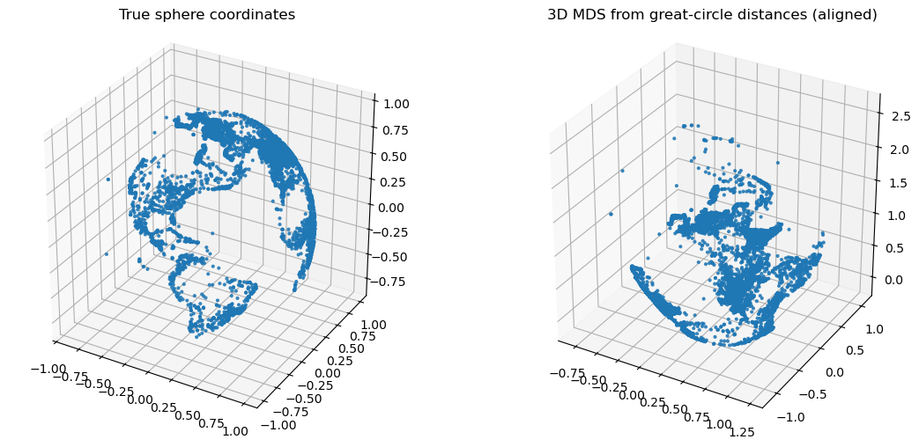
Our Problem: Curvature in 3D
We are measuring the arc length between two points on a sphere, not the euclidean distance.
We ran 3D MDS on these new distances and compared them to the same 3D ground truth coordinates
Visually, we can tell this is a poor recreation

Slide 8
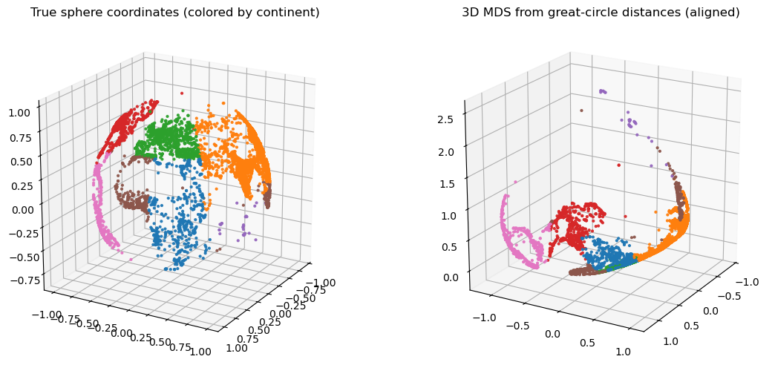
While the structure is bad, some information is still there…

Slide 9
What if we do MDS on individual continents,
Theory:
A “slice” of the entire globe covering a smaller area will yield a reconstruction with less curvature distortion. Due to bend from the local arch of the sphere being smaller, there should be less distortion in the MDS reconstruction per continent.
Stitching these continents back together with procrustes may lead to a better piece-wise reconstruction than doing it all at once.

Slide 10
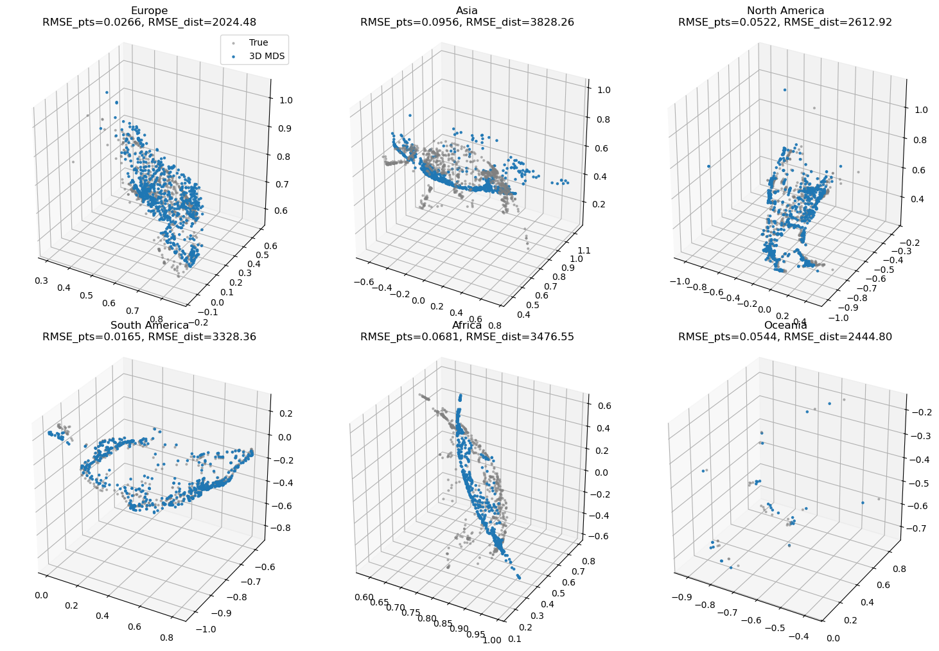
Results of 3D MDS on Geodesic Distances

Slide 11
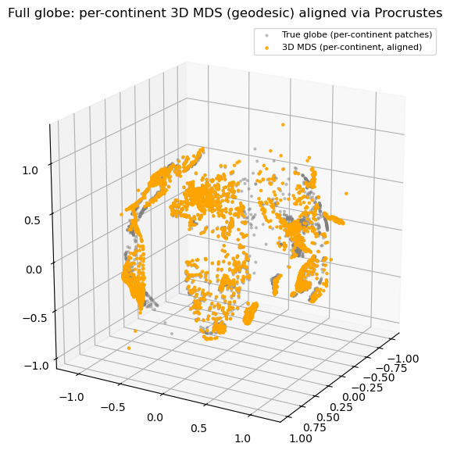
Applying Procrustes

Slide 12
3D Takeaways
Can roughly tell its a sphere
Procrustes still works
Some degree of distortion is unavoidable

Slide 13

2D Map

Slide 14
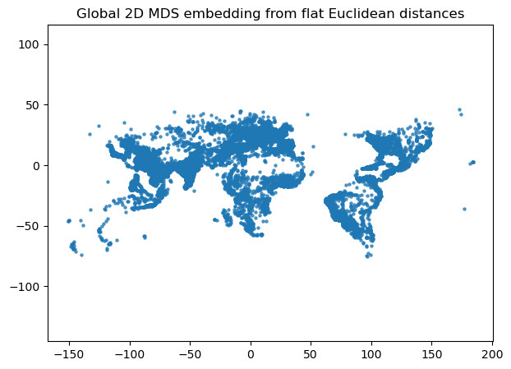
Result for 2D MDS on flat Euclidean distances
Very similar up to a reflection

Slide 15
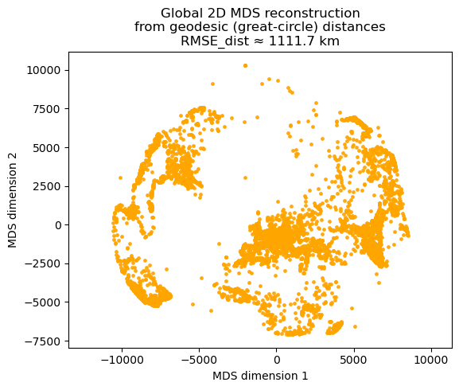
Our Problem: Curvature in 2D
This time we ran 2D MDS on these new distances and compared them to the same 2D ground truth coordinates
Visually, we can tell this is also a poor recreation

Slide 16
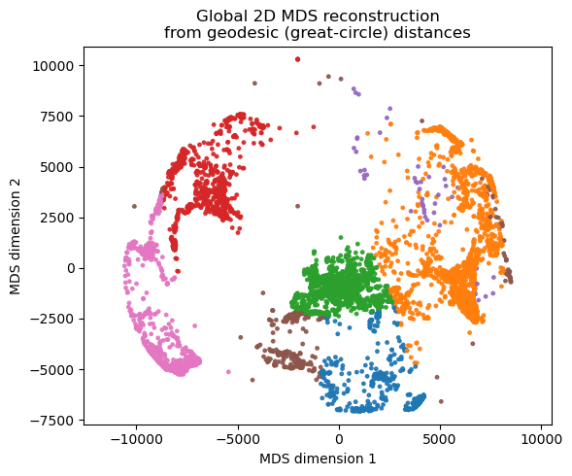
Isolating continents we can see similarly,
Notes:
Continents are sticking together but very distorted
Lets again try by using the per continent method

Slide 17
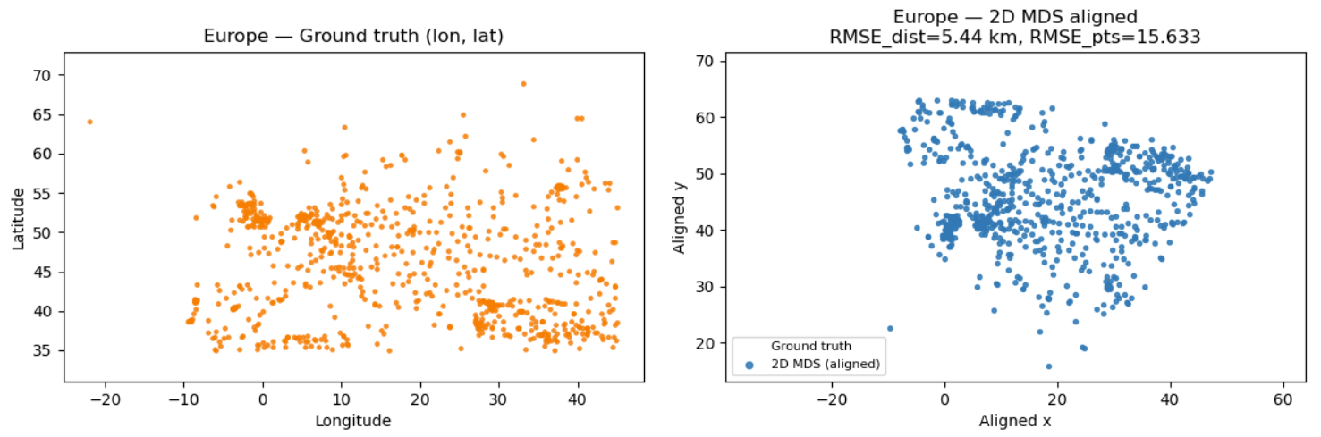
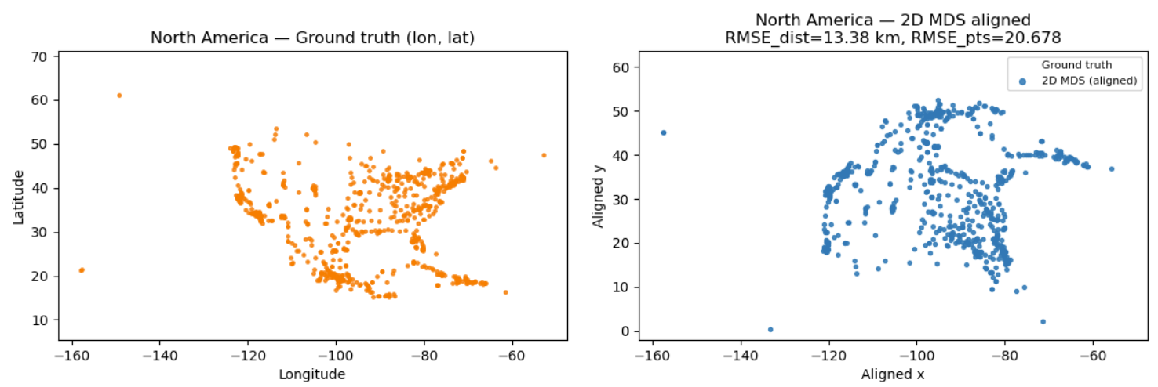
Results of 2D MDS on Geodesic Distances

Slide 18
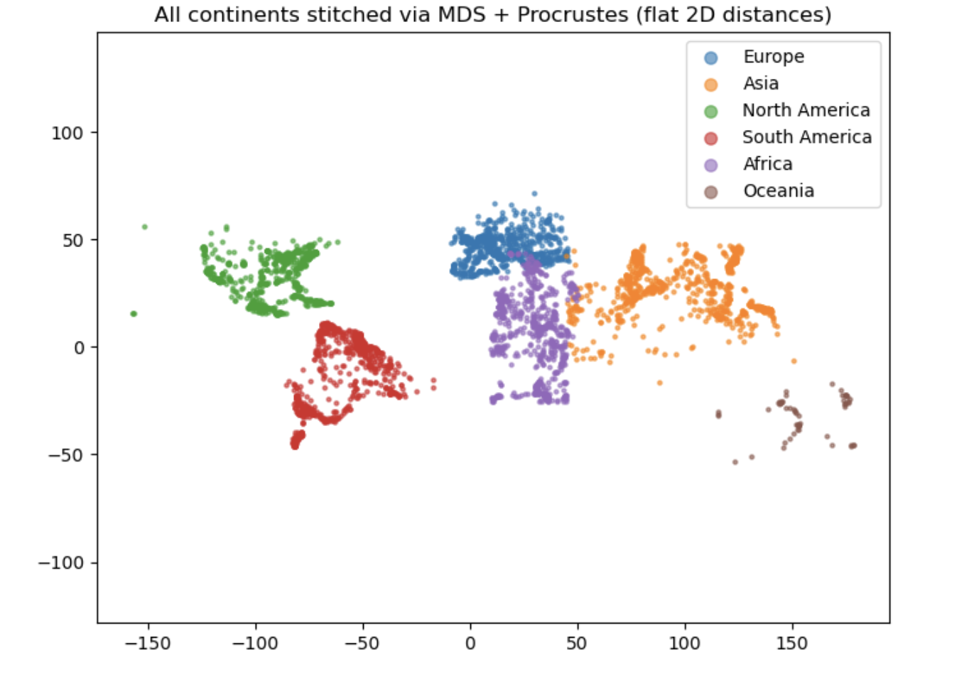
Applying Procrustes
Each continent is aligned to its own coordinates -> placed in roughly correct positions
Each continent’s 2D MDS was independent -> causes projection distortion
Projection distortion results in small rotational
mismatches that procrustes cannot fix globally
Notes:
Each continent is Procrustes-aligned to its own lon/lat coordinates, which places them into the right general global positions. But because every continent’s 2D MDS is created independently and lon/lat introduce projection distortion, the continents end up with slight rotational mismatches that Procrustes cannot fix globally.

Slide 19
Final Constructions: 3D and 2D Maps

Slide 20
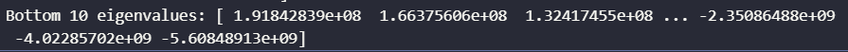
Diagnosing Failures
MDS assumes distances come from a euclidean inner product
But geodesic distances are not the square of a euclidean distance so it scales differently
There is a nonlinear relationship between geodesic distances and euclidean distance
Cannot be realized as || x_i - x_j|| in R3
This causes the Gram matrix to lose the PSD property
Negative eigenvalue appearing -> no euclidean embedding exists in R3
It's not a numerical failure but a geometric space incompatibility
MDS is built for perfect euclidean reconstruction

Slide 21
Conclusion
Using only distances between major cities, MDS can reconstruct a convincing 3D model of the Earth when distances are Euclidean chord distances.
With realistic geodesic distances, MDS runs into issues caused by the earth's curvature: even 3D embeddings can’t be exact, and 2D global maps distort heavily.
By working continent by continent and using procrustes to align and stitch, we get a good flat map constructed purely from distance data.
Surprisingly, even without using euclidean coordinates, some of our MDS reconstructions were much better than expected, yielding results that actually resembled the globe and 2d maps we are used to.
More data -> by country instead of by continent possibly leading to even better reconstruction
Notes:
Also talk about if we had bigger data set we could do by country instead of continent (even flatter)

Slide 22
Thank you

Slide 23
Any questions?
Ask away!

