Slide 1
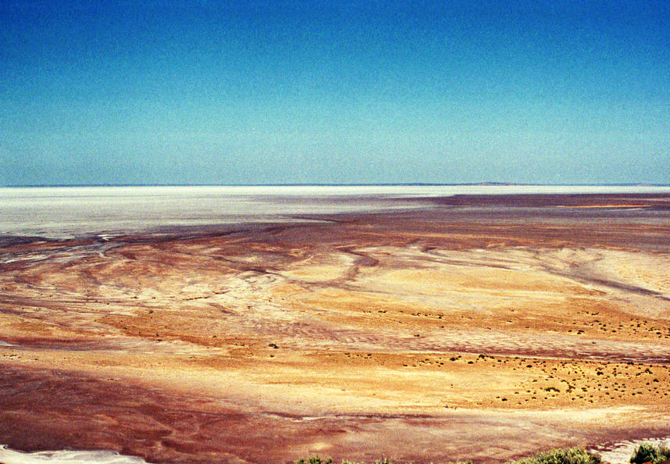
Visions in the Desert
The Australian Outback as a Testing Ground for Future Mars Missions

Slide 2
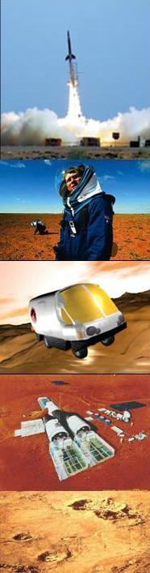


Introduction
Australia in Space
  Astronomy
  Deep Space Tracking
  Woomera
  Research Organisations
Australia as a Testing Ground for Mars
  Mars Analogue Research
  Why Australia?
  Jarntimarra Expedition
  The MarsOz Vision
  Starchaser Marsupial Rover
  Analogue Space Suits
  Expedition 1
  Expedition 2
  Human Factors

Slide 3
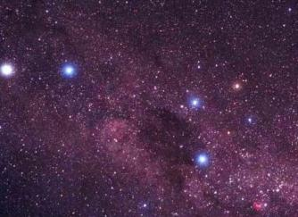
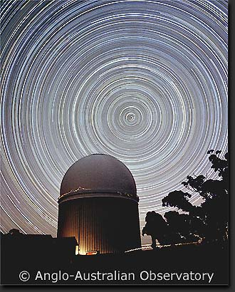
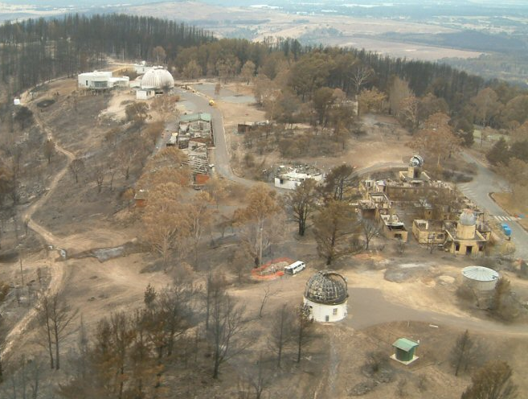
Astronomy
Background
Historical strength, reflecting early needs of timekeeping and navigation
Obvious advantages of Australia include view of the southern hemiphere, clear skies
Optical and radio
Major Facilites include …
Anglo-Australian Observatory (1974)
Mt Stromlo (1924), being rebuilt
Parkes Observatory

Slide 4
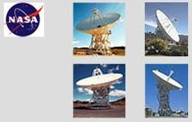

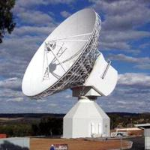
Deep Space Tracking
Tidbinbilla
Part of the NASA Deep Space Network
Located at Tidbinbilla, 16 km north of Canberra
Established in 1965 under impetus of Lunar program
Also included Parkes Radio Observatory
Supports most of NASA’s deep space missions including current Mars missions
New Norcia
ESA’s first deep space ground station
Located at New Norcia, 150km north of Perth
Opened 5 March, 2003
Missions supported include Mars Express, Rosetta and Cassini-Huygens

Slide 5
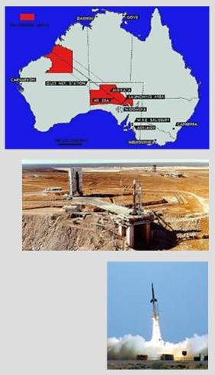
Woomera
History
1947 Long Range Weapons Establishment formed between UK & Australia.
1949 – Launch facility opened
Programs included Skylark (1957), Black Knight (1958) & Europa modified Bluestreak (1964) rockets.
1967 – Australia’s first satellite WRESAT-1 launched
1971 – British Prospero satellite launched on a Black Arrow, spaceport closes
1980s-90s - Proposals to re-open the space port, at Woomera and elsewhere in Australia
Present day – activities include ASRI sounding rocket program, Hyshot scramjet tests, Japan’s Hayabusa asteriod sample return touchdown

Slide 6


Planetary Sciences
Background Context
Australia has no national space agency, declining invitations to join or become an associate of NASA & ESA
Australia historically strong in geology, driven by needs of the mining & exploration
Australian Centre for Astrobiology
Opened 2001
Macquarie University, Sydney, NSW
Associate of NASA Astrobiology Institute
http://aca.mq.edu.au/
Planetary Science Institute
Australian National University, Canberra
http://www.mso.anu.edu.au/PSI/

Slide 7
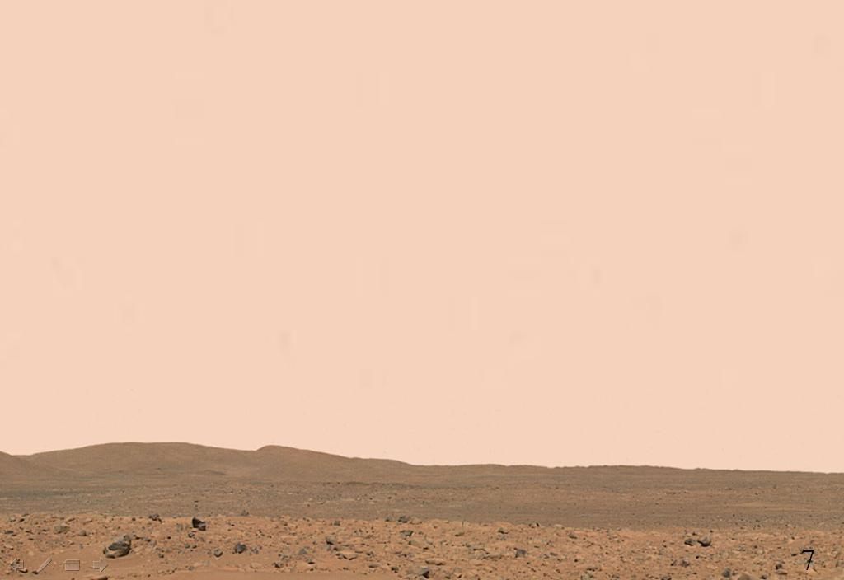
Mars Analogue Research
Definition: Analogue Research
Work that furthers an understanding through analogy and simulation, may encompass different disciplines
Terrestrial Mars analogue locations on earth have environmental characteristics which duplicate landscapes/features observed on Mars
Mars is Extremely Dangerous!
At least a 1 year return trip
Usually below freezing
Low pressure, poisonous atmosphere
Dusty, probably chemically reactive
Extraordinarily interesting scientifically
Will Need to Rigorously Field Test
Equipment – Habitats, Power & life support systems, Rovers, Tools etc.
People – For dealing with isolation, danger, confinement, group dynamics, skills balances.

Slide 8
A Testing Ground for
Future Mars Missions?

Slide 9
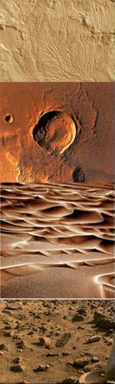
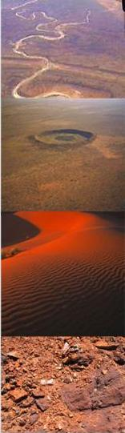

Why Outback Australia?
Unique Geology
Ancient landscape
Similar variety of landforms to those seen on Mars including dried lakes & rivers, dunes, stoney plains
Many preserved impact craters
Some of oldest fossils on earth
Dust rich environment
Practical Advantages
Modern infratructure support
Remote, yet accessible
Capacity for long range rover trials

Slide 10

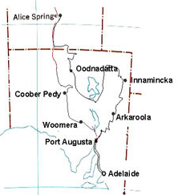
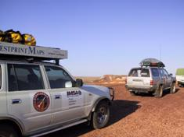
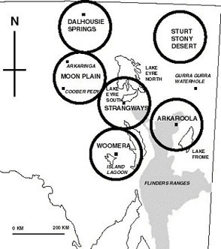
Jarntimarra
(Testing location scouting expedition)
Expedition Route
Expedition Profile
Systematic survey of outback Mars analogue environments
Sponsored by Starchaser Industries
Produced a database of locations assessed according to scientific, engineering, logistic & visual criteria
6 prime target regions were selected, each offering scope for a broad range of analogue activities (shown right)
Arkaroola in Flinders Ranges identifed as preferred site

Slide 11
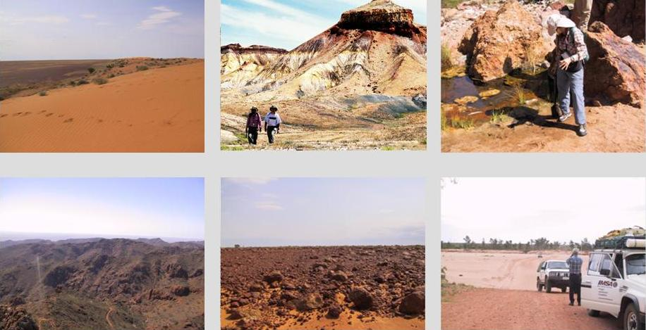

Slide 12
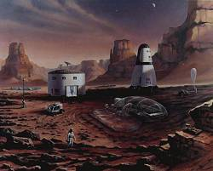
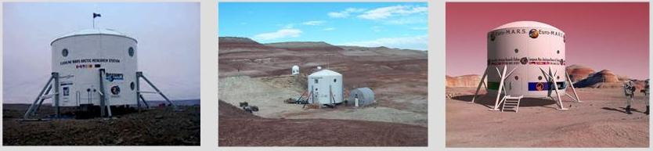
MARS (Mars Analogue Research Stations)
Mars Society Facilities
Prototype Mars base, laboratory for learning to live & work on another planet
Part of a network of 4 proposed in 1998
2 deployed another awaiting deployment
Based on Mars Direct ‘Tuna Can’ architecture
Used as a platform for multi-disciplinary R&D
Mars Direct Mission Architecture
Flashline, Devon Island
Mars Desert Research Station, Utah
Euro-Mars, Iceland (planned)

Slide 13
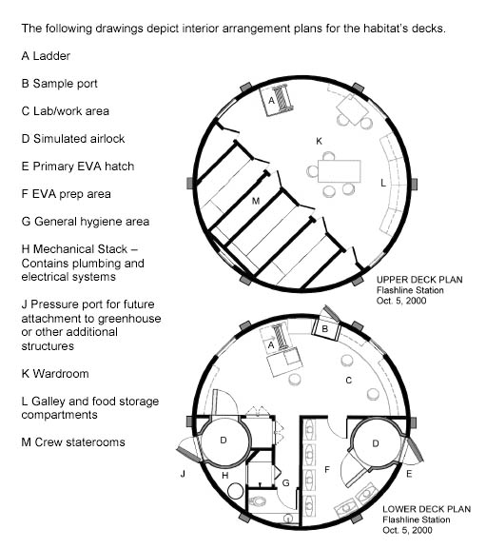
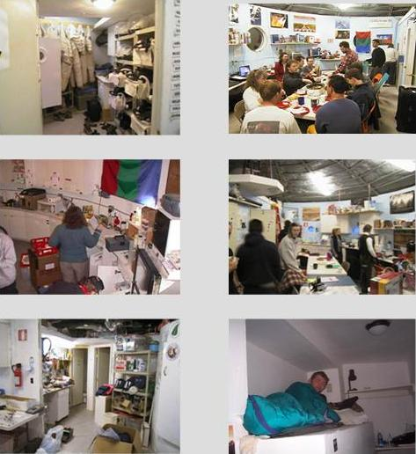
Internal plan of Flashline Research Station
(MDRS varies from this slightly)

Slide 14
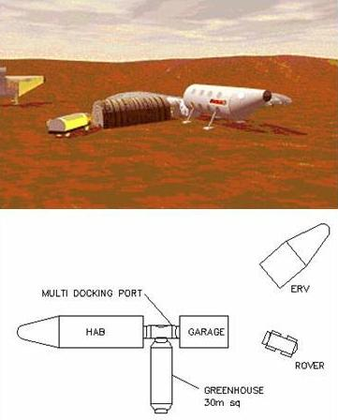
The MarsOz Vision
Key features
Uses a horizontal biconic lander form
Interior plan uses modular, fold-away planning
Platform for multi-disciplinary research
Full technical description in 2 papers appearing in JBIS this year
Seeking funding to deploy full station
Reasons for Biconic Form
Existing research stations are of ‘tuna can’ design, value in exploring alternative configurations
It enables units to be transported onto the site as a single, completed unit rather than constructed in situ.
Also more closely resembles the reality of landing units onsite.
Option of relocating units to another region or transporting them back to the city for maintenance.

Slide 15
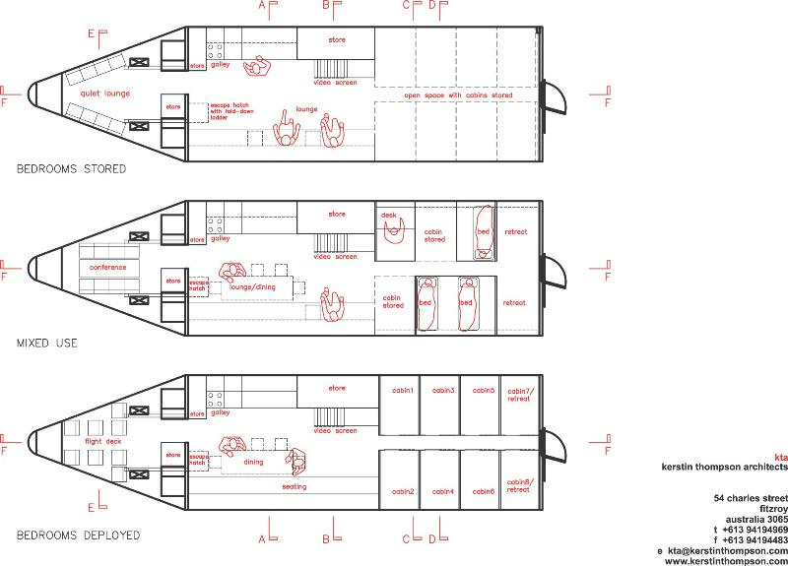

Slide 16
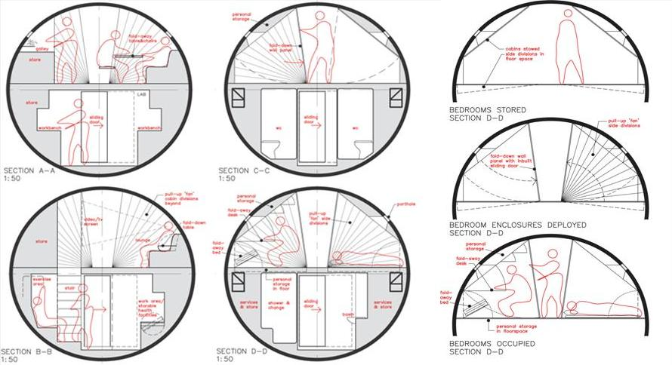

Slide 17
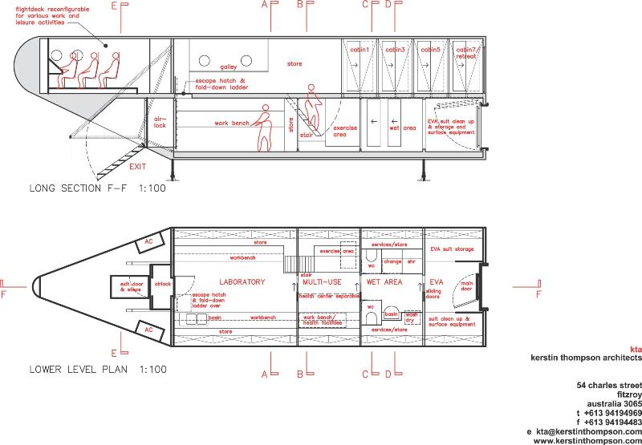

Slide 18
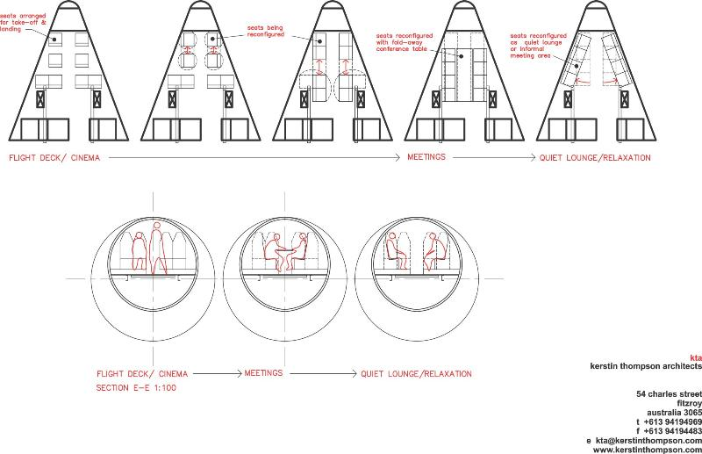

Slide 19
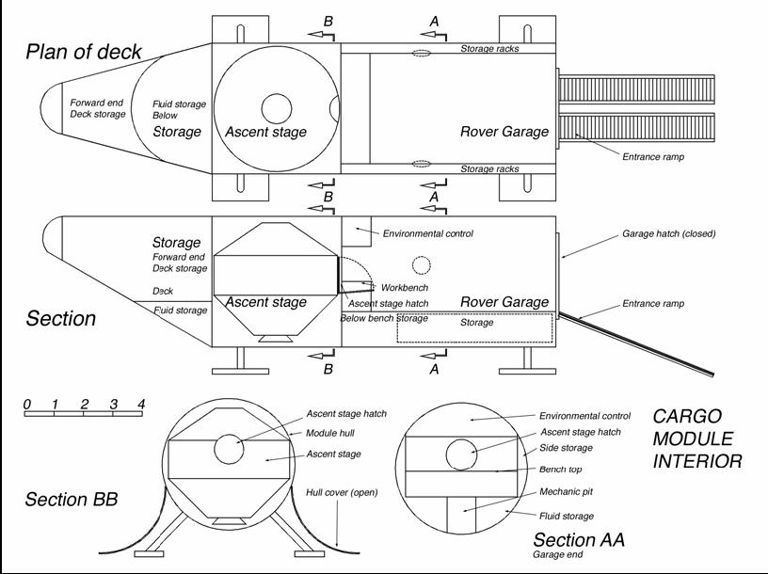

Slide 20
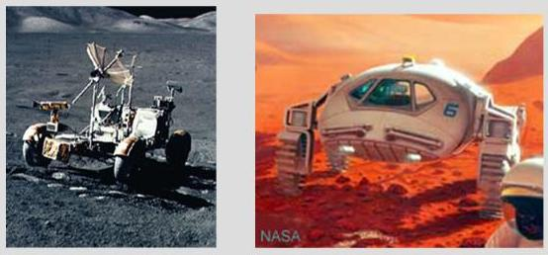
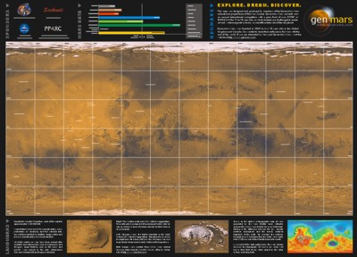
Rovers
Mobility critical for 18 month exploration of Mars landing areas.
Major gap in existing knowledge base about their optimal design & deployment.
Design Issues
What is optimal crew size?
Does the vehicle need to be completely pressurised?
What are optimal exploration strategies?
How far from home base can a rover safely go?
How does a landing party explore a land area as large as all the continents combined?

Slide 21

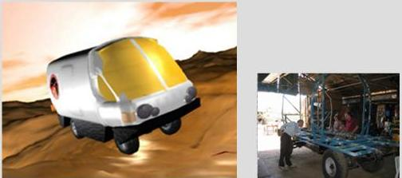
Marsupial Rover
Project Background
Based in Fremantle, Western Australia
Project Manager - Dr Graham Mann
Project one of 3 to secure seed funding in 2000 Mars Society design competition
Sponsored by Starchaser Industries
Design Approach
Analogue of a pressurised, long range exploration vehicle
Reproduces living/working facilities required in a rover to make journeys of up to 100km under full simulation conditions
Compact, light, 2 person design based on Landrover chassis

Slide 22
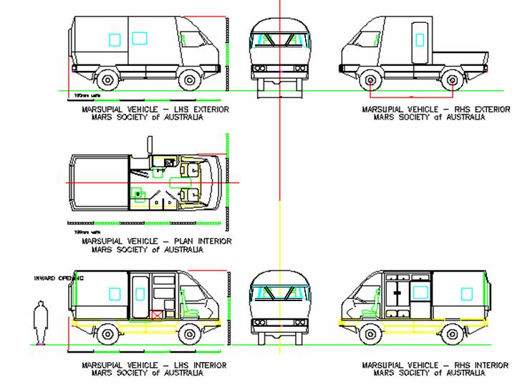
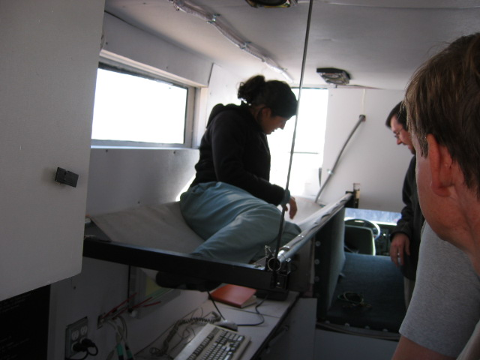

Slide 23
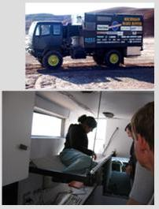
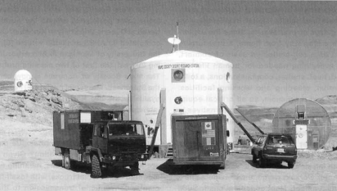
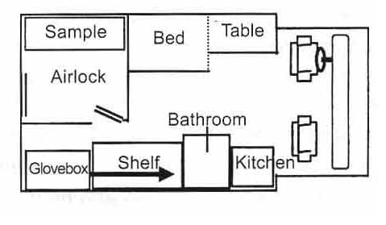
Everest Interior
Everest
Ares
2003 Comparative Study
Graham Mann undertook a comparative field trial of the Canadian Ares and Michigan Everest rovers in March 2003
Results published in JBIS (February 2004.)
Ares Interior Plan

Slide 24
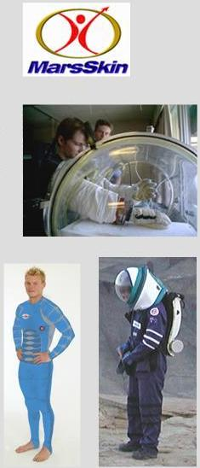

Analogue Space Suits
MCP Technology
Uses layered elastic fabrics to hold the body at liveable pressures
Unpressurised except for helmet & groin
Current suits are gas pressurised, stiff and lack dexterity, difficult for crew to work in.
MarsSkin Analogue Suits
Developed by James Waldlie
Aim to reproduce movement constraints of real suits
Field tested in Utah, Arkaroola
So far been used to examine movement, tool, field of vision issues
Mechnical Counter-Pressure (MCP) Suit

Slide 25
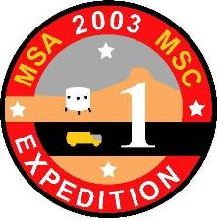
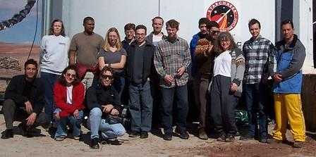
Expedition 1
Participants
- Joint Australian-Canadian Mission
- 26 crew (rotated)
- Australian, Canadian, French & American.
- Engineers, scientists, publicist.
Location & Duration
- Held at Mars Desert Research Station, Utah
- February 15 – March 15, 2003
- 1 month, comprising 4 different week long phases
- analysis of results continuing
Research Program
Geology – Detailed mapping of surroundings
Biology – Microbiology Studies
Engineering – Dataloggers, Analogue Rovers & Suits
Psychology/Human Factors

Slide 26
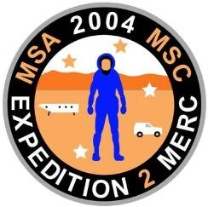
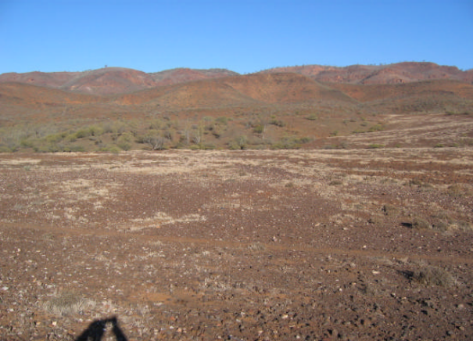
Expedition 2
Participants
- August 1-28, 2004
- Similar crew size & composition to Expedition 1
- Many of the same crew, some doing follow up studies
- Accommodation at Arkaroole resort former shearing quarters
Location & Duration
- Held in Arkaroola Region, Flinders Ranges, South Australia
- August 1-28, 2004
- 1 month, comprising 4 different week long phases
- analysis of results also continuing
Research Program
Geology – Field survey mapping of surrounding
Biology – Microbiology & Extremephile studies
Engineering – Dataloggers, Suits, MarsOz site selection
Psychology/Human Factors – group dynamics, exploration strategies
Preferred site for MarsOz

Slide 27
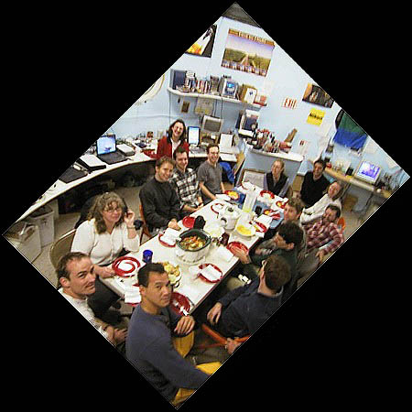
Psychology
Dr Steve Dawson & team
Groups in isolated, confined conditions have very particular needs with respect to
- Sleep
- Clothing
- Exercise
- Workload
- Leadership
- Medical & Psychological Support
- Personal Hygiene
- Food Preparation
- Group Interaction
- Outside Communications
- Recreational Opportunities
- Personnel Selection Criteria
- Privacy & Personal Space
- Remote monitoring of Performance
Potential Social Cleavages
- nationality
- profession
- research versus support crew
- age
- gender

Slide 28
Read more at
www.marssociety.org.au
The Australian Outback as a Testing Ground for Future Mars Missions

