Slide 1
Week 8
Inheritance – Derived Classes, Functions in a Hierarchy

Slide 2
Agenda
Week 8-1
Hierarchy
Relationship
Derived Classes & Base Classes
Access Levels
Week 8-2
Functions in a Hierarchy
Shadowing
Constructors and Destructors

Slide 3
Week 8-1

Slide 4
Hierarchy
Inheritance is the 2nd pillar of OOP and it forms a set of relationships between related classes
A hierarchy will help us describe the concept of inheritance in the Object Oriented style of programming

Slide 5
Hierarchy
Hierarchies exist in our world in a variety of shapes and sizes
The categorization of the animal kingdom where a species is related to another
The chain of command in an army
The genealogy of a family
The evolution of Pokémon
In essence this sort of connecting relationship of related items is a visual representation of inheritance. It looks like a tree of sorts.

Slide 6
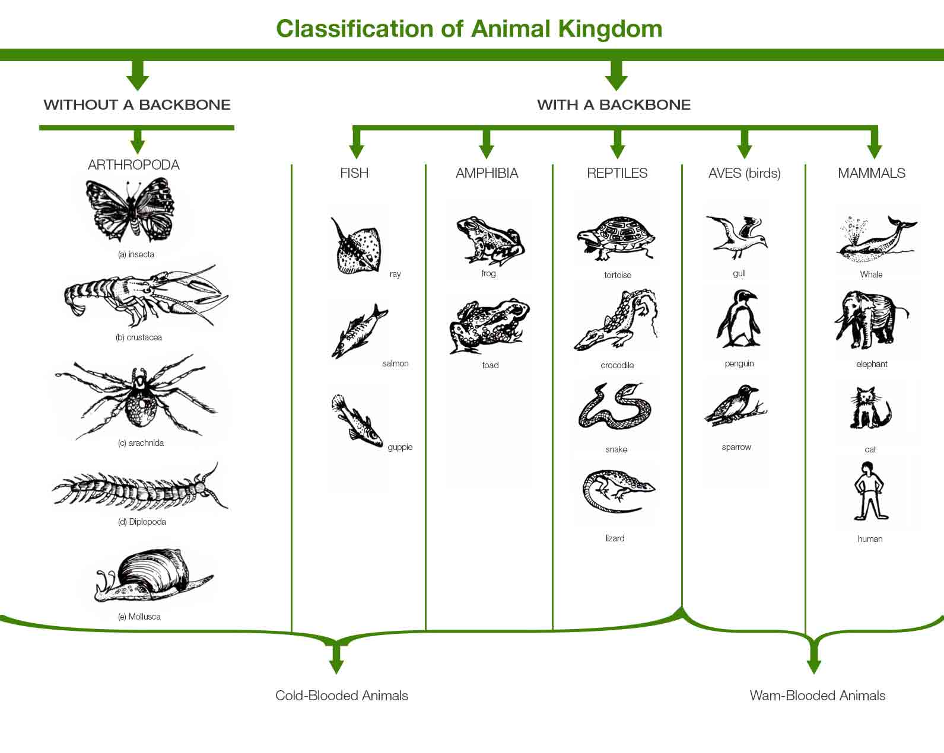
Hierarchy

Slide 7
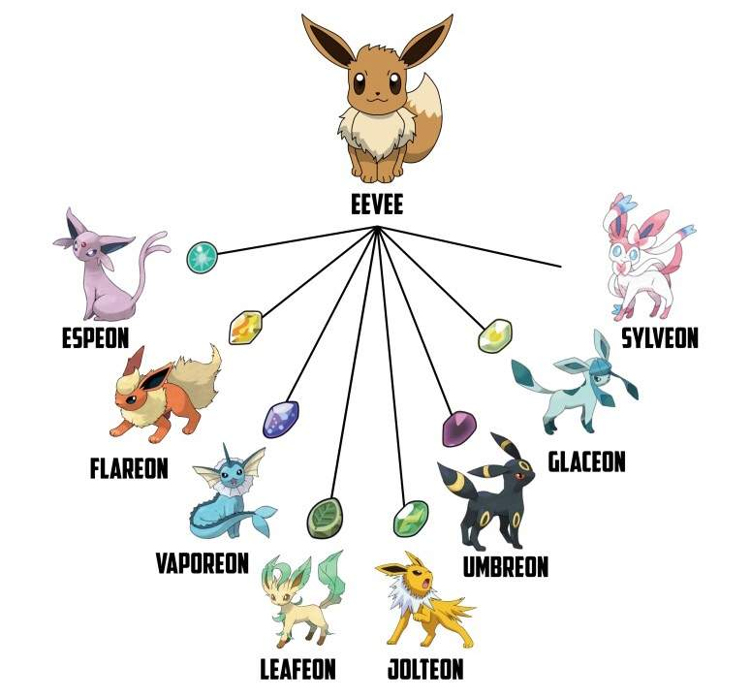
Hierarchy

Slide 8
Hierarchy
Each of these are C++ classes
Father
Mother
Person
Student
Teacher
You
A common hierarchy for inheritance in OOP
A common hierarchy

Slide 9
Relationship
The relationship of inheritance is said to be a transitive one
Considering the previous example of a person class:
A student is a person
A teacher is person
A person could be a student or a teacher but isn’t necessarily one
Person
Student
Teacher

Slide 10
Relationship
Effectively we can use those arrows to denote a “is a kind of” relationship between the classes.
A Student is a type of Person
A Teacher is a type of Person
In other words, the student class derives from person class.
Person
Is a kind of
Is a kind of
Student
Teacher

Slide 11
Derived Classes & Base Classes
Going into how these relationships will be represented in our code let’s place down the terms derived and base for our classes.
Person
Student
Teacher

Slide 12
Derived Classes & Base Classes
A base class can be said to be a parent class or a super class
The base will act like our origin from which other classes can spring from
Much like the birth of a child requires an origin which is their parent
It is essentially just a regular class as we have experienced so far
Parent
Person
Student
Teacher

Slide 13
Derived Classes & Base Classes
A derived class can be said to be a child class or a sub class
The derived will use the base class as a starting point to build themselves
In other words anything in the base class will be inherited by the child (much like DNA, or physical traits)
Person
Student
Teacher
Child
Child

Slide 14
Derived Classes
As mentioned previously, a derived class takes in all the attributes of its parent class and builds on top that. When speaking of all the attributes, this means all the data members and all the member functions (NOT including the specials ones ie constructors, destructors…)

Slide 15
Derived Classes
The syntax to define a class as a derived class is as follows:
class Derived : access Base { … }
class playdoh : public compound { … }
In this case the Derived is the name of the derived class, the access is the access level permitted to the derived class from the base (eg can the derived class access the base’s private members?). Typically access is stated to be public but by default it is private. Lastly the Base is the name of the base class.

Slide 16
Compound + Playdoh Example

Slide 17
Access Levels
There are three access levels present for use in C++, you already know two of them:
Public – Essentially everyone can access this from anywhere.
Private – Can only access from within a class or its members.

Slide 18
Access Levels
The third is protected.
This level of access specifies that only members of a derived class (and the class itself) can access this member
Protected access should be limited to member functions only (a query perhaps)

Slide 19
Access Levels
Giving protected access to a data member is not advised as this can allow for unwarranted access to what would be our private data from the base class. We should continue to access private members through member functions (perhaps protected ones)

Slide 20
Week 8-2
Functions in a Hierarchy

Slide 21
Functions in a Hierarchy
Perhaps already noted from the compound base class + playdoh derived class example, we encountered functions in both our base class and the derived class
The functions present in our base class were inherited to the derived class which could make use of them

Slide 22
Functions in a Hierarchy
Note that we had a display function in both classes with the exact same identifier.
When we called p.display(); which display function was called?
Was it the playdoh display or the compound display?
Was it the base display or the derived display function?

Slide 23
Functions in a Hierarchy - Shadowing
The answer to that previous question was the derived class’ display function was called.
This act wherein the derived function masks the base function of the same name is called shadowing.

Slide 24
Functions in a Hierarchy - Shadowing
Eventually we’ll learn what controls this mechanism in the weeks to come but for now consider that when a class in a hierarchy makes a call to a function that exists throughout that hierarchy the ‘most derived one’ that matches will be called.
Eg a playdoh object calling display will default to the playdoh definition of display rather than the compound version

Slide 25
Functions in a Hierarchy - Shadowing
We can choose to manually access a particular member function from our hierarchy with the use of the scope resolution operator :: (double colon)
The syntax looks similar to when we are specifying the scope/domain of a member function of class’s definition:
Base::identifier(arguments)
Eg. compound::display() – This will explicitly call the compound version of display

Slide 26
Constructors
A derived class doesn’t inherit the base class constructor by default
If we don’t define a constructor in our derived class as per normal the compiler inserts an empty default for us

Slide 27
Constructors
So then what occurs for our playdoh object when it goes through construction? One part of its data is derived from the base compound class (the weight)
The sequence will be reminiscent to our previous stint with the creation of objects

Slide 28
Constructors
Broken down into to phases and using our compound and playdoh example:
1. The base class portion of the derived class is created first
Allocate memory for the compound portion of the playdoh object
Execute the base class’ (compound) constructor
2. The derived portion is then constructed
Allocate memory for the playdoh portion of the playdoh object
Execute the derived class’ (playdoh) constructor

Slide 29
Constructors
Allocate memory for compound portion
Execute the compound default constr
Allocate memory for playdoh portion
Execute the playdoh 2 arg constr
Compound
Compound
weight = 0
Compound
weight = 0
Compound
weight = 55
Playdoh
Playdoh
colour = ‘r’
Playdoh p (‘r’, 55); // Goes through the above process

Slide 30
Constructors
Notice that in our previous attempt we saw that the compiler seemed to automatically call the default constructor when creating the playdoh derived object.
In regards to derived classes the following is the default behavior:
A derived class' constructor automatically calls the base class' default constructor.
A derived class' destructor automatically calls the base class' destructor.
A derived class' copy assignment operator automatically calls the base class' copy assignment operator.

Slide 31
Constructors
Rather than default to the compiler’s automatic calls for the default constructor when we’re creating a playdoh object, we can reuse the compound’s constructors
While we don’t inherit those special functions in our derived class we can pass values into the base constructor by adding the following to our derived constructors:
Derived (parameters) : Base (parameters) { … }
playdoh(char c, int w) : compound (w) { … }

Slide 32
Destructors
As mentioned already destructors in a derived class automatically call the destructors of its base class
Because of this nature, clean up of derived classes will act in the way we desire. Ie everything will be cleaned up in sequence in a domino like fashion
This will be similar to what we learned about destruction order previously (First in Last out, first created last destroyed – FILO)
The base portion of a derived class is created first thus it is destructed last and the derived portions are destructed first

Slide 33
Destructors
Deallocate memory for compound portion
Execute the compound destructor
Deallocate memory for playdoh portion
Execute the playdoh destructor
Compound
weight = 0
Compound
weight = 55
Compound
Compound
weight = 0
Playdoh
Playdoh
colour = ‘r’
Playdoh p (‘r’, 55); // Goes through the above process for destruction

