Slide 1
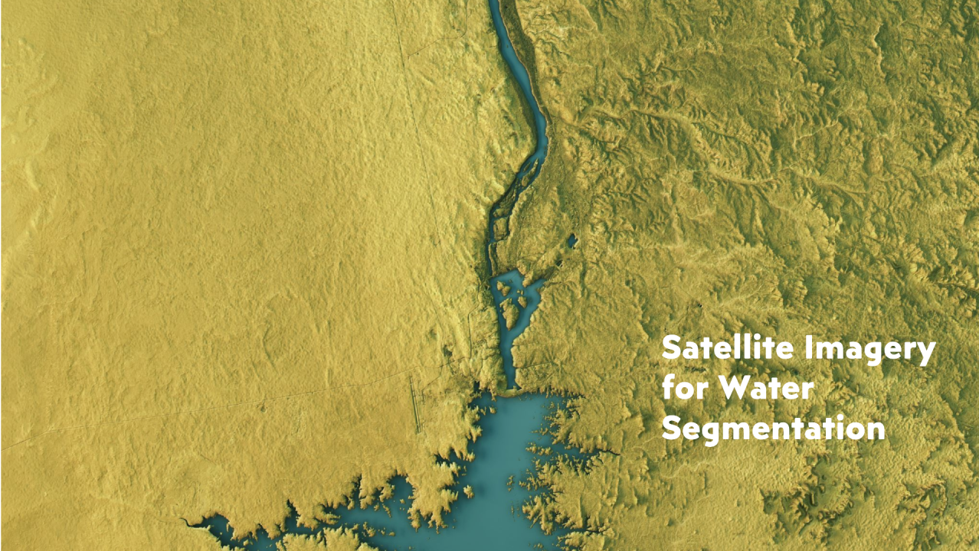
Water Bodies Segmentation in Multispectral and Optical Images
Team members:
Mohamed Mostafa Mohamed
Mostafa Ahmed Mostafa

Slide 2
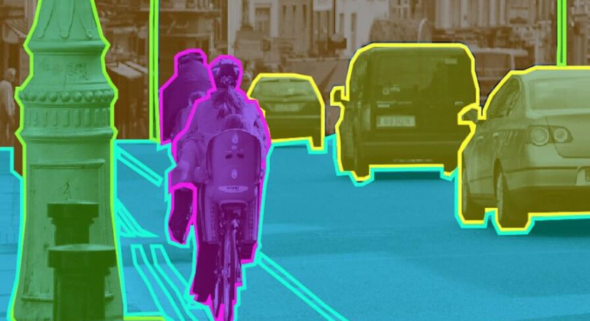
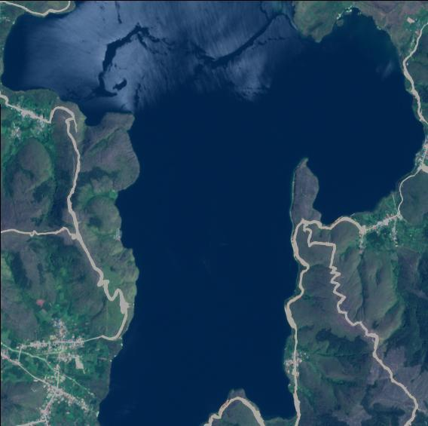

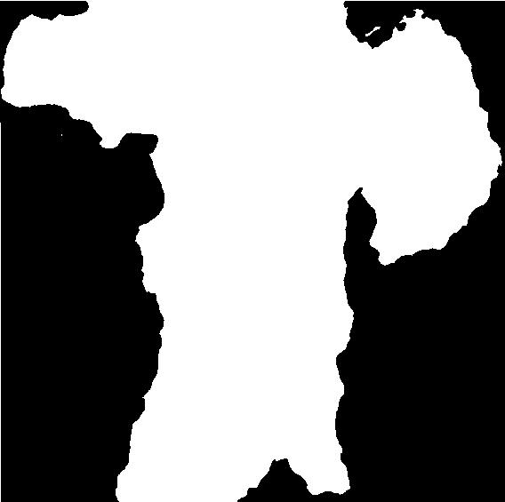
What is the image segmentation?

Slide 3
Table of contents
01
02
03
04
Introduction
Types of models
Related Work
Dataset Overview
05
Conclusion

Slide 4
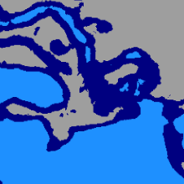
01
Introduction
.

Slide 5
Introduction
Importance of Water: Critical natural resource for life, hydrological cycles, and agriculture.
Traditional Methods: Complex spectral analysis and manual feature extraction; resource-intensive and time-consuming.
Challenges: Increasing pressures from population growth and human activities necessitate efficient water resource monitoring.
Deep Learning Solutions: U-Net, a powerful deep learning architecture, provides significant improvements in waterbody segmentation but requires substantial training data and computational resources.

Slide 6
02
models
.

Slide 7
Types of models for segmentation
1. U-Net: U-Net is a convolutional neural network (CNN) designed for semantic segmentation, particularly in biomedical imaging but widely applicable to remote sensing.
3. Mask R-CNN: An extension of Faster R-CNN, this model adds a branch for predicting segmentation masks on each Region.
2. Fully Convolutional Networks (FCNs): FCNs modify traditional CNNs to perform pixel-wise predictions, making them suitable for segmentation tasks.
4. ENet (Efficient Neural Network): ENet is designed for real-time semantic segmentation. It is computationally efficient and suitable for applications with limited computational resources.

Slide 8

03
Related Work
.

Slide 9
Paper 1.
Title: Segmentation of Waterbodies in Remote Sensing Images Using Deep Stacked Ensemble Model.
Key Points:
. Objective: Enhance the accuracy of waterbody detection in remote sensing images through a deep stacked ensemble model.
. Methodology: The model combines three deep learning architectures (U-Net, Deepwater Map, and BCDU-Net) into an ensemble, leveraging their strengths for enhanced semantic segmentation of water bodies.
. Results: The proposed model achieves high segmentation accuracy, with an F1 Score of 97.10% and improved robustness in waterbody detection across various scales and environments.
https://doi.org/10.1016/j.asoc.2022.109038

Slide 10
Paper 2.
Title: Water Body Extraction from High Spatial Resolution Remote Sensing Images Based on Enhanced U-Net and Multi-Scale Information Fusion
Key Points:
. Objective: Improve water body detection in high-resolution remote sensing images using an enhanced U-Net model with multi-scale information fusion.
. Methodology: The enhanced U-Net combines improved residual connections, multi-scale dilated convolution, and attention mechanisms to capture water bodies in complex environments better.
. Results: The model shows superior performance, achieving high accuracy, including an Average Accuracy of 97.31% and an F1 Score of 96.62%, effectively handling difficult scenarios like irregular water boundaries and dense vegetation.
https://doi.org/10.1038/s41598-024-67113-7

Slide 11
04
Dataset
.

Slide 12

Dataset Overview
The dataset used in this study is “Satellite Images of Water Bodies”, sourced from Kaggle. It contains a collection of satellite images aimed at identifying and segmenting water bodies in various environments. This dataset provides essential information for tasks such as water resource management, environmental monitoring, and flood detection.
Content: Contains satellite images showing lakes, rivers, and other water bodies.
Resolution: High-resolution images for clear details.
Labels: Images are labeled to show water and non-water areas.
Variety: Includes different locations and environments.
Use: Great for training models to detect and segment water bodies in images.
Link: https://www.kaggle.com/datasets/franciscoescobar/satellite-images-of-water-bodies

Slide 13
05
Conclusion
.

Slide 14

Conclusion
This project focused on developing a model to segment water bodies from high-resolution remote sensing images. Accurate water body detection is essential for environmental monitoring and resource management.
By employing an enhanced U-Net architecture, we aimed to improve segmentation efficiency. This work provides a solid foundation for future research and applications in remote sensing, highlighting the potential for better management of water resources.

Slide 15
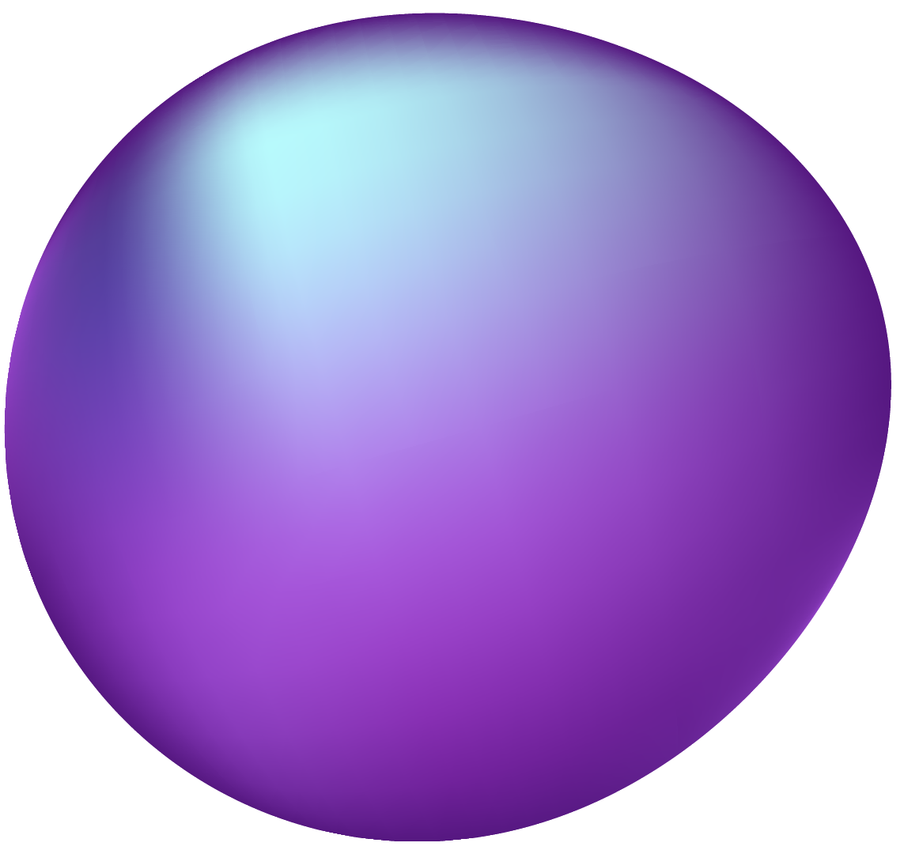
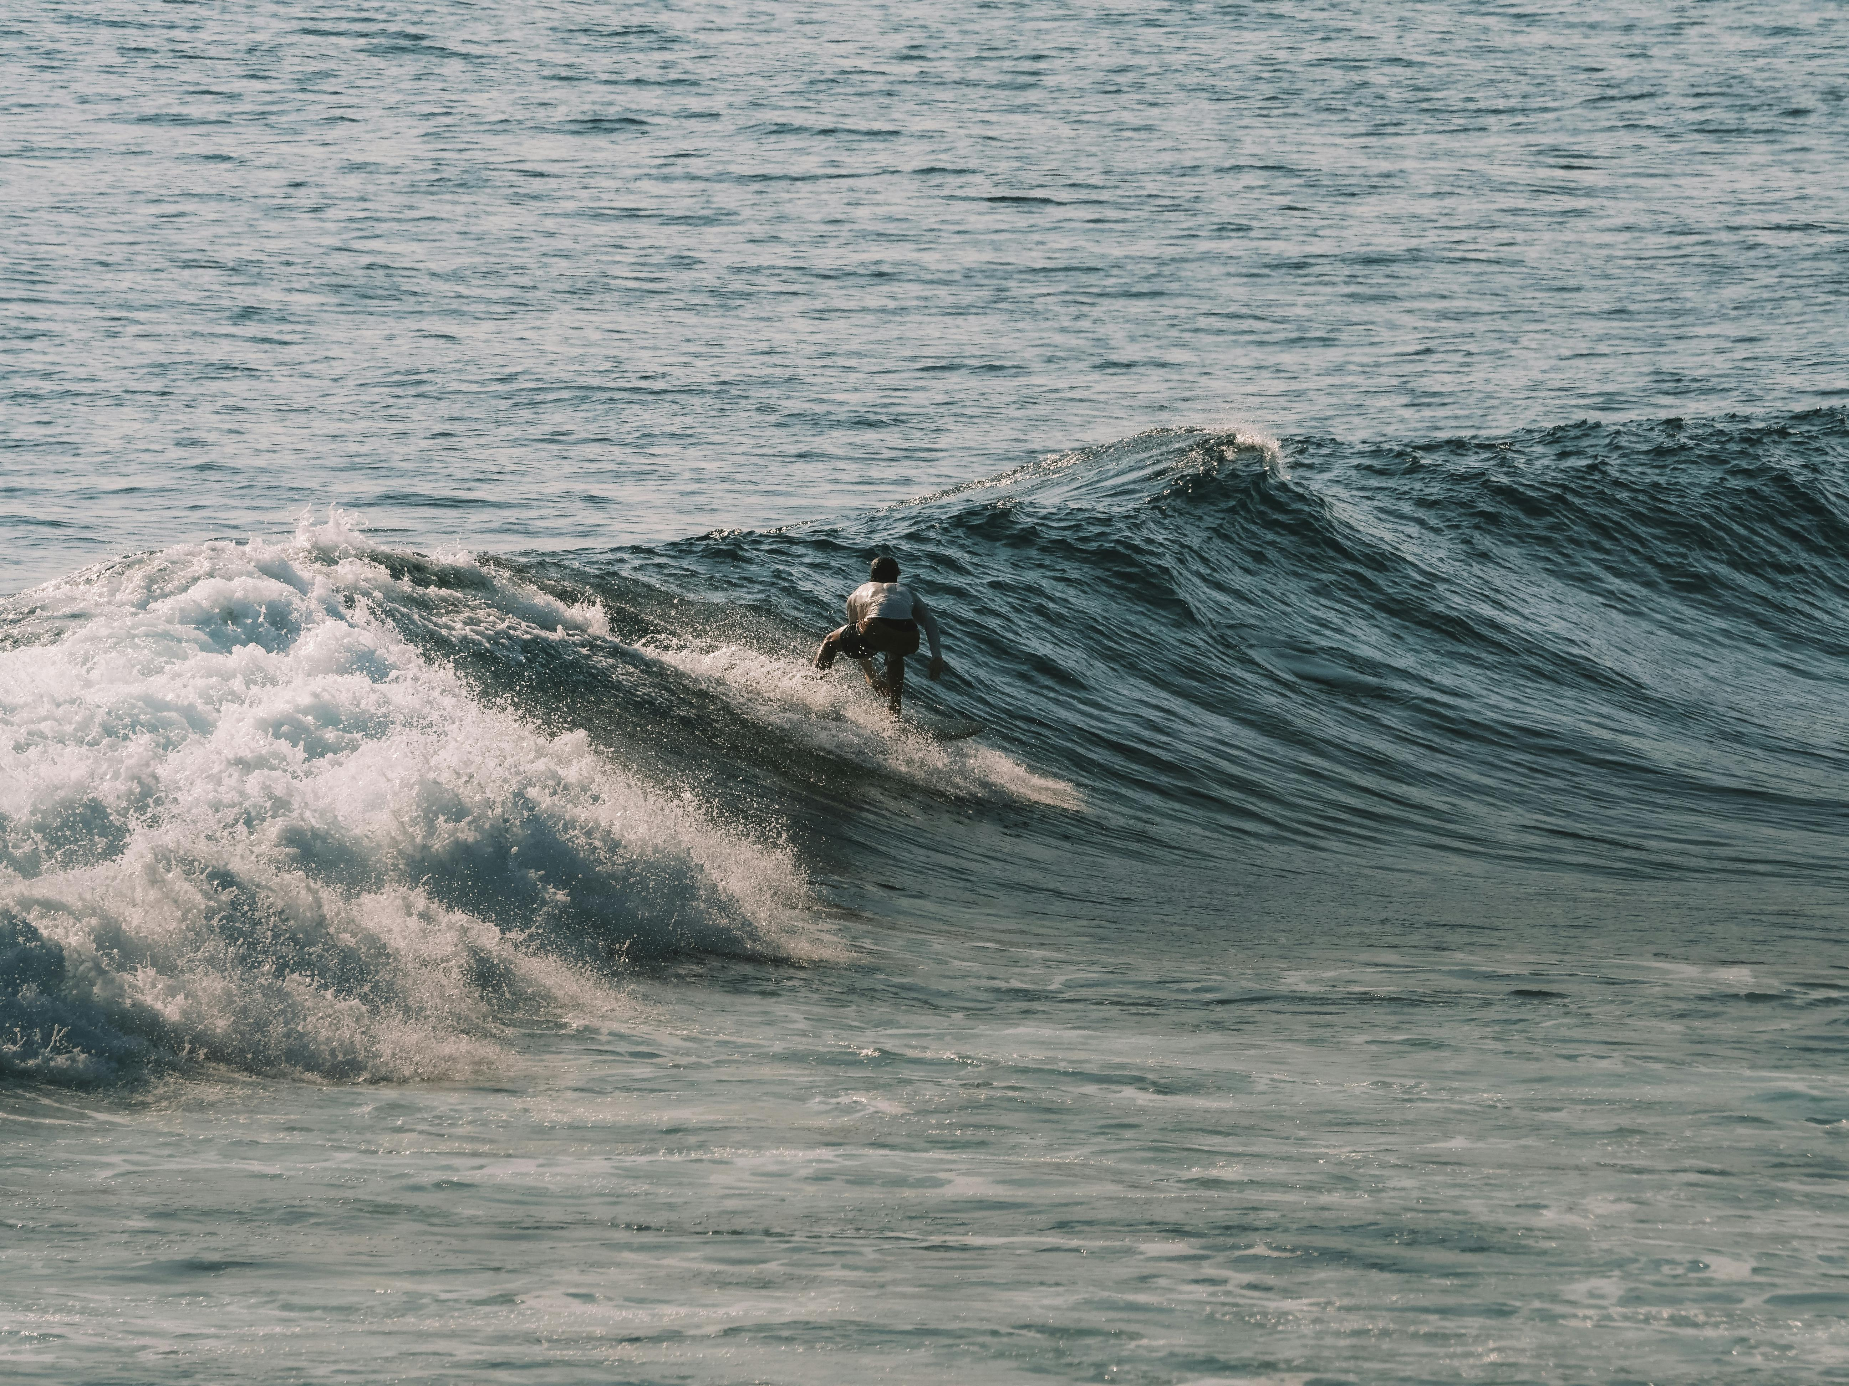
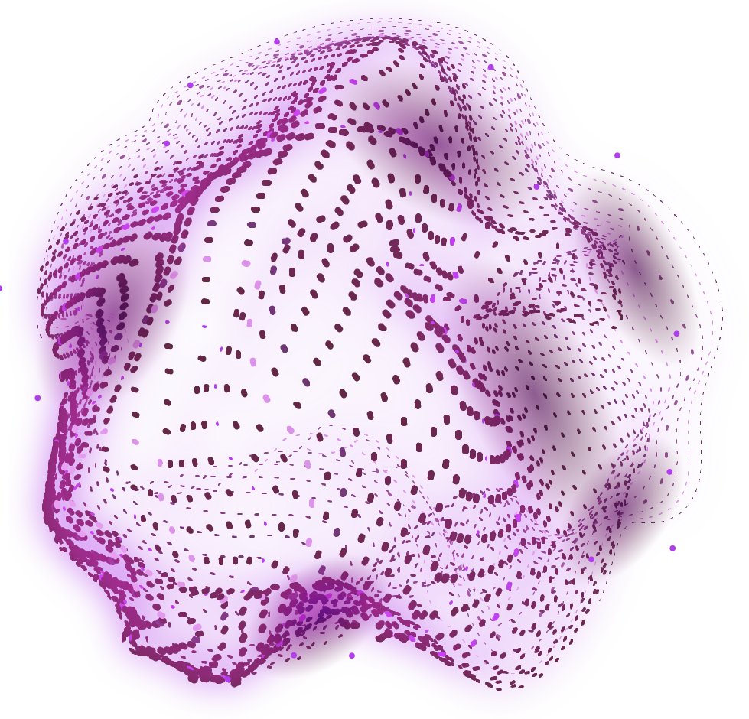
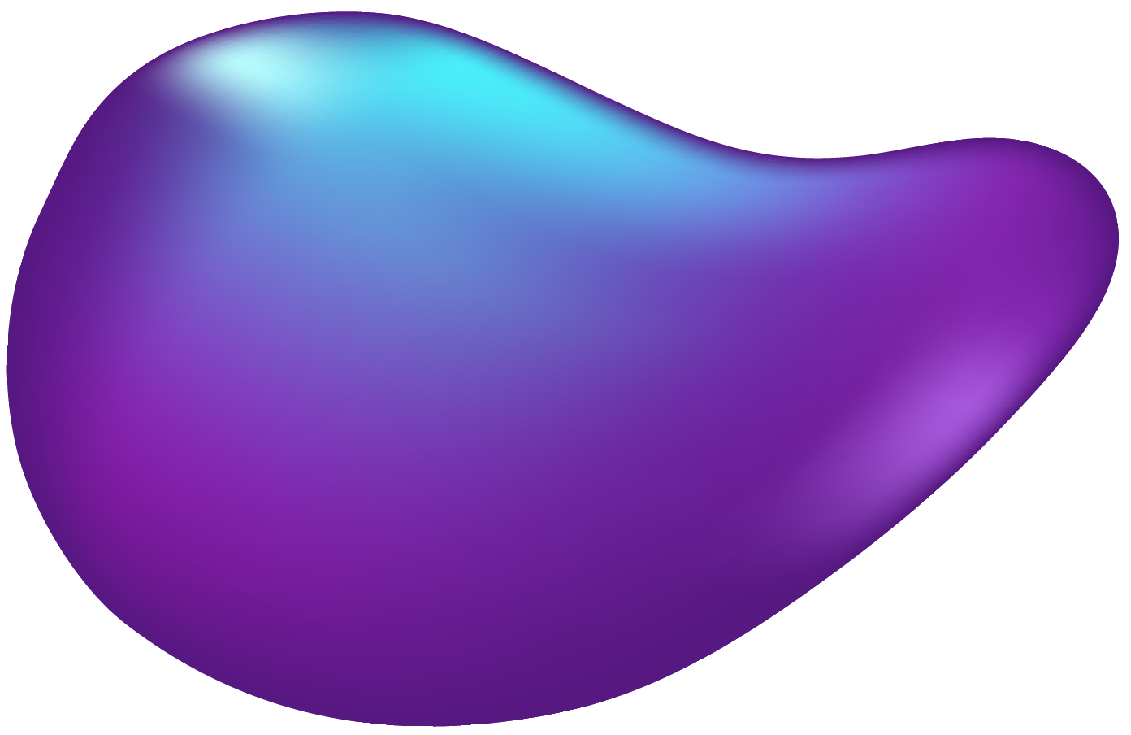
THANK YOU

