Slide 1
Stacking

Slide 2

Averaging - recap
f1 | f2 | f3 | … | fn | Class
0.345 | -0.983 | 1.201 | … | -0.004 | 1
1!
Decision Tree
1
Log. Regression
0
Random Forest
0
XGBoost
1
LightGBM
1

Slide 3
Stacking
f1 | f2 | f3 | … | fn | Class
0.345 | -0.983 | 1.201 | … | -0.004 | 1
f1 | f2 | f3 | f4 | f5 | Class
 |  |  |  |  | 1
Decision Tree
1
Log. Regression
0
Meta classifier
Random Forest
0
XGBoost
1
1
LightGBM
1

Slide 4
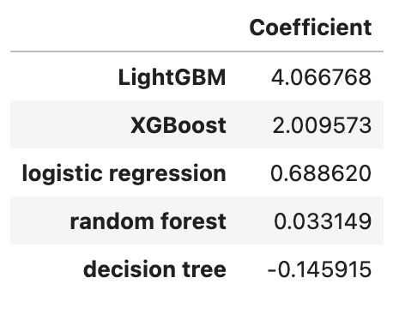
Confidence in estimators

Slide 5
iClicker
Select all true statements:
Averaging works best when the base models are highly correlated and make similar predictions
In stacking, base models are trained independently
Stacking always improves performance compared to the best individual model
In stacking, individual models are trained using all samples, but the meta-model is trained on out-of-fold predictions to avoid data leakage

