Slide 1
Midterm 1 prep
February 11, 2025

Slide 2
Rules
We’ll do as many iClicker questions as possible to review and test different topics
You have 20 seconds to answer
If the majority answers correctly within the time limit, you win the round
If the majority answers incorrectly or not enough students answer, I win the round

Slide 3
Introduction to Machine Learning
Which of the following problems is most suitable for machine learning?
A) Computing the sum of two numbers B) Predicting housing prices based on historical data C) Sorting a list of numbers D) Checking if a number is prime

Slide 4
Introduction to Machine Learning
Unsupervised learning would be more useful for:
A) Predicting stock prices B) Classifying spam emails C) Identifying types of customers of an online retail store D) Diagnosing diseases

Slide 5
Introduction to Machine Learning
Which of the following is an example of a regression problem?
A) Identifying if an email is spam or not B) Predicting tomorrow’s temperature in degrees C) Classifying different species of flowers D) Identifying fraudulent credit card transactions

Slide 6
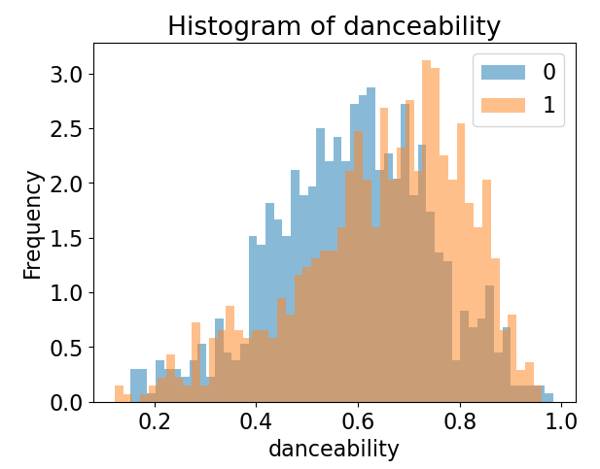
EDA
Based on this histogram, danceability is not a very good discriminant to separate the two classes. Should I remove it from my model?
Yes, because it is not informative
Yes, because its range is too narrow
No, because the classes shows different frequencies across the range
No, because it could be informative when combined with other features
0 = not liked song; 1 = liked song

Slide 7
Decision trees
Increasing the depth of a decision tree will do all of the following, except one:
A) Always improve model performance on training samples B) Increase the risk of overfitting C) Increase model complexity D) Make the model more interpretable

Slide 8
K-Nearest Neighbors
What is a key limitation of k-Nearest Neighbors (kNN)?
A) It requires labeled data B) It does not work for regression tasks C) It is computationally expensive for large datasets D) It cannot handle numerical features

Slide 9
K-Nearest Neighbors
All of the following will make a kNN classifier slower at generating predictions, but which one will have the smaller impact?
A higher number of features
A higher number of training samples
A higher value of k
Using a distance metric that is computationally expensive (e.g., Mahalanobis distance instead of Euclidean)

Slide 10
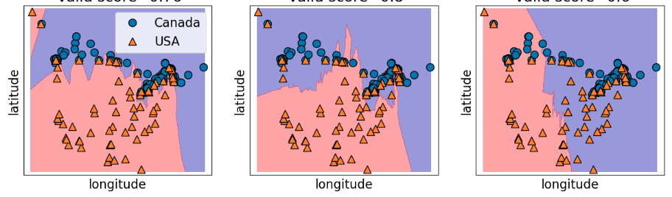
Decision boundaries
The following decision boundaries correspond to kNN classifiers trained with different values of k. Which one do you think was trained with the highest value of k?
A
B
C

Slide 11
Underfitting/overfitting
What should I do to help prevent overfitting?
A) Increase the number of features B) Reduce the amount of training data C) Use regularization techniques, like Ridge D) Train for a longer time

Slide 12
Underfitting/overfitting
Which of the following scenarios suggests a model is suffering from high bias?
A) The training and test errors are both high and similar in magnitude B) The training error is low, but the test error is significantly higher C) The model performs well on the training set but struggles with new data D) The model's performance improves significantly when adding more features

Slide 13
Cross validation
Cross-validation helps by:
A) Increasing dataset size B) Reducing bias in performance estimates C) Making training faster D) Avoiding the need for feature scaling

Slide 14
Preprocessing
Which of the following is not a common preprocessing step?
A) Feature scaling B) Removing duplicate labels C) Replacing missing values D) Converting categorical variables to numerical

Slide 15
Preprocessing
Sophia is a data scientist working on a sentiment analysis model for customer reviews. She decides to use CountVectorizer from scikit-learn to convert text into numerical features.
After applying CountVectorizer to her dataset, she notices something odd:
The feature matrix has many columns, making it very sparse.
Common words like "the," "and," "is" appear frequently, inflating the feature counts.
Words like "awesome" and "terrible", which are important for sentiment analysis, are overshadowed by common words.
Her colleague suggests tweaking CountVectorizer's parameters to improve the feature representation. Which of the following would be the best approach?
A) Set stop_words='english' to remove common words that don’t add meaning to the sentiment. B) Set max_features=10 to drastically reduce the vocabulary size. C) Use binary=True so that word frequency is ignored completely. D) Remove low-frequency words by setting min_df=10 to filter out rare words.

Slide 16
Hyperparameters tuning
Given an SVM with an RBF kernel, increasing the gamma parameter will likely:
A) Make the decision boundary more linear B) Reduce model complexity C) Make the model more sensitive to individual data points D) Decrease the risk of overfitting

Slide 17
Hyperparameters tuning
Compared to Grid Search, what is a key advantage of Randomized Search?
A) It guarantees finding the best hyperparameters B) It reduces computational cost by sampling fewer hyperparameter combinations C) It always improves model accuracy D) It is also applicable to regression problems

Slide 18
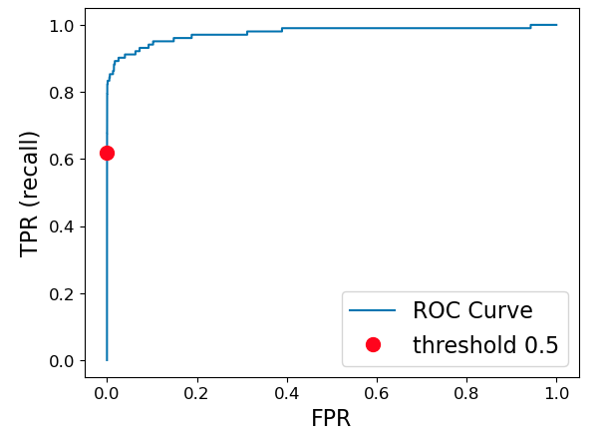
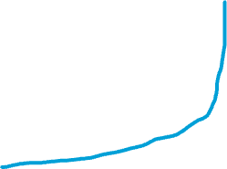
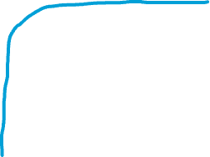

Classification metrics
I am tasked to solve a binary classification problem, but I am lazy and I decide to use a coin toss to assign each sample to a class (head = positive, tail = negative). The classes in the dataset are balanced. What ROC curve better corresponds to my approach?
A
B
C

Slide 19
Classification metrics
If a classification model achieves 100% recall, what can we conclude?
A) The model also has 100% accuracy B) The model correctly identified all positive samples but may have false positives C) The model does not make false positive predictions D) The model has a high precision score

Slide 20
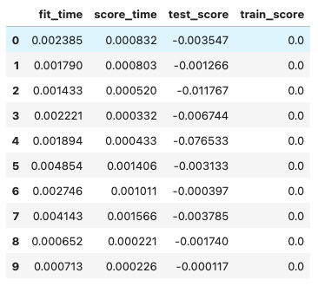
Regression metrics
The table on the left shows the cross-validation results for a regression problem. Which regressor is likely being used here?
DummyRegressor(strategy=”median”)
SVR(kernel='rbf')
DummyRegressor(strategy=”mean”)
SVR(kernel=‘linear')

Slide 21
Regression metrics
Liam is a financial analyst at a startup that predicts monthly revenue for different business units. He is evaluating the model's performance and has to choose between using Mean Absolute Percentage Error (MAPE) and R² (coefficient of determination).
Liam notices something interesting:
The model performs well for high-revenue business units but poorly for smaller ones.
The R² score is high (0.92), but the MAPE is 40%, meaning predictions are off by an average of 40% of actual revenue.
Some business units have low actual revenue.
Which metric should Liam trust more in this case, and why?
A) MAPE is better because it considers percentage errors, making it fair across different revenue sizes. B) R² is better because a high value (0.92) means the model explains most of the variance; Liam should use R² and ignore MAPE. C) R² is always the best metric for regression, regardless of data characteristics. D) MAPE may be misleading when actual values are small; Liam should pick R² because it gives a more reliable picture of the model’s ability to explain variance.

