Slide 1
CSS3
Cascading Style Sheet 3
E-Business Department

Slide 2

Table of Contents
What is CSS 3?
Selectors
Fonts
Colors
Backgrounds
Borders
Box Model
Animations

Slide 3
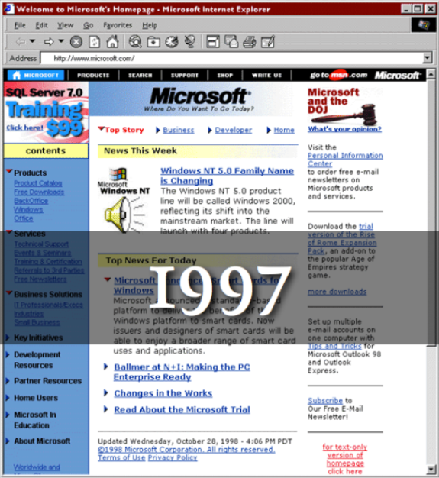

What is CSS3

Slide 4

What is CSS3
Cascading Style Sheets level 3 is the most recent iteration of CSS
It is divided into several separate
documents called "modules"
CSS 3 has not been approved as a specification,
but there are already a lot of properties that are
supported in various browsers.
The earliest CSS 3 drafts were published in June 1999

Slide 5
Vendor Prefix
Some CSS rules won’t work without the vendor prefix.
  Mozilla Browsers (Firefox)
  -moz
  Webkit Browsers (Safari, Chrome)
  -webkit
  Opera
  -o
  Internet Explorer
  -ms

Slide 6

New Selectors!

Slide 7

Attribute Selectors
[attribute^=value]
  Represents an element with the attribute whose value begins with the prefix value.
  Example: a[src^="https://"]
[attribute$=value]
  Represents an element with the attribute whose value ends with the prefix value.
[attribute*=value]
  Represents an element with the attribute whose value contains the prefix value.

Slide 8

Structural Pseudo-classes
:root
  The root of the document
  E:nth-child(n)
  An E element, the n-th child of its parent
  E:nth-last-child(n)
  An E element, the n-th child of its parent, counting from the last on
  E:nth-of-type(n)
  An E element, the n-th sibling of its type

Slide 9
Structural Pseudo-classes
E:nth-last-of-type(n)
  An E element, the n-th sibling of its type, counting from the last one
  E:last-child
  An E element, last child of its parent
  E:first-of-type
  An E element, first sibling of its type
  E:last-of-type(n)
  An E element, last sibling of its type

Slide 10
Structural Pseudo-classes
E:only-child
  An E element, only child of its parent
  E:only-of-type
  An E element, only sibling of its type
  E:empty
  An E element that has no children (including text nodes)

Slide 11

UI Selectors
E:enabled
  A user interface element E which is enabled
  E:disabled
  A user interface element E which is disabled
  E:checked
  A user interface element E which is checked (for instance a radio-button or checkbox)
  Currently supported only in Opera!

Slide 12

Other CSS3 Selectors
E:target
  An E element being the target of the referring URI
  E:not(s)
  An E element that does not match simple selector
  E ~ F
  An F element preceded by an E element

Slide 13





Fonts

Slide 14
Font Embeds
Use @font-face to declare font
Call font with font-family
Currently not supported in IE
Use font embedding instead of images
@font-face {
font-family: SketchRockwell;
src: url('SketchRockwell-Bold.ttf');
}
.my_CSS3_class {
font-family: SketchRockwell;
font-size: 3.2em;
}

Slide 15


Text Shadow
Applies shadow to text
Syntax:
text-shadow:<horizontal-distance> <vertical-distance> <blur-radius> <shadow-color>;
Do not alter the size of a box
text-shadow: 2px 2px 7px #000000;

Slide 16


Text Overflow
Specifies what should happen when text overflows the containing element
Syntax: text-overflow: <value>;
Possible values:
  ellipsis - Display ellipses to represent clipped text
  clip - Default value, clips text
Currently not supported in Firefox and IE

Slide 17
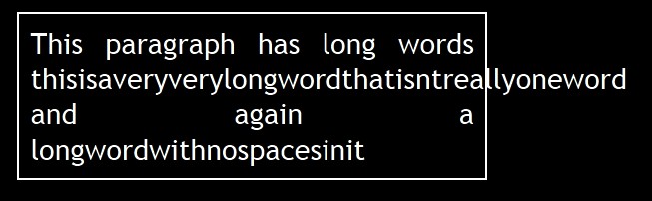
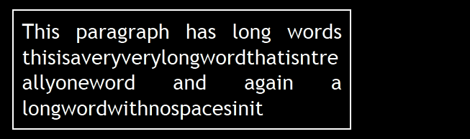
Word Wrapping
Allows long words to be able to be broken and wrap onto the next line
Syntax: word-wrap: <value>;
Possible values:
  normal
  break-word
Supported in all major browsers

Slide 18

Colors

Slide 19



Opacity
Sets the opacity level for an element
Syntax: opacity: <value>;
Value from 0.0 (fully transparent) to 1.0
The opacity is supported in all major browsers.
Note: IE8 and earlier supports an alternative, the filter property: filter: Alpha(opacity=50).
Example:
<img src="img.jpg" style= " opacity: 0.4;
filter: alpha(opacity=40)" />

Slide 20


RGBA
Standard RGB colors with an opacity value for the color (alpha channel)
Syntax: rgba(<red>, <green>, <blue>, <alpha>)
The range for red, green and blue is between integers 0 and 255
The range for the alpha channel is between 0.0 and 1.0
Example:
  rgba(255, 0, 0, 0.5)

Slide 21
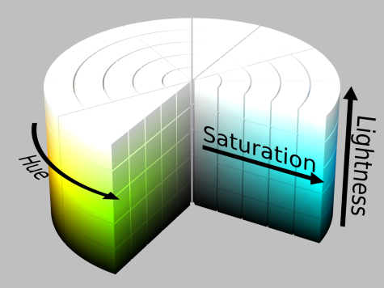
HSL Colors
Hue is a degree on the color wheel
  0 (or 360) is red, 120 is green, 240 is blue
Saturation is a percentage value
  100% is the full color
Lightness is also a percentage
  0% is dark (black)
  100% is light (white)
  50% is the average

Slide 22
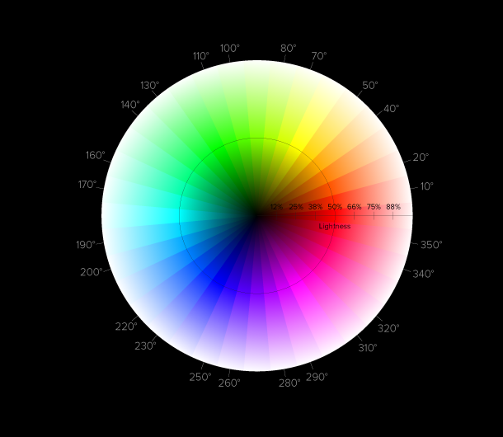
HSLA
HSLA allows a fourth value, which sets the Opacity (via the Alpha channel) of the element.
As RGBA is to RGB, HSLA is to HSL
Supported in IE9+, Firefox 3+, Chrome, Safari, and in Opera 10+
Example:
  hsla(0, 100%, 50%, 0.5)
Result:

Slide 23

Backgrounds

Slide 24

Gradient Background
Gradients are smooth transitions between two or more specified colors
Use of CSS gradients can replace images and reduce download time
Create a more flexible layout, and look better while zooming
Supported in all major browsers via different keywords
This is still an experimental feature

Slide 25

Gradient Background
/* Firefox 3.6+ */
background: -moz-linear-gradient(100% 100% 90deg,FFFF00, #0000FF);
/* Safari 4-5, Chrome 1-9 */
background: -webkit-gradient(linear, 0% 0%, 0% 100%, from(#0000FF), to(#FFFF00));
/* Safari 5.1+, Chrome 10+ */
background: -webkit-linear-gradient(#FFFF00, #0000FF);
/* Opera 11.10+ */
background: -o-linear-gradient(#2F2727, #0000FF);

Slide 26



Multiple Backgrounds
CSS3 allows multiple background images
Simple comma-separated list of images
Supported in Firefox (3.6+), Chrome (1.0/1.3+), Opera (10.5+) and Internet Explorer (9.0+)
Comma separated list for the other properties
background-image: url(sheep.png), url(grass.png);

Slide 27
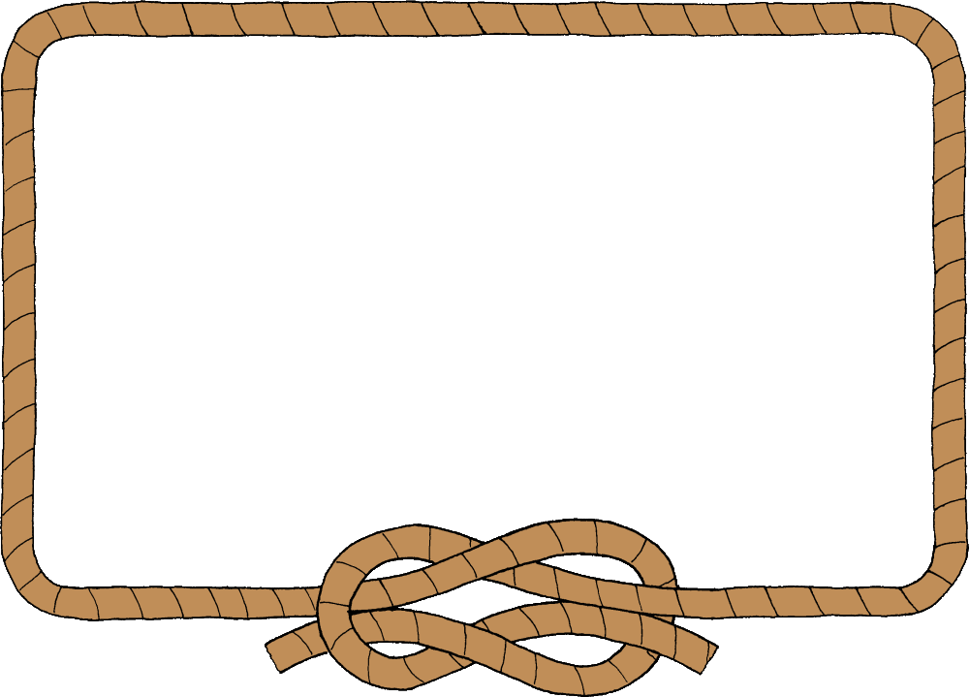
Borders

Slide 28
Border Image
Defines an image to be used instead of the normal border of an element
Split up into a couple of properties
Example:
The border-image property has 3 parts:
  border-image: url(border-image.png) 25% repeat;

Slide 29

Border radius
Allows web developers to easily utilize rounder corners in their design elements
Widespread browser support
Example:
-moz-border-radius: 15px;
border-radius: 15px;
background-color: #FF00FF;

Slide 30

Box shadow
Allows to easily implement multiple drop shadows (outer or inner) on box elements
Specifying values for color, size, blur and offset
Example:
-moz-box-shadow: 10px 10px 5px #888;
-webkit-box-shadow: 10px 10px 5px #888;
box-shadow: 10px 10px 5px #888;

Slide 31
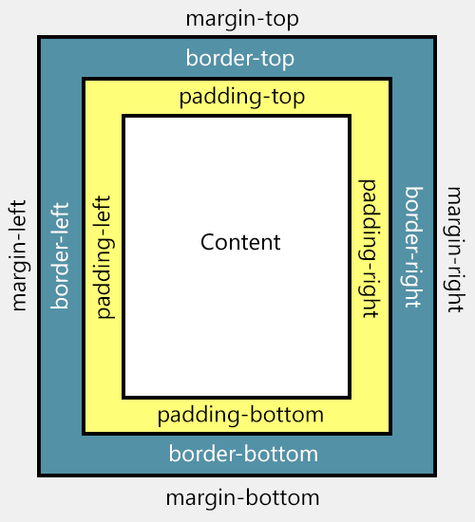
Box Model

Slide 32
Box Sizing
Determine whether you want an element to render it's borders and padding within its specified width, or outside of it.
Possible values:
  box-sizing: content-box (default)
  box width: 288 pixels + 10 pixels padding and 1 pixel border on each side = 300 pixels
  box-sizing: border-box
  box width: 300 pixels, including padding and borders

Slide 33

Animations

Slide 34
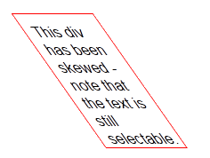

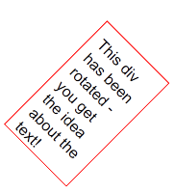
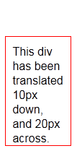
2D Transformations
2D transforms are widely supported
Skew – skew element
  transform: skew(35deg);
Scale – scale element
  transform: scale(1,0.5);
Rotate – rotates element
  transform: rotate(45deg);
Translate – moves element
  transform: translate(10px, 20px);

Slide 35
Transitions
Add an effect when changing from one style to another
Different timing functions:
  ease, ease-in, ease-out, ease-in-out, linear
#id_of_element {
-webkit-transition: all 1s ease-in-out; - -moz-transition: all 1s ease-in-out;
-o-transition: all 1s ease-in-out;
-ms-transition: all 1s ease-in-out; transition: all 1s ease-in-out;
}

Slide 36
Keyframes
@keyframes myAnimation{
0% {...}
50% {...}
100% {...}
}
#box {
animation-name: myAnimation;
animation-duration: 1s;
animation-iteration-count: 4;
animation-direction: alternate;
animation-timing-function: ease-in-out;
}

Slide 37
Thank you

