Slide 1

Jashore University of Science and Technology
Computer Science and Engineering
LitSphere
A Collaborative Systematic Literature Review, Benchmark, and Research Synthesis Platform
Presenter:
Md Mostafa Kamal
Student Id: 200108
Dept. of Computer Science and Engineering(CSE)
Jashore University of Science and Technology
Supervisor:
Dr. Mohammad Nowsin Amin Sheikh
Assistant Professor
B.Sc (Engg.), M.Sc (Engg.), PhD
Dept. of Computer Science and Engineering (CSE)
Jashore University of Science and Technology
1 / 28

Slide 2
Introduction & Research Motivation
CHALLENGE 01
Scientific Literature Explosion
Over 1.5 million peer-reviewed papers are published annually. Researchers face severe cognitive overload attempting to manually track, read, extract, and synthesize evidence across hundreds of PDF manuscripts.
CHALLENGE 02
Fragmented Academic Toolchains
Reviewers are forced to juggle disconnected applications: Zotero for reference storage, Excel for data tables, and Word/Notepad for notes. This disjunction causes lost citations and version discrepancy.
LIMITATION 03
Absence of Coordinate Traceability
Conventional spreadsheets store extracted claims with zero link to source text. Verifying a recorded benchmark requires re-reading multi-page papers from scratch due to missing bounding-box coordinates.
THE SOLUTION
LitSphere Centralized Synthesis Platform
A unified, collaborative platform integrating split-screen PDF reading, coordinate-accurate claim anchoring, live synthesis matrix grids, and 1-click publication-ready LaTeX table generation.
2 / 28

Slide 3
Existing Systems & Limitations
REFERENCE MANAGERS
Zotero, EndNote
• Strengths: Reliable bibliographic indexing, citation metadata generation, and local PDF file storage. • Critical Gaps: Incapable of structured variable extraction; zero comparative matrix synthesis; no PRISMA consensus screening.
MANUAL SPREADSHEETS
Microsoft Excel, Google Sheets
• Strengths: Flexible rows and columns; universally accessible tabular format. • Critical Gaps: Completely detached from PDF documents; severe data entry error rates; zero coordinate-anchored jump; high formatting overhead.
SPECIALIZED SLR TOOLS
Rayyan, Covidence
• Strengths: Structured title/abstract screening workflow for medical reviews. • Critical Gaps: Prohibitive subscription paywalls; rigid clinical focus; lack of interactive split-screen matrix extraction and benchmark clustering.
NOTE-TAKING SYSTEMS
Obsidian, Notion, LiquidText
• Strengths: Freeform markdown notes and visual bi-directional document linking. • Critical Gaps: Lack structured systematic review protocols; no multi-reviewer dual-blind voting; no automated LaTeX publication export.
3 / 28

Slide 4
LitSphere: Proposed System Architecture
CENTRALIZED COLLABORATIVE RESEARCH SYNTHESIS PLATFORM
Researcher Workspace: Dual-Pane Reviewer
• Split-Screen PDF Reader: Synchronous in-browser PDF viewing without requiring external desktop software.
• Coordinate BBox Anchoring: Highlights are permanently bound to exact geometric coordinates in the PDF.
• Direct Variable Extraction: Populate dataset, model, metrics, and limitations side-by-side with reading.
• Search & Tag Filters: Instant filtering by keyword, publication year, and domain taxonomy tags.
Synthesis Lead: Master Matrix & Analytics
• Interactive Master Matrix: Unified comparative grid aggregating extracted variables across all papers.
• Dynamic Clustering: Automated thematic grouping by methodology, problem type, and benchmarks.
• Dual-Blind PRISMA Engine: Independent reviewer screening and Cohen's Kappa agreement check.
• 1-Click Academic Export: Direct output to LaTeX booktabs, formatted Excel (.xlsx), and BibTeX.
Core Impact: Eliminates the 80% administrative friction between reading academic literature and synthesizing publishable survey articles.
4 / 28

Slide 5
Feature Comparison: LitSphere vs Existing Tools
Feature Dimension | Zotero | MS Excel / Sheets | Rayyan / Covidence | LitSphere (Proposed)
In-Browser PDF Annotation | ✓ (Basic) | ✗ | ✗ | ✓ (Dual-Pane)
Coordinate-Anchored Claims | ✗ | ✗ | ✗ | ✓ (Exact BBox)
Master Synthesis Matrix Grid | ✗ | ✓ (Manual) | ✗ | ✓ (Real-Time)
Thematic Clustering | ✗ | ✗ | ✗ | ✓ (Taxonomy)
Dual-Blind PRISMA Screening | ✗ | ✗ | ✓ (Paid) | ✓ (Built-in)
One-Click LaTeX booktabs Export | ✗ | ✗ | ✗ | ✓ (Native)
Local-First SQLite WAL Storage | ✓ (Proprietary) | ✗ | ✗ (Cloud-only) | ✓ (Open ACID)
Zero-Framework Sub-15ms Latency | ✗ | ✗ | ✗ | ✓ (Optimized)
VERIFIABILITY
100% Traceability
Every extracted claim jumps directly to its original sentence in the PDF.
STANDARDS
PRISMA Compliance
Structured screening, consensus voting, and automated exclusion reporting.
EFFICIENCY
Publication-Ready
Direct generation of publication-grade LaTeX tables and BibTeX citation keys.
5 / 28

Slide 6
Advanced Features: LitSphere Advantage (Part 1)
FEATURE MODULE 01
Split-Screen Dual-Pane PDF Reviewer
• Synchronous side-by-side layout: PDF reader docked alongside data extraction form. • Eliminates disruptive Alt-Tab switching between viewer and external spreadsheets. • Native PDF.js rendering with continuous vertical scrolling, zoom, and page jump.
FEATURE MODULE 02
Coordinate-Accurate Text Highlighting
• Bounding box coordinates recorded in normalized [x, y, w, h] geometry. • Highlighting survives zoom, scaling, and responsive viewport adjustments. • Clicking an extracted matrix metric instantly navigates to the exact sentence.
FEATURE MODULE 03
Master Synthesis Matrix Grid
• Real-time multi-dimensional comparison table across all ingested papers. • Inline editing with instant database persistence and audit trails. • Dynamic filtering by publication year, taxonomy tags, and performance metrics.
Engineering Significance: Closed-loop verification cycle guarantees that every scientific claim in the synthesis matrix is verifiable in under 2 seconds.
6 / 28

Slide 7
Advanced Features: LitSphere Advantage (Part 2)
FEATURE MODULE 04
Dual-Blind PRISMA Screening
• Independent voting protocol (Include / Exclude / Maybe) for peer reviewers. • Automated calculation of Cohen's Kappa (κ) inter-rater agreement score. • Arbitration interface for lead supervisors to resolve inclusion conflicts.
FEATURE MODULE 05
Zero-Framework High Performance
• Built entirely using Vanilla ES6 JavaScript without bloated runtime frameworks. • Sub-15ms client interaction latency and ultra-fast DOM redraw speeds. • SQLite WAL mode enables concurrent reader execution with zero locking stalls.
FEATURE MODULE 06
1-Click Academic Export Engine
• Direct generation of IEEE/ACM compliant LaTeX booktabs code tables. • Formatted Excel export (.xlsx) for statistical meta-analysis. • Automatic BibTeX synchronization with sanitized citation keys and DOIs.
Research Rigor: Conforms to international PRISMA guidelines, ensuring standard-compliant literature reviews.
7 / 28

Slide 8
System Architecture & Technology Stack
FRONTEND LAYER
Native Web Architecture
• HTML5 & CSS3: Modular design tokens, light theme, CSS grid and flexbox. • Vanilla ES6 JS: High performance, zero dependency bundle overhead. • PDF.js Library: Mozilla client-side PDF rendering engine. • Canvas Overlay: Coordinate highlight layer with precise BBox geometry.
BACKEND LAYER
Node.js REST API Service
• Node.js & Express: Non-blocking asynchronous event-driven I/O. • Multer Engine: Streaming multipart PDF ingestion and validation. • JWT Security: Stateless authorization with bcrypt hash encryption. • Export Pipeline: Programmatic LaTeX table and XLSX synthesis.
PERSISTENCE LAYER
SQLite 3 Database Engine
• SQLite 3 Engine: Embedded, zero-configuration relational database. • WAL Mode: Write-Ahead Logging for high-throughput concurrency. • ACID Guarantees: Transactional integrity on all matrix cell writes. • JSON Extension: Dynamic storage for extensible extraction schemas.
Design Philosophy: Local-first privacy, minimal deployment dependencies, maximum performance, and open standards compliance.
8 / 28

Slide 9
Expected Functional Modules
FOR RESEARCHERS
Extraction & Reading Tools
• Drag-and-drop batch PDF ingestion. • Synchronized split-screen reader. • Text selection and BBox anchor. • BibTeX key and DOI lookup. • Contextual annotation notes. • Dynamic keyword cloud inspector.
FOR PROJECT LEADS
Synthesis & Governance
• PRISMA screening protocol manager. • Extraction schema configuration. • Real-time master matrix dashboard. • Dynamic thematic clustering view. • Reviewer conflict resolution tools. • LaTeX booktabs & Excel export.
SYSTEM-WIDE
Core Infrastructure
• Role-Based Access Control (RBAC). • Comprehensive action audit logging. • Local-first offline data resilience. • Automated database backups. • Responsive cross-browser layout. • REST API interface for extensions.
9 / 28

Slide 10
12-Month Project Timeline (Gantt Overview)
M1
M2
M3
M4
M5
CURRENT STATUS (M6)
M6
M7
M8
M9
M10
M11
M12
Phase 1: SRS (100% Complete)
Phase 2: Design (100% Complete)
Phase 3: Core UI (100% Complete)
Phase 4: PRISMA (Active Target)
Phase 5: ML & Clustering
Phase 6: SUS & Final Defense
✓ Months 1–6 (Complete): Problem Analysis, Architecture, Reviewer & Matrix
➢ Months 7–12 (Target): PRISMA Consensus, Clustering, User Studies & Defense
10 / 28

Slide 11
Development Phases & Milestone Targets
Phase | Focus Domain | Timeline | Status | Key Deliverable
1 | Problem Formulation & SRS | M1–M2 | COMPLETED | Formal requirements specification document
2 | Architecture & Schema Design | M3–M4 | COMPLETED | Relational ERD, Use Case model, API contract
3 | Core Reviewer & Matrix | M5–M6 | COMPLETED | Split-screen PDF reader, BBox highlight, matrix grid
4 | Collaborative PRISMA Screening | M7–M8 | NEXT FOCUS | Dual-blind voting, Cohen's Kappa, conflict resolver
5 | Synthesis Analytics & ML | M9–M10 | PLANNED | Dynamic thematic clustering, keyword frequency
6 | Benchmarking & Defense | M11–M12 | PLANNED | SUS usability evaluation, thesis, final defense
MILESTONE 1: CURRENT STATUS
Current Deliverables (Month 6)
Complete functional system operational with PDF ingestion, coordinate-anchored annotations, interactive master matrix, and live LaTeX export.
MILESTONE 2: FUTURE TARGET
Final Defense Deliverables (Month 12)
Multi-user real-time PRISMA screening consensus engine, automated taxonomy clustering, empirical user study, and completed thesis dissertation.
11 / 28

Slide 12
SECTION 02
6-Month Progress Overview
Milestones Achieved, Core Deliverables, and Current System Status
12 / 28

Slide 13
Progress Summary: Month 1 to 6
Phase-Wise Completion Status
Key Metrics at Month 6
Phase 1: Literature Review & SRS
100%
3 / 6
Phases Completed
55%
Overall Progress
Phase 2: Architecture & Database Design
100%
12
Core Modules Active
Phase 4
Next Immediate Target
Phase 3: Reviewer & Master Matrix Grid
100%
Overall 12-Month Project Trajectory
55%
Executive Assessment: All preliminary research, system architecture, database modeling, and core functional implementation milestones for the first 6 months have been successfully executed according to the approved project plan.
13 / 28

Slide 14
Completed Modules (Month 1 to 6)
MODULE 01
User Auth & Access Control
Secure JWT session tokens, role-based route middleware, and bcrypt password encryption.
MODULE 02
Survey Initializer
Multi-project creation, research protocol configuration, and inclusion criteria setup.
MODULE 03
PDF Ingestion Pipeline
Drag-and-drop batch file ingestion, automatic BibTeX parsing, and metadata indexing.
MODULE 04
Dual-Pane PDF Reviewer
Synchronous in-browser PDF reader docked beside dynamic variable extraction forms.
MODULE 05
Coordinate BBox Highlighting
Geometric bounding box anchors bound to PDF coordinates for instant jump-to-quote.
MODULE 06
Master Matrix & Export
Live synthesis grid, inline cell editing, and 1-click LaTeX booktabs code output.
14 / 28

Slide 15
Remaining Work (Month 7 to 12)
MONTH 7–9: COLLABORATION & PRISMA
PRISMA Consensus & Validation
• Dual-Blind Screening Workflow: Multi-reviewer independent vote recording without bias.
• Cohen's Kappa (κ) Engine: Automated inter-rater agreement computation and threshold alerts.
• Supervisor Arbitration Panel: Centralized dashboard for resolving reviewer inclusion discrepancies.
• Automated Deduplication: Title and DOI hash matching to eliminate redundant search imports.
MONTH 10–12: ANALYTICS & DEFENSE
Thematic Analytics & Final Dissertation
• Dynamic Thematic Clustering: Automated categorization by methodology, problem domain, and dataset.
• User Evaluation (SUS): Comprehensive usability study with academic research groups (N ≥ 20).
• Security Hardening: SQL injection audit, rate limiting, and automated backup routines.
• Dissertation & Defense: Final thesis documentation and formal defense preparation.
Target Outcome: A production-ready, peer-reviewed collaborative systematic literature review software system.
15 / 28

Slide 16
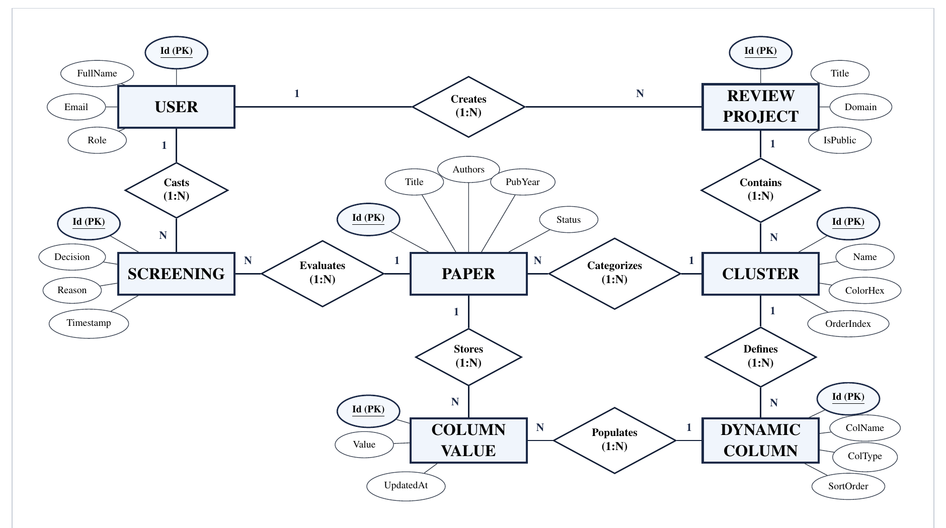
System Design: Entity-Relationship Diagram
DATABASE ARCHITECTURE
Relational Model & Integrity
• Core Entities: Users, Projects, Papers, Annotations, MatrixRows, and ExtractionFields.
• Relational Integrity: Foreign keys with ON DELETE CASCADE prevent orphan records.
• Coordinate Storage: Precise bounding boxes stored as JSON-encoded geometric coordinates.
• Concurrency Mode: SQLite WAL enables high-frequency simultaneous reads and writes.
16 / 28

Slide 17
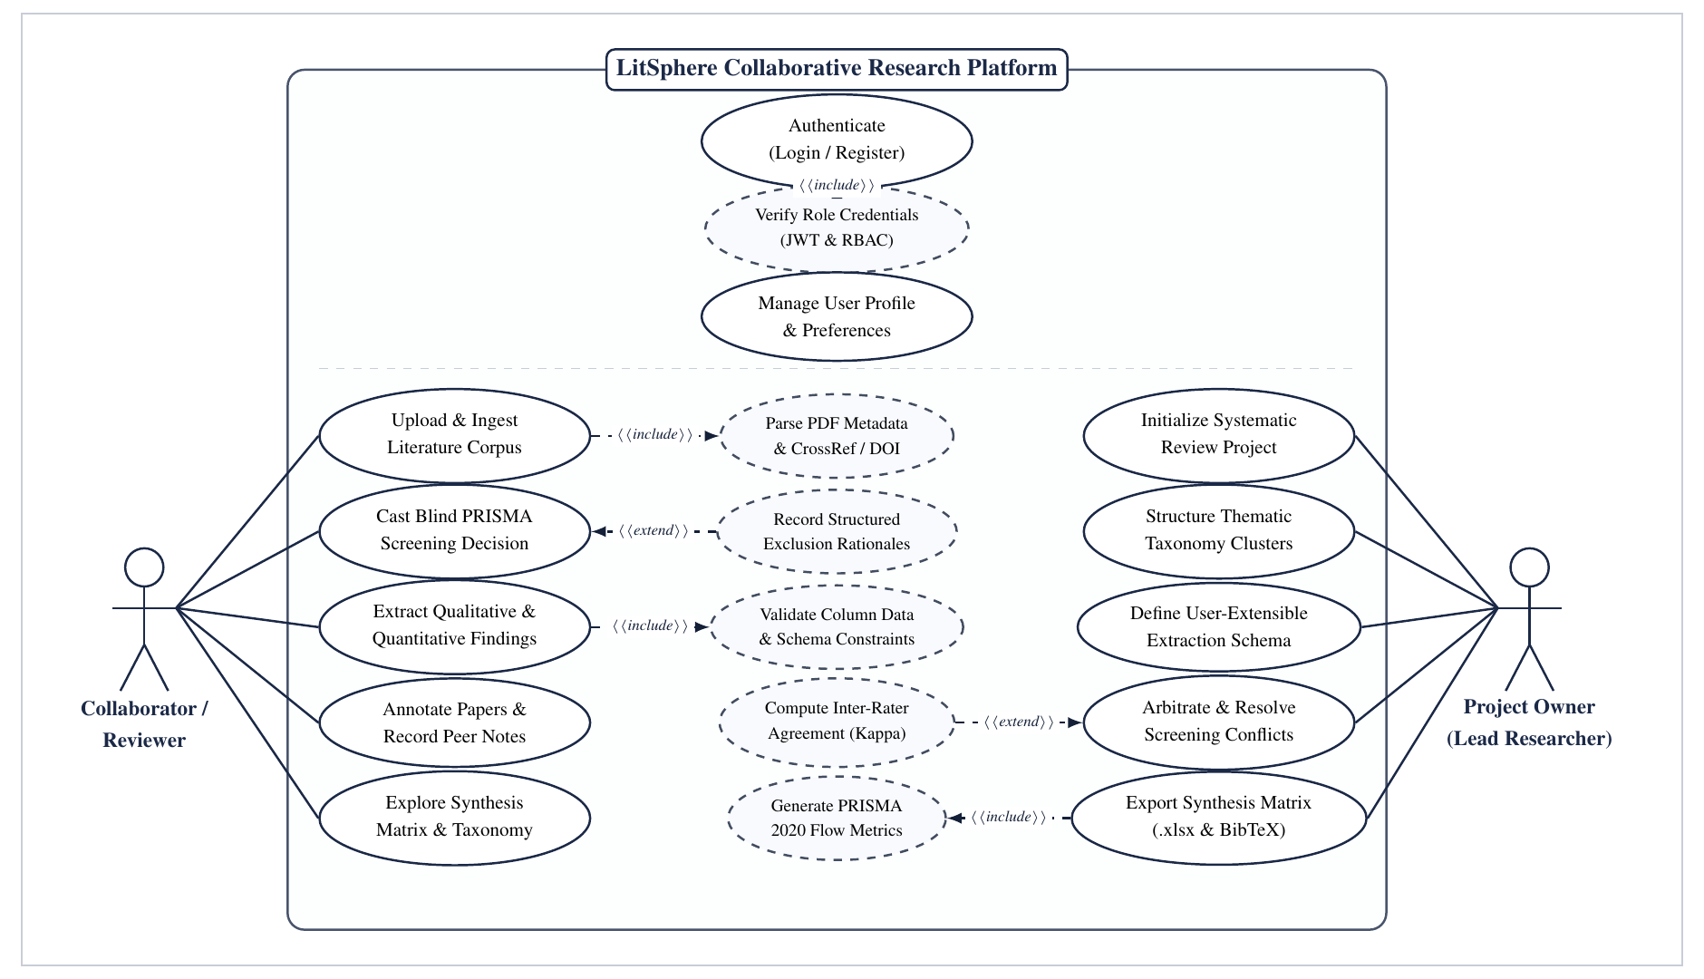
System Design: Use Case Diagram
WORKFLOW GOVERNANCE
Actor & Role Workflows
• Primary Actors: Researcher (Reviewer), Project Lead (Supervisor), and Admin.
• Researcher Actions: Ingest papers, highlight text coordinates, extract synthesis variables.
• Project Lead Actions: Define research questions, configure schemas, arbitrate conflicts.
• Admin Actions: Manage user accounts, role allocations, system audit logs, and backups.
17 / 28

Slide 18
SECTION 03
UI Implementation & Live Demo
Visual Inspection of the Fully Functional LitSphere System
18 / 28

Slide 19
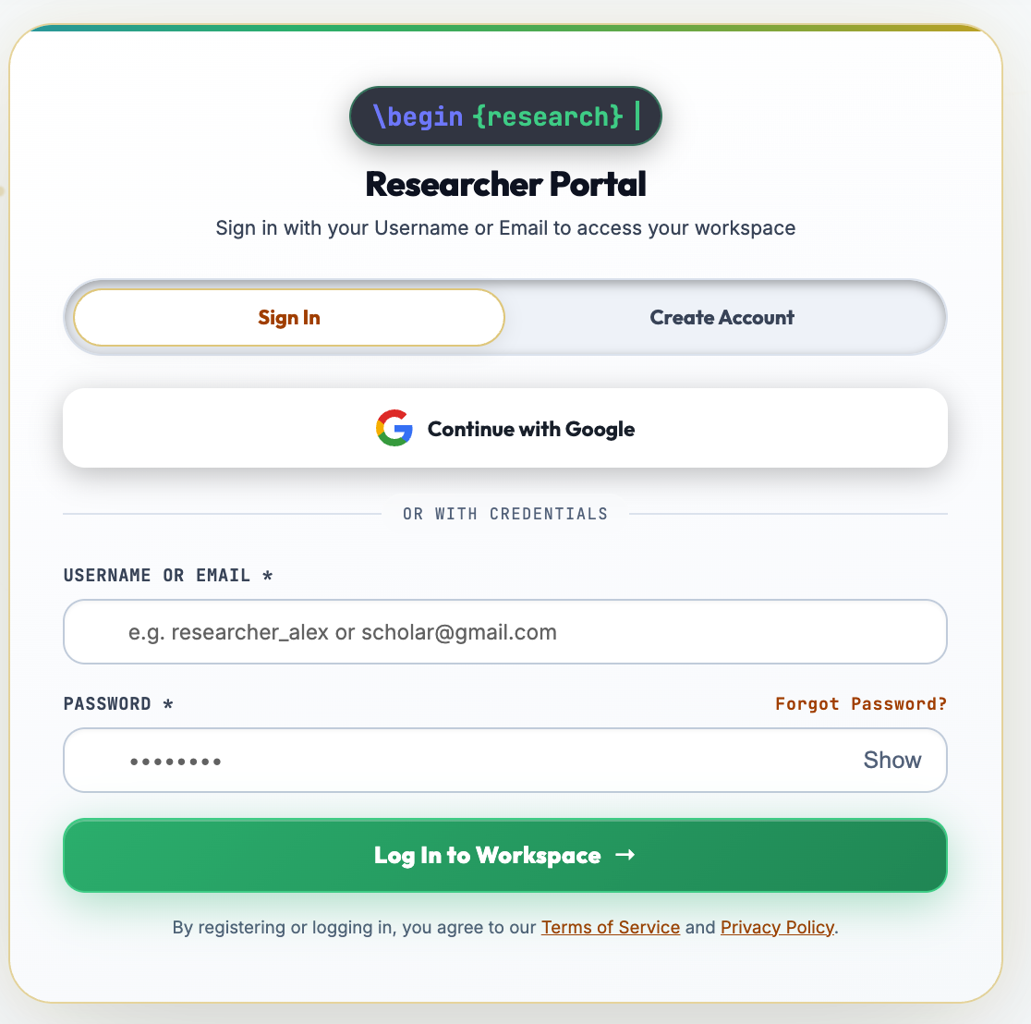
UI: User Authentication & Session Login
AUTHENTICATION LAYER
Single-Sign-On & Session Security
• Regex Input Validation: Instant client-side format checks for academic email addresses and password security.
• JWT Bearer Generation: Issues cryptographically signed stateless tokens upon successful credential verification.
• Bcrypt Hashing: High-entropy password encryption protecting user accounts from brute-force vectors.
• Persistent Session State: Secure local credential caching for seamless navigation across literature workspace tabs.
19 / 28

Slide 20
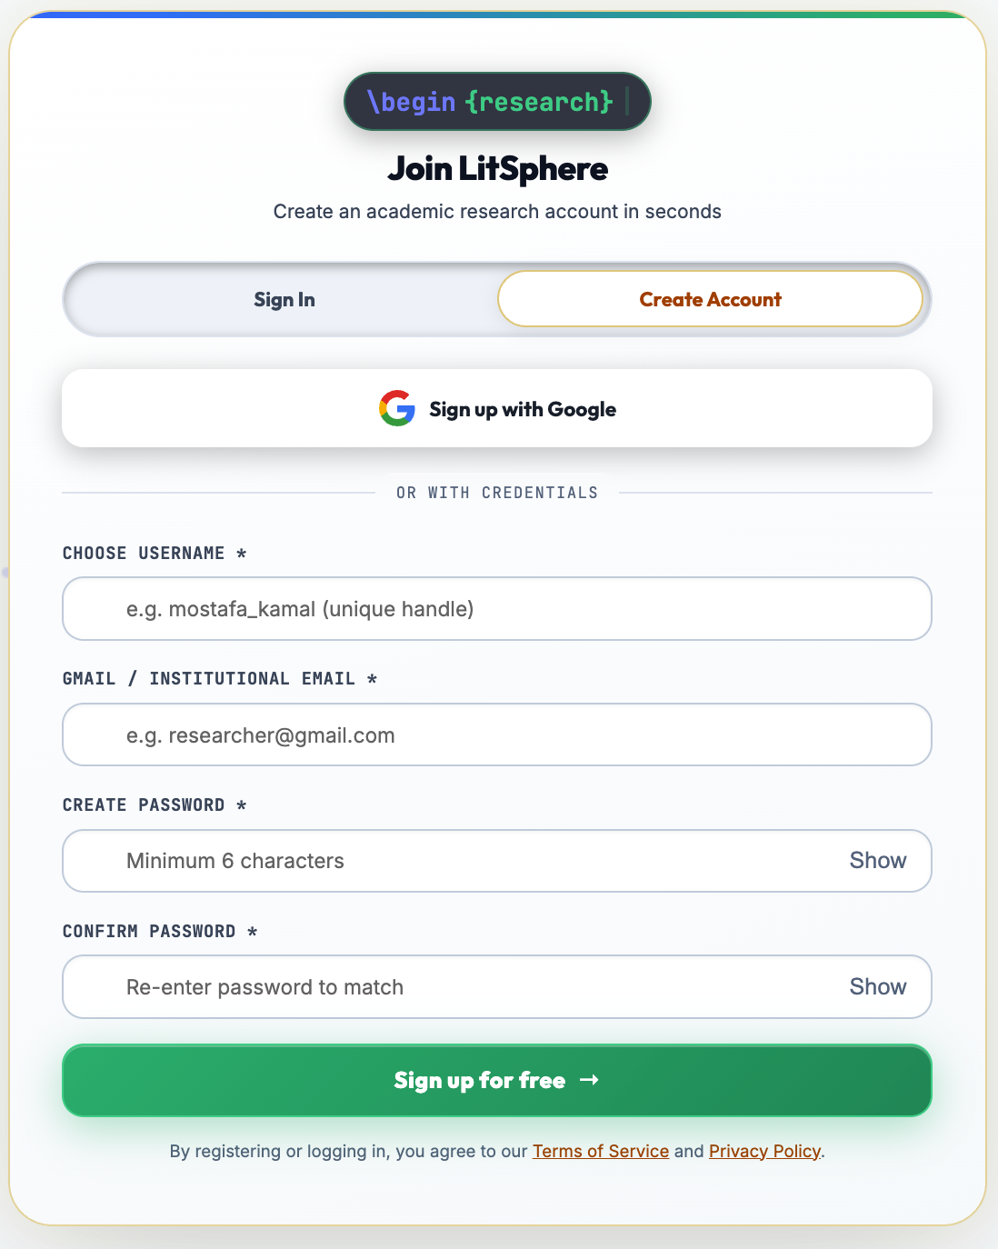
UI: Researcher Registration & Account Setup
USER ONBOARDING
Institutional Registration & Role Assignment
• Academic Profile Capture: Records researcher full name, department, and university affiliation during signup.
• Role-Based Governance: Grants initial access tiers (Student Researcher, Reviewer, or Principal Investigator).
• Password Policy Enforcement: Multi-condition character validation ensures robust credential security.
• Immediate Workspace Access: Direct transition into systematic literature review projects without manual activation lag.
20 / 28

Slide 21
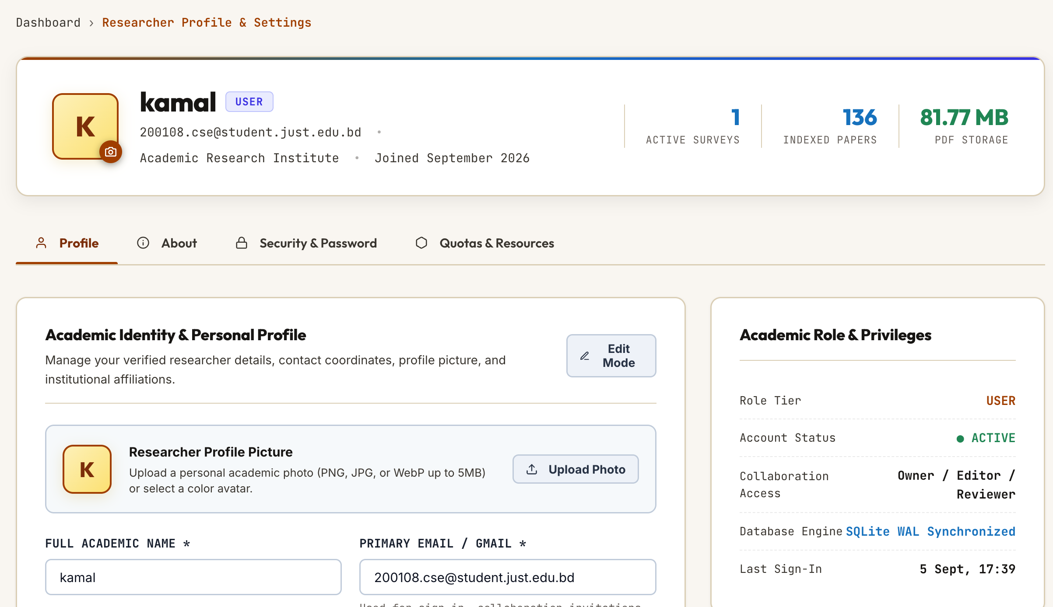
UI: Researcher Profile & Institutional Affiliation
ROLE GOVERNANCE
Account Credentials & Access Roles
Displays active identity credentials, institutional department metadata, and user privileges across all assigned review teams.
ACTIVITY TELEMETRY
Project Memberships & Contributions
Monitors active literature survey projects, tracks individual paper extraction tallies, and manages password updates.
21 / 28

Slide 22
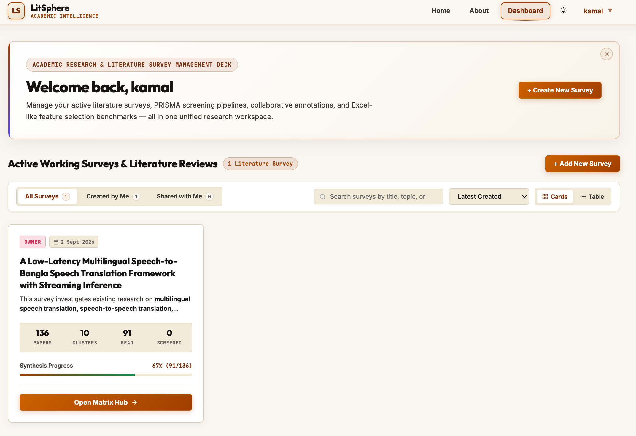
UI: Project Dashboard & Review Metrics
EXECUTIVE METRICS
Survey Portfolio & Extraction KPIs
Real-time operational dashboard providing high-level progress tracking, paper ingestion counts, and variable extraction status.
WORKFLOW ACTIONS
Protocol Launch & Batch Ingestion
One-click shortcuts to initiate new PRISMA literature review protocols, import BibTeX bibliographic libraries, and add collaborators.
22 / 28

Slide 23
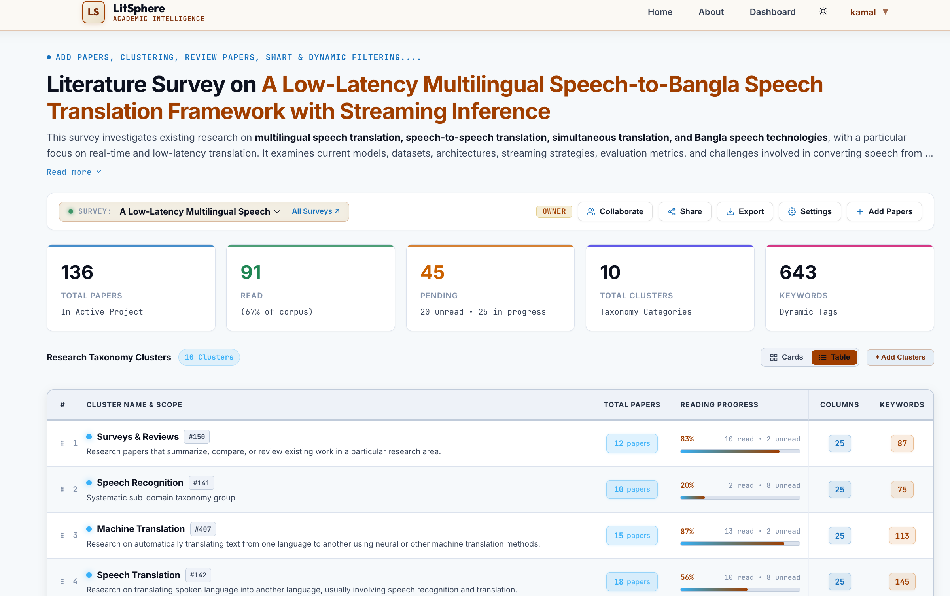
UI: Survey Workspace & Literature Ingestion
INGESTION PIPELINE
Drag-and-Drop Batch File Upload
High-throughput multi-file PDF ingestion interface with automated bibliographic parsing, title hashing, and metadata normalization.
LITERATURE CATALOG
Status Filtering & Review Queue
Organized research repository featuring status pills (Uploaded, In Progress, Synthesized) and multi-field keyword filtering.
23 / 28

Slide 24
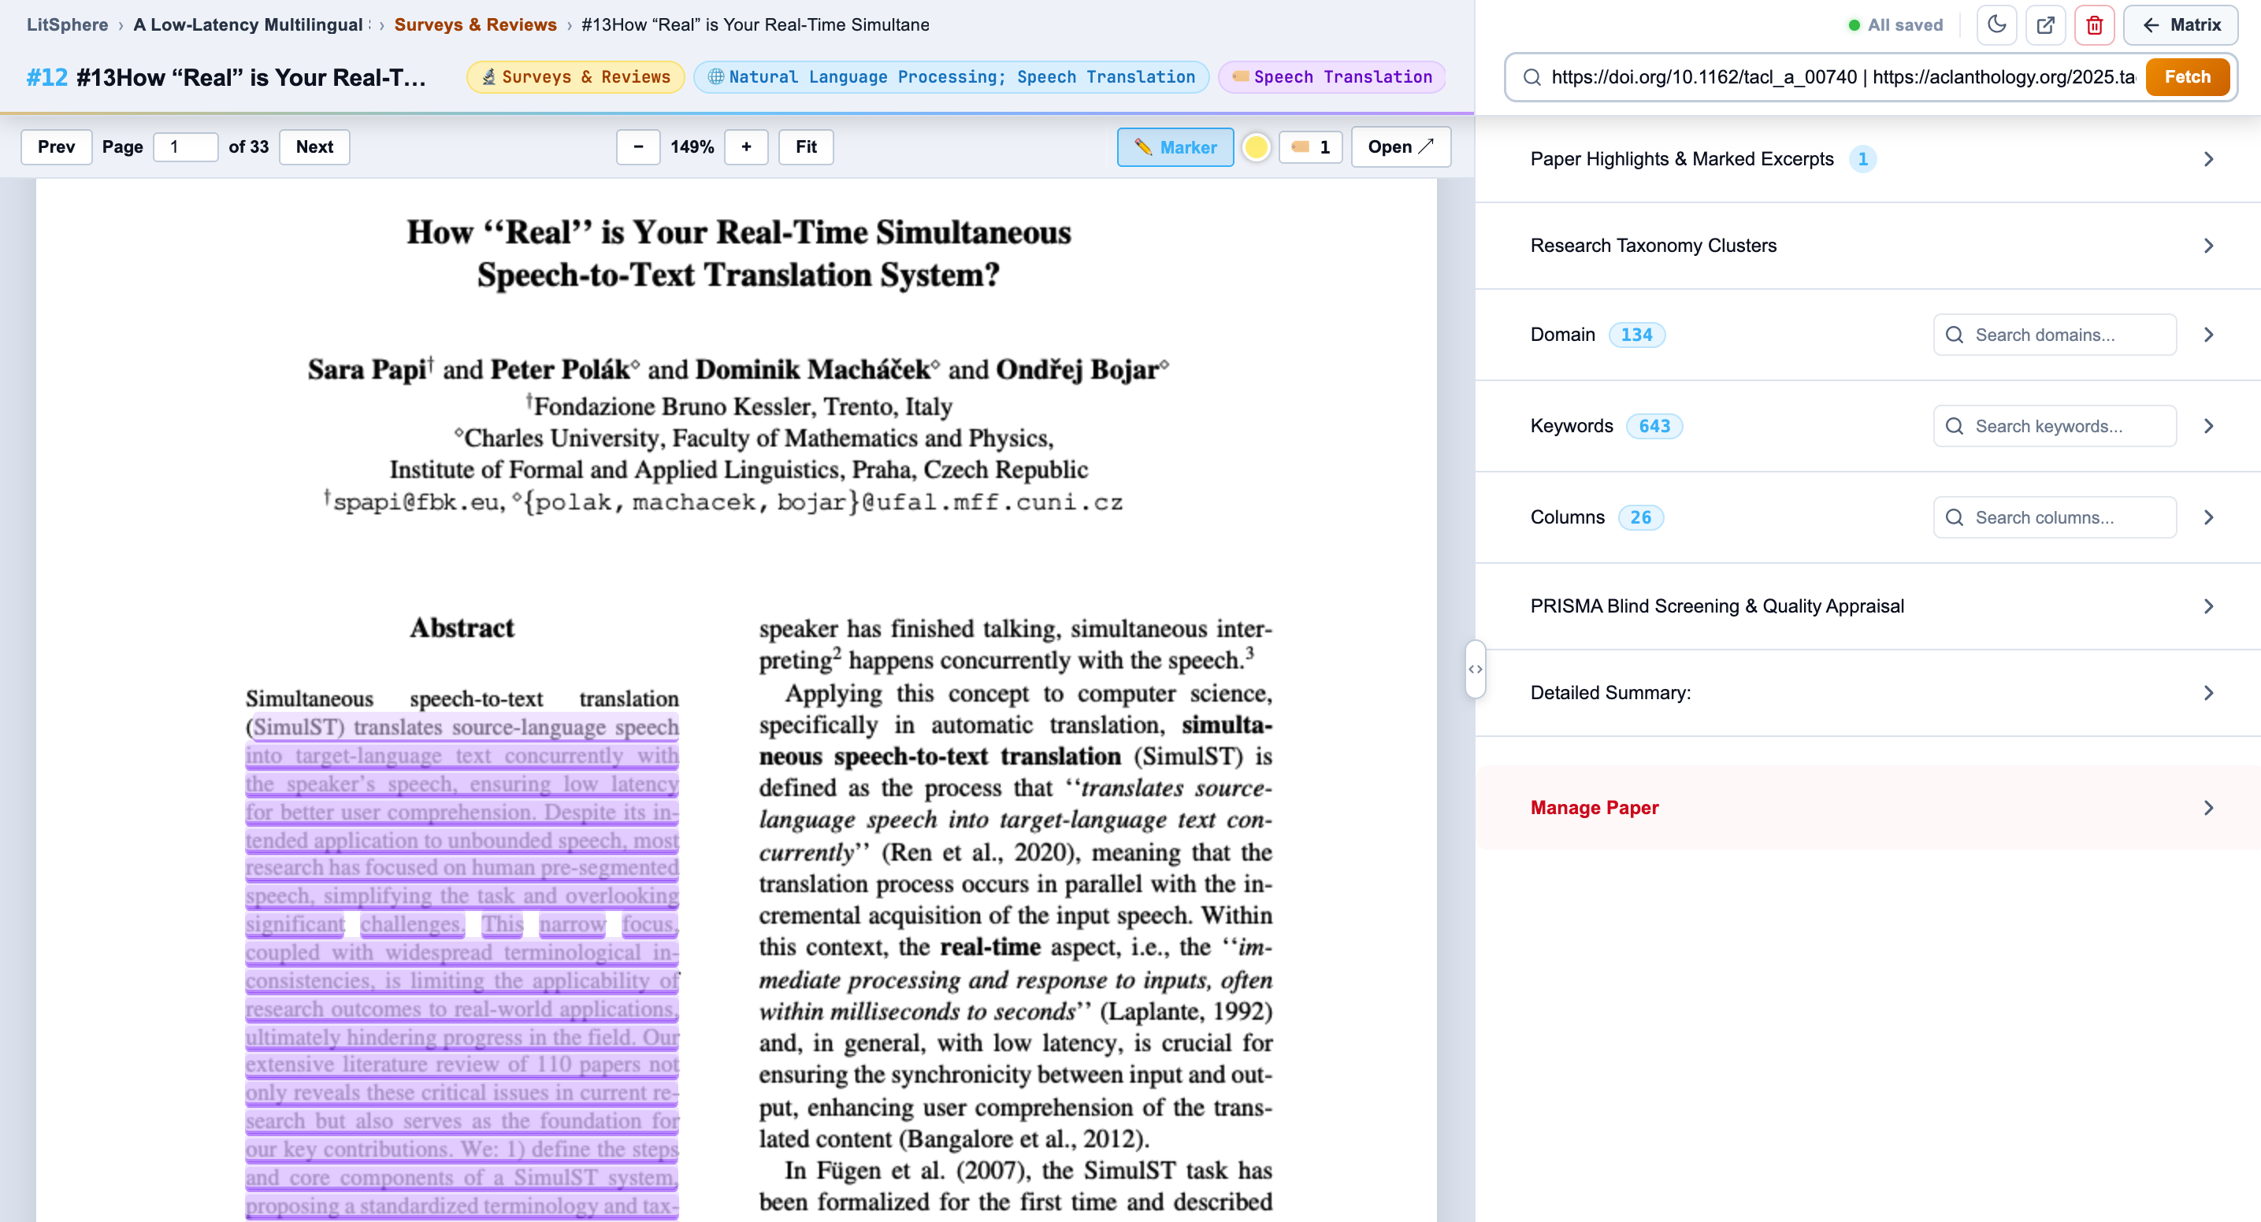
UI: Split-Screen Dual-Pane Paper Reviewer
DUAL-PANE WORKSPACE
Synchronous In-Browser PDF Reading
Integrated PDF reader docked side-by-side with extraction inputs, eliminating workflow disruption from external desktop viewers.
COORDINATE ANCHORING
Geometric BBox Text Highlighting
Text selections capture exact normalized bounding-box coordinates, providing direct jump-to-quote verification in under 2 seconds.
24 / 28

Slide 25
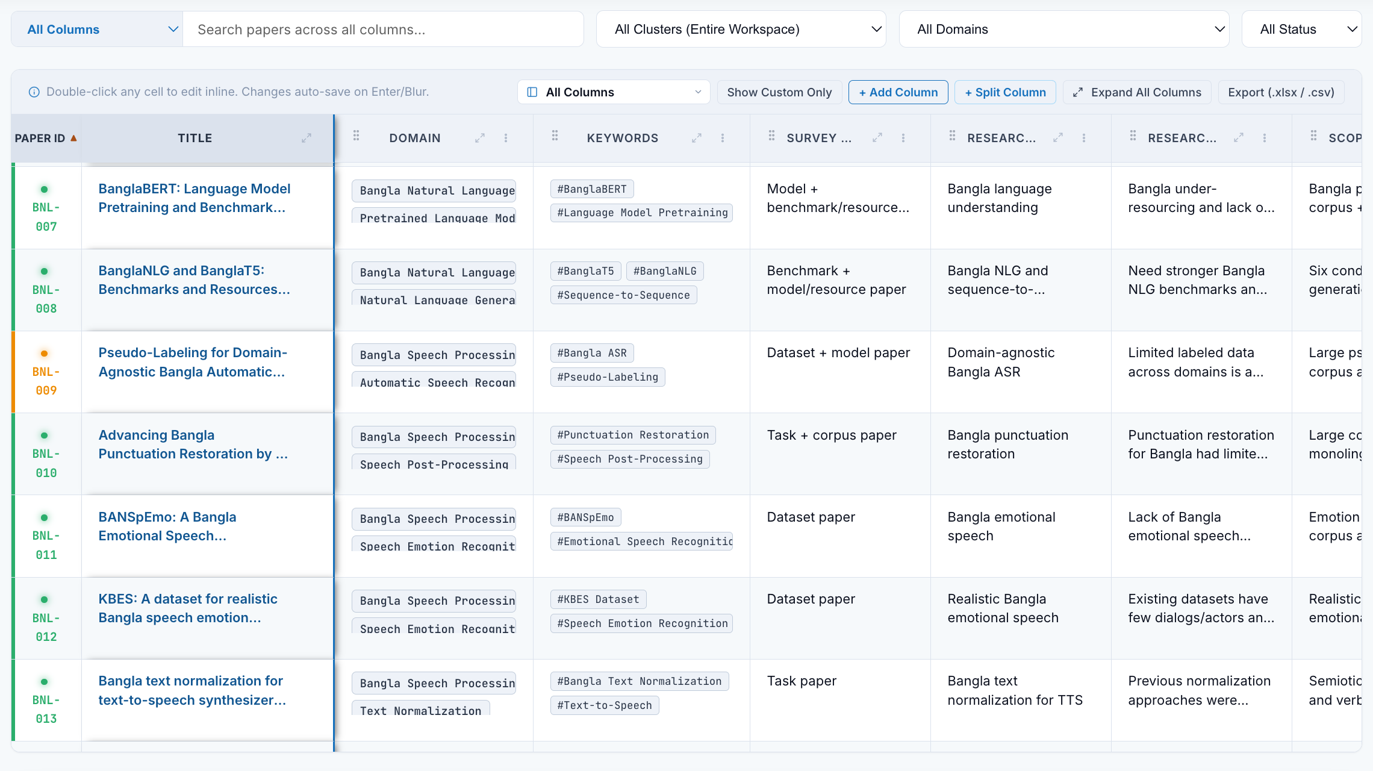
UI: Interactive Master Synthesis Matrix Grid
CROSS-STUDY SYNTHESIS
Consolidated Comparative Grid
Multi-dimensional tabular matrix harmonizing extracted variables (methodology, datasets, metrics, limitations) across all papers.
TRANSACTIONAL EXPORT
Inline Editing & 1-Click LaTeX
Supports real-time inline updates with ACID database guarantees, plus direct 1-click export to publication-ready LaTeX booktabs code.
25 / 28

Slide 26
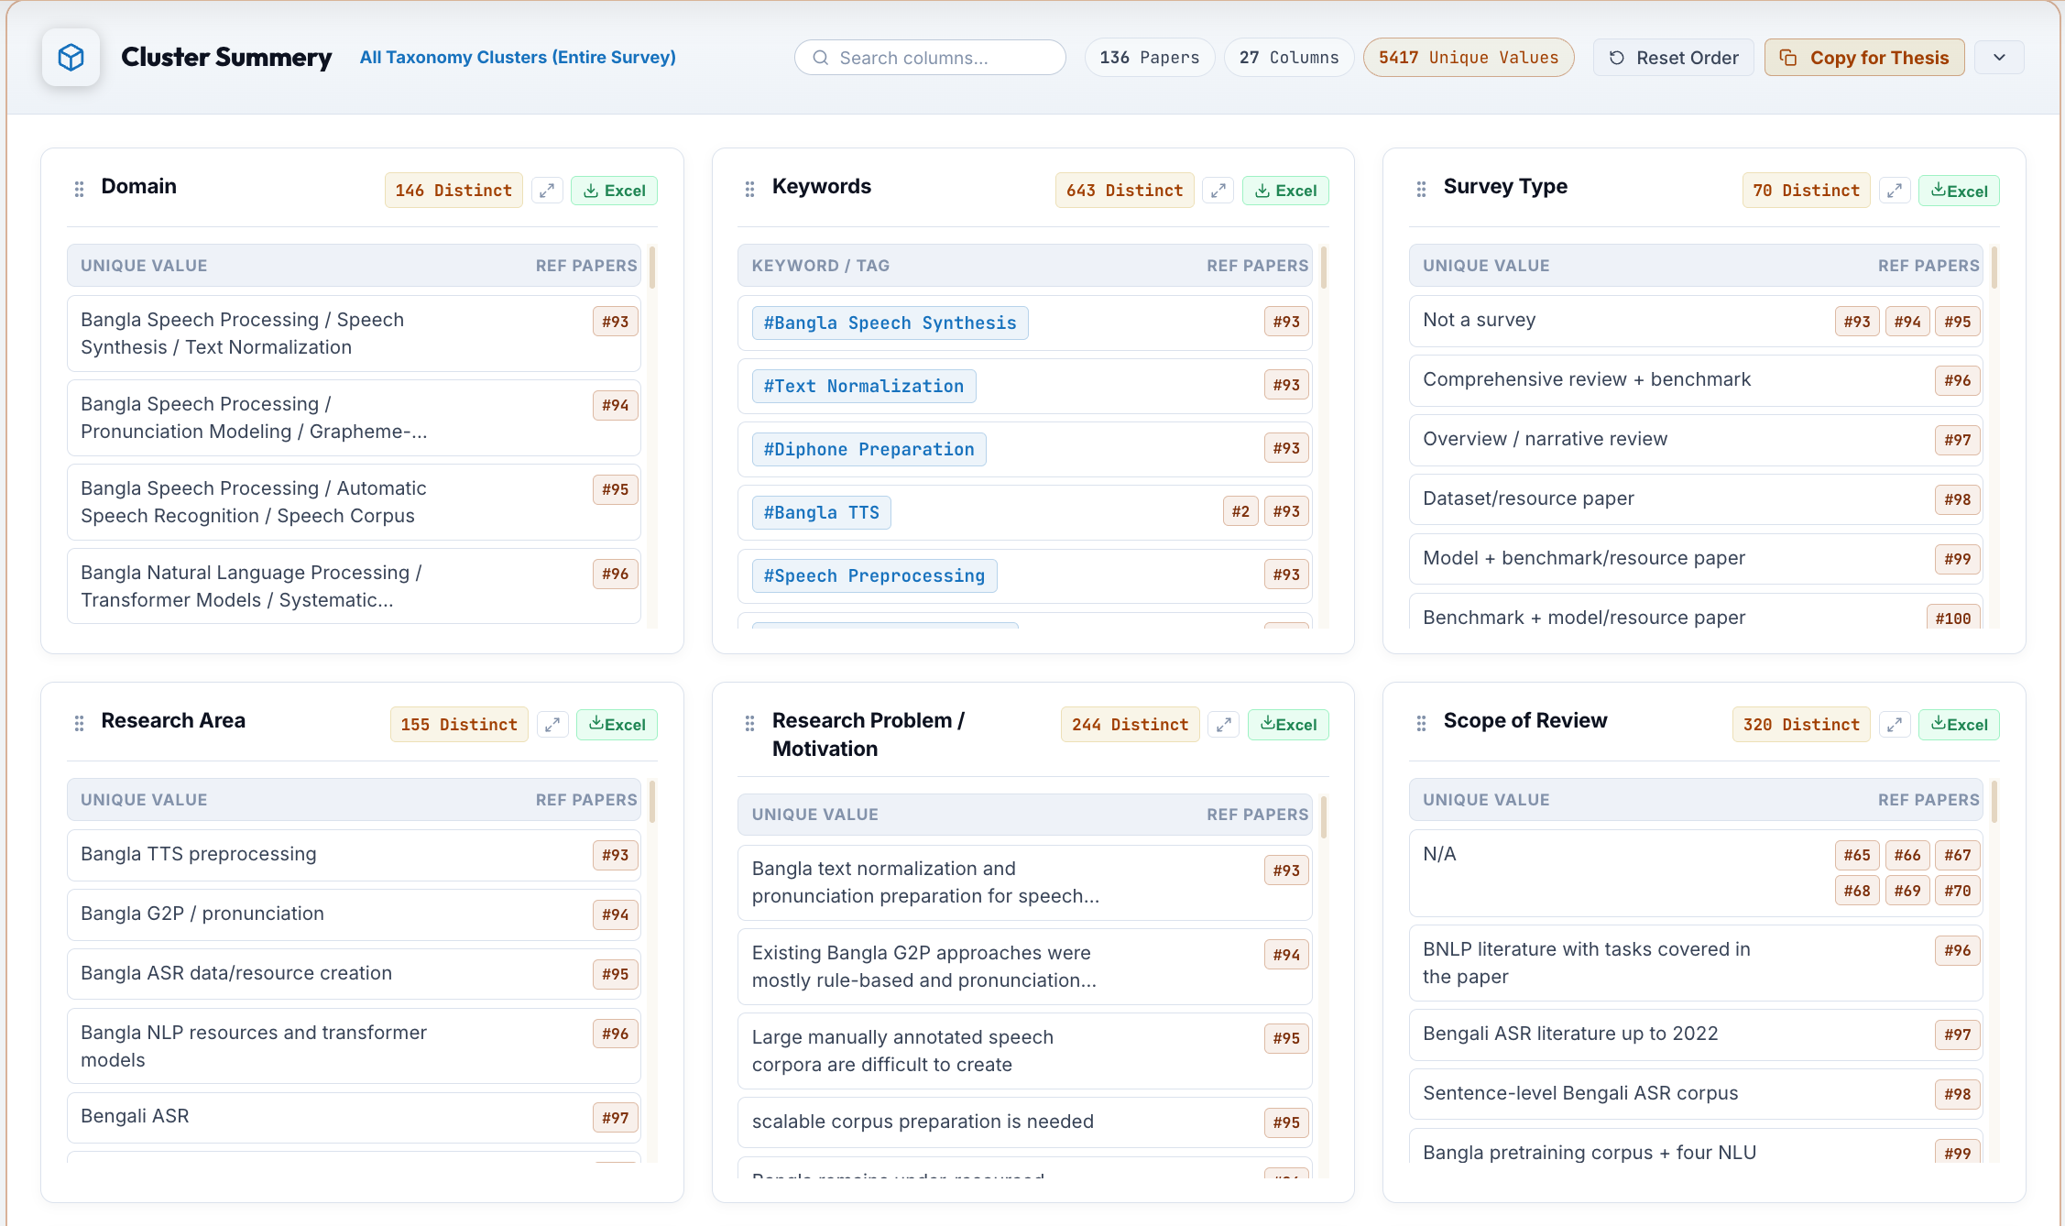
UI: Thematic Clustering & Synthesis Taxonomy
TAXONOMY DISCOVERY
Algorithmic Research Grouping
Automated thematic clustering categorizing ingested literature into distinct methodological paradigms, architectures, and focus domains.
SYNTHESIS ANALYTICS
Comparative Paradigm Distributions
Visual analytics displaying literature density, benchmark trends, and research frequency across surveyed publications.
26 / 28

Slide 27
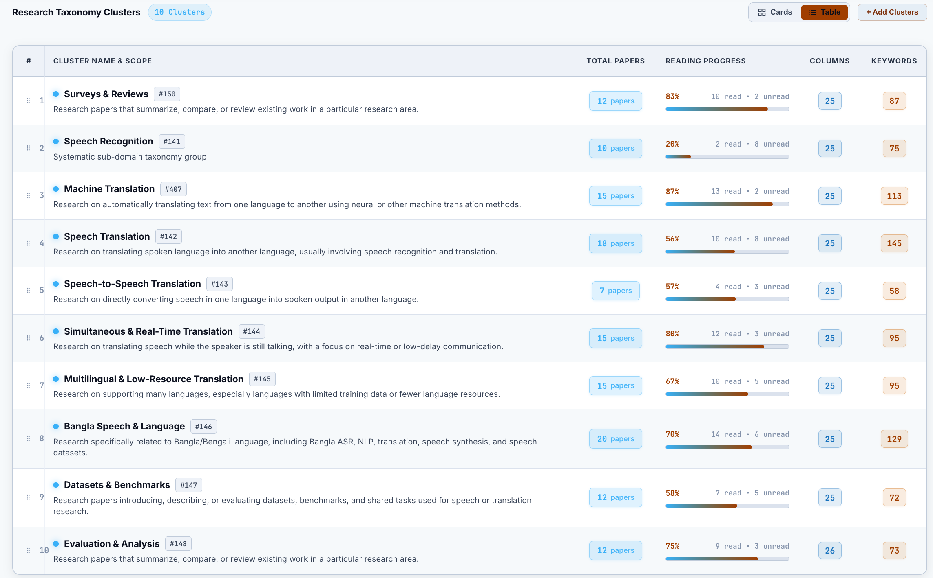
UI: Benchmark Sample & Cluster Details
GRANULAR DRILLDOWN
Benchmark Sample Breakdown
Deep-dive inspection panel displaying constituent papers within a cluster, comparing evaluation metrics and algorithmic models.
RESEARCH GAP IDENTIFICATION
Cross-Methodology Discrepancies
Reveals performance discrepancies, benchmark dataset limitations, and unexplored research gaps across competitive methodologies.
27 / 28

Slide 28
Conclusion & Project Outlook
ACHIEVEMENTS
Phases 1–3 Complete
• End-to-end working system. • Dual-pane PDF reviewer. • Coordinate BBox anchoring. • Live master matrix grid. • Native LaTeX export.
STATUS
Current Milestone (M6)
• 55% roadmap executed. • Zero major blockers. • High UX performance. • Proven architectural scale. • On track for M12 defense.
NEXT STEPS
Months 7 to 12 Focus
• Collaborative PRISMA voting. • Cohen's Kappa score engine. • Supervisor conflict resolver. • SUS usability evaluation. • Final thesis dissertation.
28 / 28

