Slide 1
Satellite Imaging Project

Slide 2
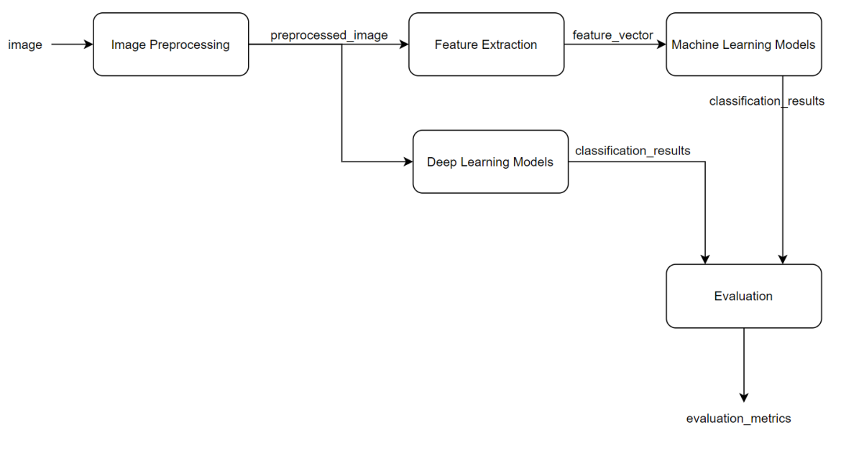
Pipeline

Slide 3
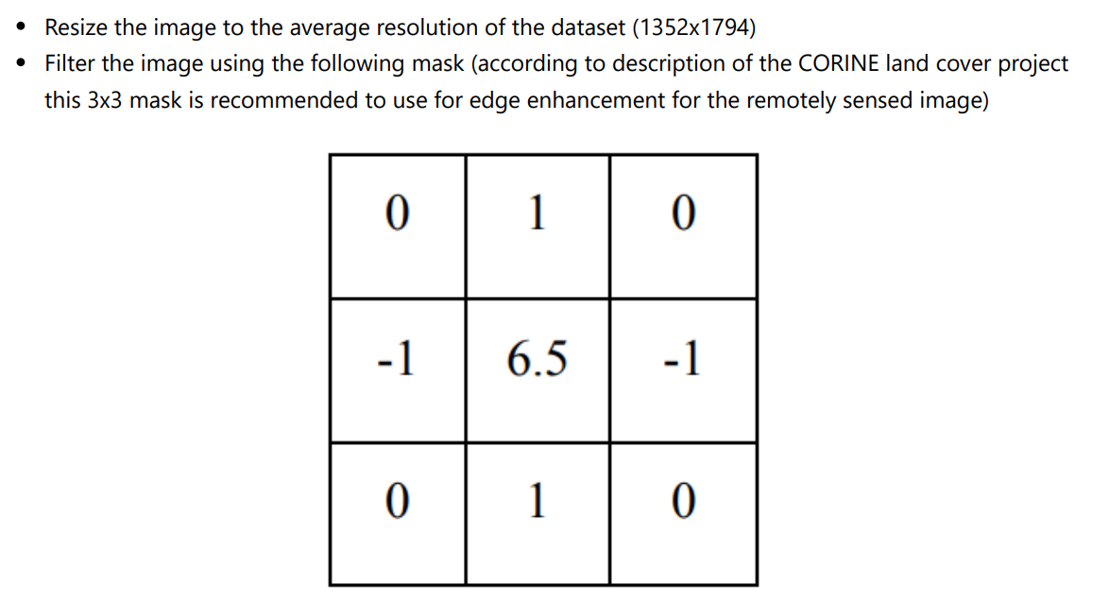
Preprocessing

Slide 4
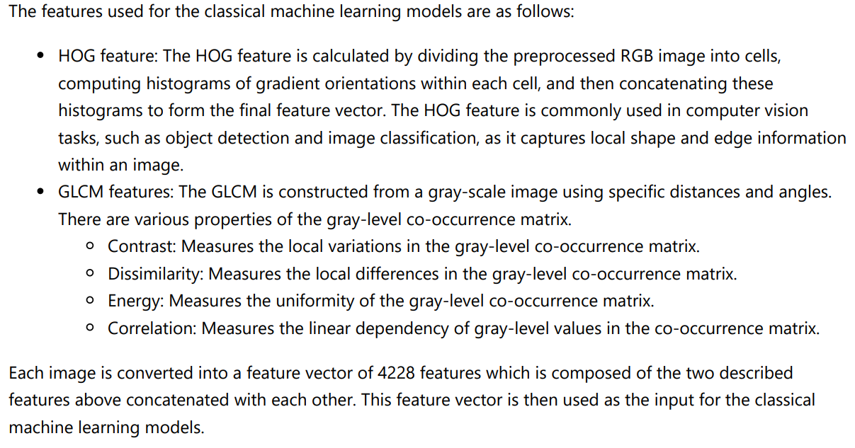
Feature Engineering

Slide 5
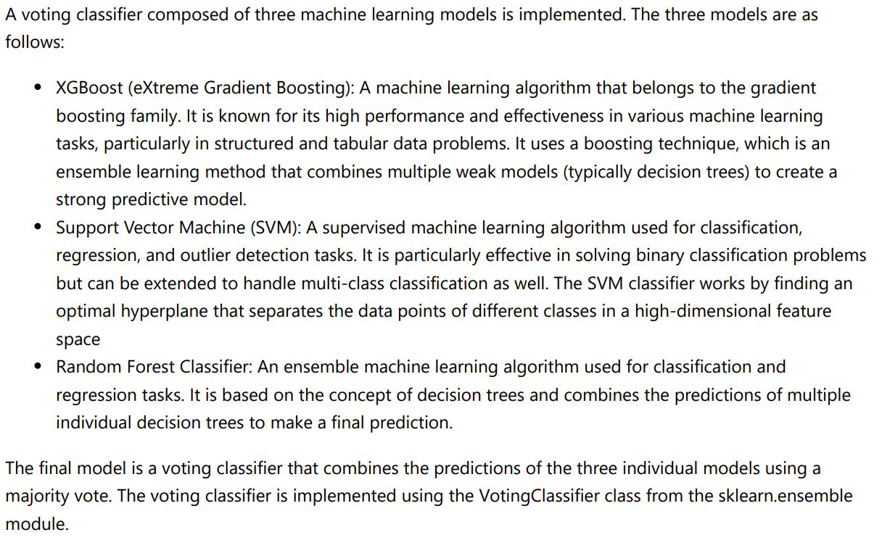
Classical Machine Learning Models

Slide 6
Deep Learning Models
Convolutional Neural Network (CNN): This model is implemented from scratch using pytorch.
ResNet-50 (pre-trained model):
AlexNet (pre-trained model):
DenseNet-201 (pre-trained model):

Slide 7
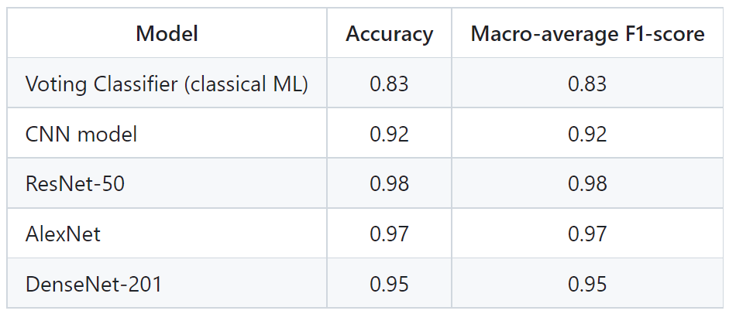
Models’ Comparison

Slide 8
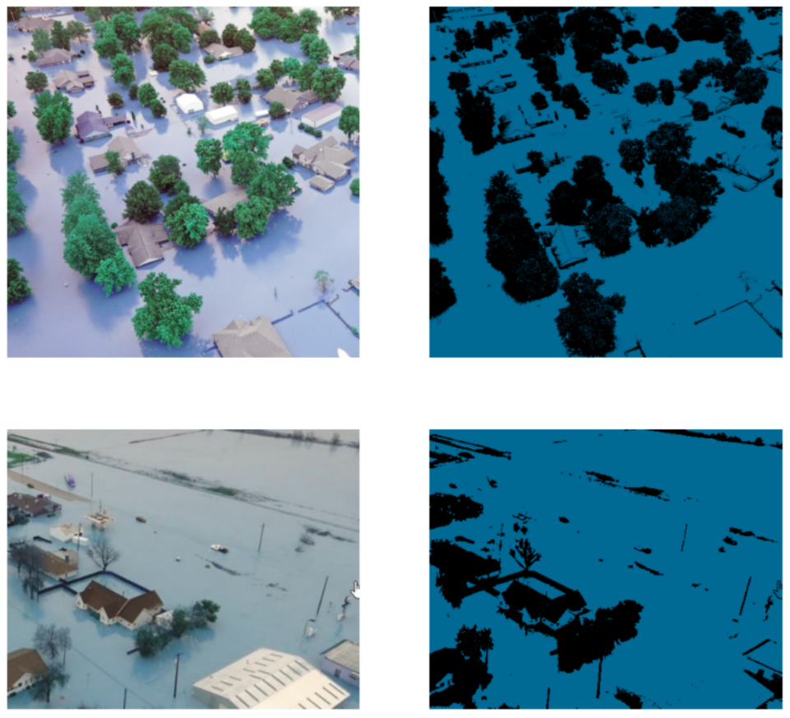
Per-pixel Classification (K-means)

Slide 9
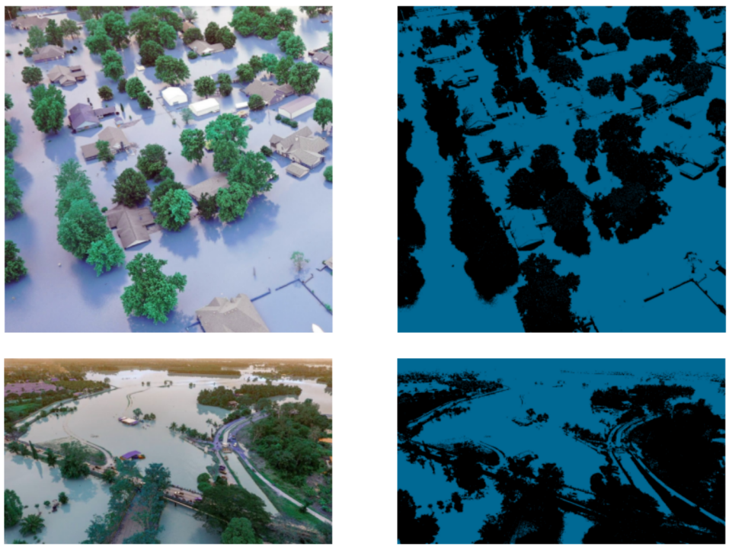
Per-pixel Classification (ISODATA)

