Slide 1
Machine Learning Project
Team 9
Supervised by: Dr. Dina Elreedy

Slide 2
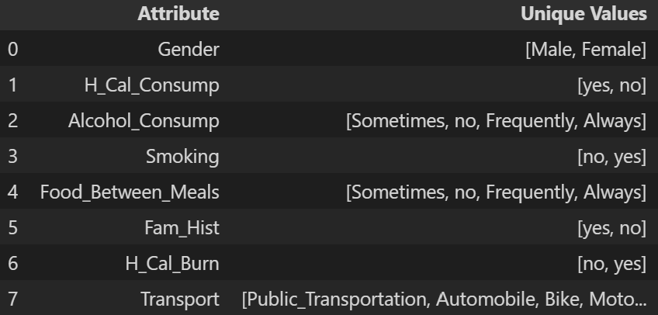
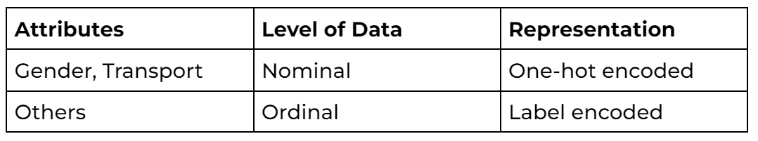
Data Analysis & Preprocessing
The continuous attributes are normalized
The categorical attributes’ details are shown in the following table
Those attributes can be classified and represented as follows according to the four levels of data.

Slide 3
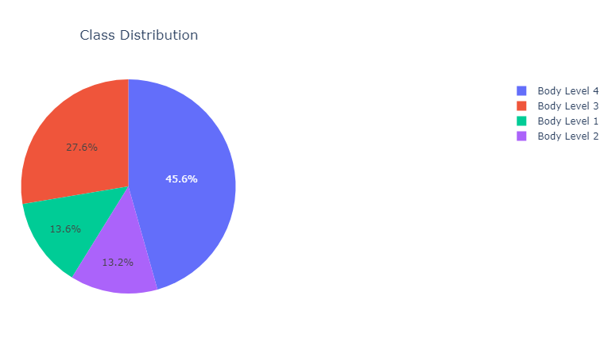
Data Analysis & Preprocessing

Slide 4
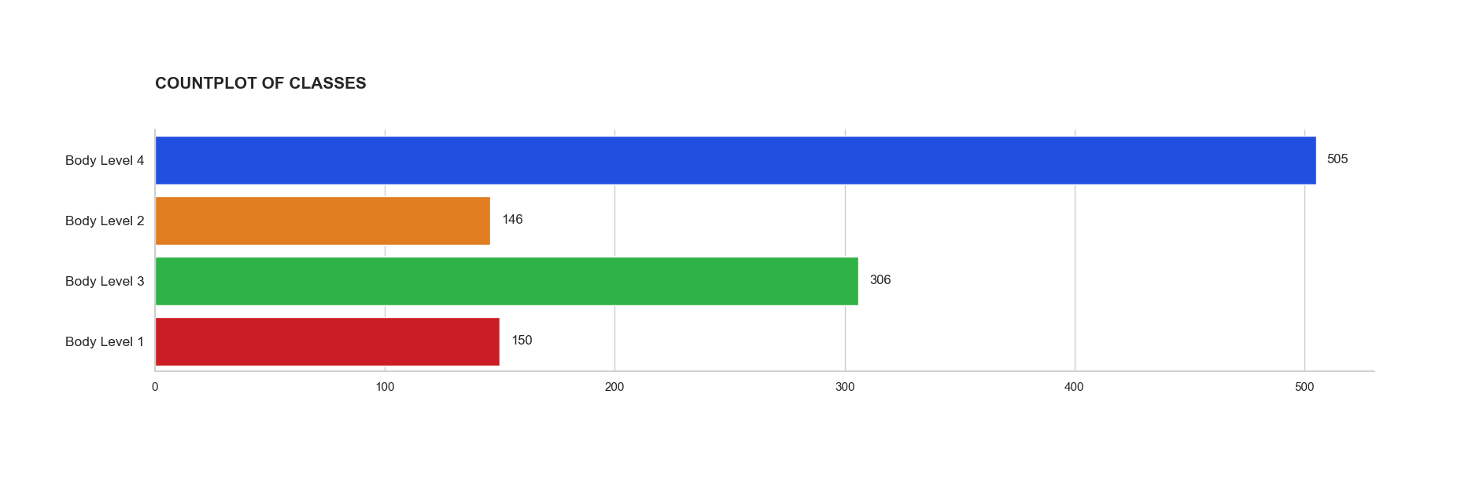
Data Analysis & Preprocessing

Slide 5
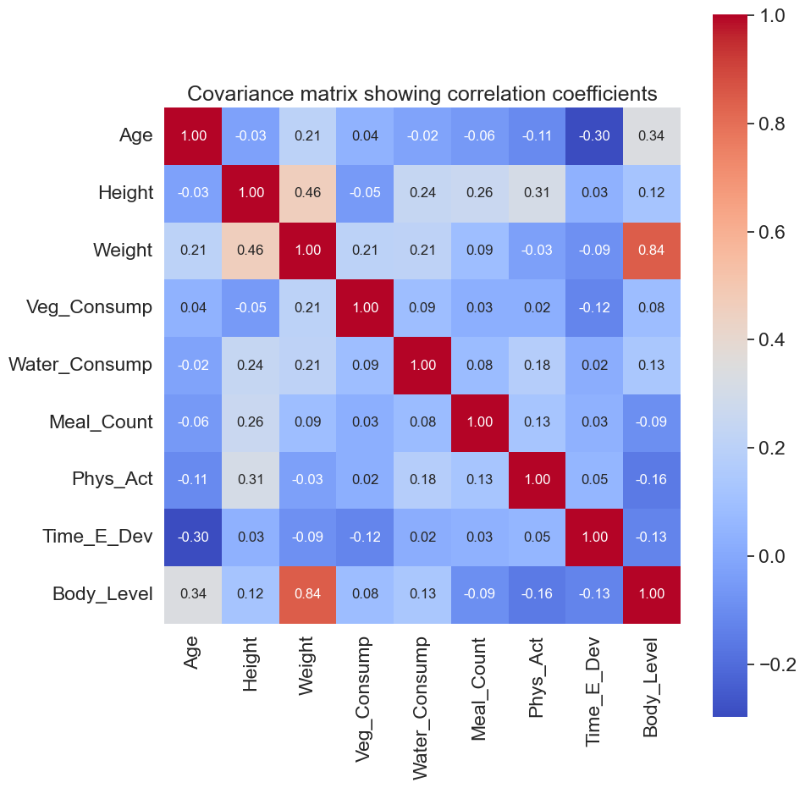
Feature Engineering
This plot shows the covariance matrix between all continuous features (after standardization) and the target label.
The ‘Meal_Count’ attribute has very low correlation to the target

Slide 6
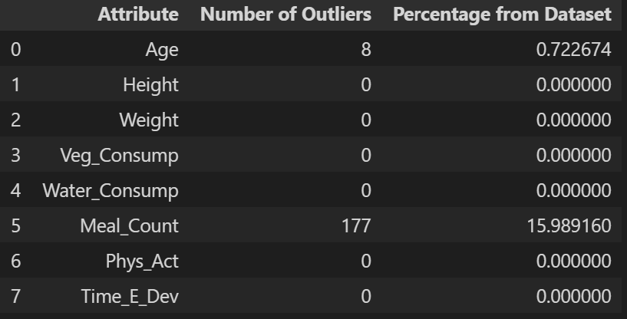
Feature Engineering
Outlier analysis was performed based on the interquartile distance of each continuous variable.
An attribute value (x) is considered to be an outlier if one of the following conditions is satisfied:
x > Q3 + 3 * IQD
x < Q1 - 3 * IQD

Slide 7
Models

Slide 8
Logistic Regression
Hyperparameter tuning:
Penalty: the type of regularization to be used model (L1 / L2)
C: the strength of the regularization in the model.
Solver: the algorithm to be used for optimization in the model
Grid search tuning produced the following results:
{'C': 100, 'penalty': 'l2', 'solver': 'lbfgs'}

Slide 9
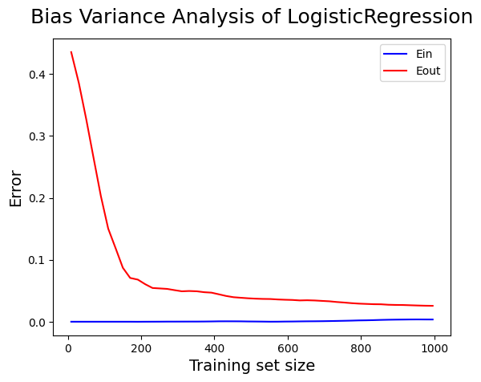
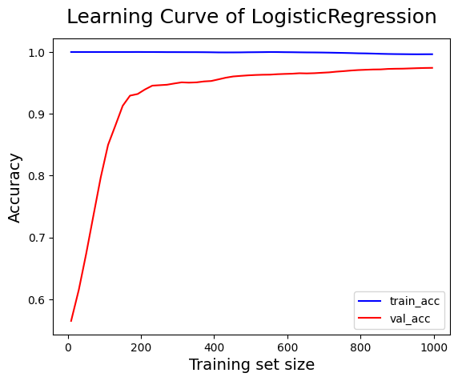
Logistic Regression

Slide 10
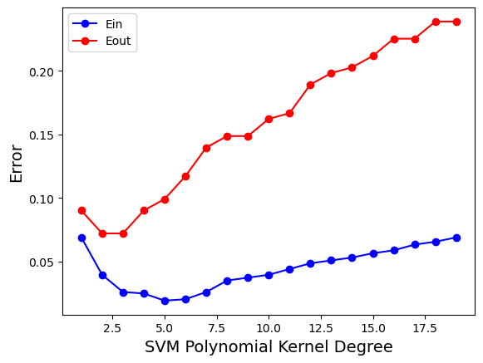
SVM
Parameter tuning by setting the kernel to polynomial and trying values for the degree from 1 to 20.
This shows that the model is overfitting because the Ein decreases & Eout decreases by increasing complexity.

Slide 11
SVM
Hyperparameter tuning:
kernel: the type of kernel (linear, polynomial, …)
gamma: the shape of the decision boundary
C: controls the tradeoff between maximizing the margin and minimizing the classification error
Grid search tuning produced the following results:
{kernel='linear', degree=1, gamma=1, C=10}

Slide 12
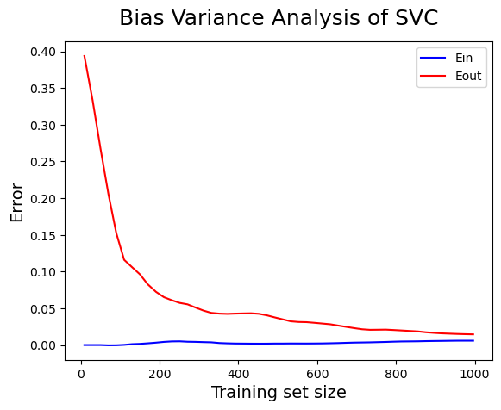
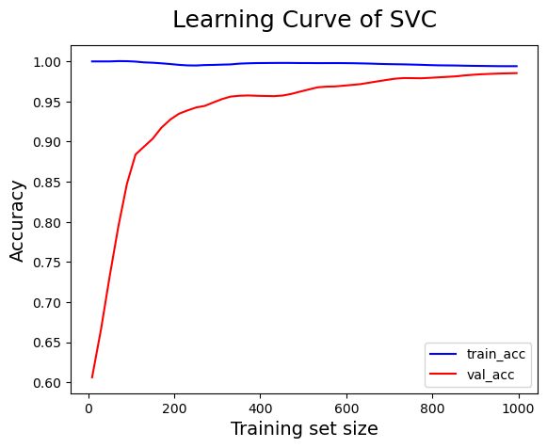
SVM

Slide 13
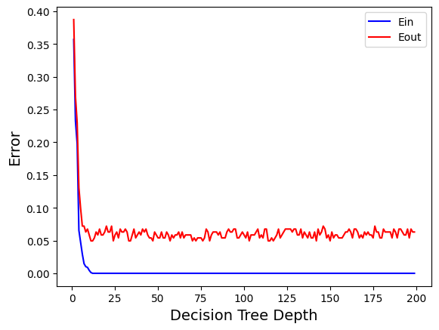
Decision Trees
The depth of the tree is an indicator for complexity
Evaluating decision tree for every depth in the range of 1 to 200
Tune tree depth to 25 because Ein and Eout almost saturated after that depth

Slide 14
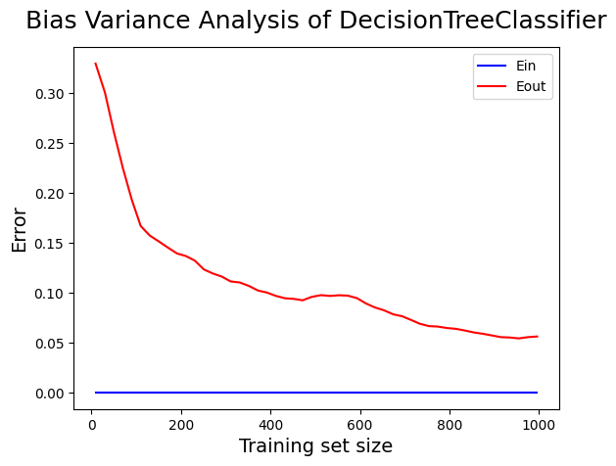
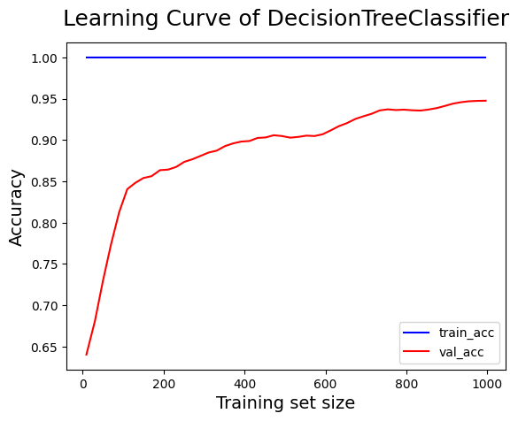
Decision Trees

Slide 15
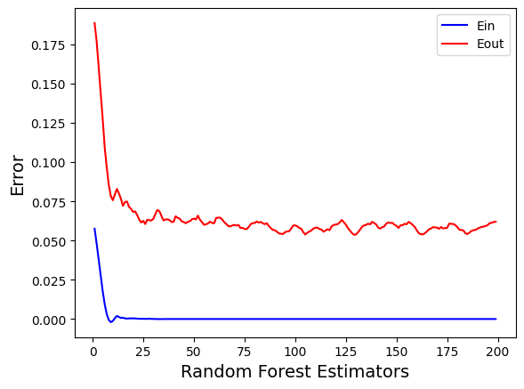
Random Forest
The no. of estimators is a parameter that controls the number of decision trees built during training (it is indicator for complexity).
Tune no. of estimators to 25 because Ein and Eout almost saturated after that value

Slide 16
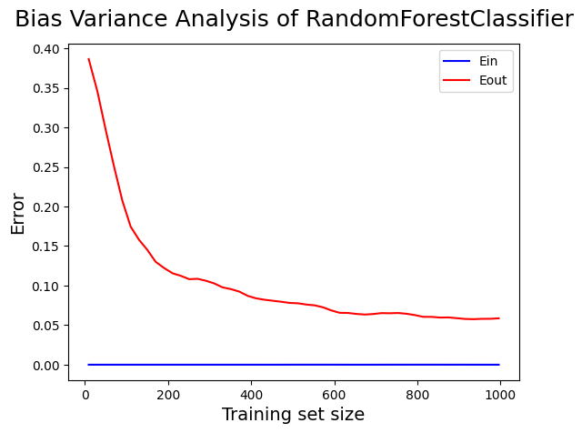
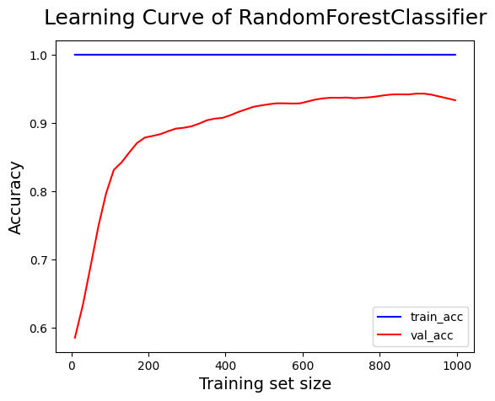
Random Forest

Slide 17
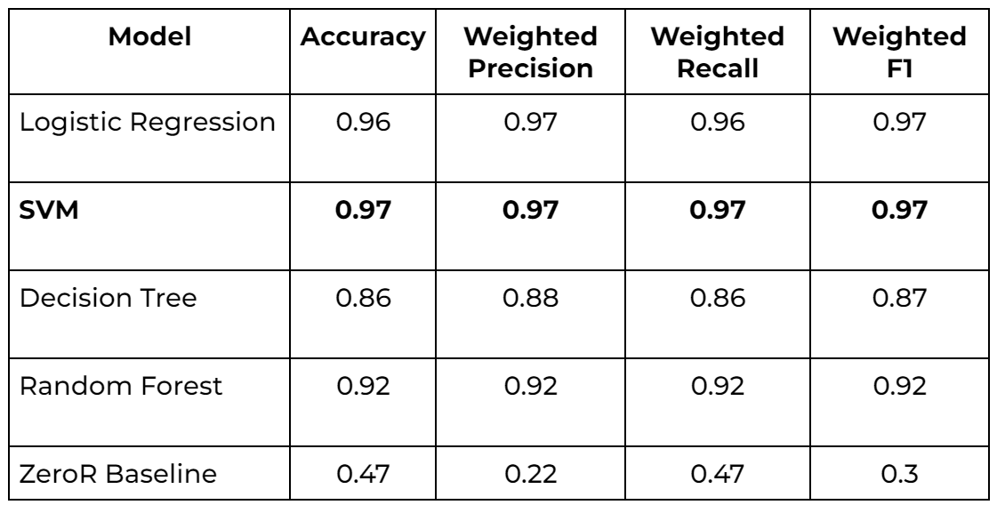
Model Comparison

Slide 18
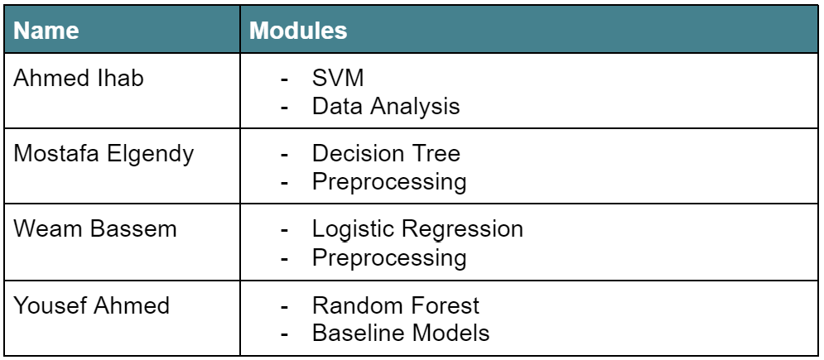
Workload Division

Slide 19
Thanks

