Slide 1
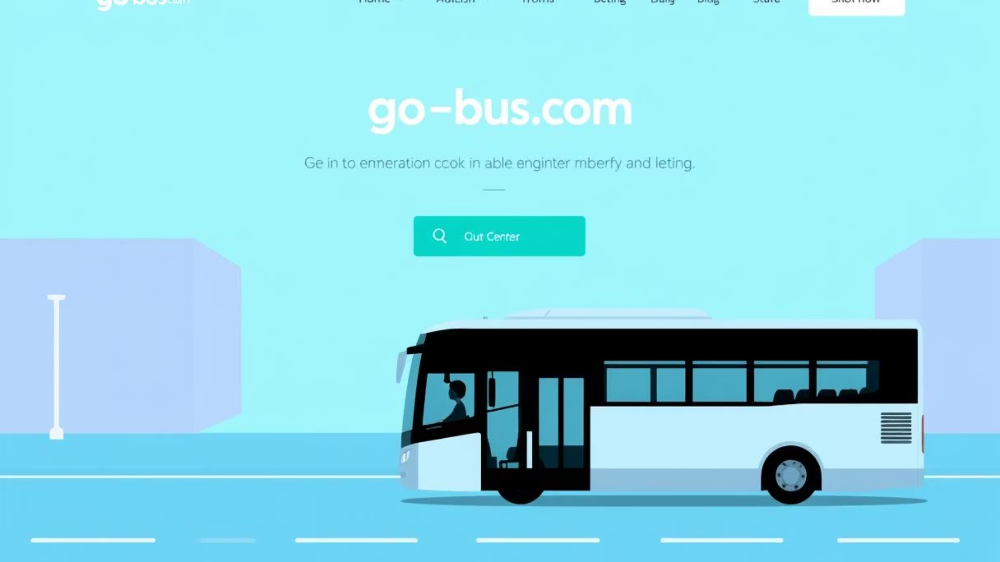
GO-BUS Project

Slide 2


Project Team
Our Project Team: Dedicated to collaboration and teamwork to drive success.
Salah Adel
Hazem Amer
Ashraf Adel
Mostafa Fekry
Asmaa Elazab
Samar Abdelrahman

Slide 3
Presentation Outline
1
Overview
2
Objective
3
Design
4
Testing Approach
5
Test Environment
6
Testing Results
7
Future Plans
Conclusion
8

Slide 4

Overview
The goal of this project is to ensure the “Go Bus” (https://go-bus.com) online platform provide a smooth and reliable booking experience for users. The focus will be on testing functionalities like ticket booking, user registration, and customer support.
The Test Plan is designed to prescribe the scope, approach, resources, and schedule of all testing activities of the project “Go Bus”. The plan identify the features to be tested, the types of testing to be performed and the risks associated with the plan.

Slide 5
Objective
TEST OBJECTIVE The test objectives are to verify the Functionality of website Go Bus, the project should focus on Booking a Ticket, Searching for Buses, Cancelling a Booking, Viewing Booking Details, Tracking Bus Status, Creating an Account to guarantee all these operation can work normally in real business environment:
Ensure system reliability and stability.
Validate user-friendly interface.
Identify and report functional bugs.
Verify user registration flow
Improve compatibility across devices and browsers.

Slide 6
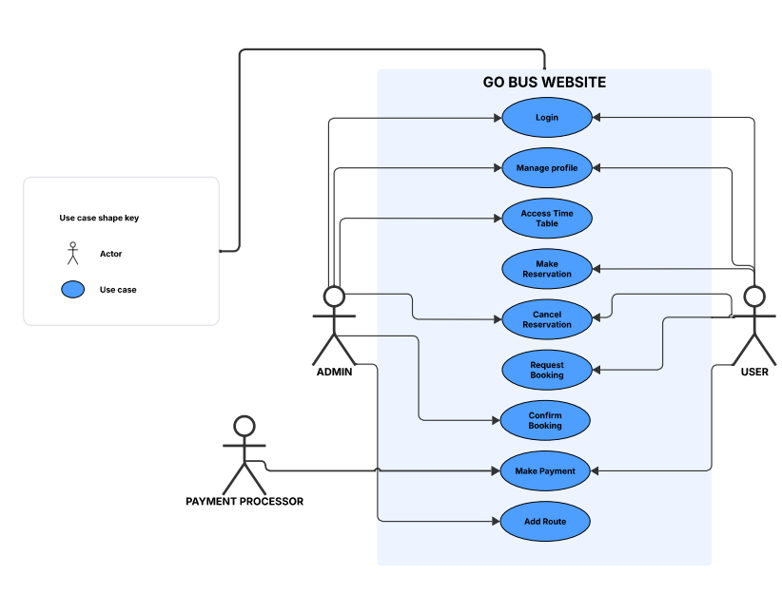
Design
USE CASE

Slide 7
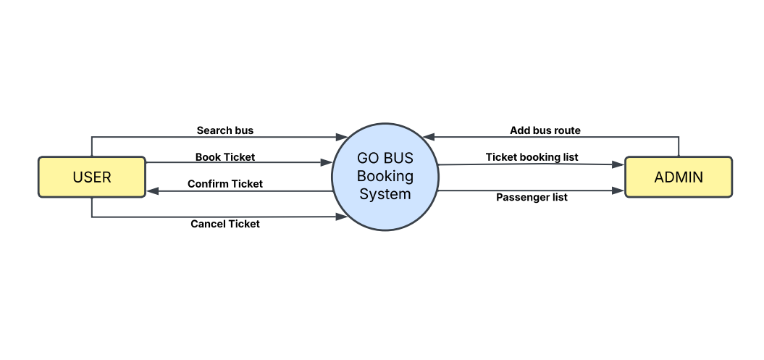
Design
Context Diagram

Slide 8
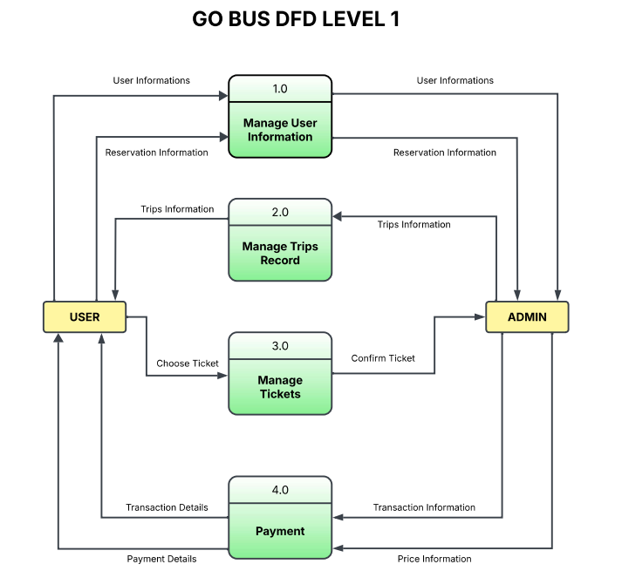
Design

Slide 9
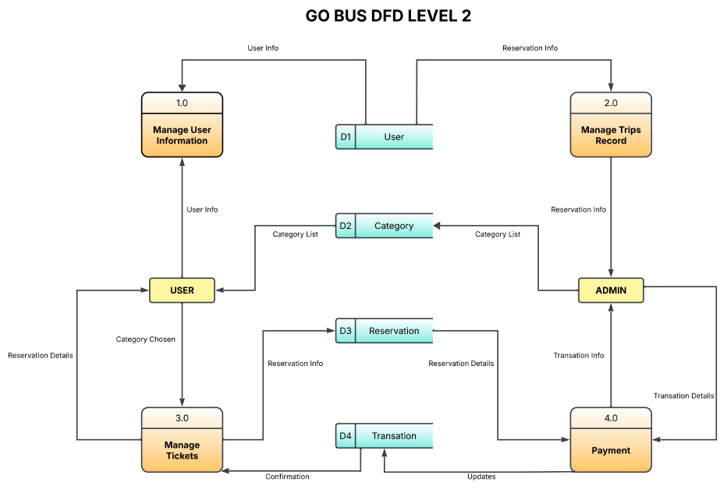
Design

Slide 10




Testing Approach
Manual Testing
Unit, Integration, System, and Acceptance testing to verify functionality.
Automation
Using Selenium and TestNG frameworks to automate regression and repetitive tests.
Agile Methodology
Iterative and incremental testing integrated with Agile sprints for continuous feedback.
Exploratory Testing
Simultaneous learning, test design, and execution to discover unexpected issues.

Slide 11





Test Environment
Environments
Development, Staging, Production, and multiple browsers including Chrome, Firefox and Edge
Defect Tracking
Manual bug reports/test cases managed in Google Sheets
Automation Tools
Automation using IntelliJ IDE with Selenium and TestNG integration
Project Collaboration
Source code and documentation shared via GitHub repository
We maintain distinct test environments, including Development, Staging, and Production, and test across multiple web browsers such as Chrome, Firefox and Edge to ensure cross-browser compatibility.
Defect tracking is managed through manual testing bug reports and test cases are documented in Google Sheets for easy access and updates.
Automation testing is performed using IntelliJ IDE integrated with Selenium and TestNG frameworks, facilitating efficient regression and repetitive test execution.
All source code, test scripts, and documentation are maintained and shared via GitHub, enabling collaborative project development and version control.

Slide 12
Testing Results
Number of Test Cases = 118
Passed = 94 , Failed = 15 , Blocked = 9
Number of Bugs = 15
Critical = 2 , High= 7, Medium = 3 , Low = 3

Slide 13
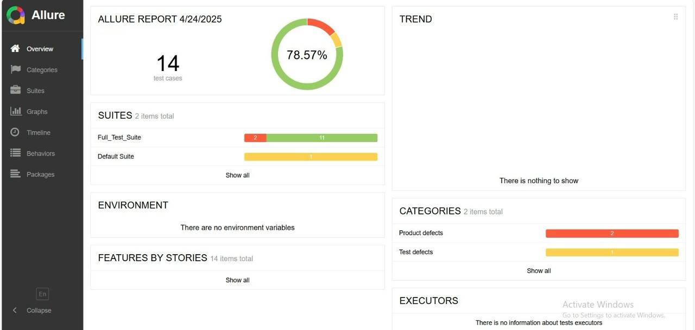
Testing Results

Slide 14






Future Plans
CI/CD Pipeline
Implement Continuous Integration/Continuous Deployment.
Automated Regression Testing
Create a comprehensive automated regression testing suite.
AI-Powered Testing
Utilize AI for test case generation and optimization.
Expanded Test Coverage
Extend test coverage to new features and platforms.
UI Testing
Implement User Interface testing with Cypress.
Mobile and PerformanceTesting
Conduct mobile and performance testing.
Future plans for the GO-BUS project include implementing a continuous integration/continuous deployment (CI/CD) pipeline and creating an automated regression testing suite. We aim to leverage AI-powered test case generation and optimization to enhance efficiency.

Slide 15




Conclusion
High-Quality Software
Key Lessons Learned
Delivered through rigorous testing.
1
2
Documented and shared for future projects.
4
3
Expanding Capabilities
Continuous Improvement
Enhance testing capabilities and automation.
Commitment to enhancing testing processes.
The GO-BUS project successfully delivered high-quality software through rigorous testing practices. Key lessons learned and best practices have been documented for future projects.
Our commitment to continuous improvement in testing processes ensures we stay ahead of evolving technological landscapes. Next steps involve expanding our testing capabilities and automation to further enhance the reliability and performance of the GO-BUS system.

