Slide 1
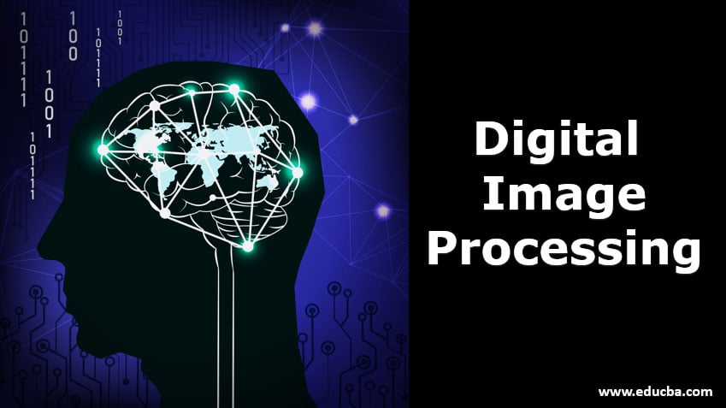

Sayed Mostafa Modaqeq
Gharjistan University
Computer Vision Workshop

Slide 2
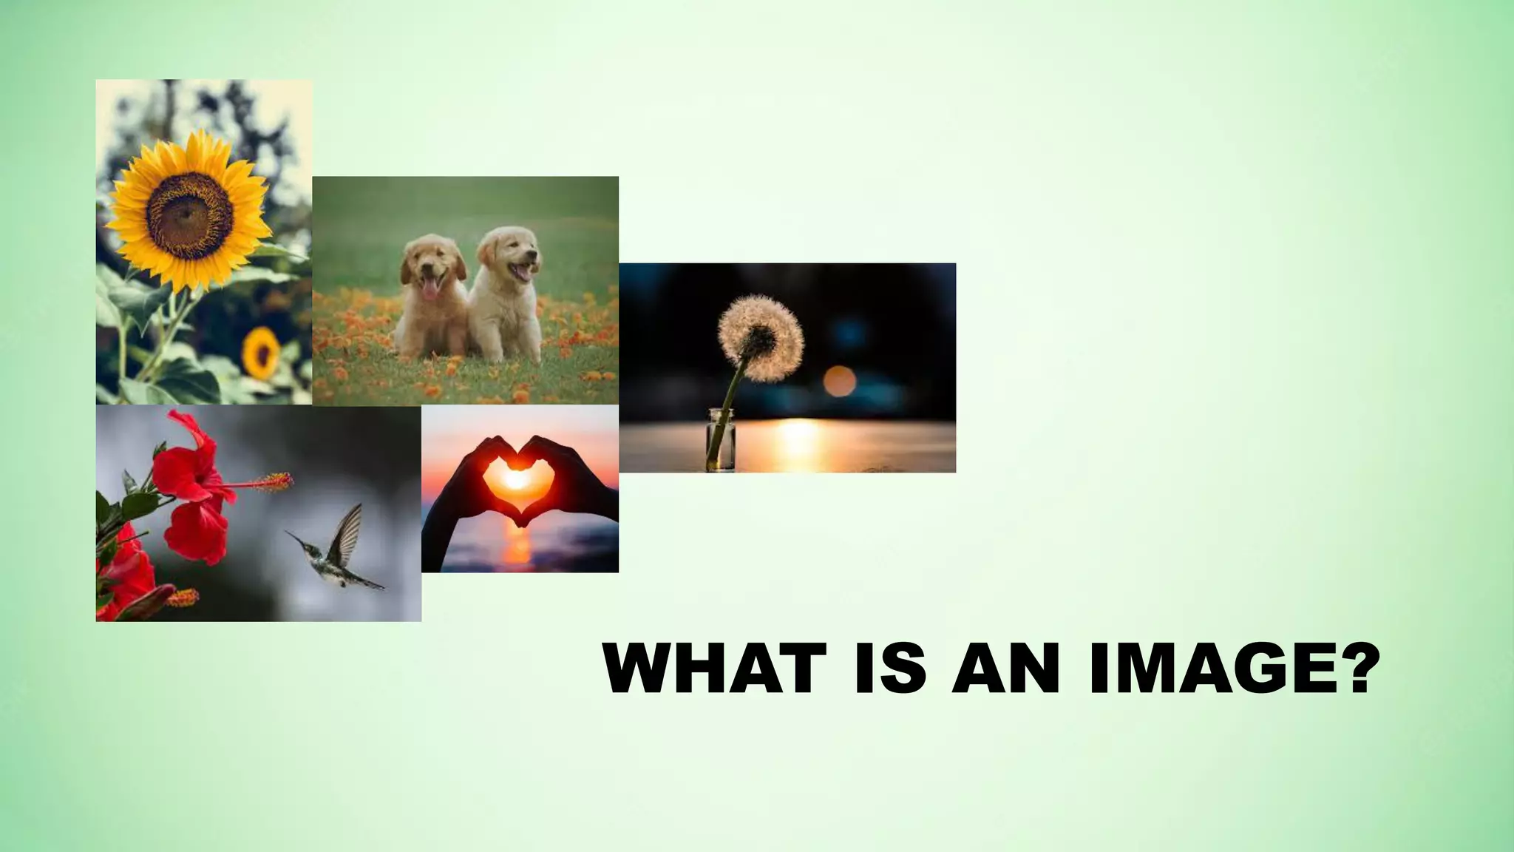

Slide 3
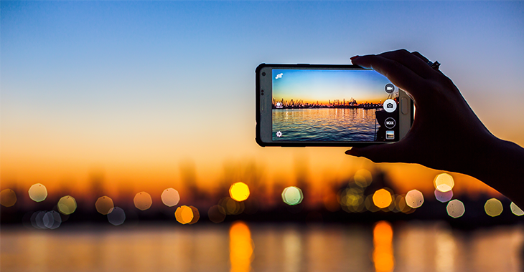
An image is a two-dimensional (2D) representation of a three-dimensional (3D) scene or reality.

Slide 4
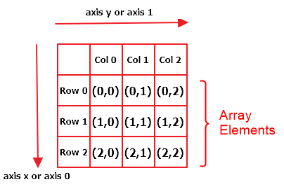

Slide 5
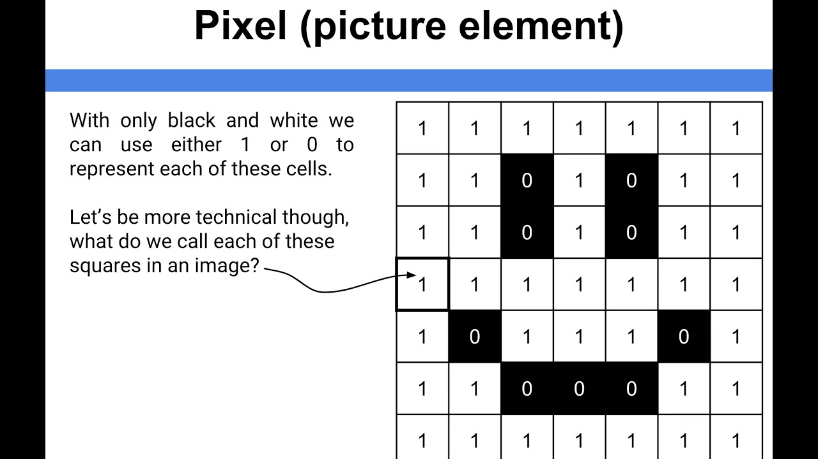

Slide 6
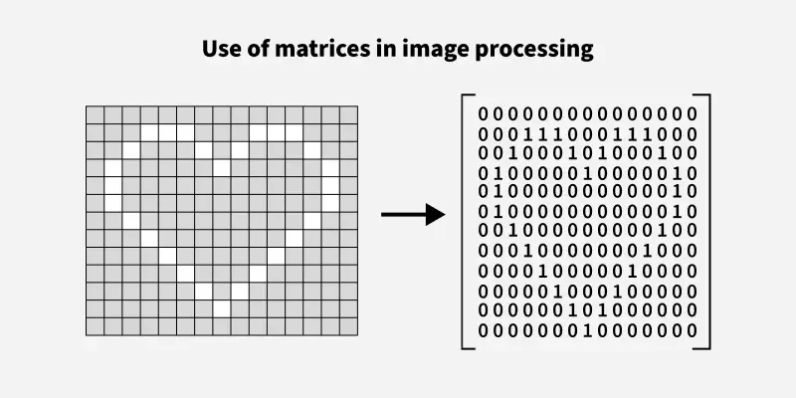

Slide 7
Basic types of images

Slide 8
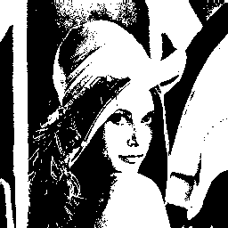
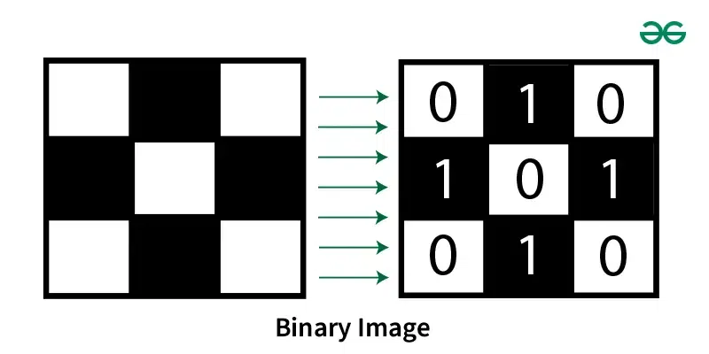

Slide 9
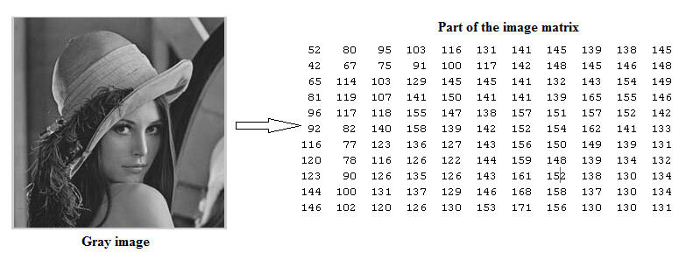
Grayscale Image

Slide 10
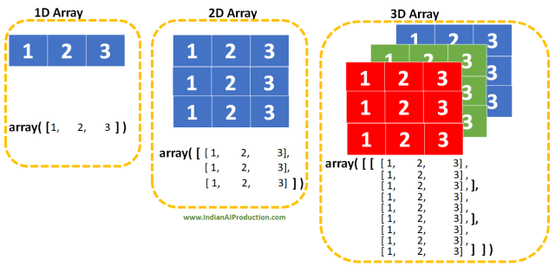

Slide 11
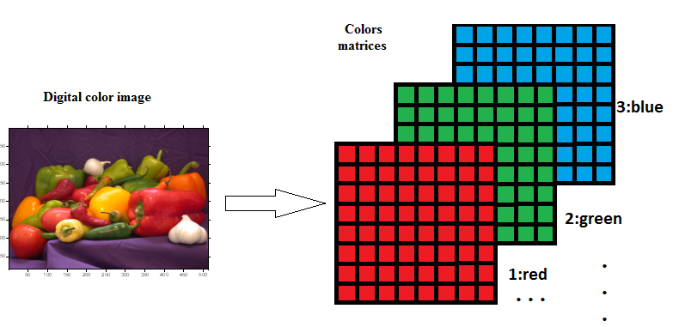
Color Image (RGB)

Slide 12
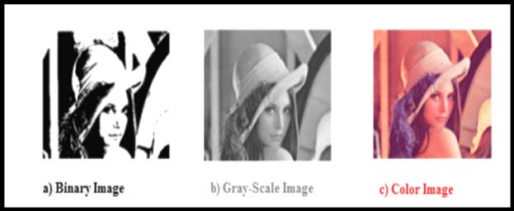

Slide 13
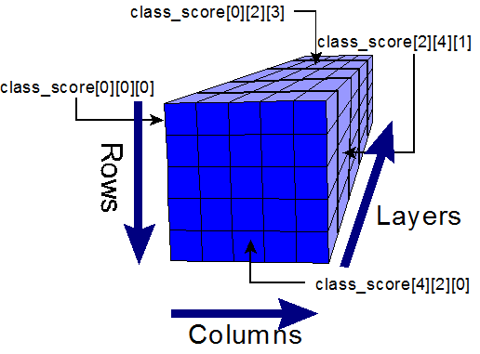
Rows = Height
Columns = Width
Layers = Depth or Channel

Slide 14
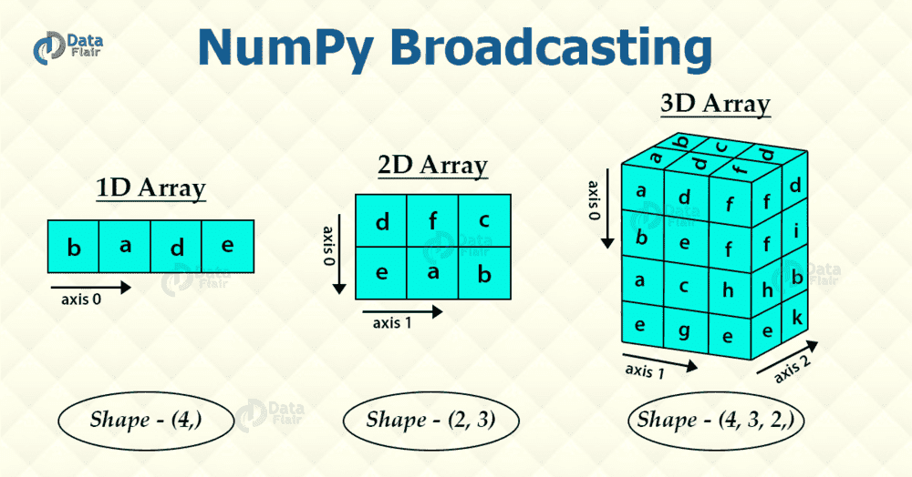

Slide 15
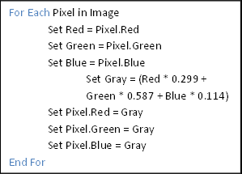
RGB to Grayscale

Slide 16
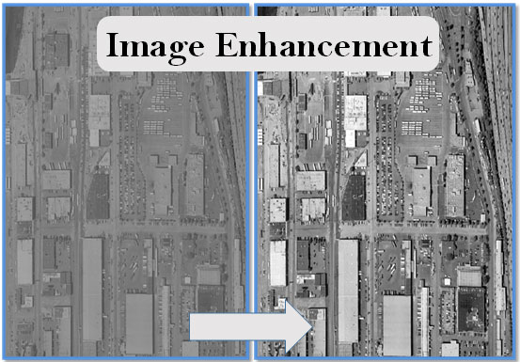

Slide 17
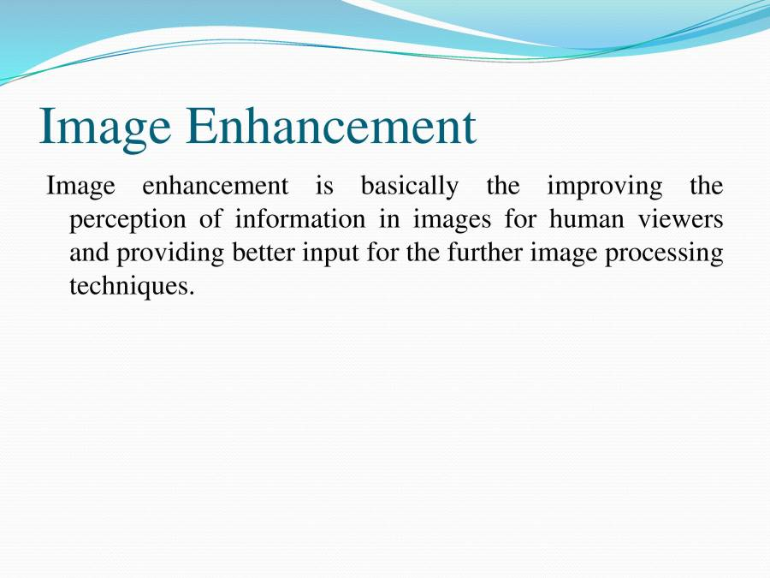
_Poor contrast
_Noisy
_Wrong size and shape
Problems

Slide 18
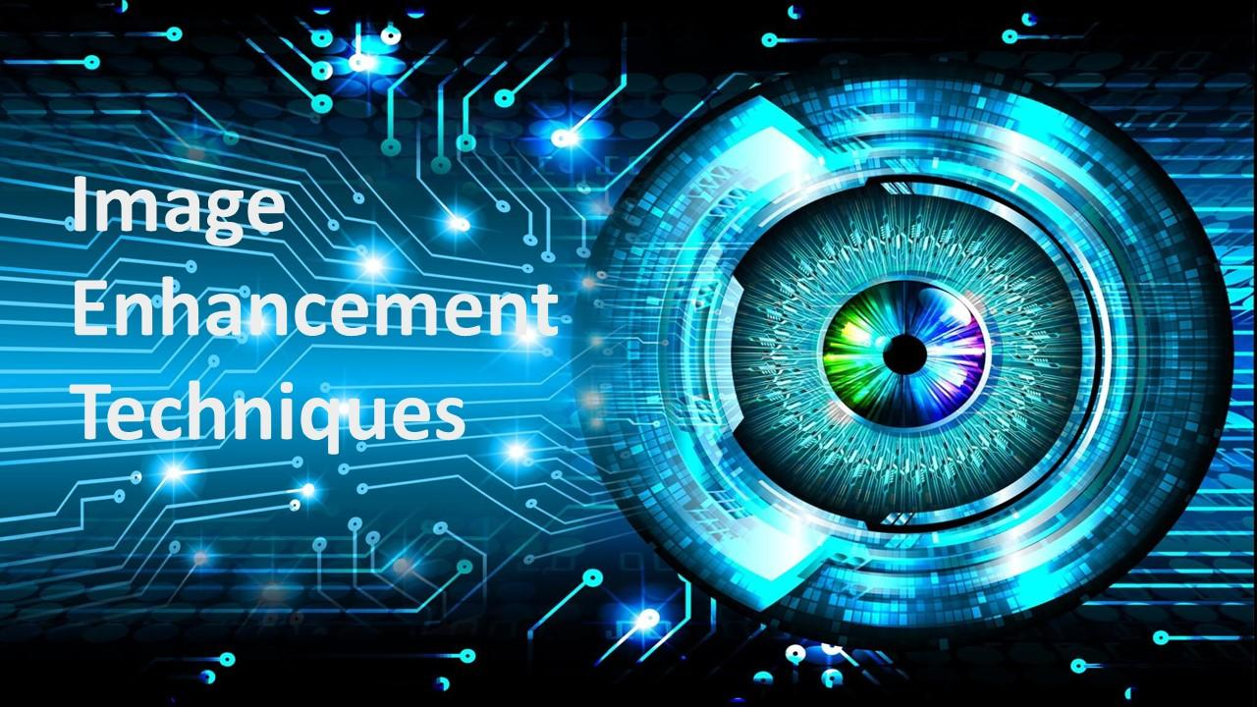

Slide 19
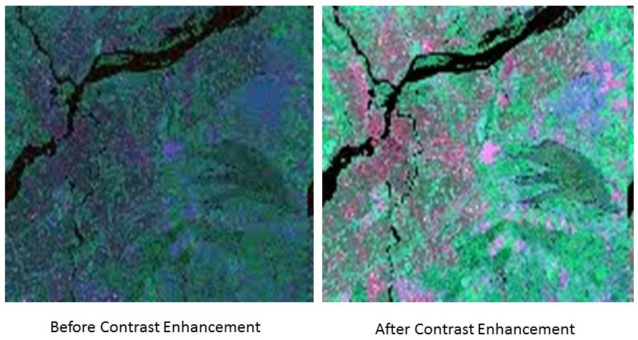
Contrast Enhancement

Slide 20
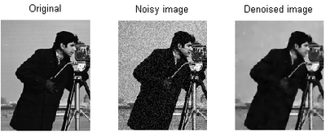
Denoising

Slide 21
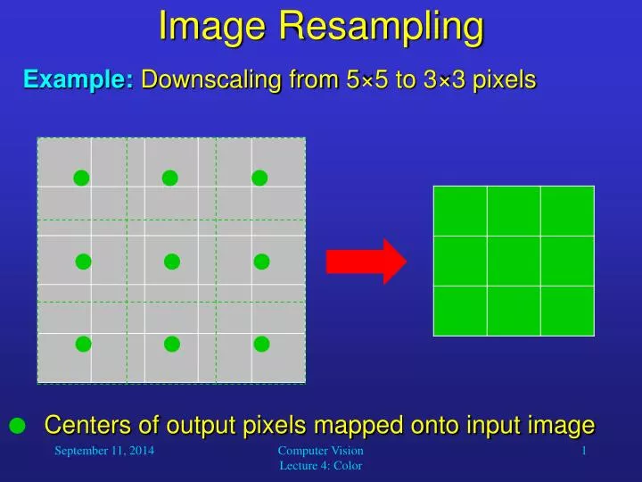
Resampling

Slide 22
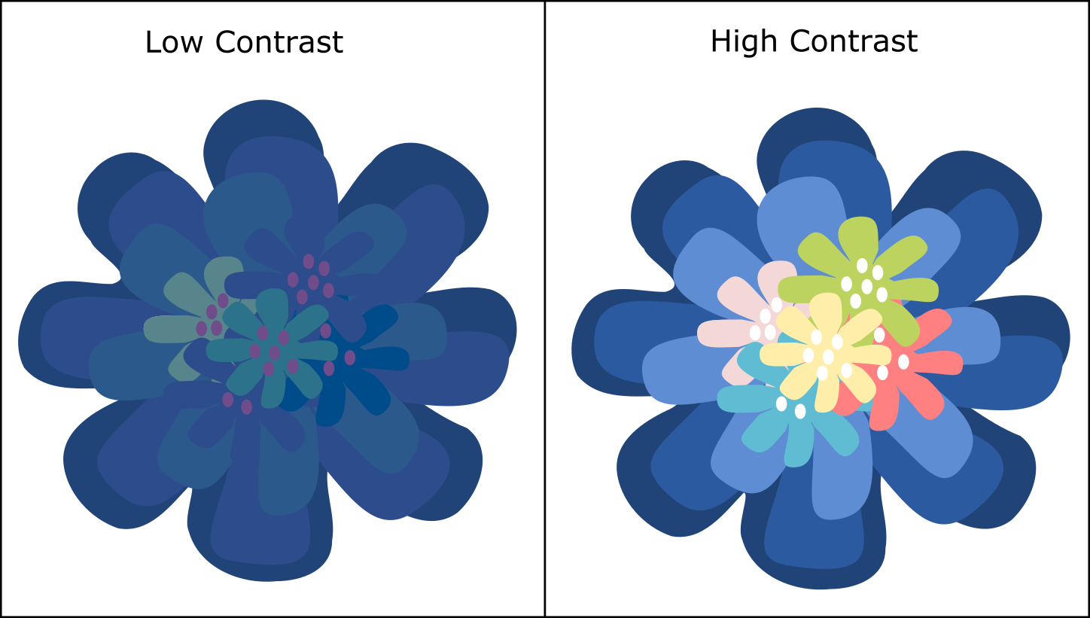
Contrast
Difference between the brightest and darkest parts of an image.
Low contrast: Image looks dull and flat.
High contrast: Image looks vivid and clear.

Slide 23
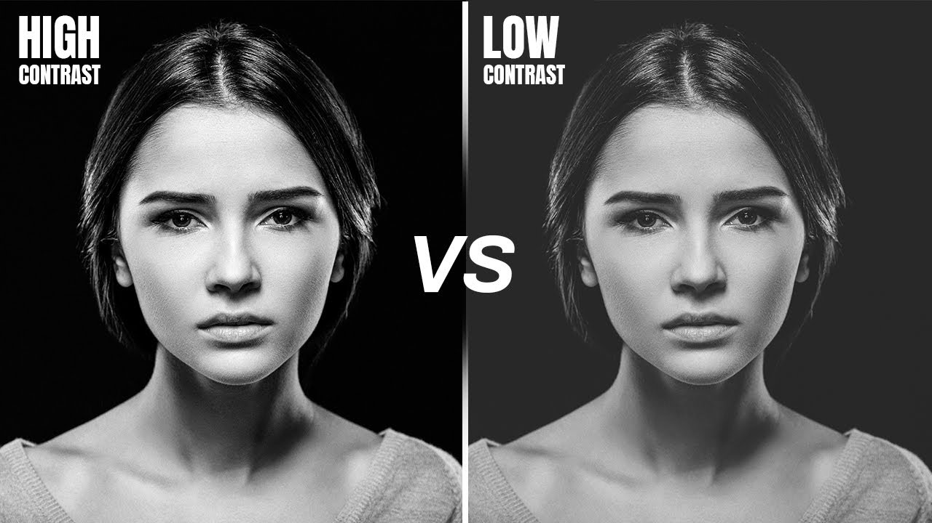

Slide 24
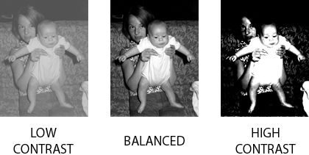
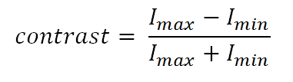
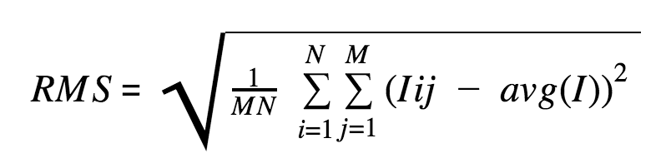

Slide 25
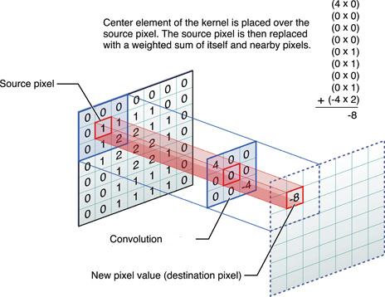
Convolution

Slide 26
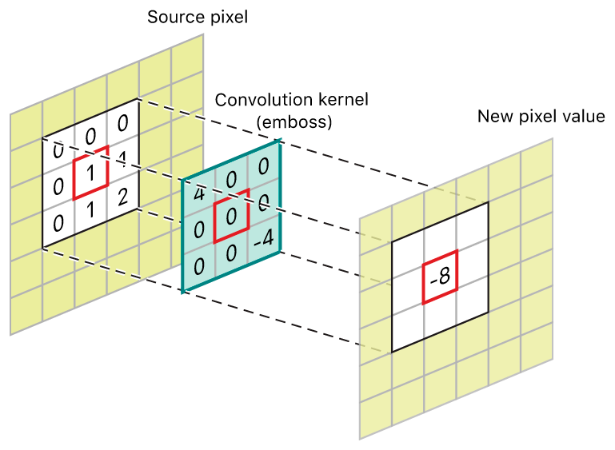

Slide 27
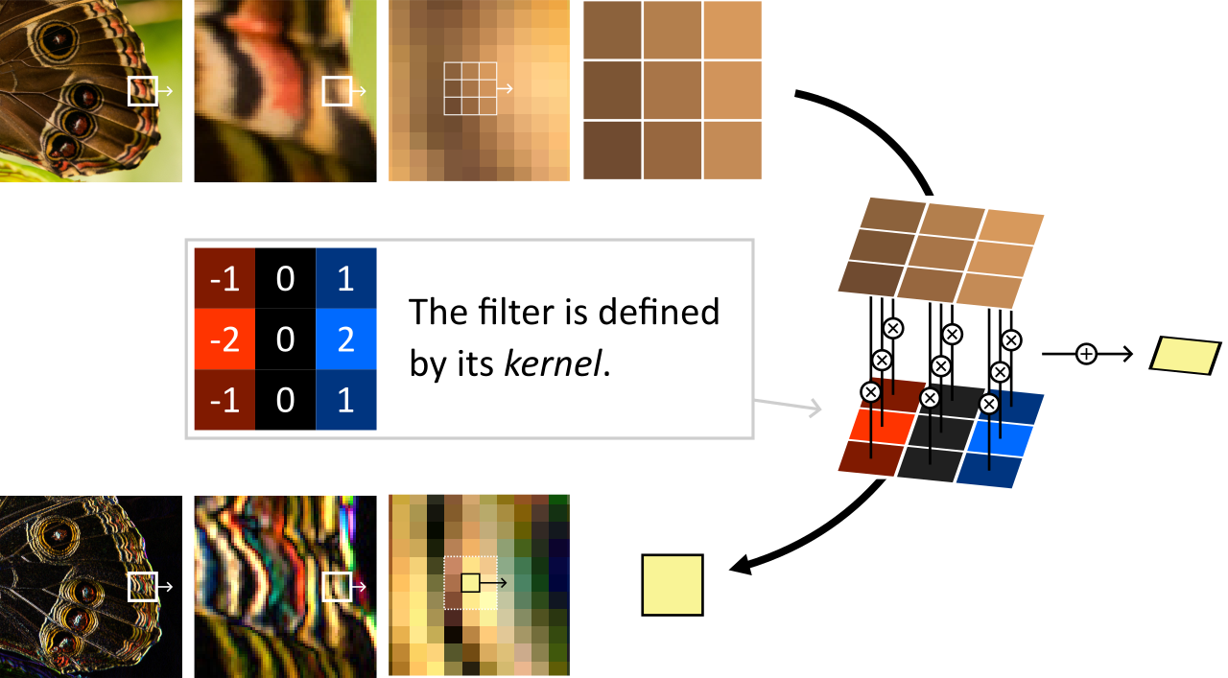
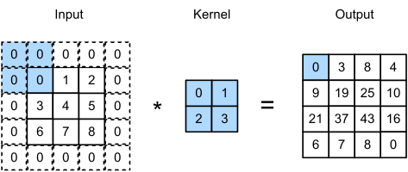
Filter

Slide 28
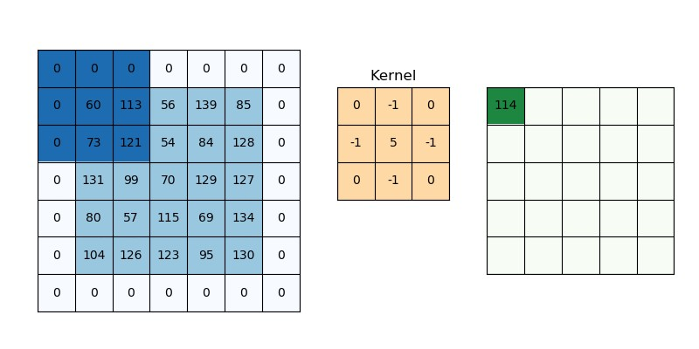

Slide 29
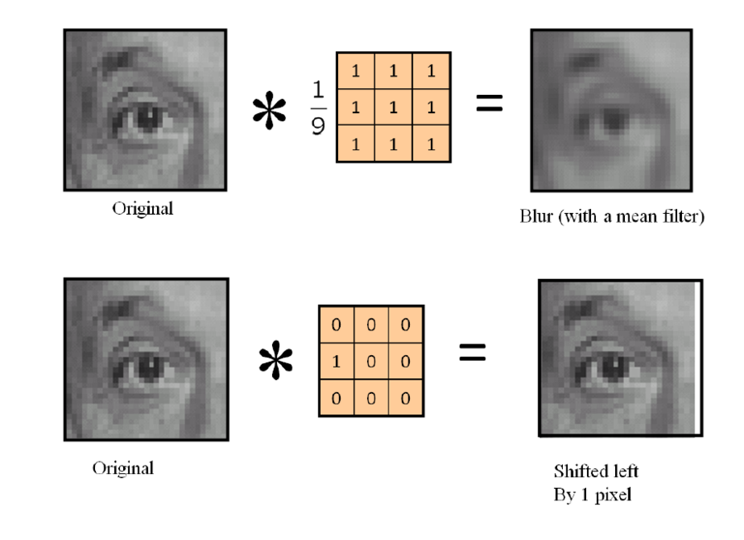

Slide 30
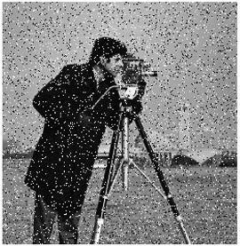
Sources:
_Sensor errors
_transmission
_compression
Noise in Images
Definition:
Unwanted random variations in pixel values
that degrade image quality.

Slide 31
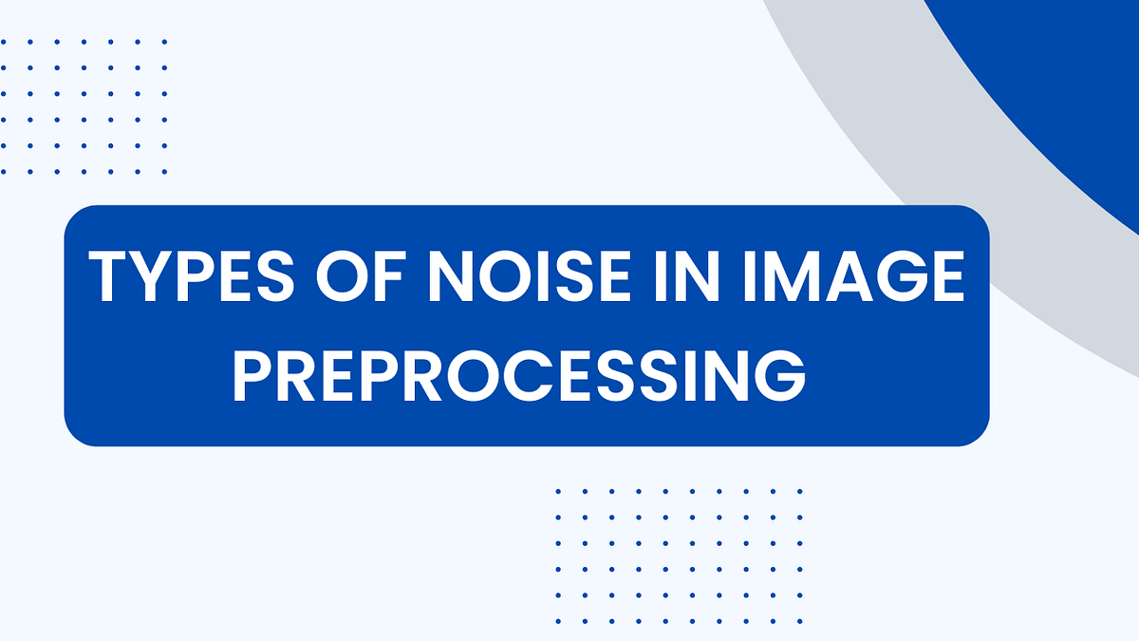

Slide 32
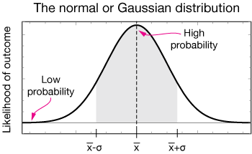
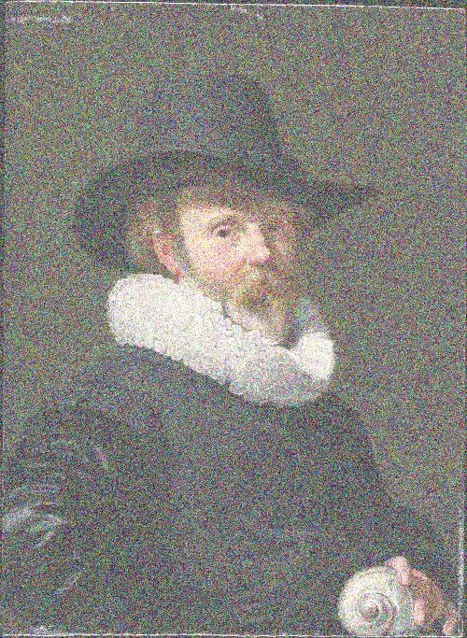
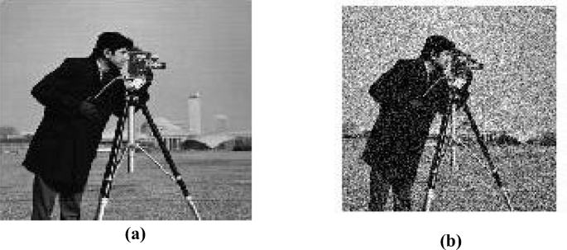
1.Gaussian

Slide 33
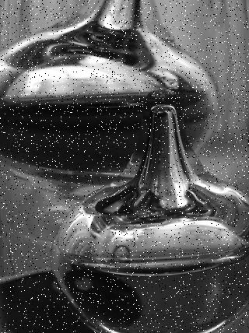
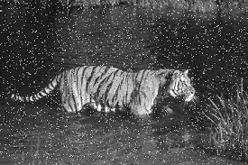
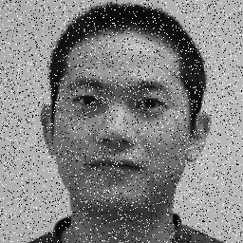
2.Salt and Pepper

Slide 34
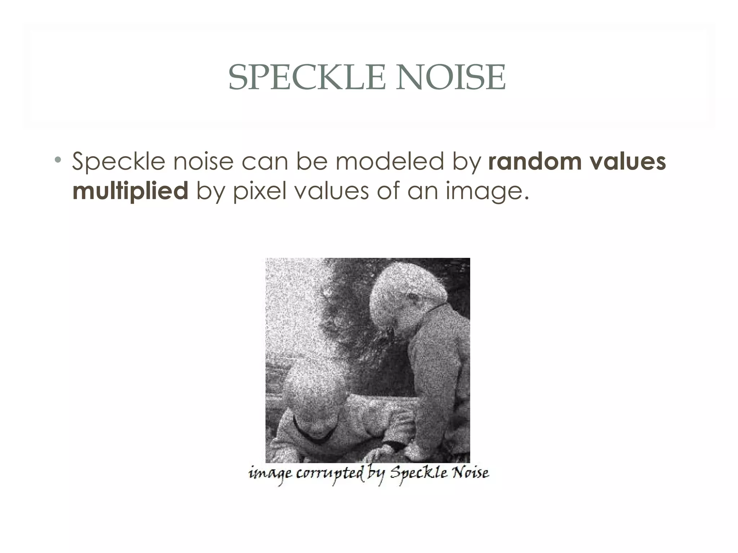
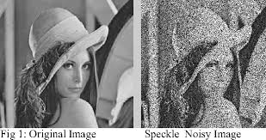
3.Speckle

Slide 35
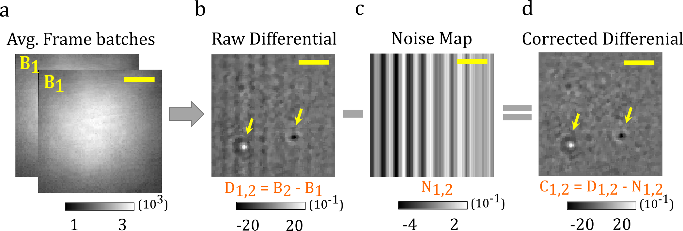
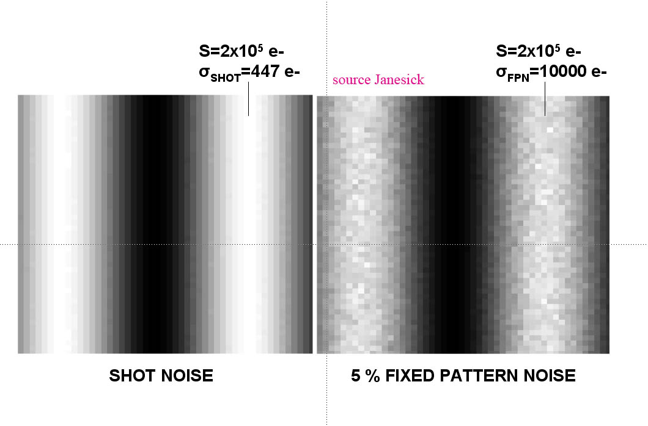
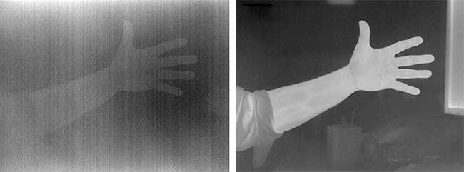
4.Fixed Pattern

Slide 36
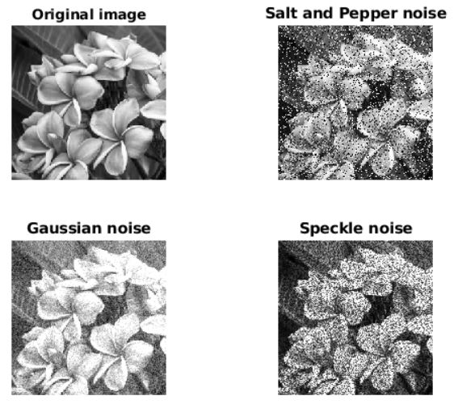

Slide 37
Denoising Kernels

Slide 38
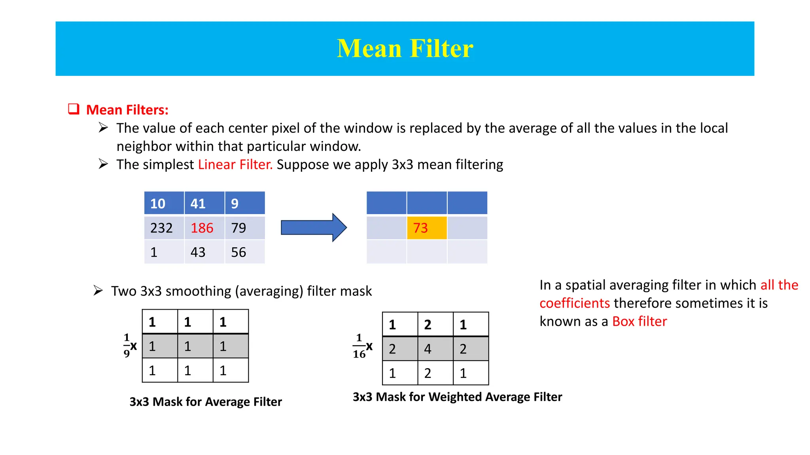

Slide 39
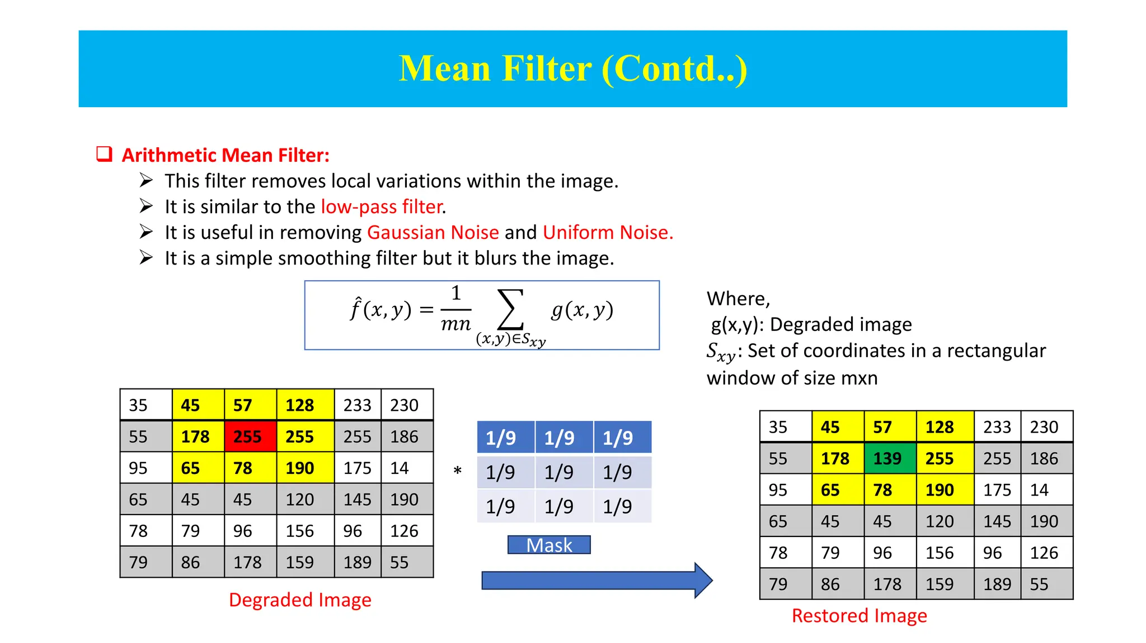

Slide 40
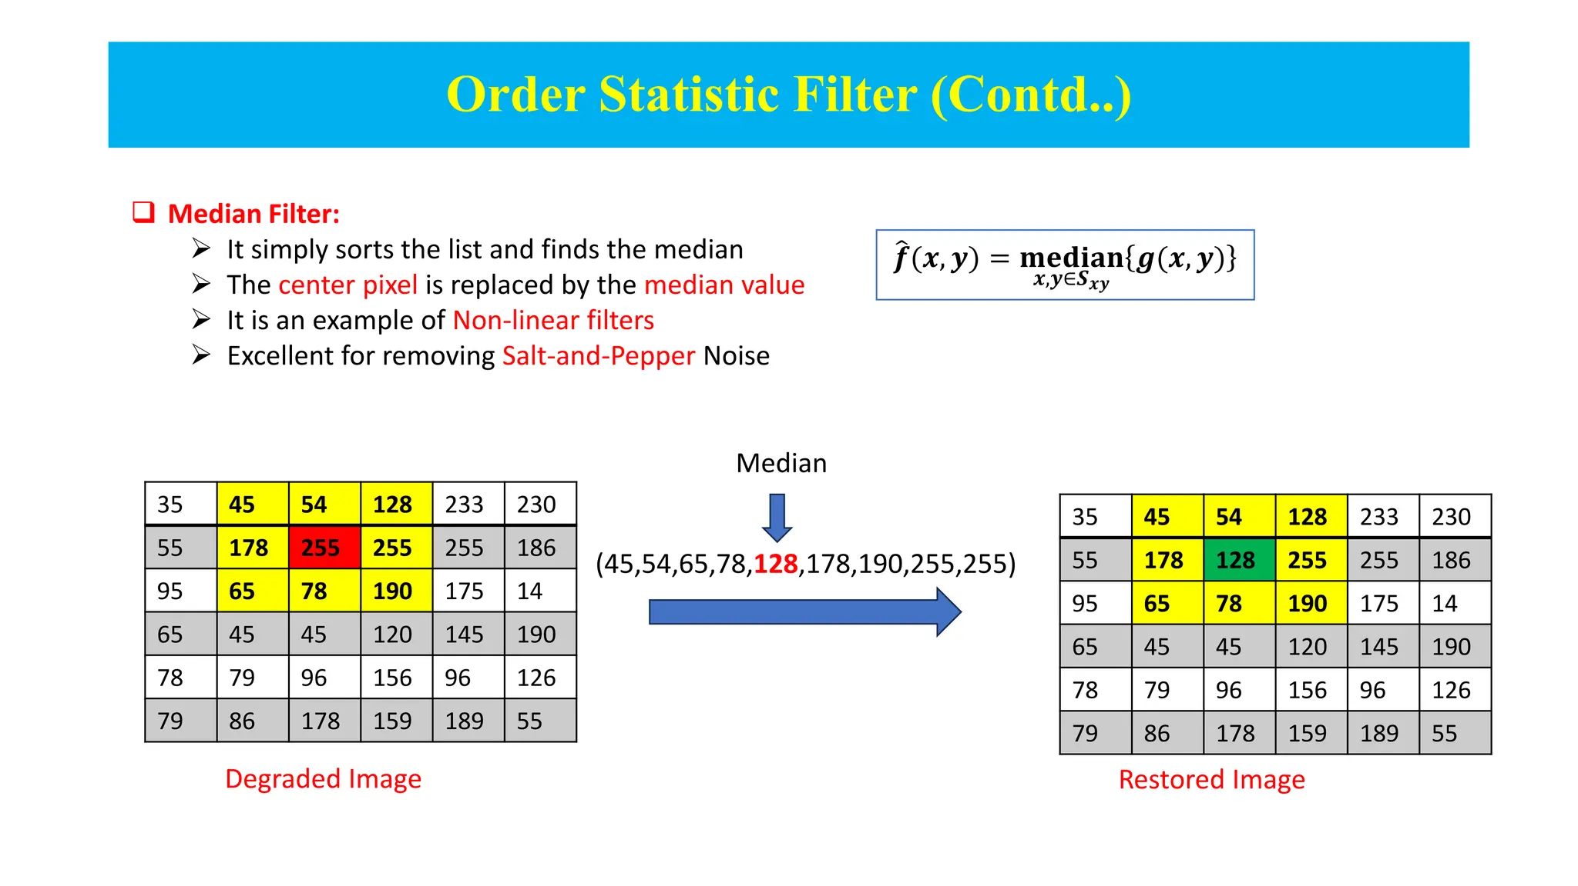
Median Filter

Slide 41
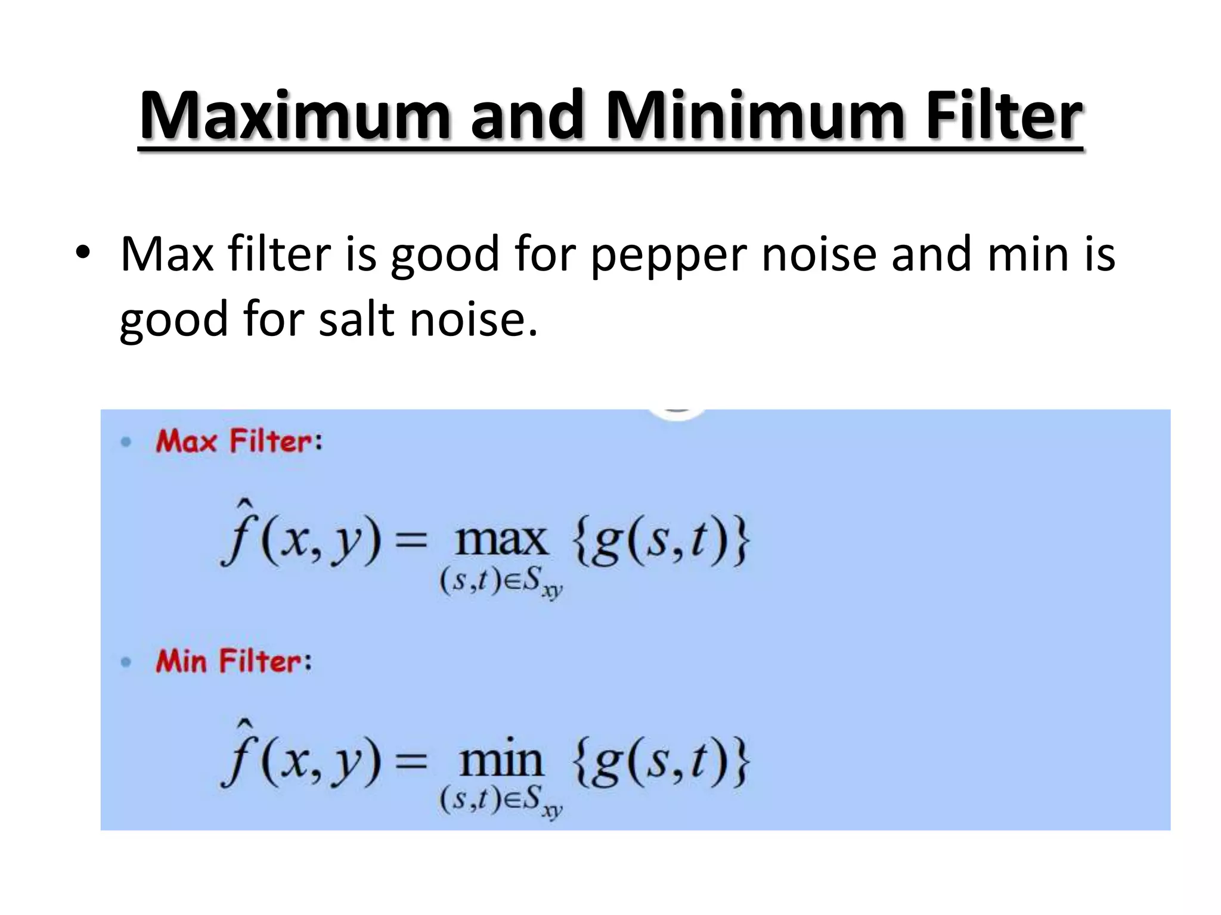

Slide 42

Gaussian Filter

Slide 43

Gaussian kernels

Slide 44


Slide 45

Dilation and Erosion

Slide 46


Slide 47


Slide 48


Slide 49


Slide 50


Slide 51


Edge Detectors

Slide 52


Roberts

Slide 53


Slide 54


Slide 55


Slide 56


Slide 57


Slide 58


Slide 59


Slide 60


Slide 61


Slide 62


Slide 63


Slide 64


Slide 65


Slide 66




Thank You
About me:
Sayed Mostafa Modaghegh
AI and Robotics student
Computer vision developer
Sm.mostafa79modaqeq@gmail.com
@mostafa79modaqeq

