Slide 1
VLM
Sayed Mostafa Modaghegh

Slide 2
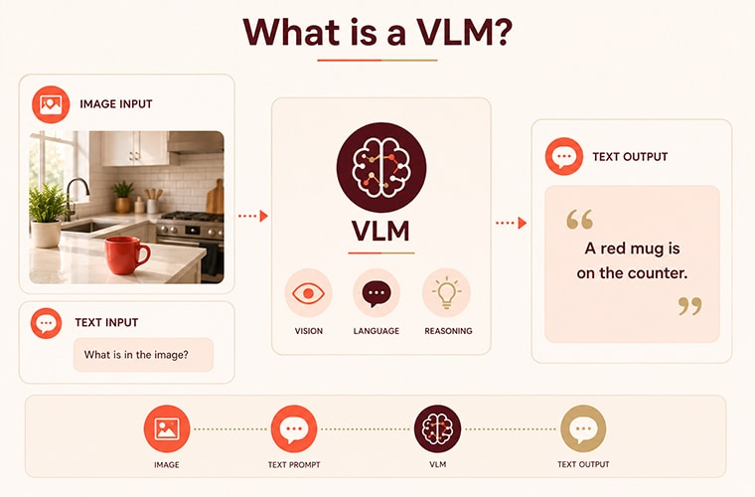
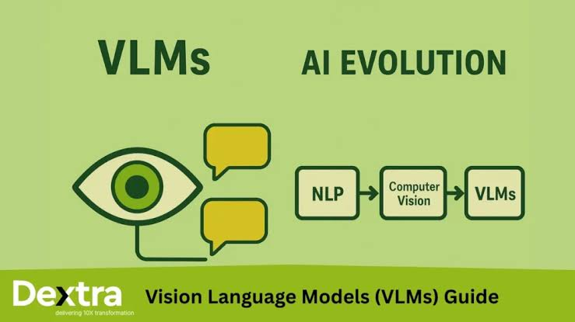
Introduction
Computers can process images.
Computers can process natural language.
But images and language are fundamentally different modalities.
VLMs aim to connect these modalities.

Slide 3
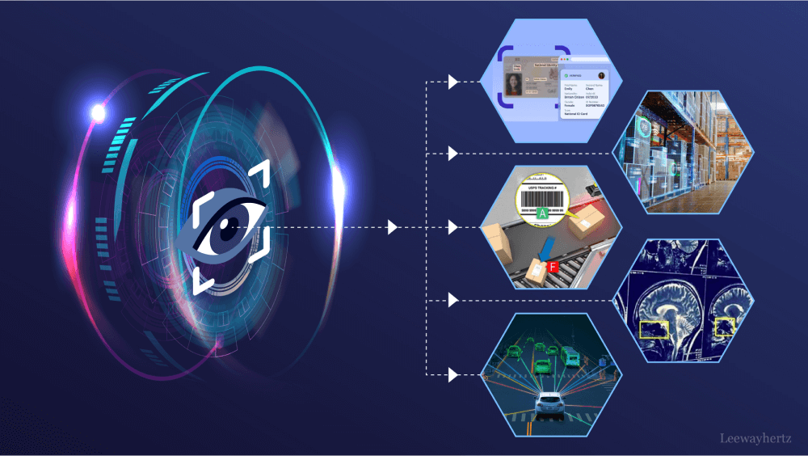
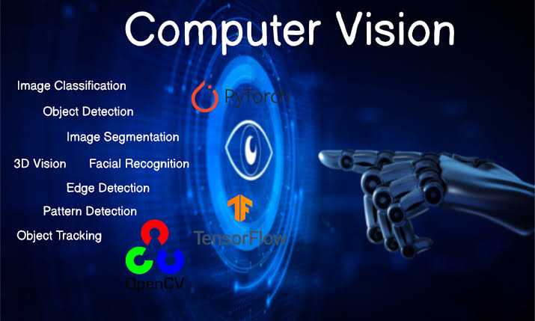
Computer Vision
How can a machine understand an image?
Computer vision is a subfield of artificial intelligence
Process, analyze and interpret visual inputs such as images and videos
An image is represented as numerical pixel values.
Computer Vision extracts meaningful visual representations from these pixels.
Traditional systems were usually designed for specific tasks.
Classification / Detection / OCR

Slide 4
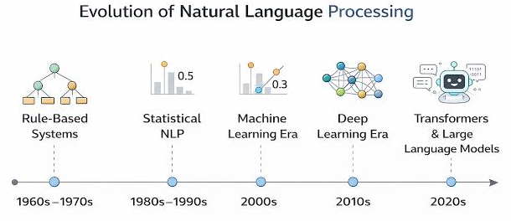
Natural Language Processing
How can a machine understand language?
Natural language is sequential and symbolic.
NLP enable computers to understand and communicate with human language
NLP converts text into numerical representations.
These representations allow models to learn linguistic patterns.

Slide 5
Tokenization
Neural networks cannot directly process raw text.
Tokenization converts text into discrete units called tokens.
Tokens are then mapped to numerical representations.(Token ID)
Tokenization is essential in NLP!
Tokenization
“Tokenization”
“is”
“essential”
“in”
“NLP”
“!”
{238}
{17}
{5342}
Token ID

Slide 6
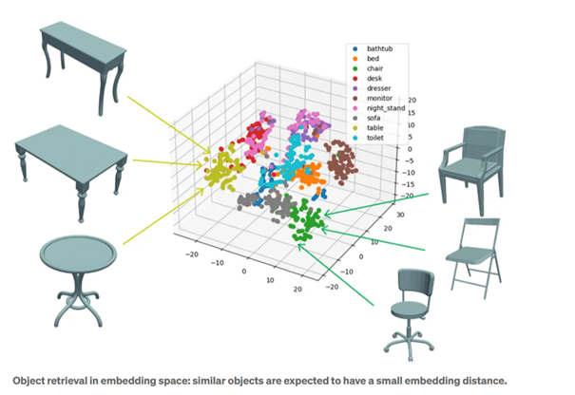
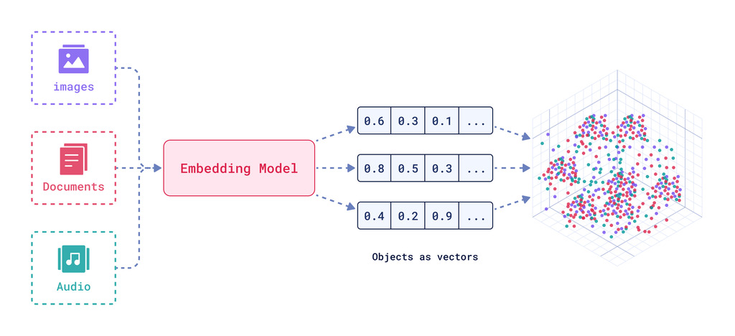
Embeddings
Tokens → Vectors
An embedding represents a token as a vector.
Similar meanings can have similar representations.
Embeddings provide a numerical semantic space for language.

Slide 7
RNN
Recurrent Neural Network
RNNs are designed to process sequential data.
Key idea:
The previous hidden state is passed to the next time step,
allowing the model to maintain information from the past.
Sequential processing
Hidden state as memory
Shared parameters across time steps

Slide 8
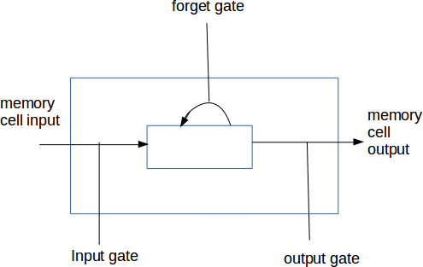
LSTM
Long Short-Term Memory
LSTM is a specialized RNN designed to learn
long-term dependencies in sequential data.
Instead of relying only on a hidden state,
LSTM introduces:
• Cell State
• Forget Gate
• Input Gate
• Output Gate
Main idea: Learn what to remember, what to forget, and what to output

Slide 9
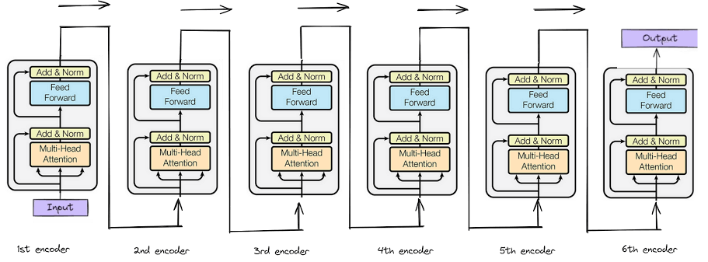
Transformer
Limitations of Sequential Architectures
Sequential computation limits parallelization.
Long-range dependencies are difficult to preserve.
Processing long sequences becomes inefficient.
Can we process relationships between all tokens more directly?
Transformer

Slide 10
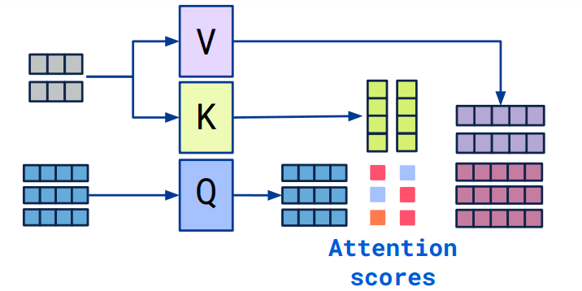
Transformer
Input Tokens
↓
Embedding
↓
Positional Information
↓
Self-Attention
↓
Feed Forward Network
↓
Output Representations
It allows tokens to interact with each other.
Transformer removes the need for recurrent processing.
It enables highly parallel computation.
It became the foundation of modern LLMs.

Slide 11
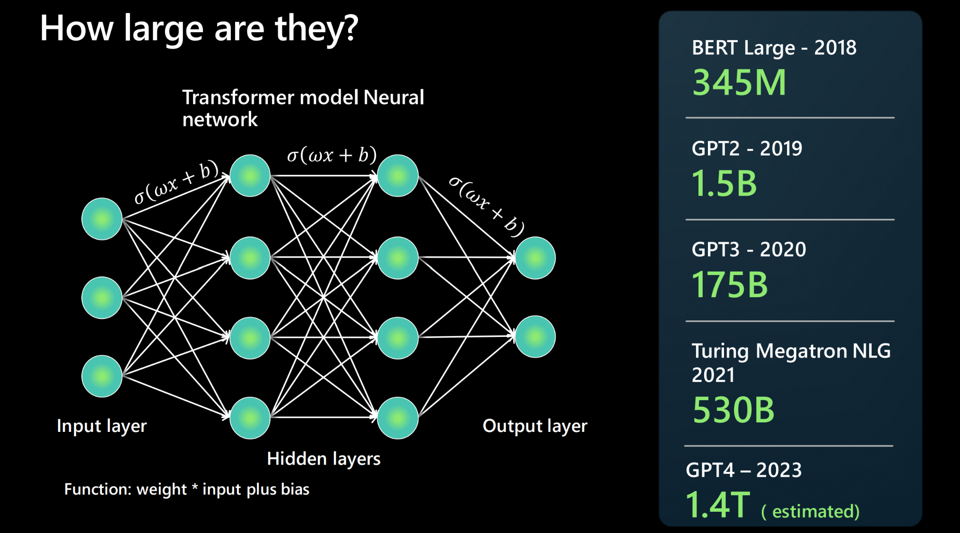
LLM
Large Language Models
LLMs are large Transformer-based language models.
They are pre-trained on massive amounts of text.
They learn linguistic patterns, knowledge, and reasoning capabilities.
They can generate text autoregressively.
Why Can't We Directly Feed
an Image to an LLM?
IMAGE
[Pixels]
[Pixels]
[Pixels]
LLM
[Tokens]
[Tokens]
[Tokens]
Different modalities → Different representations

Slide 12
CLIP
Learning Transferable Visual Models From Natural Language Supervision
- **Authors:** Alec Radford et al.
- **Conference:** ICML 2021
**Year:** 2021
Problem:
Fixed visual categories and limited supervision
Key Idea:
Align images and natural language
Architecture:
Image Encoder + Text Encoder
Contribution:
Zero-Shot Transfer
Limitation:
Not a conversational image-to-text model
┌──────────────────┐
│ Image Encoder │
Image ──────────►│ │
└────────┬─────────┘
│
▼
Image Vector
│
│ Similarity
│
▲
Text Vector
│
┌────────┴─────────┐
Text ───────────►│ Text Encoder │
└──────────────────┘

Slide 13
Flamingo
a Visual Language Model for Few-Shot Learning
- **Authors:** Jean-Baptiste Alayrac et al.
- **Conference:** NeurIPS 2022
- **Year:** 2022
Problem
How to connect pretrained vision and language models?
Key Idea
Build a bridge between them
Architecture
Perceiver Resampler + Gated Cross-Attention
Contribution
Few-Shot Multimodal Learning
Limitation
Very large and computationally expensive
Vision Encoder
Perceiver Resampler
Visual Tokens
Gated Cross-Attention
Language Model

Slide 14
BLIP-2
Bootstrapping Language-Image Pre-training with
Frozen Image Encoders and Large Language Models
- **Authors:** Junnan Li et al.
- **Conference:** ICML 2023
- **Year:** 2023
Problem
Expensive end-to-end training of large vision-language models
Key Idea
Use frozen pretrained models and learn a lightweight bridge
Architecture
Vision Encoder + Q-Former
Contribution
Efficient Vision-Language Learning
Limitation
Q-Former can limit fine-grained visual information
Vision Encoder
Visual Features
Q-Former
Projection
LLM

Slide 15
LLaVA
Visual Instruction Tuning
- **Authors:** Haotian Liu et al.
- **Conference:** NeurIPS 2023
- **Year:** 2023
Image
Vision Encoder
Visual Features
Projection Layer
LLM
Problem
How to make a vision-language model follow user instructions?
Key Idea
Connect a pretrained vision encoder to an LLM using a projection layer
Architecture
Vision Encoder + Projection + LLM
Contribution
Visual Instruction Following
Limitation
Limited visual understanding compared with specialized models

Slide 16
Qwen-VL
A Versatile Vision-Language Model for Understanding,
Localization, Text Reading, and Beyond
- **Authors:** Jinze Bai et al.
- **Base Model:** Qwen-LM
- **Year:** 2023
Image
Vision Encoder
Visual Features
Visual Receptor
Visual Tokens
Qwen-LM
Text Output
Problem
How to achieve fine-grained visual understanding?
Key Idea
Connect visual features to Qwen-LM and train for diverse visual tasks
Architecture
Vision Encoder + Visual Receptor + Qwen-LM
Contribution
OCR, Grounding, Localization and Visual Chat
Limitation
Larger and more complex than lightweight VLMs

Slide 17
InternVL
Scaling up Vision Foundation Models and
Aligning for Generic Visual-Linguistic Tasks
- **Authors:** Zhe Chen et al.
- **Conference:** CVPR 2024
- **Year:** 2024
Image
InternViT-6B
Visual Features
MLP Projector
Visual Tokens
LLM
Problem
How can we improve visual understanding by scaling the vision component?
Key Idea
Scale up the Vision Encoder and align it with an LLM
Architecture
InternViT + MLP Projector + LLM
Contribution
Strong Visual-Linguistic Understanding
Limitation
High computational and hardware requirements

Slide 18
Model Comparison
Model | Main Question | Key Mechanism | Main Capability
CLIP | How can vision and language be aligned? | Dual Encoder + Contrastive Learning | Zero-Shot
Flamingo | How can pretrained vision and language models interact? | Resampler + Cross-Attention | Few-Shot Multimodal Learning
BLIP-2 | How can this connection be made more efficiently? | Q-Former | Efficient VLM
LLaVA | How can a VLM follow user instructions? | Vision Projection + LLM | Visual Chat
Qwen-VL | How can a VLM understand fine-grained visual information? | Visual Receptor + LLM | OCR / Grounding
InternVL | How far can visual capability be scaled? | Large Vision Encoder + Alignment | Strong Visual Understanding

Slide 19
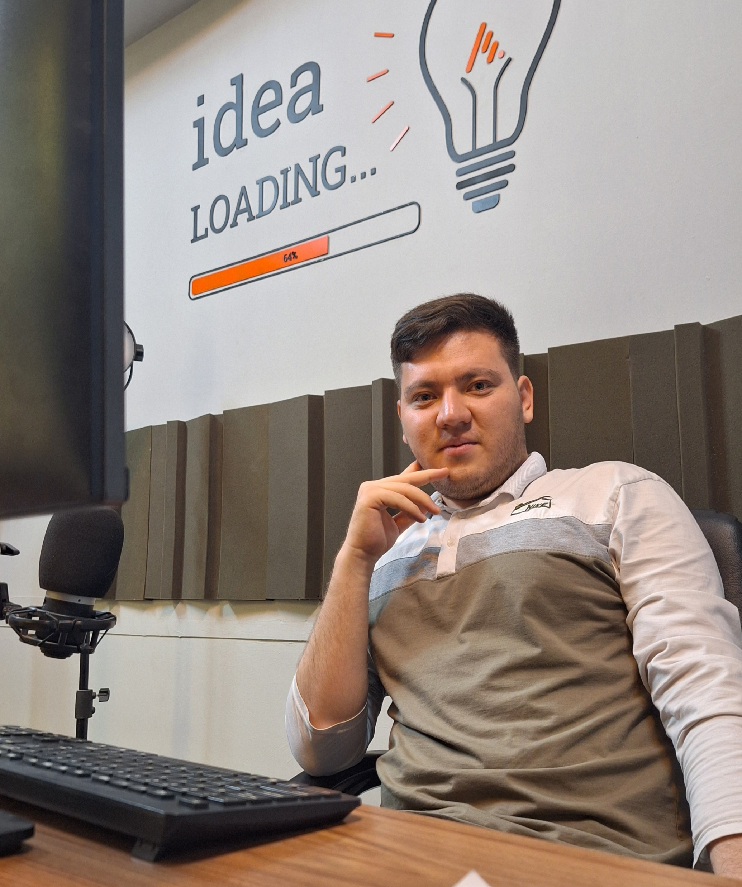



Thank You
About me:
Sayed Mostafa Modaghegh
AI and Robotics student
Computer vision developer
Sm.mostafa79modaqeq@gmail.com
@mostafa_modaghegh

