Slide 1
Programming(0)
Sayed Mostafa Modaghegh

Slide 2
Introduction to Python

Slide 3
Introduction to Python
Learning Objectives
Understand what Python is and why it’s used
Learn to write and run a Python program
Use print() to display information
Store data in variables
Perform arithmetic operations
Get user input with input()
Convert data types (casting)

Slide 4
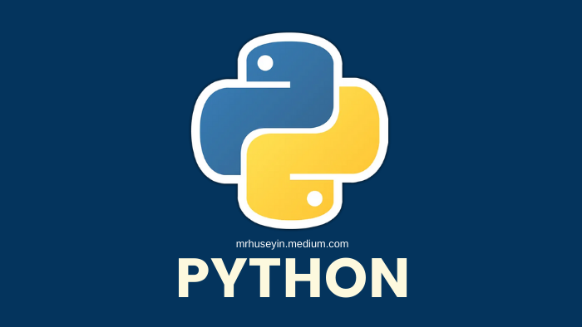
Introduction to Python
What is Python?
Python is a high-level, easy-to-learn programming language.
Created by Guido van Rossum in 1991.
Used in:
Web development 🌐
Data Science 📊
Artificial Intelligence 🤖
Automation ⚙️

Slide 5
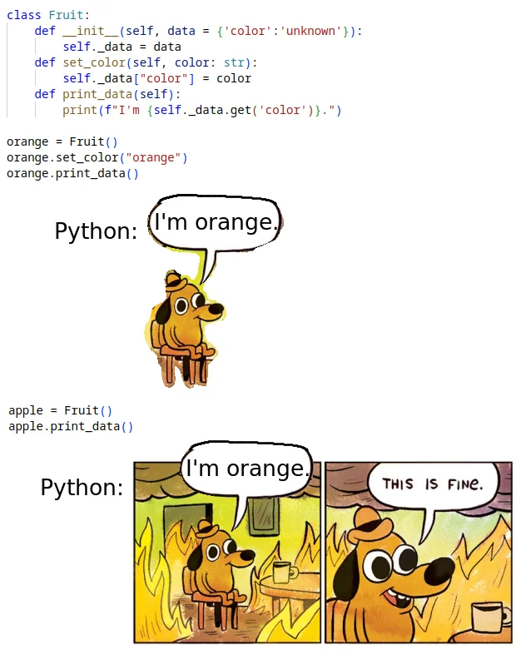
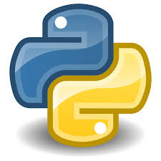
Introduction to Python
Why Python?
Simple syntax (like English)
Huge community and support
Works on all platforms (Windows, Linux, Mac)
Great for beginners and professionals

Slide 6
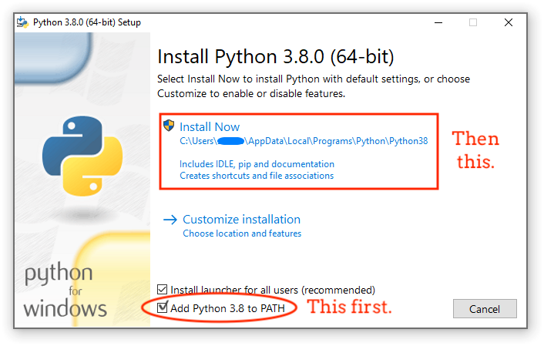
Introduction to Python
Installing Python
1. Go to python.org
2. Download the latest version
3. Check the box ✅ Add Python to PATH

Slide 7
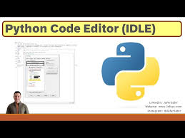
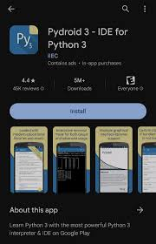
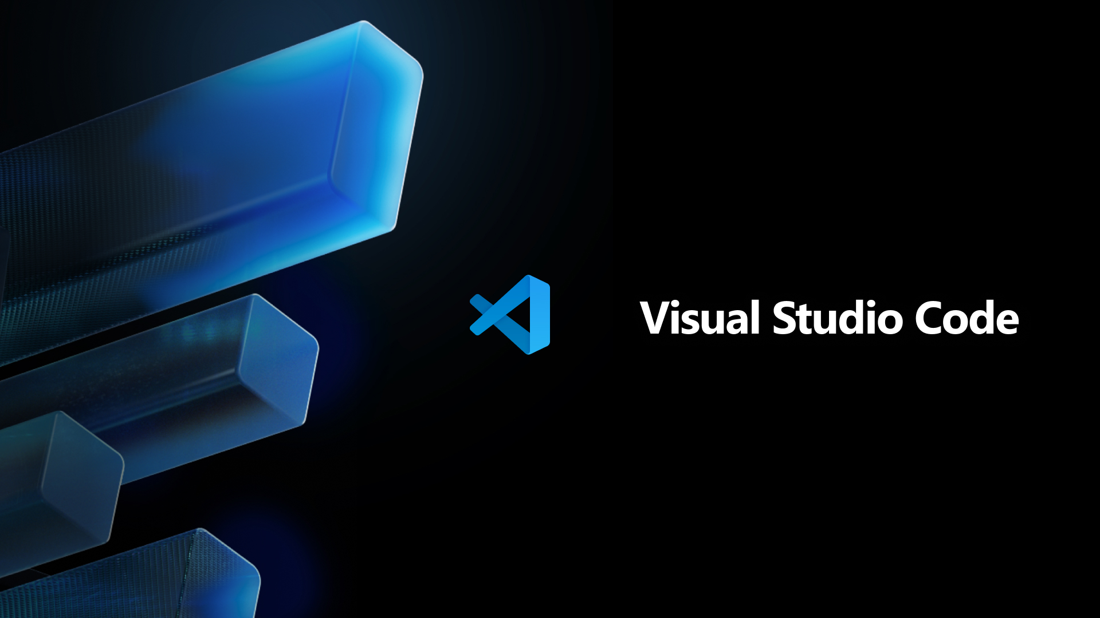
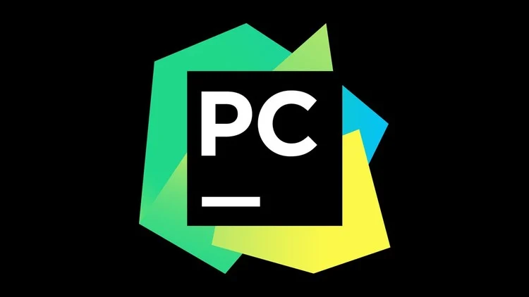
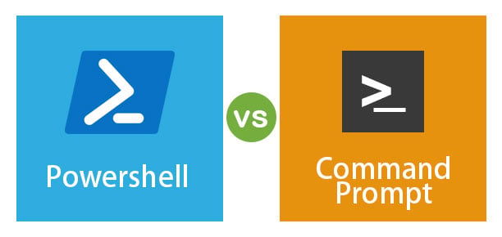
Introduction to Python
Where to Write Python Code?
IDLE (Python’s default editor)
VS Code (recommended IDE)
PyCharm (advanced IDE)
Command Line / PowerShell
Pydroid 3 (for Android users 📱)

Slide 8
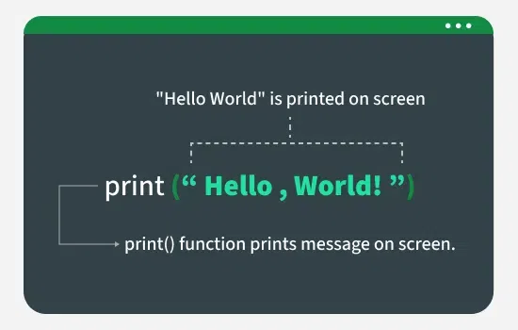
Introduction to Python
First Program
Create a python file.
‘hello.py’ is a python file.
First code: print()
print(“Hello World!”)
In cmd : python hello.py

Slide 9
Variables

Slide 10
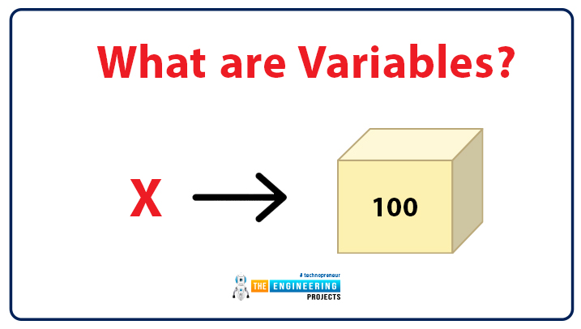
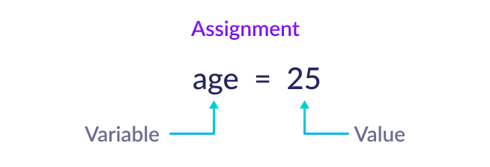
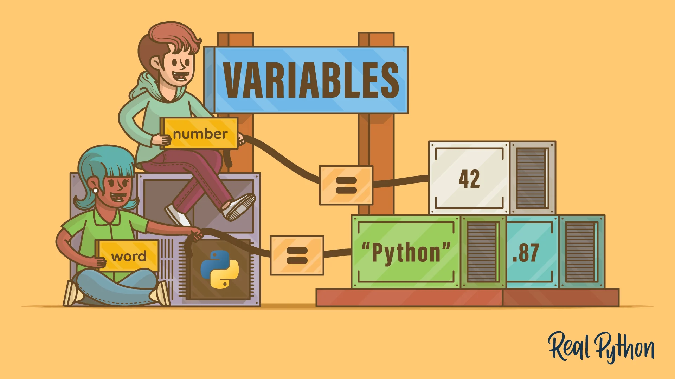
Variables
What is a Variable?
Variable = A container that stores data
Think of it like a box with a label 🧰

Slide 11
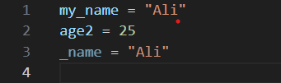
Variables
Variable Naming Rules
✅ Must start with a letter or underscore _
✅ Can contain letters, numbers, and underscores
❌ Cannot start with a number
❌ No spaces or special symbols

Slide 12
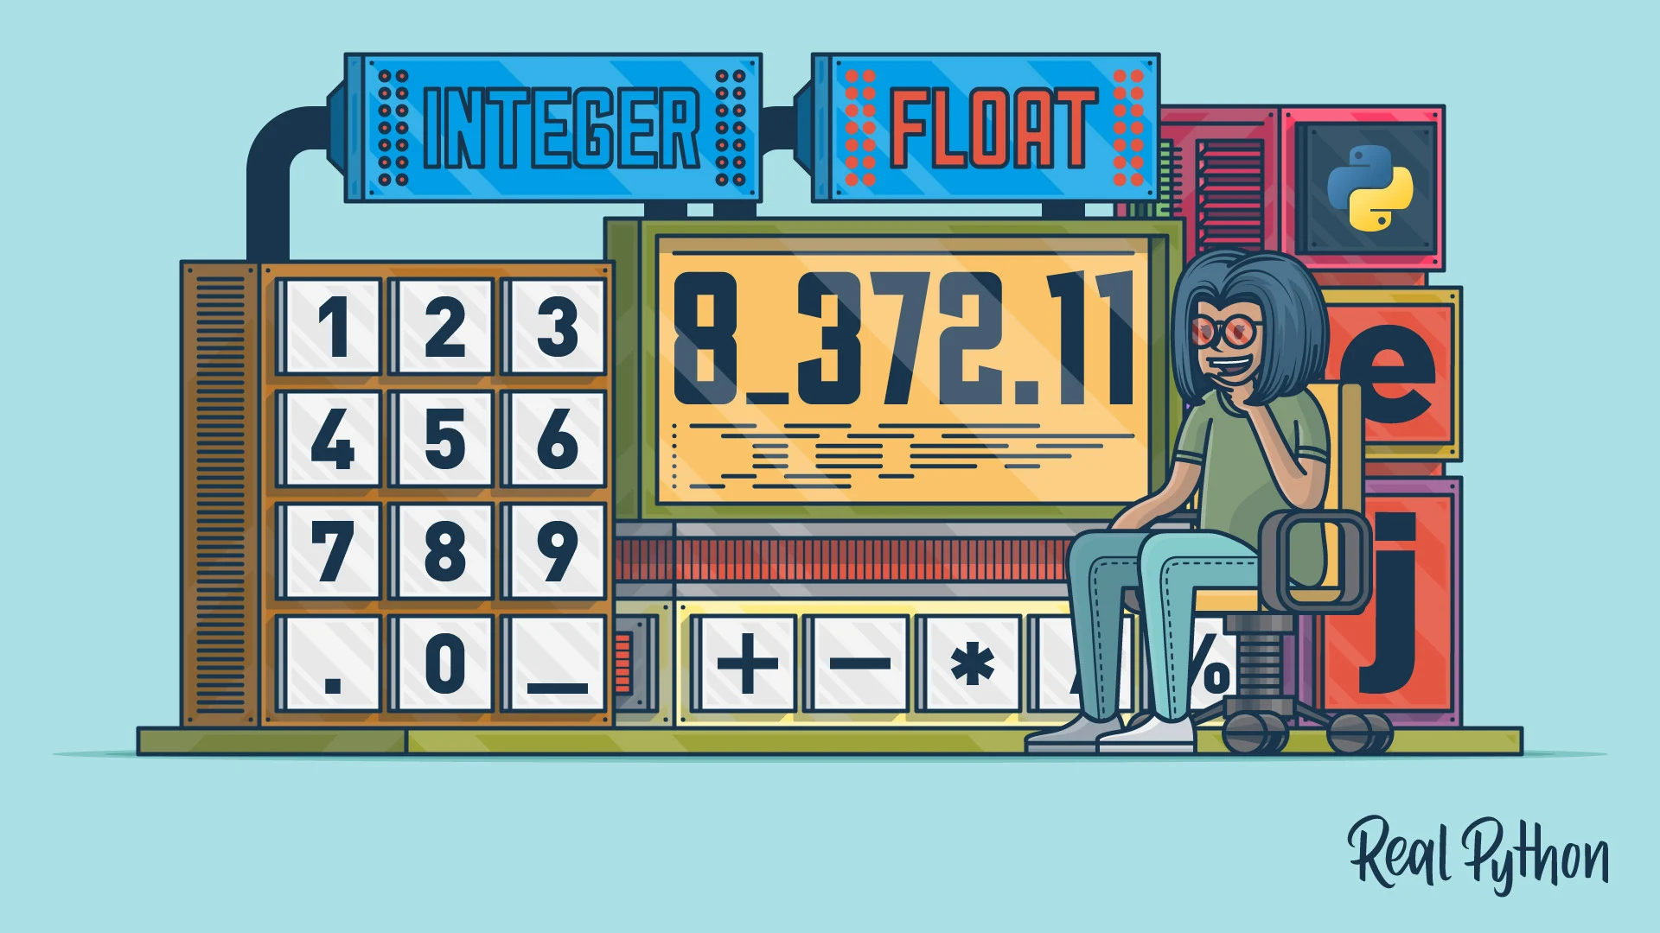
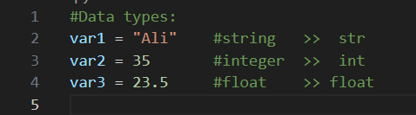
Variables
Datatypes
String
Integer
Float

Slide 13
Arithmetic Operators

Slide 14
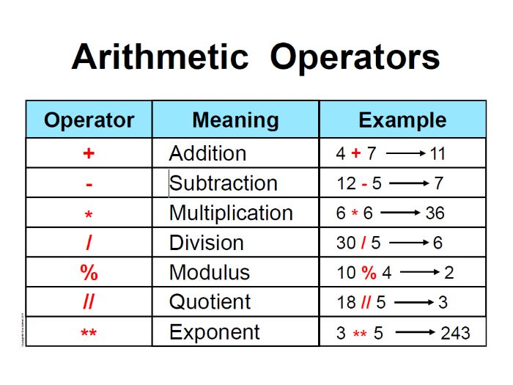
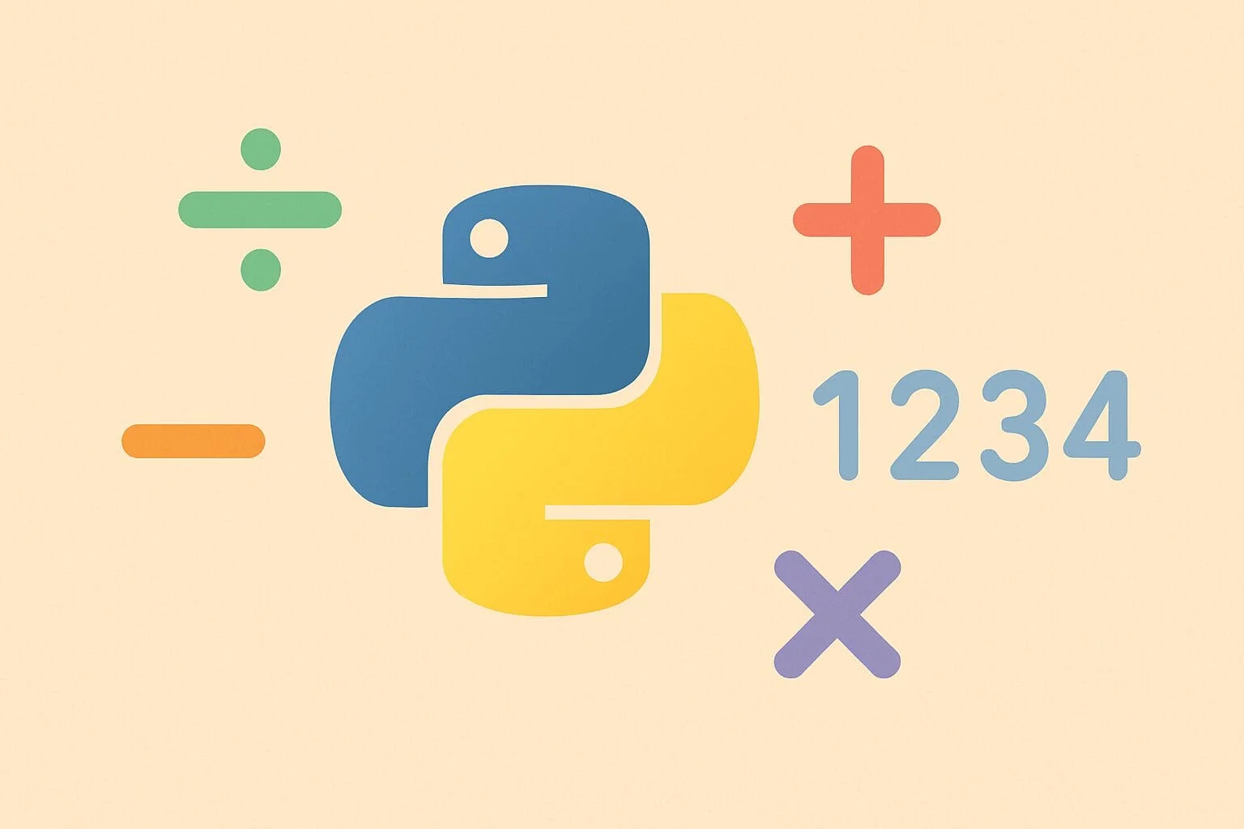
Arithmetic Operators

Slide 15
Input

Slide 16

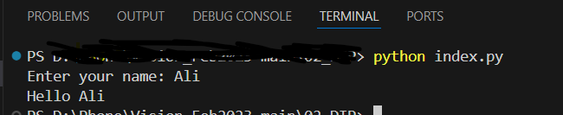
Input
Getting Input from User
input() always returns the value as a string.

Slide 17
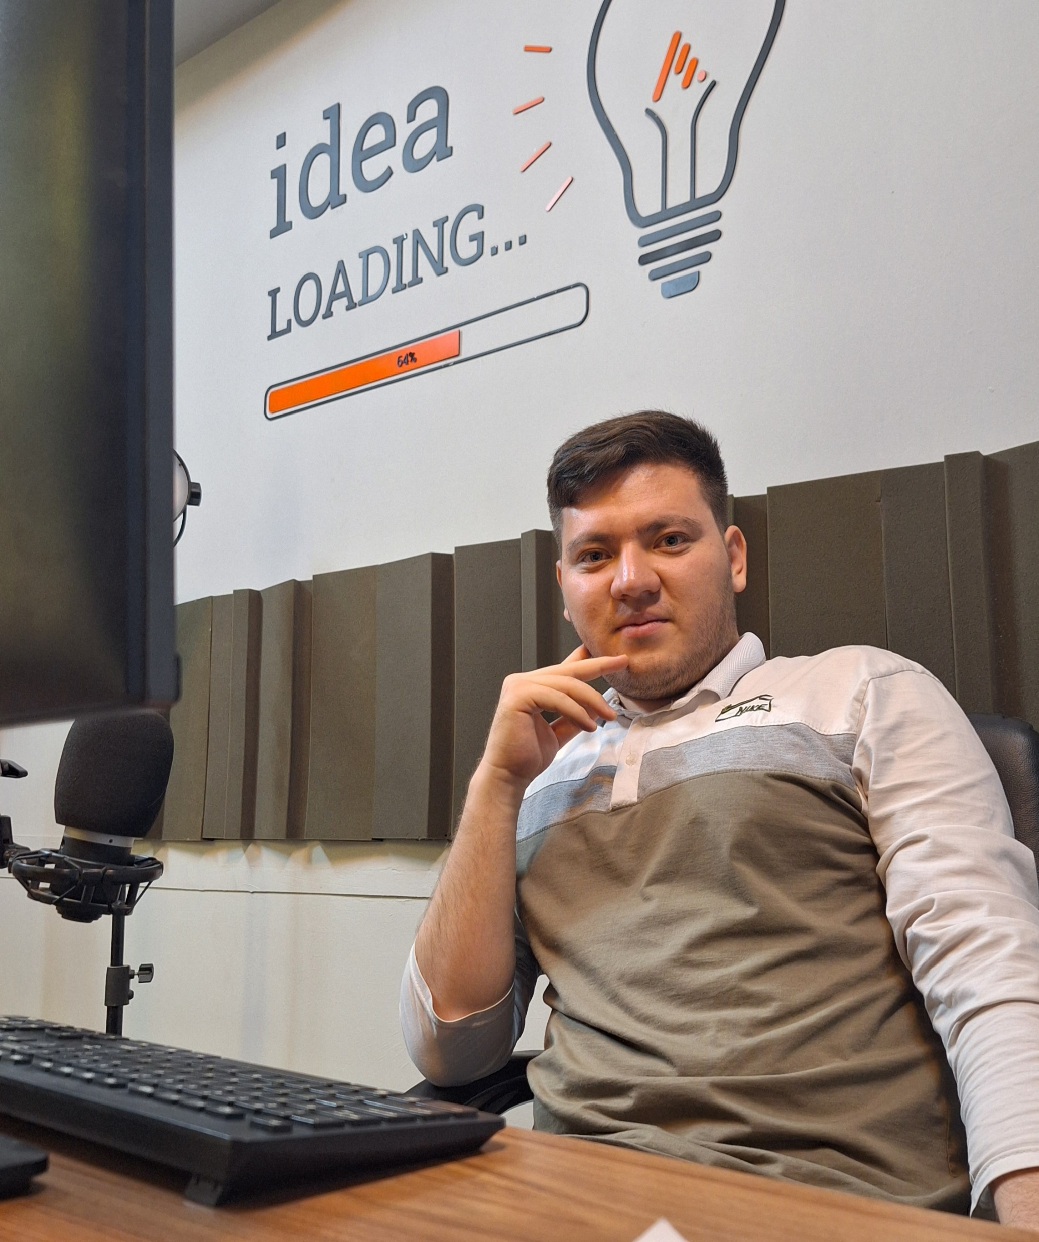



Thank You
About me:
Sayed Mostafa Modaghegh
AI and Robotics student
Computer vision developer
Sm.mostafa79modaqeq@gmail.com
@mostafa_modaghegh

