Slide 1
Programming(1)
Sayed Mostafa Modaghegh

Slide 2
Programming_1
Learning Objectives
Identify and understand different data types
Use boolean values (True / False)
Format text with f-strings
Create and modify lists

Slide 3
Boolian

Slide 4
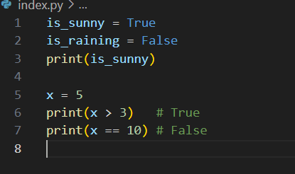

Boolian
Booleans are used for logical decisions

Slide 5
f-string

Slide 6
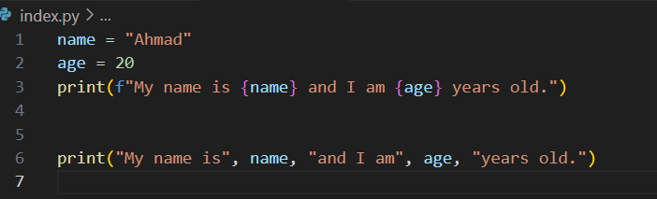
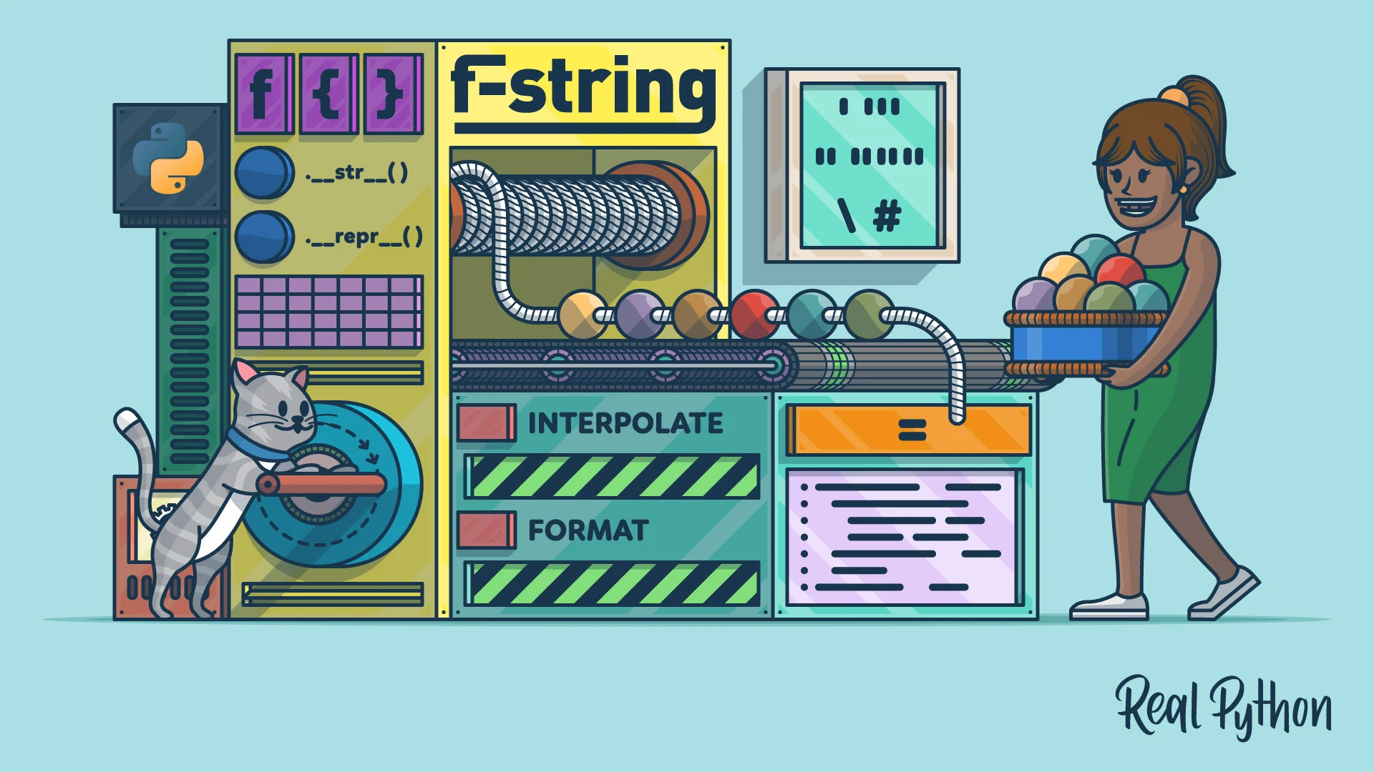
f_string

Slide 7
Datatypes

Slide 8

Datatypes
List
Used to store multiple values in one variable
Written with square brackets []
Example
Example

Slide 9
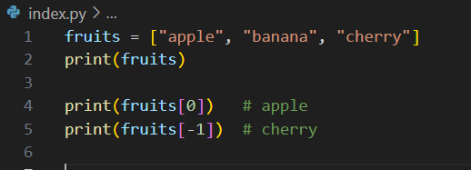
Datatypes
List Example

Slide 10
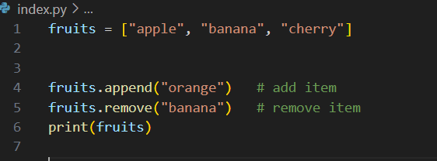
Datatypes
Modifying Lists
Lists are mutable → you can change them.

Slide 11
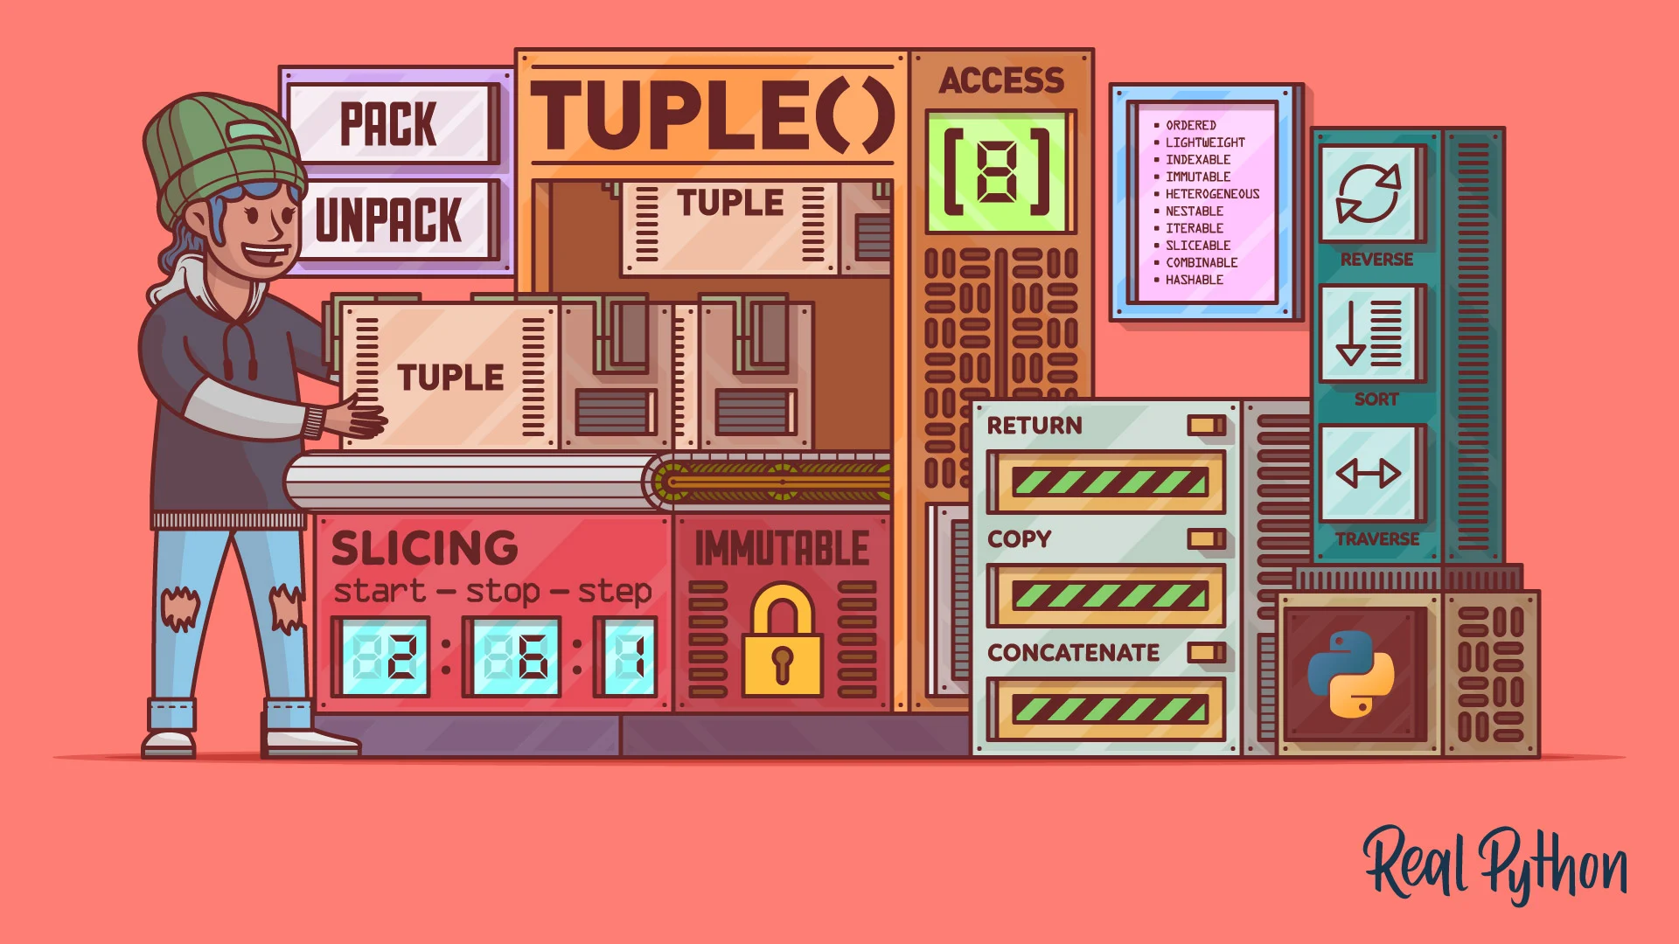
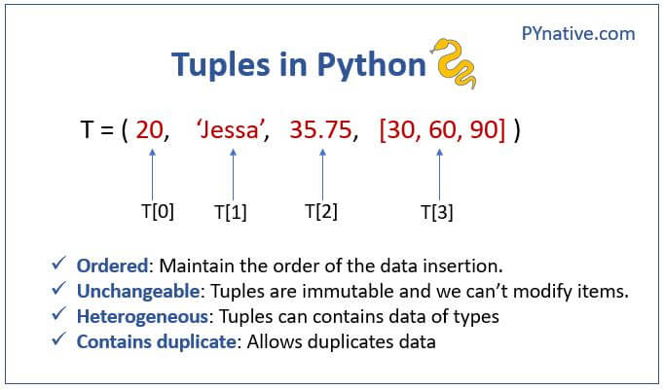
Datatypes
Tuple

Slide 12
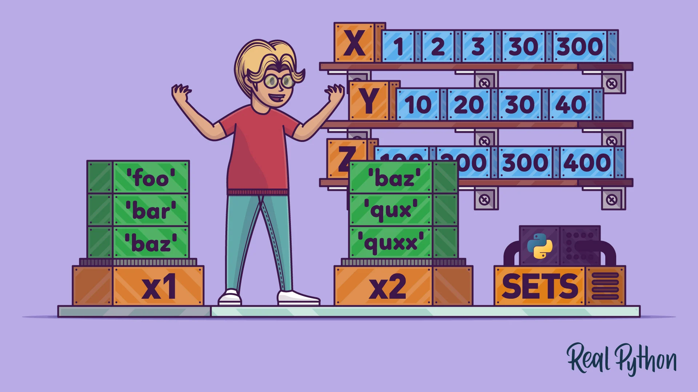
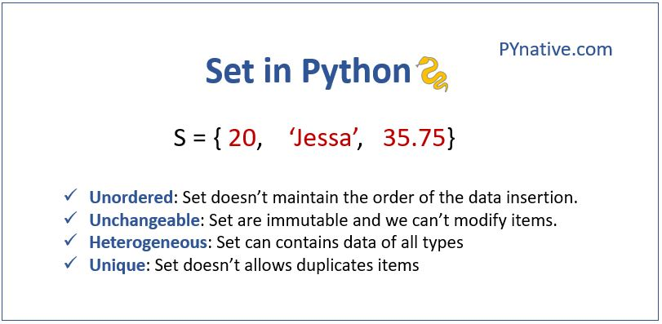
Datatypes
Set

Slide 13
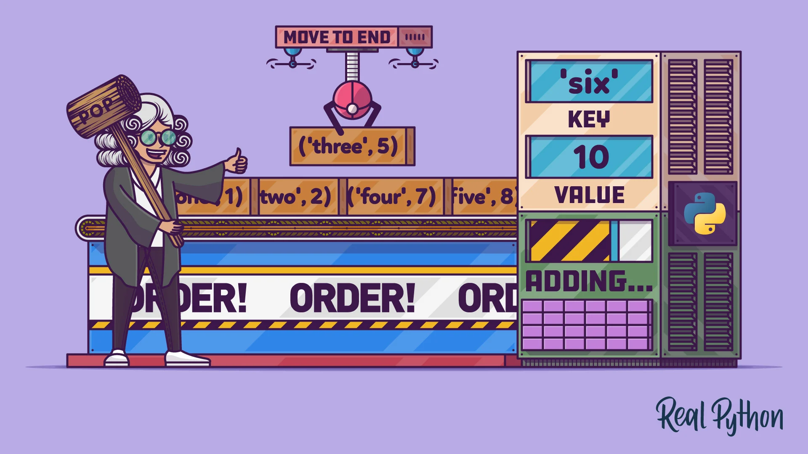
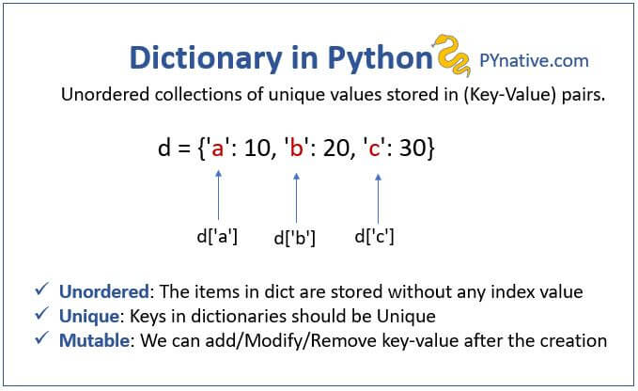
Datatypes
Dict

Slide 14




Thank You
About me:
Sayed Mostafa Modaghegh
AI and Robotics student
Computer vision developer
Sm.mostafa79modaqeq@gmail.com
@mostafa_modaghegh

