Slide 1
Programming(2)
Sayed Mostafa Modaghegh

Slide 2
Programming_2
Learning Objectives
Compare values using comparison operators
Combine conditions with logical operators
Use if and else for decision making
Understand type conversion (casting)
Write simple decision-based programs

Slide 3
Casting

Slide 4
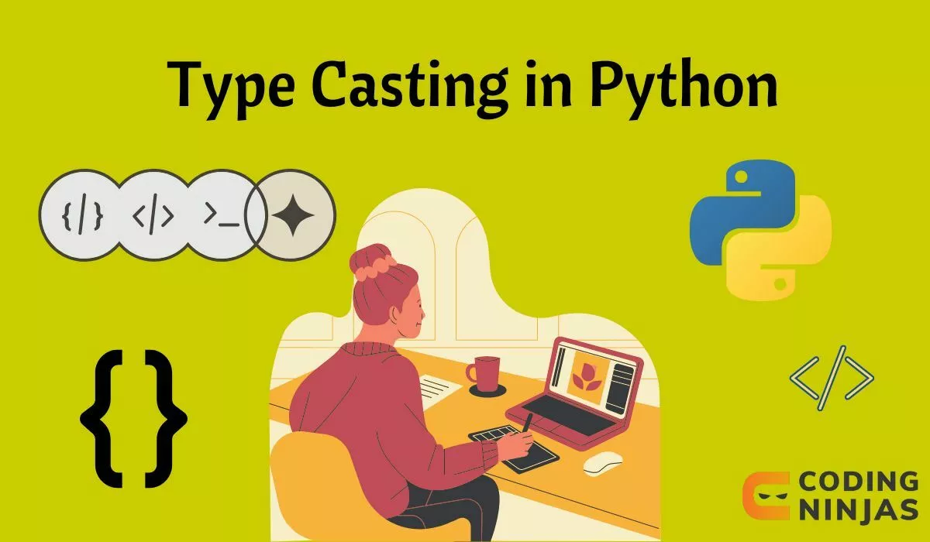
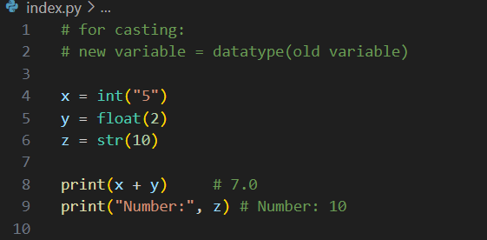
Casting
Use casting when you need to convert data types.

Slide 5
Comparison Operators

Slide 6
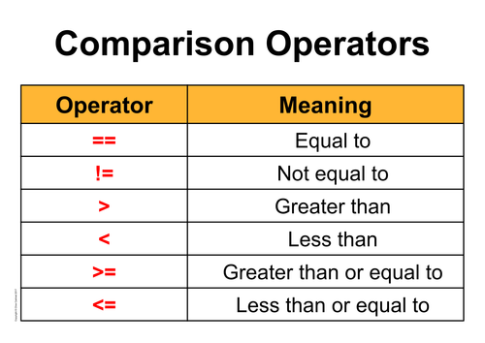
Comparison Operators
always return True or False

Slide 7
Logical Operators

Slide 8
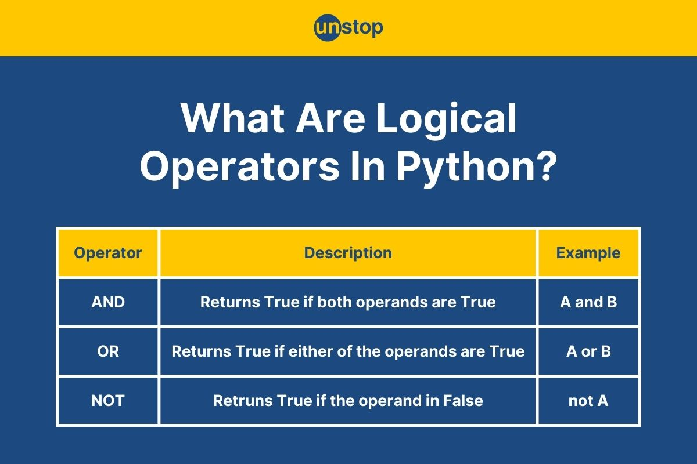
Logical Operators
always return True or False

Slide 9
If statement

Slide 10

If statement
🧠 What is an if statement?
The if statement is used :
when we want the program to make a decision.
It checks a condition, and if that condition is True, a block of code runs.
If it’s False, that block is skipped (or another block runs using else).

Slide 11
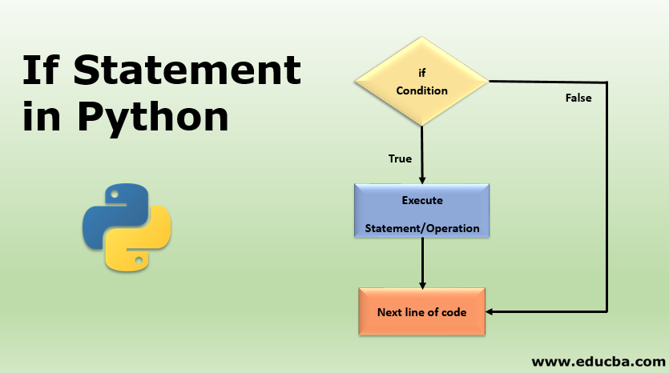
If statement
Tips for Writing Conditions
Use indentation (4 spaces) after if and else
Always end each condition line with :
Python cares about spacing!

Slide 12
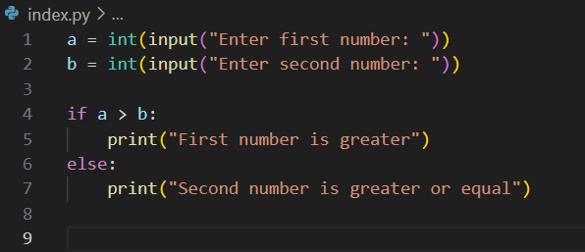
If statement
If example

Slide 13
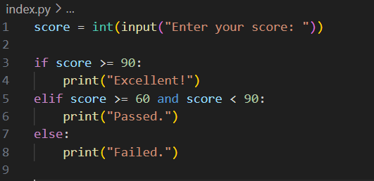
If statement
Combining Conditions

Slide 14




Thank You
About me:
Sayed Mostafa Modaghegh
AI and Robotics student
Computer vision developer
Sm.mostafa79modaqeq@gmail.com
@mostafa_modaghegh

