Slide 1
Programming(3)
Sayed Mostafa Modaghegh

Slide 2
Programming_3
Learning Objectives
Understand what a loop is and why it’s needed
Use for to repeat tasks
Generate sequences with range()
Check if an item exists with in / not in
Write clear decision logic using match-case

Slide 3
match-case

Slide 4
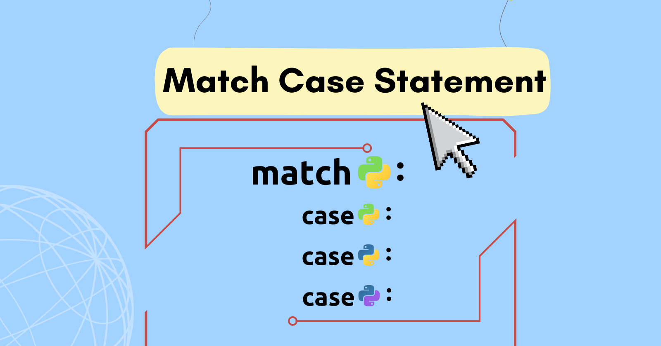
Match_Case
Introduced in Python 3.10+
Cleaner alternative to many if-elif statements.
✅ Always include case _: as the “default” option
✅ Case values must be exact (match is case-sensitive)
✅ Works great when checking fixed categories (e.g., days, menu options)

Slide 5
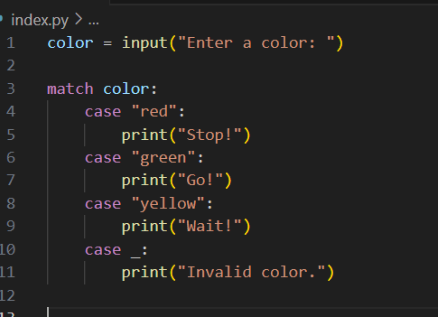
Match_Case

Slide 6
Membership Operators

Slide 7
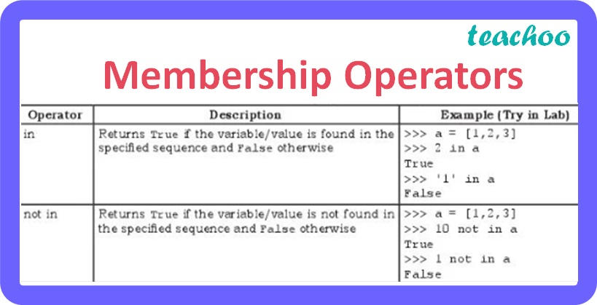
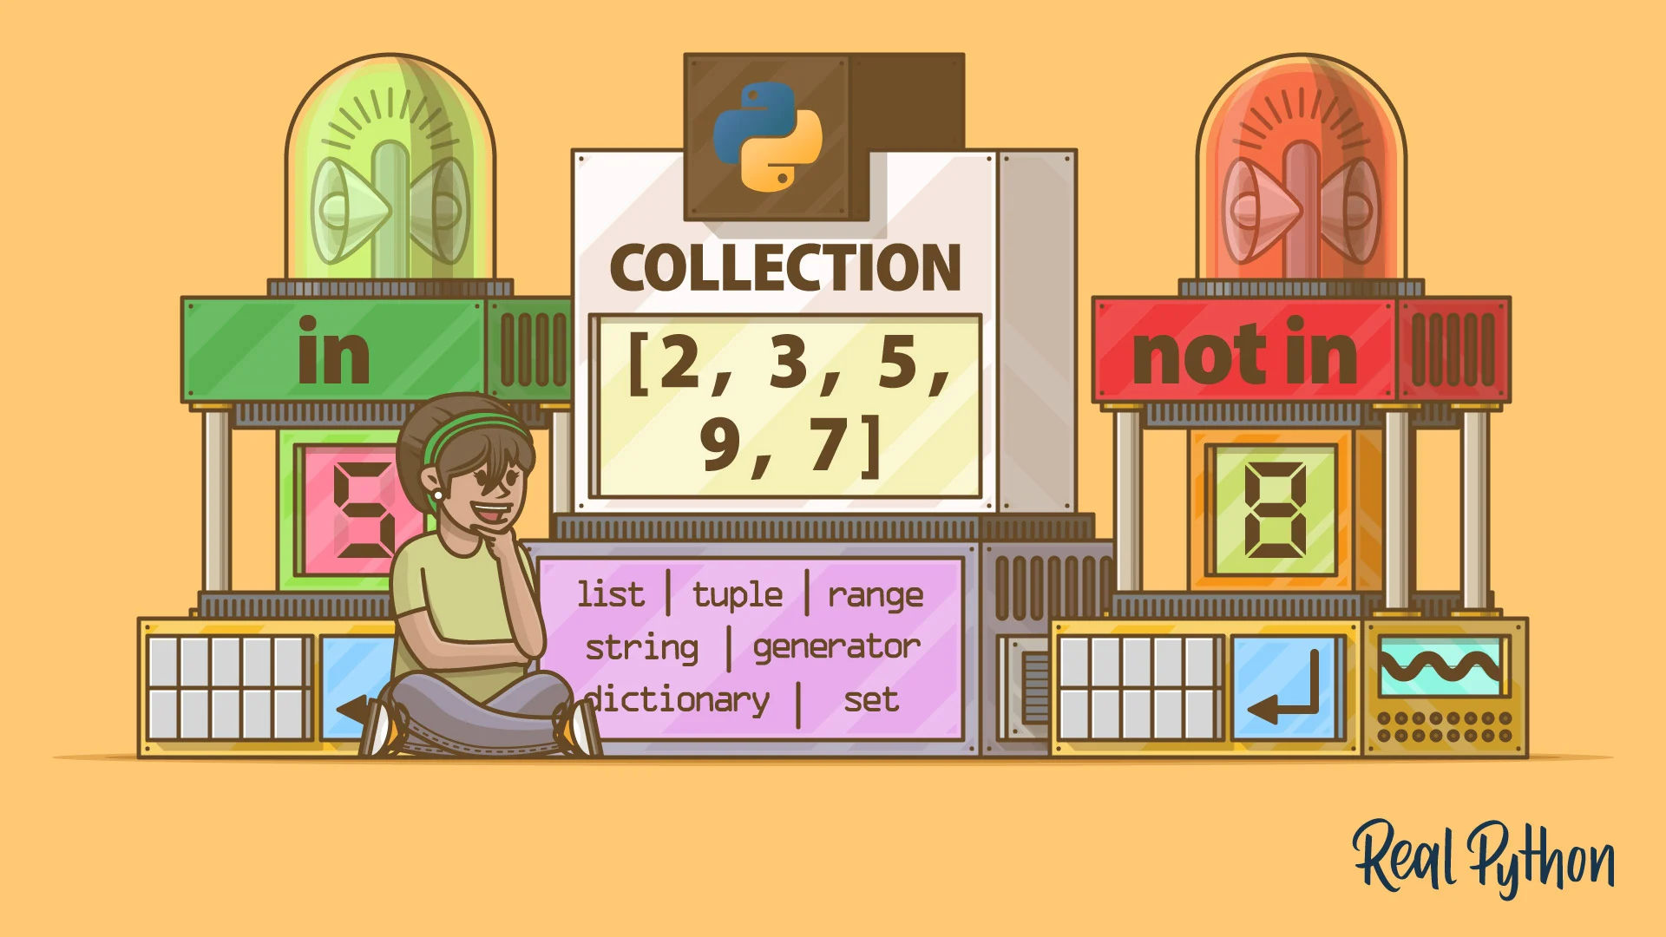
Membership Operators
Used to check if something exists in a list, tuple, or string

Slide 8
Range

Slide 9
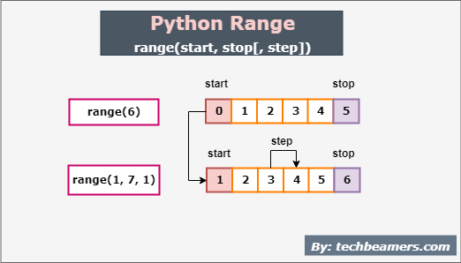
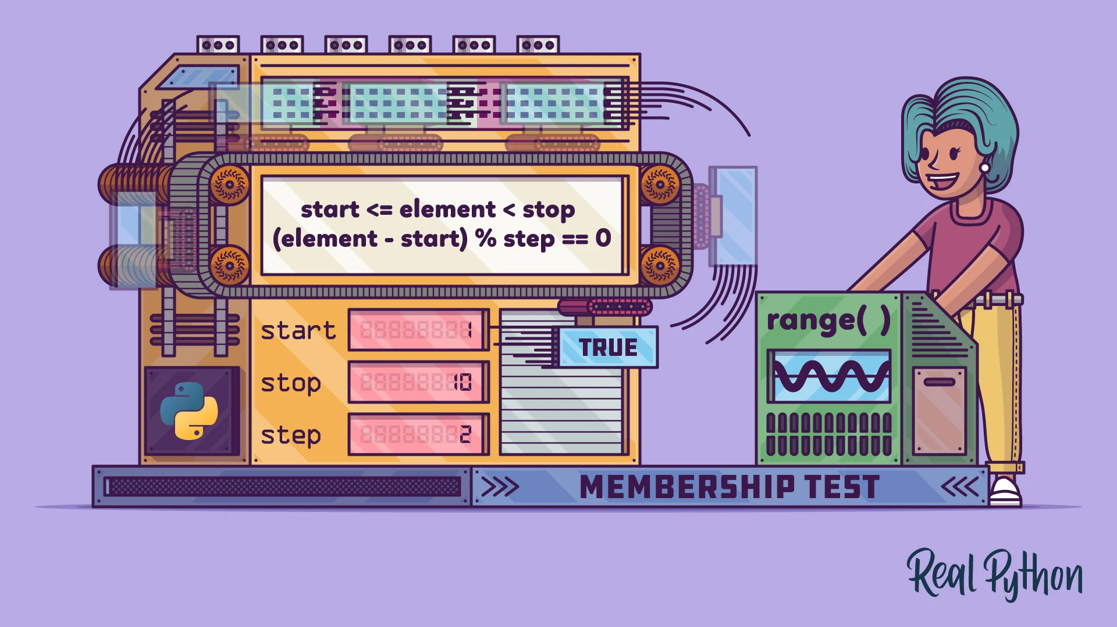
Range
Creates a sequence of numbers

Slide 10
For

Slide 11
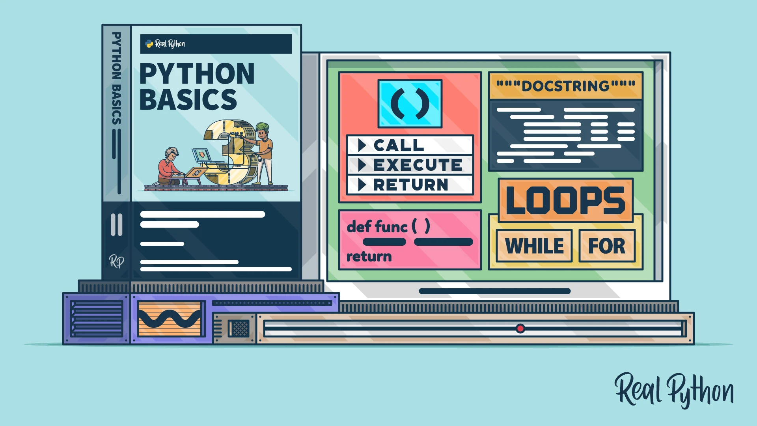
For
What is a Loop?
A loop lets us repeat a block of code several times.
Instead of writing the same line many times, we can use a loop.

Slide 12
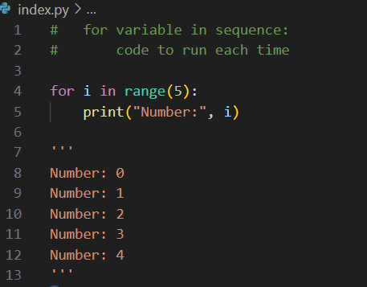
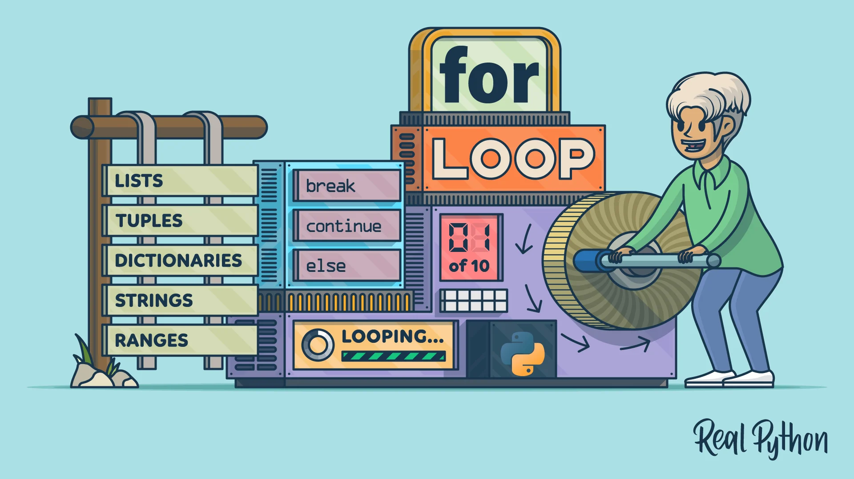
For

Slide 13




Thank You
About me:
Sayed Mostafa Modaghegh
AI and Robotics student
Computer vision developer
Sm.mostafa79modaqeq@gmail.com
@mostafa_modaghegh

