Slide 1
Programming(4)
Sayed Mostafa Modaghegh

Slide 2
Programming_4
Learning Objectives
Understand how loops help repeat code efficiently
Use for and while loops for repetition
Apply break and continue to control loops
Use an accumulator variable to keep running totals
Compare for and while loops

Slide 3
Accumulators

Slide 4
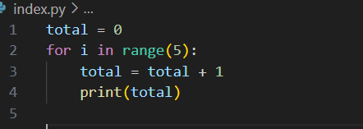
Accumulators
Why do we need accumulators?
When we need to keep a running total (like sum, count, or average),
we use a variable that “remembers” the previous value.
This variable total is called an accumulator

Slide 5
While

Slide 6
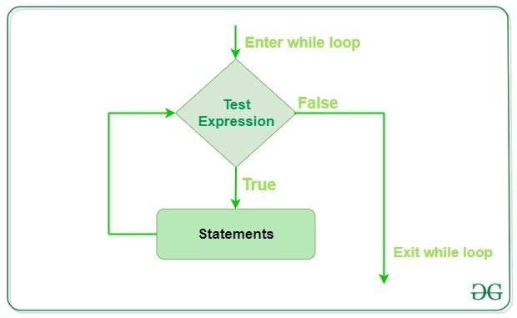
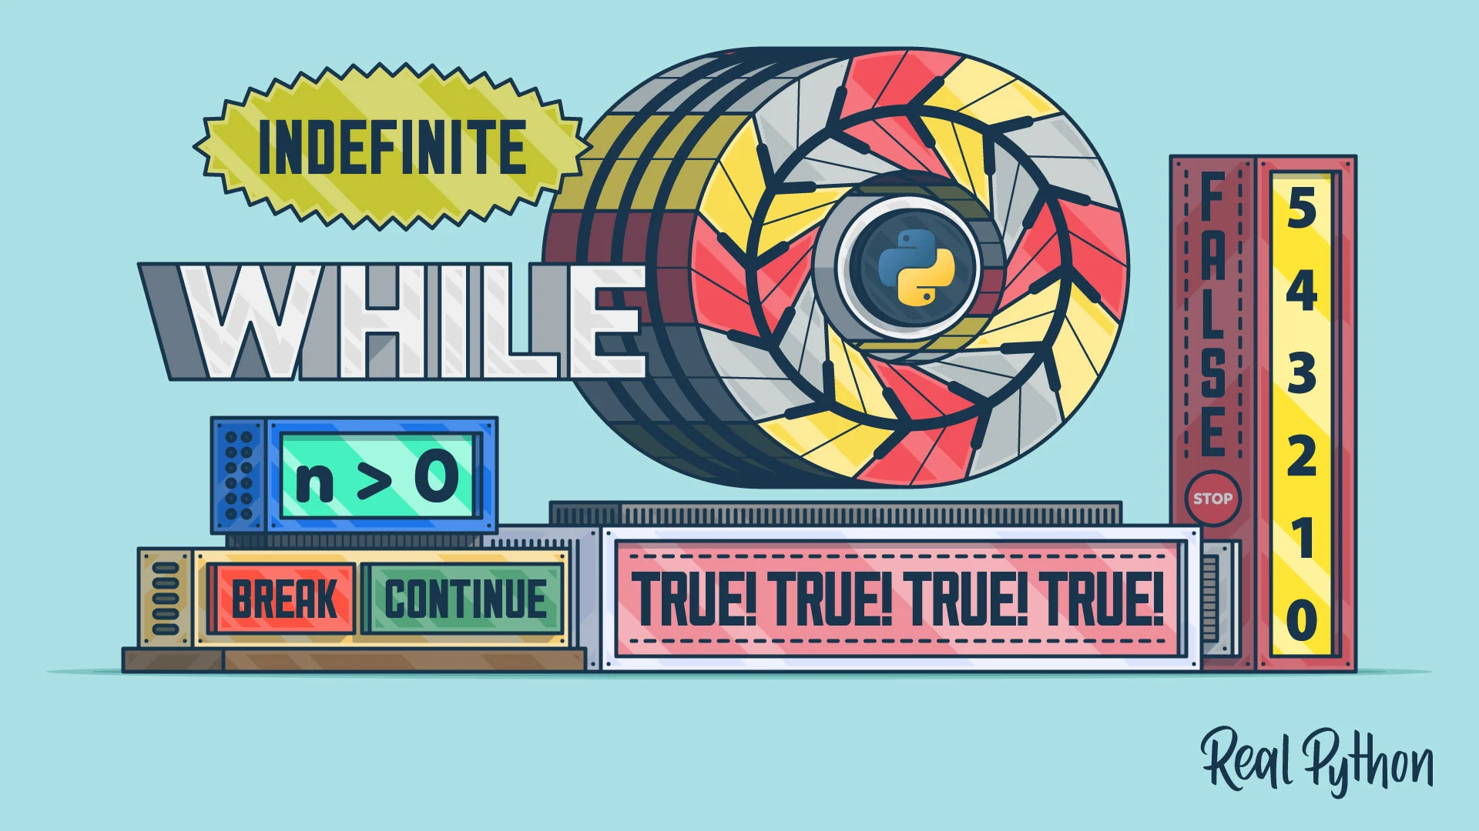
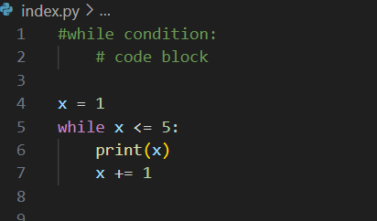
While
Repeats code as long as a condition is True.

Slide 7
Break

Slide 8

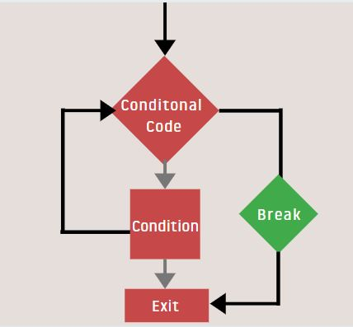
Break
Breaking out of a loop
break immediately stops the loop, no matter what the condition is.

Slide 9
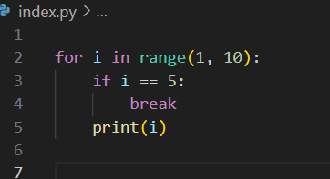
Break
For_example

Slide 10
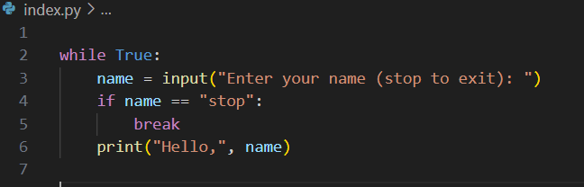
Break
While_example

Slide 11
Continue

Slide 12
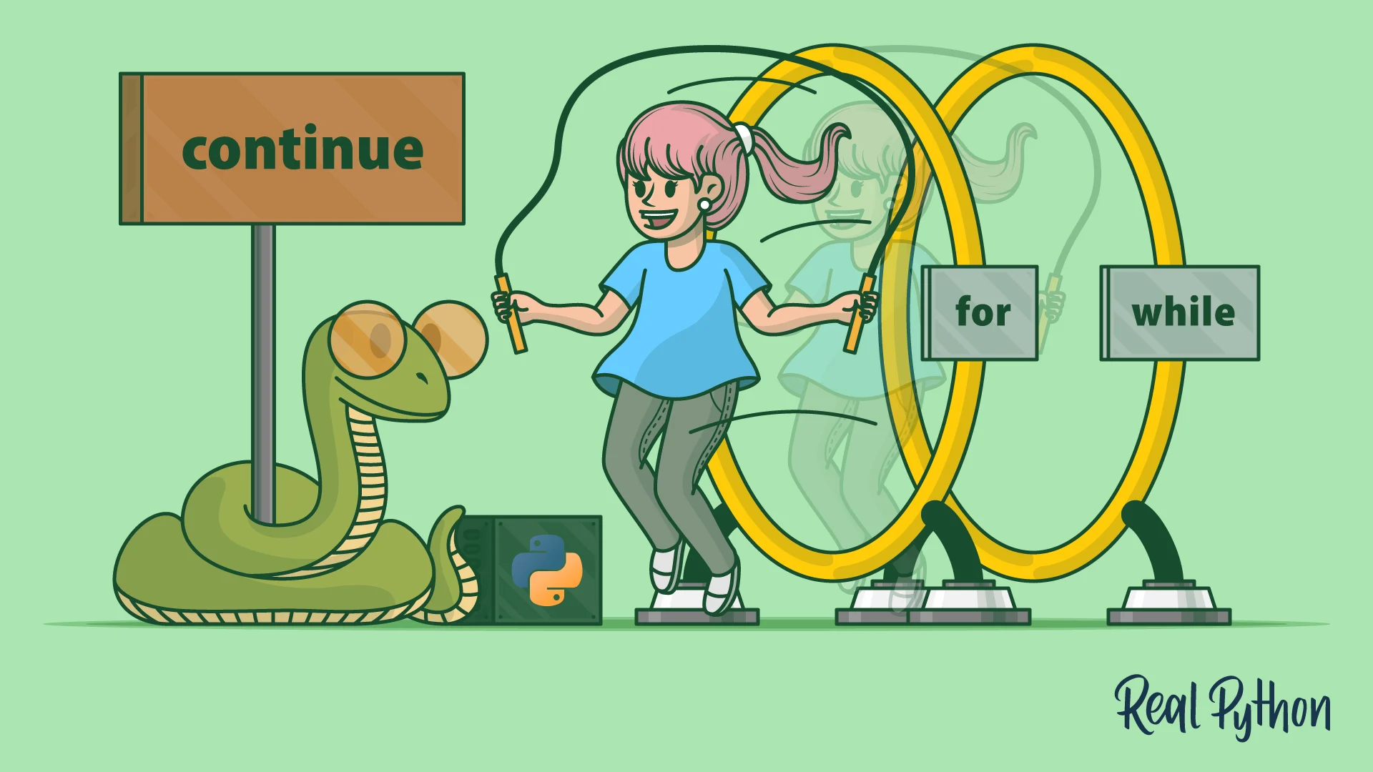
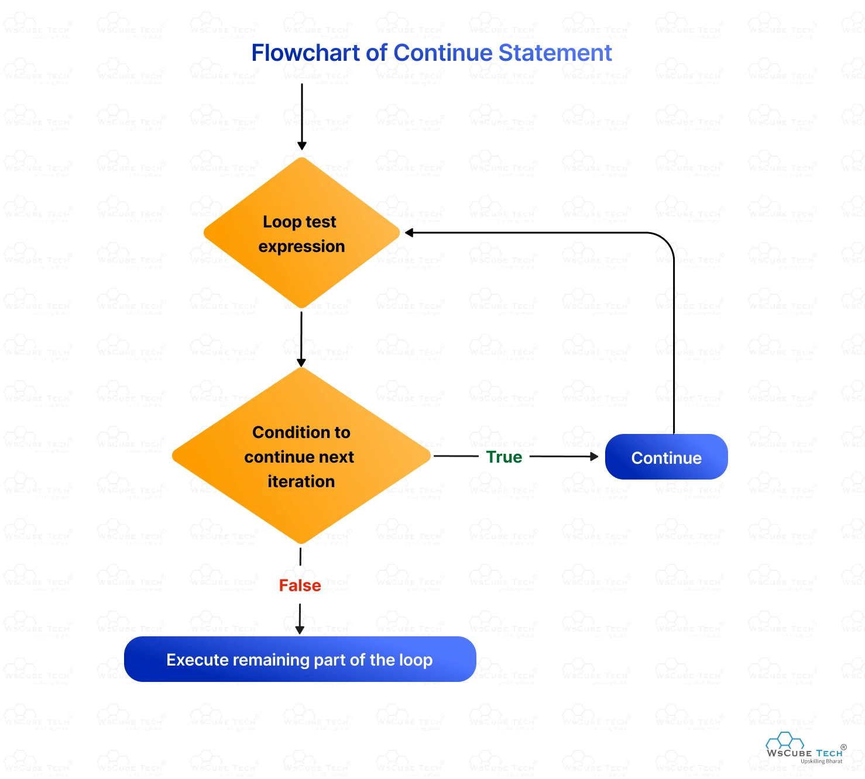
Continue
Skipping an iteration
continue jumps to the next loop cycle
(skips the rest of the code in this iteration).

Slide 13
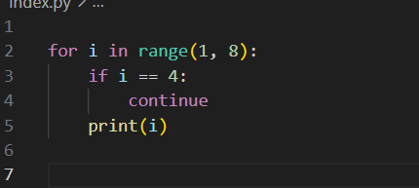
Continue
For_example

Slide 14
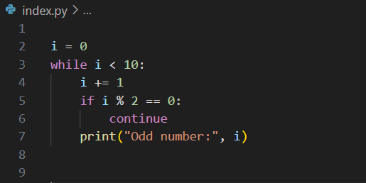
Continue
While_example

Slide 15




Thank You
About me:
Sayed Mostafa Modaghegh
AI and Robotics student
Computer vision developer
Sm.mostafa79modaqeq@gmail.com
@mostafa_modaghegh

