Slide 1
Programming(5)
Sayed Mostafa Modaghegh

Slide 2
Programming_5
Learning Objectives
✅ Understand Python string & list behavior
✅ Learn useful string methods
✅ Learn useful list methods
✅ Practice processing text and collections
✅ Improve problem-solving & code readability

Slide 3
String

Slide 4
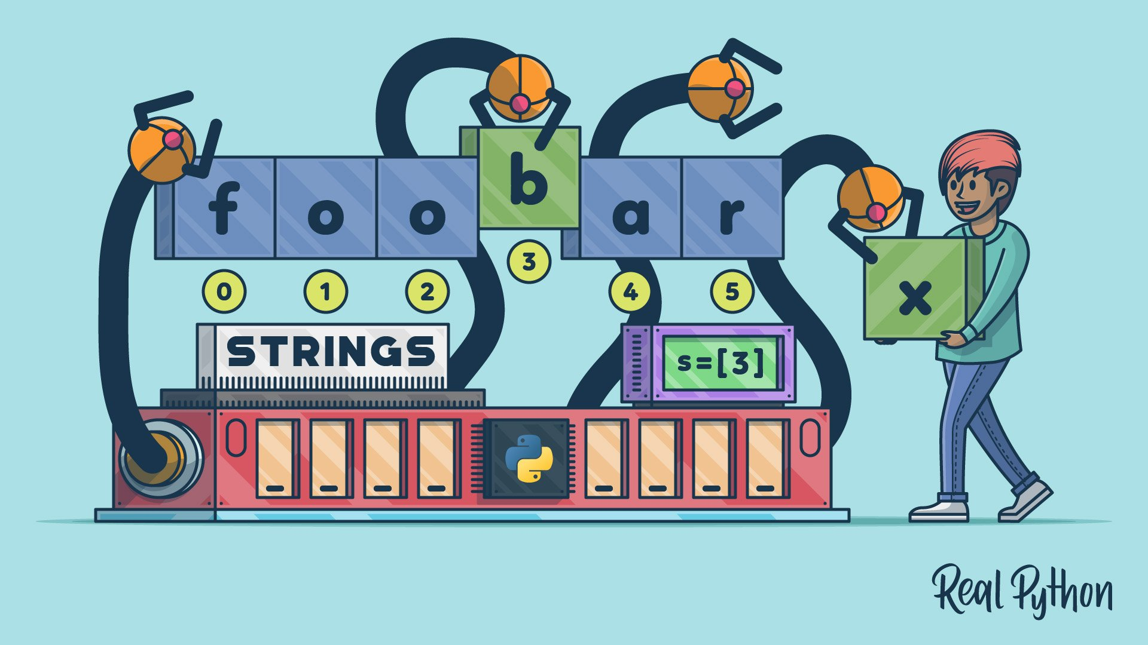
String
What Are Strings?
Text data
Sequence of characters
✅ Ordered
❌ Not changeable (immutable)

Slide 5
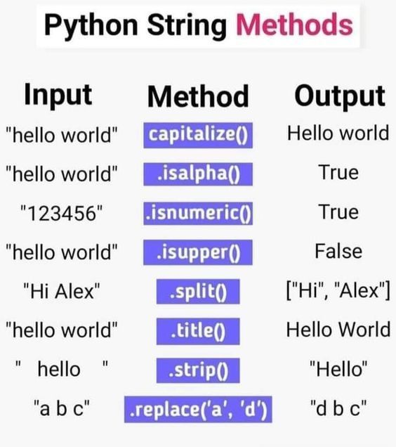
String
String Methods

Slide 6
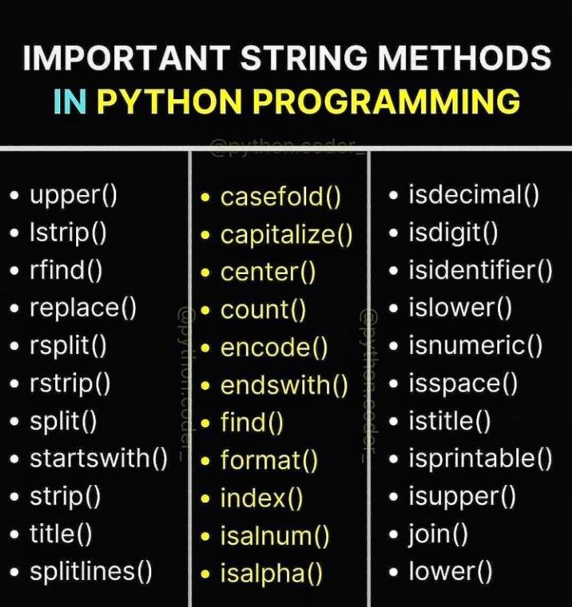
String
String Methods

Slide 7
List

Slide 8

List
What Are Lists?
Store multiple values
✅ Ordered
✅ Mutable (changeable)
Supports different data types

Slide 9
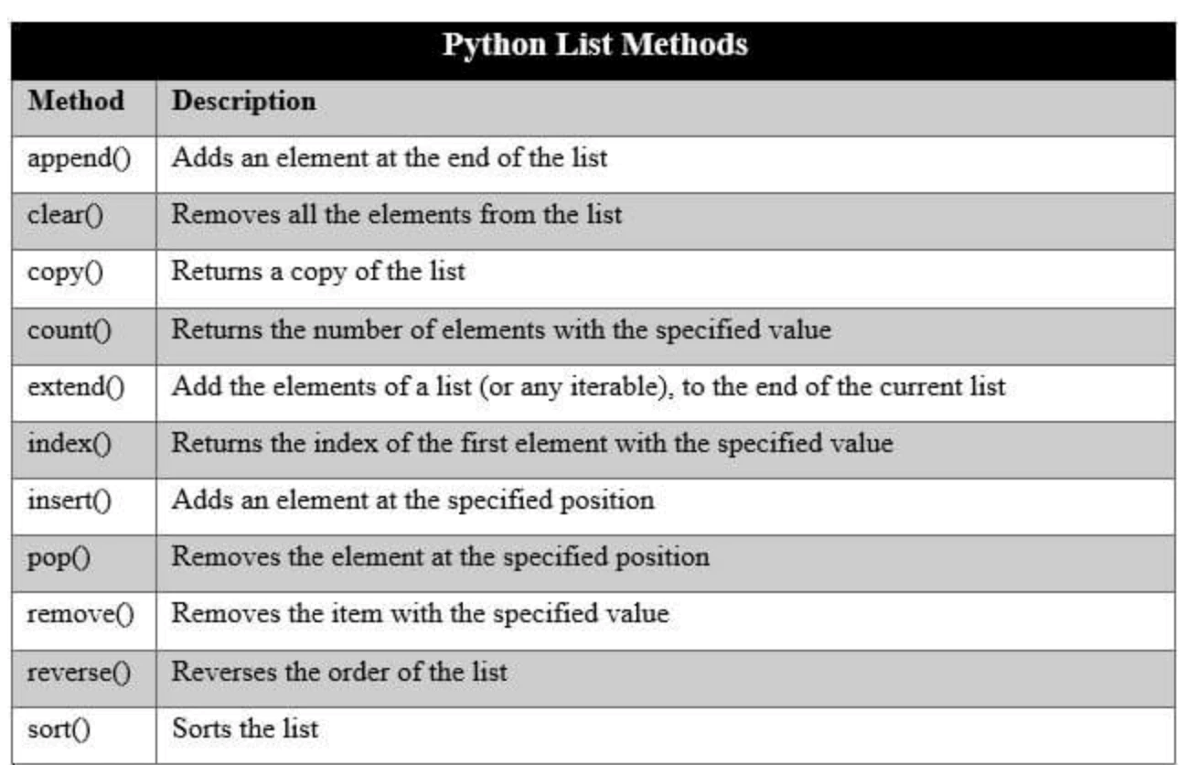
List
List Methods

Slide 10




Thank You
About me:
Sayed Mostafa Modaghegh
AI and Robotics student
Computer vision developer
Sm.mostafa79modaqeq@gmail.com
@mostafa_modaghegh

