Slide 1
Programming(6)
Sayed Mostafa Modaghegh

Slide 2
Programming_6
Learning Objectives
✅ Define and call functions
✅ Use parameters & arguments
✅ Use default parameter values
✅ Understand return vs print
✅ Return multiple values from a function
✅ Use functions with loops & if
✅ Understand basic variable scope

Slide 3
Functions

Slide 4
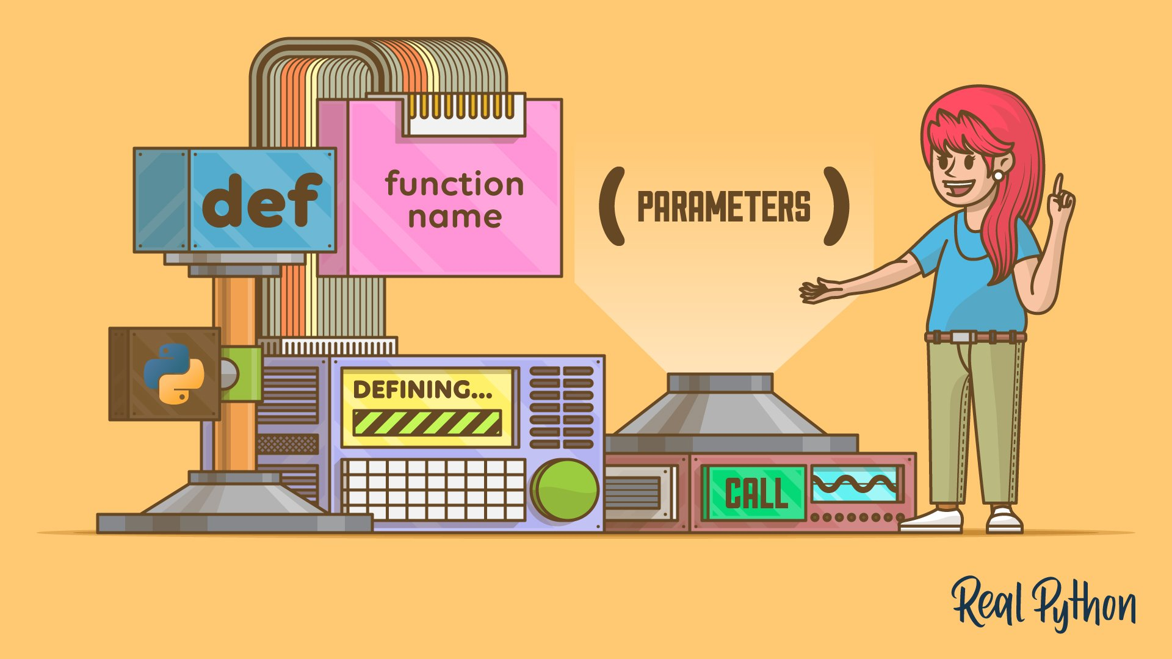
Functions
Why Functions?
🟣 Avoid repeating code
🟣 Make programs cleaner and easier to read
🟣 Reuse logic many times
🟣 Organize code into logical blocks
💡 Think of a function like a small worker that does one job.

Slide 5
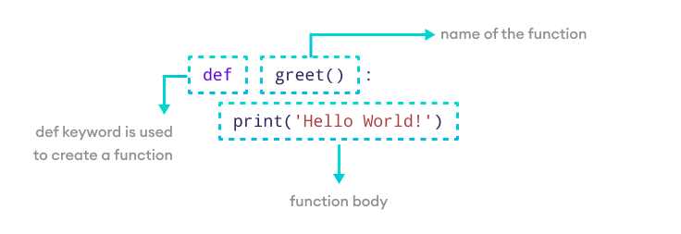
Functions
Basic Function Syntax

Slide 6
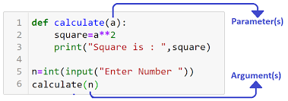
Functions
Parameters

Slide 7
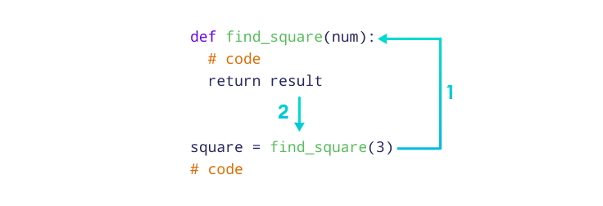
Functions
Return

Slide 8
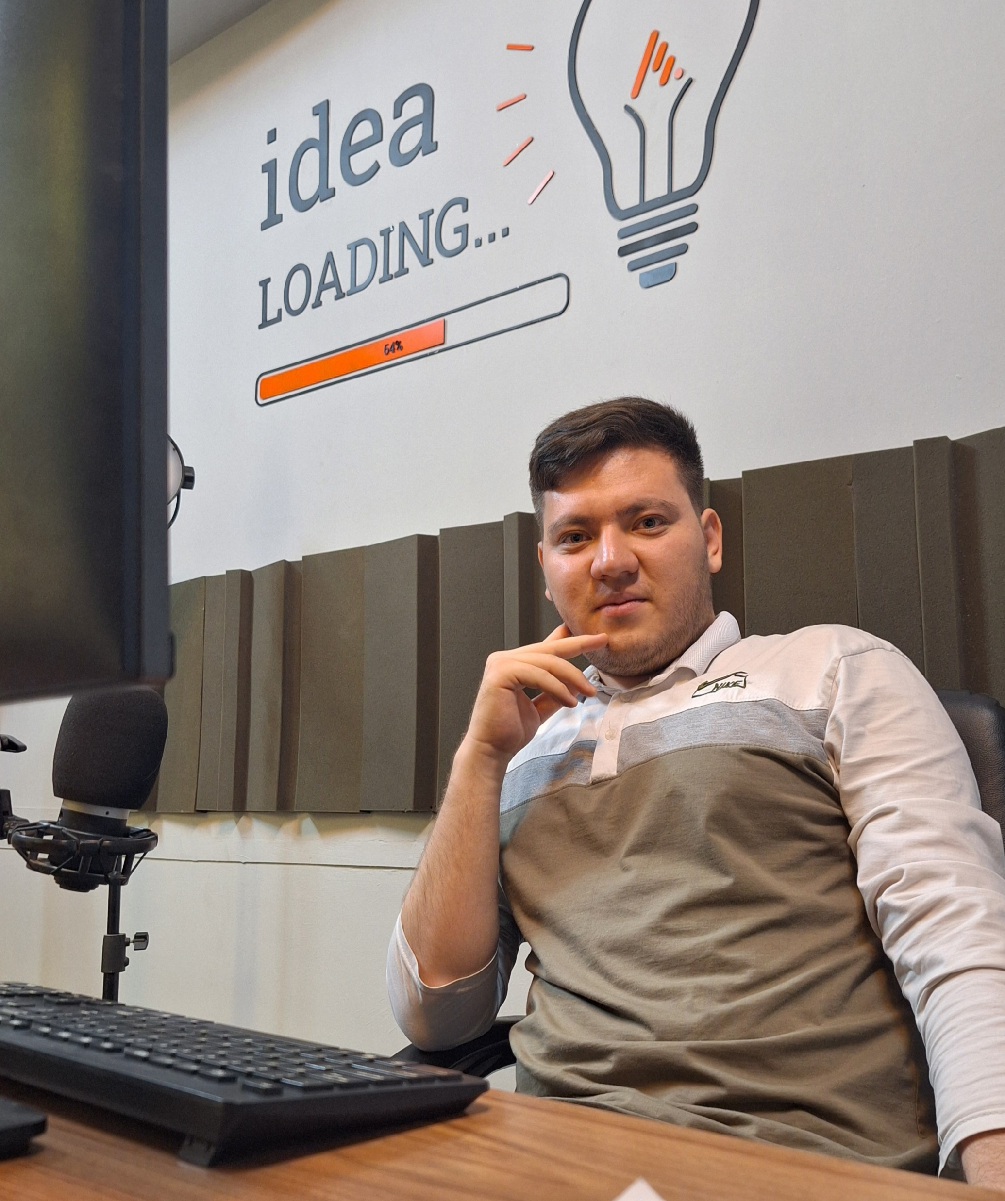



Thank You
About me:
Sayed Mostafa Modaghegh
AI and Robotics student
Computer vision developer
Sm.mostafa79modaqeq@gmail.com
@mostafa_modaghegh

