Slide 1
Programming(7)
Sayed Mostafa Modaghegh

Slide 2
Programming_7
Learning Objectives
Understand and write nested if statements
Recognize when nested conditions are needed
Build multi-level decision structures
Import and use Python modules
Create a simple custom module
Organize code into separate files
Understand modular programming

Slide 3
Nested Conditions

Slide 4
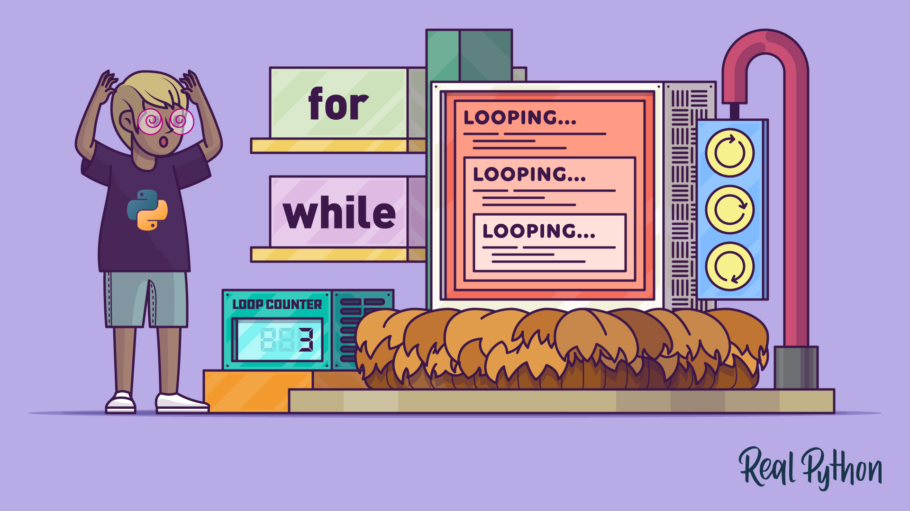
Nested Conditions
Why Nested Conditions?
We use nested conditions when:
A decision depends on another decision
Multi-level checking is needed
Input validation requires steps
The problem includes “first check X, then inside it check Y”

Slide 5
Python Modules

Slide 6

Python Modules
What are Modules?
A module is a file containing Python code that we can import and reuse.
Reasons for modules:
Code organization
Reusability
Clean and scalable programs
Separation of logic (login module, item module, main program)

Slide 7
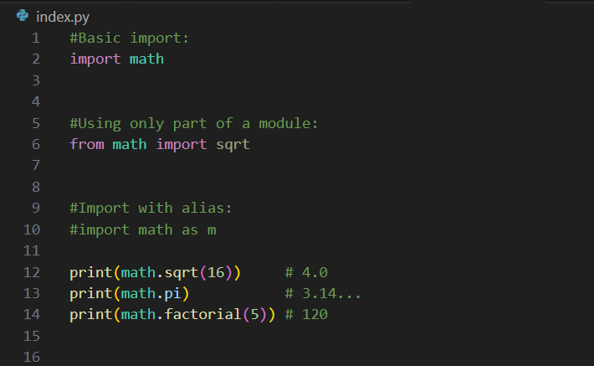
Python Modules
Using math module

Slide 8




Thank You
About me:
Sayed Mostafa Modaghegh
AI and Robotics student
Computer vision developer
Sm.mostafa79modaqeq@gmail.com
@mostafa_modaghegh

