Slide 1
Analyzing the Long-Term Behavior of the Bangladesh Exchange Rate: A Univariate Time Series Approach
Mohammad AsrarulHasanatª, Mostafa Monir^{b}
ª Lecturer, Department of Economics, Southeast University (SEU)
^{b}Lecturer, Department of Economics, Dhaka International University (DIU)

Slide 2
Introduction and Literature
Impact of Exchange Rate Volatility on Businesses
Exchange rates significantly affect operations and profitability across businesses (both large and small).
Exchange rate risk is crucial for business owners and investors.
Types of Foreign Exchange Rate Systems
Pegged: Fixed to another currency.
Managed Float: Fluctuates freely but influenced by policy.
Freely Floating: Determined solely by market forces.
Fixed: Set by government, unchanged.

Slide 3
Introduction and Literature
Volatility Models
ARCH Model (Engle, 1982): Captures volatility patterns.
Models address aspects like volatility clustering and the leverage effect.
Study Focus
Investigates leverage effect on Bangladesh's exchange rate volatility (1982-2022).
Examines dominance of bad vs. good news in exchange rate movements.

Slide 4
Introduction and Literature
GARCH Family Models for Exchange Rate Volatility
Brooks & Burke (1998): Information criteria used to select GARCH models for USD volatility; outperforms GARCH (1,1) on mean absolute error, but not on mean squared error.
Hansen & Lunde (2005): Evaluated 330 ARCH models. GARCH (1,1) competes well for currency rates but underperforms for IBM returns with leverage effects.
Other Studies:
Choo et al. (2002): GARCH models captured Malaysian Ringgit volatility.
Clement & Samuel (2011): Simulated Nigerian exchange rate volatility using GARCH models.
Bala & Asemota (2013): Found better results with volatility breaks in GARCH models.
Mia & Rahman (2019): GARCH (1,1) is most accurate for forecasting BDT/USD volatility.

Slide 5
Research Gap
Focus on Long-Term Data
Existing studies often use short-term or limited time frames for exchange rate volatility modeling.
Contribution: Leveraged a 40-year dataset to capture long-term trends and dynamics, providing a more comprehensive analysis of volatility patterns across decades.
Significance: Long-term data offers deeper insights into persistent effects, structural changes, and government policy impacts on exchange rates over time.

Slide 6
Research Design
Data Overview
Dataset: Monthly time-series data (BDT/USD) from 1982 to 2022.
Source: International Monetary Fund (IMF).
Variable Used
Nominal Exchange Rate (rₜ): Represents the trading rate between the Bangladeshi Taka and the US Dollar.
Data Transformation
Non-Stationarity: Nominal exchange rate typically shows non-stationarity.
Logarithmic Transformation: Applied to convert the nominal exchange rate into rate of return, facilitating analysis of volatility.

Slide 7
Research Design
Importance of Mean Equation in Volatility Modeling
Choosing the correct mean equation is critical for accurate volatility modeling with GARCH family models.
Incorrect mean equation formulation can lead to unaddressed autocorrelation issues in the model.
Methodology
This study evaluates the following models for Bangladesh's exchange rate volatility:
ARCH (Autoregressive Conditional Heteroskedasticity)
GARCH (Generalized Autoregressive Conditional Heteroskedasticity)

Slide 8
Result and Discussion
Table 1: Unit Root Test Results of Exchange Rate
Note: (*, ** and *** specify statistical significance, respectively, at the 10%, 5% and 1% levels for ADF & PP tests; *, ** and *** specify the null hypothesis cannot be rejected, respectively, at the 10%, 5% and 1% levels for KPSS test).
 | ADF | PP | KPSS
Test Statistic | -15.75978*** | -16.30432*** | 0.566955***

Slide 9
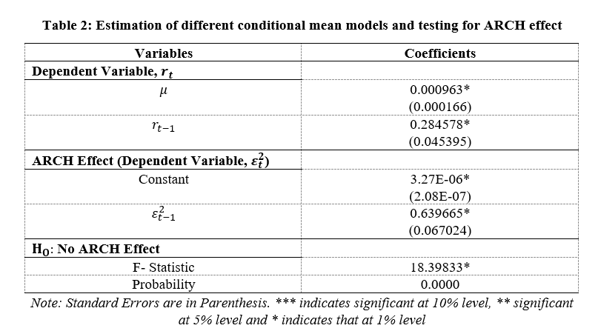
Result and Discussion

Slide 10
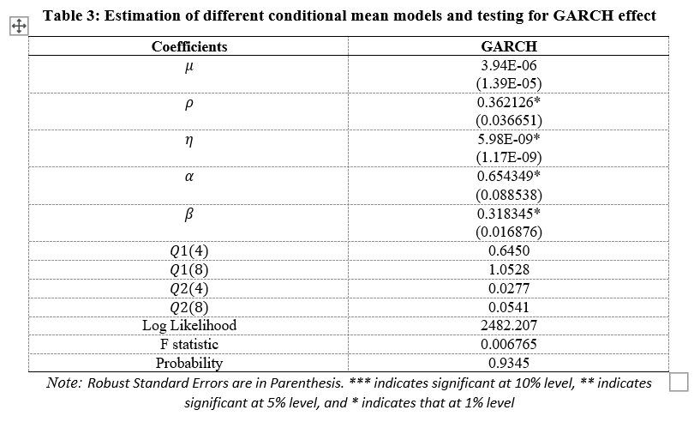
Result and Discussion

Slide 11
Conclusion
The study investigates the leverage effect on Bangladesh's exchange rate volatility (BDT/USD) over a 40-year period.
Unit root tests (ADF, PP, KPSS) confirm the stationarity of the series after transformation.
The ARCH effect is validated, allowing for the application of ARCH family models.
GARCH (1,1) results show significant coefficients with no serial correlation or heteroscedasticity.

Slide 12
Policy Recommendations
Improve forecasting tools: Leverage advanced volatility models (e.g., TGARCH, EGARCH) to better anticipate fluctuations in the exchange rate.
Monitoring frameworks: Develop early-warning systems that incorporate the findings of asymmetric volatility to better handle both domestic and international shocks.

Slide 13
References
Brooks, C., & Burke, S. P. (1998): Used information criteria to select GARCH models for forecasting USD exchange rate volatility.
Hansen, P. R., & Lunde, A. (2005): Compared 330 ARCH-type models using IBM and DM-USD exchange rate data to assess volatility modeling.
Choo, L., Loo, S. C., & Ahmad, Z. (2002): Applied GARCH models to analyze Malaysian Ringgit volatility against the British Pound.
Clement, O., & Samuel, J. (2011): Modeled Nigerian exchange rate volatility using GARCH models for Naira against USD and GBP.
Bala, D. A., & Asemota, J. O. (2013): Investigated volatility in Naira/US dollar and Naira/Euro exchange rates using GARCH models with breakpoints.
Mia, M. A., & Rahman, M. (2019): Assessed GARCH (1,1) as the most accurate model for predicting BDT/USD exchange rate volatility.
Abdullah, M., et al. (2017): Modeled BDT/USD volatility using various GARCH models with Student's t-distribution, achieving better forecasting accuracy.

Slide 14
Any Question?

Slide 15
Thank You

