Slide 1
A Subtitle Processor Application
S. Mostafa Razavi

Slide 2
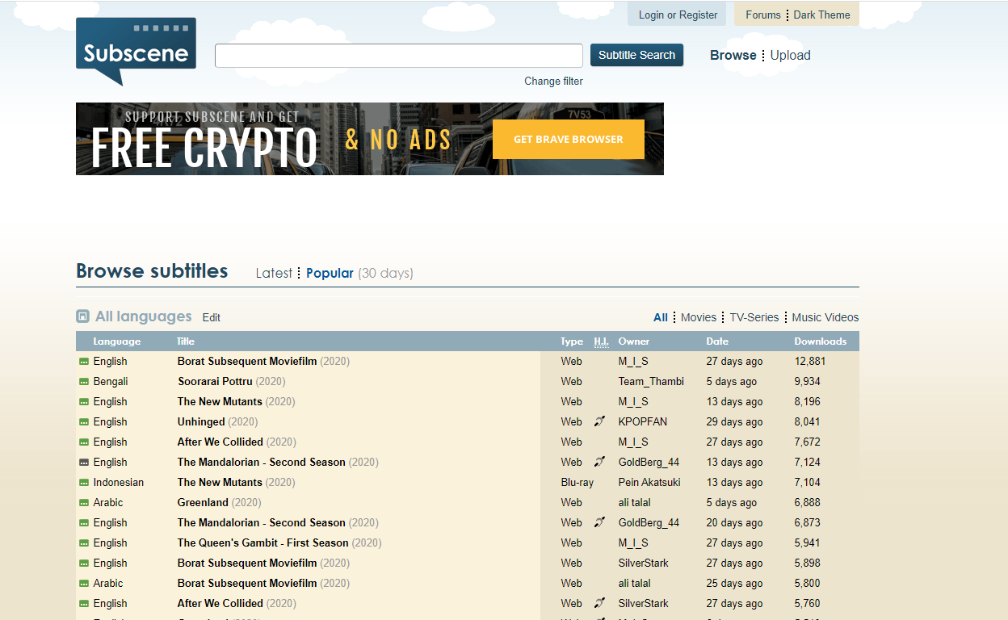

Slide 3
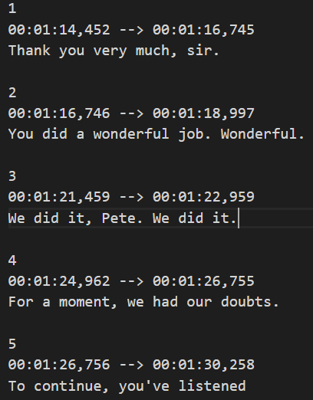
Srt files

Slide 4
Potential Objectives
Use Natural Language Processing (NLP) techniques to process movie and subtitles
Rate the movies based on profanity (swear words), violence, language complexity, etc
Determine the overall mood of the movie (happy, depressing, exciting, provocative etc.)
Build a model to predict the genre of the movie based on the word frequency
Generate a modified subtitle file and provide definitions and meanings of the most difficult words and remove the simple sentences
Obtain potential trends in the characteristics of Oscar best pictures winner over the years

Slide 5
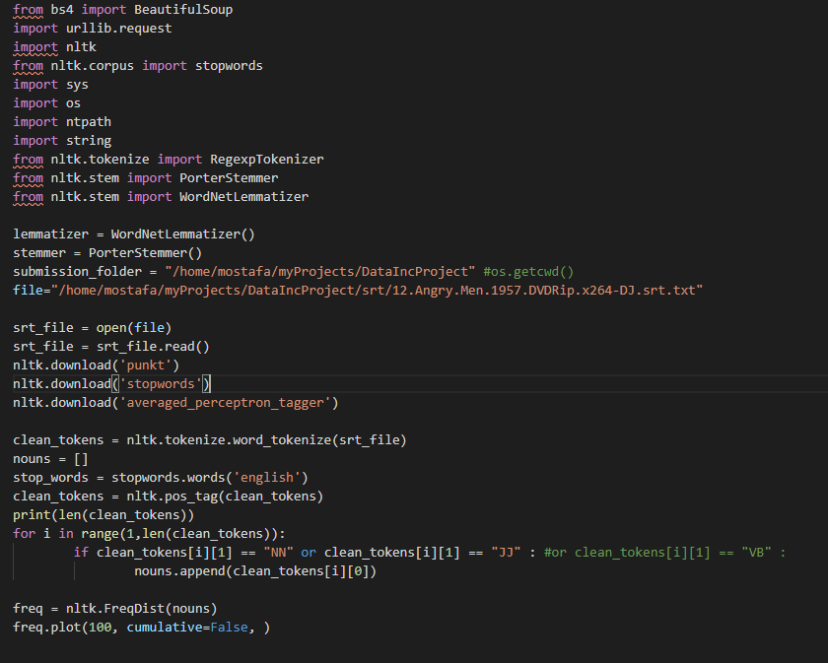
Natural Language Toolkit (NLTK)

Slide 6
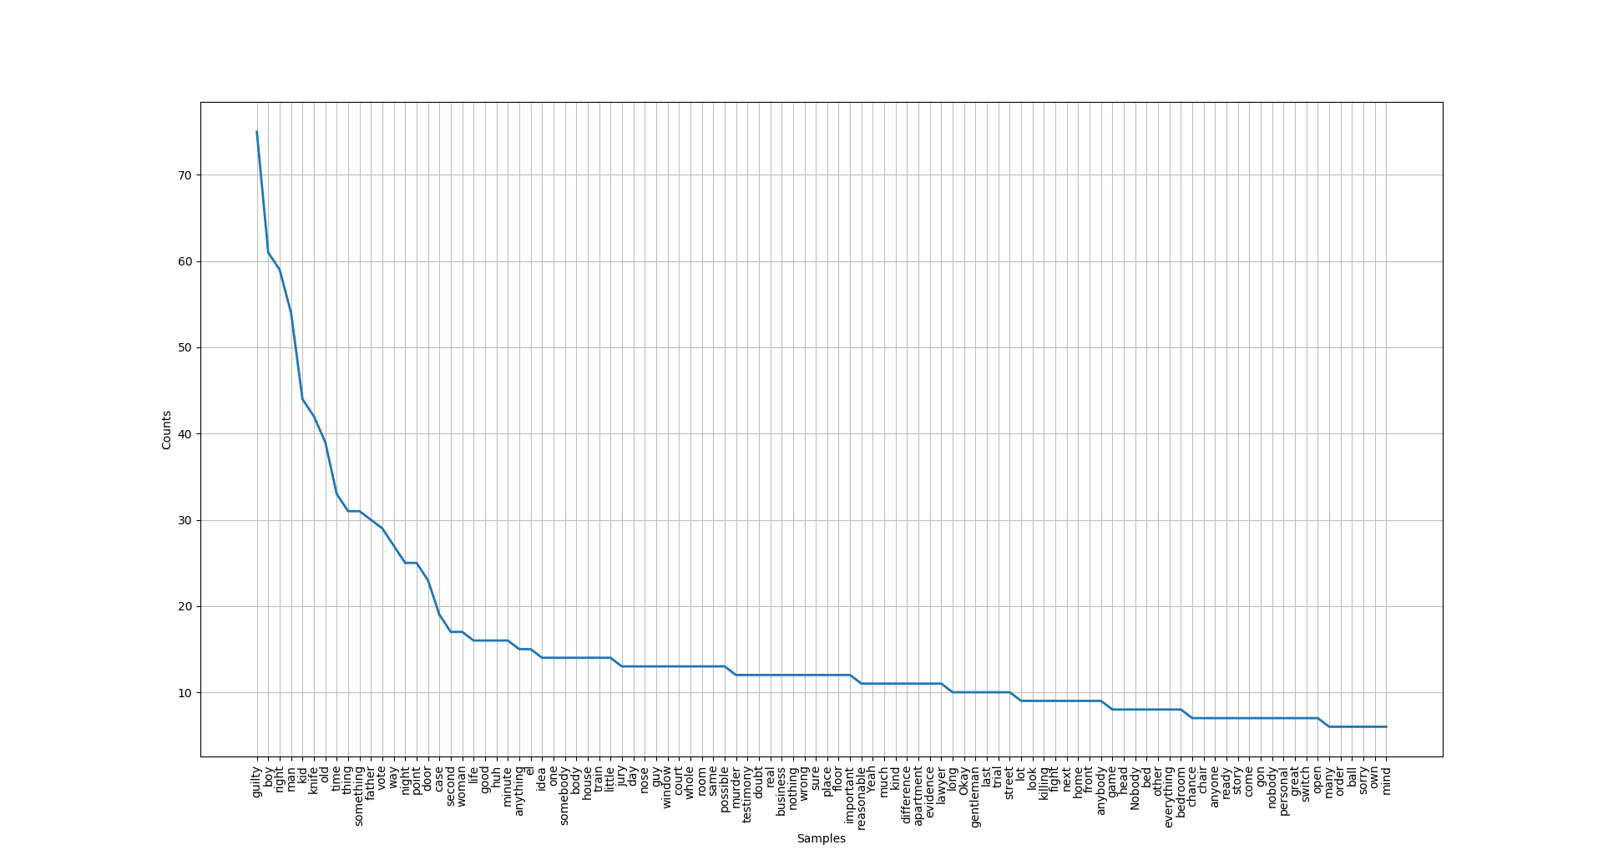
Word frequency (12 angry men)

Slide 7
Potential Business Values
Customer upload a srt file and obtain a quick overview of what they might experience
Parents can decide whether a movie is appropriate for their child
Language learners can upload a srt file and obtain a customized srt with highlighted difficult words and definitions

