Slide 1

Fast Point Feature Histogram
Mennatullah Siam

Slide 2

Agenda
1
3D Sensors
Object Representation
Shape Matching Taxonomy
Normal Estimation
Point Feature Histogram
Fast Point Feature Histogram
Applications
Problems
Potential Directions
Useful Tools & Libraries.

Slide 3
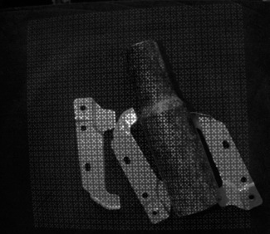
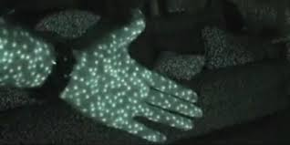
3D Sensors
1
Structured Light:
Old Kinect
PrimeSense

Slide 4
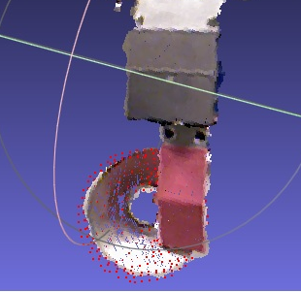
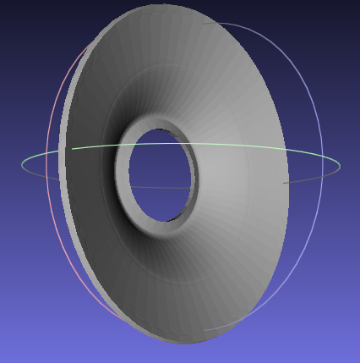
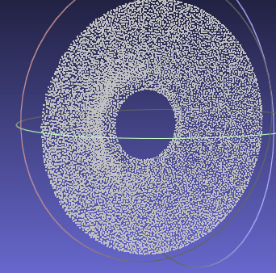
Object Representation
1
Point Clouds.
RGBD
CAD Models sampled to generate point-clouds.

Slide 5
Shape Matching Taxonomy
1
Shape Matching
Feature Based
Global Features
Local Features
Graph Based
Volumetric Error Based
Geometry Based
Model Graphs
Skeletons
Deformation Based
Less Computational Cost
Good in handling Occlusions
Better for arbitrary shape representation.

Slide 6
Good Point Feature
1
A “good” point feature representation capture the same local surface characteristics in the presence of:
3D Rigid transformations – that is, 3D rotations and 3D translations.
Varying sampling density
Noise.

Slide 7
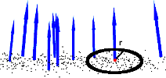
Normal Estimation
1
Least-square plane fitting estimation problem.
Normals computed by analyzing Eigen Values and Eigen Vectors of Covariance Matrix
Eigen Vectors = Principal Components (Orthogonal Frame).
Eigen Vector corresponding to smallest Eigen Value approximates the normal.
Oriented Normals (ambiguity).

Slide 8
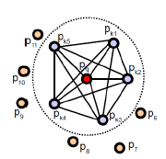
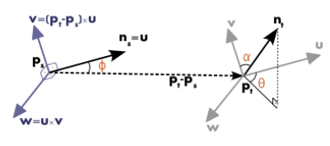
Point Feature Histogram
1
Get neighbors of key-point.
For each point pair, Compute Local Reference Frame UVW (Darboux Frame)
Notes:
Darboux frame (unit tangent, unit normal, unit tangent normal)
If arcos (ni, pji) < arcos (nj pij)
Ps =pi, pt =pj

Slide 9
Point Feature Histogram
1

Slide 10
Fast Point Feature Histogram
1
PFH Computational Complexity . O(nk² )
n : number of points
k: number of neighbours used
FPFH Computational Complexity . O(nk)
Caching and Ordering(reduced runtime by 75%).
Simplified Point Feature.

Slide 11

Fast Point Feature Histogram
1
Simplified Point Feature.
Foreach query point compute only relationships between itself and its neighbours.
Foreach point we re-determine its k neighbors and use the neighboring SPFH values to weight final histogram. (Wk is distance to query point)

Slide 12
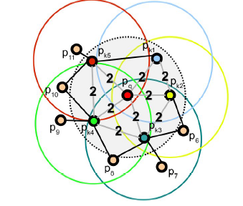
Fast Point Feature Histogram
1
FPFH VS PFH:
Missing Value Pairs (e.g: Pk5-Pk3)
Additional point pairs outside radius r, max 2r. (P11)

Slide 13
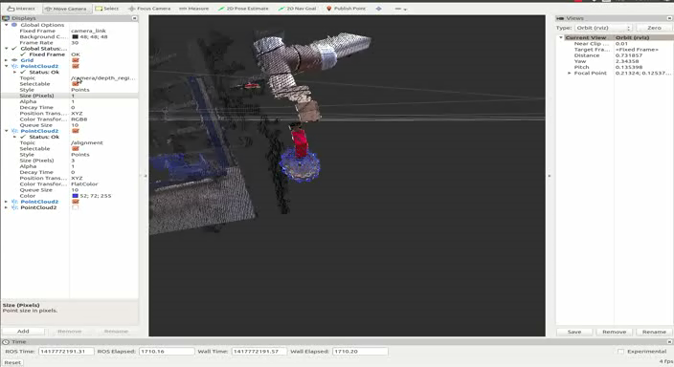
Applications
Notes:
3 seconds per frame
Machine Specs: 8 GB RAM, Intel Core 2 Quad 2.4 GHZ

Slide 14
Problems
1
Point descriptors describe locally, small radius will make it hard to discriminate self similar surface parts.
If you increase the radius, descriptor is more sensitive to missing parts and to clutter.
Increasing the radius will enhance the accuracy with some objects, but will increase the computational time as well.

Slide 15
Potential Directions
1
Multi Resolution Surfel Maps
Maintaining Topological Relations between matches.

Slide 16



Useful Tools & Libs
1
Meshlab

Slide 17
Thanks
1

