Slide 1

Convolutional neural networks (CNN)
Presented By: Mostafa Saad Ibrahim
PhD Student @ Simon Fraser University

Slide 2
Agenda
What?
CNN vs NN
LeNet 5
Winter...Wakeup
Deep Learning Boom
Images
Videos
Experimenting & Running

Slide 3
What?
CNN = Neural Network + Some New Layers
Mainly: Convolution layers
Let’s learn the features too
Helpers: Pooling, ReLu, Dropout
Applications where data = grid-like topology
E.g. Images / videos (2D grid)
History (LeNet5)
Y. LeCun, L. Bottou, Y. Bengio and P. Haffner: Gradient-Based Learning Applied to Document Recognition, Proceedings of the IEEE, 86(11):2278-2324, November 1998

Slide 4
CNN vs NN
Much less: Connections / Parameters
In NN, every connection is parameter
In CNN, We share parameters in sparse manner
Why matter? Think in Fully connected NN with input as an image
Huge Capacity => Need too much data
CNN: Better invariance to translations
CNN: Better consideration to input topolgy
Others: Easier Train, Comparabable performance...

Slide 5
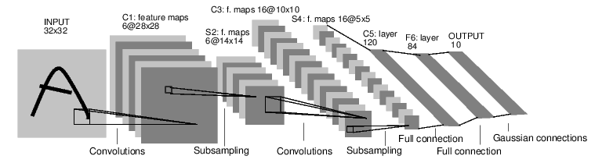
LeNet 5
MNIST: Input (28x28 images) – Output (0-9)
Convolutional Layers: C1, C3, C5 (kernel 5x5)
Sub-Sampling Layers: S2, S4 (2x2)
Full Network (NN Style): F6, Output
Notes:
Image Src: http://eblearn.sourceforge.net/lib/exe/lenet5.png

Slide 6
LeNet 5: Convoltional Layers
Several Feature maps..each unit is 5x5 kernel in previous layer (s).
Same kernel per feature map
Convolution Layer C1:
(5*5+1)*6=156 parameters
28*28*(5*5+1)*6=122,304 Connections
Layers C3 and C5 a bit diferrent in kernel connections
How many parameters if in NN?
Notes:
Image Src: http://eblearn.sourceforge.net/lib/exe/lenet5.png

Slide 7
LeNet 5: Sampling Layers
Sub-sample using 2x2 factor in the previous layer
Bias + Map Parameter * region average [2 Parameters per map]
Same parameter per a feature map
Sub-sampling Layer 2:
6*2=12 parameters
14*14*(2*2+1)*6=5880 Connections
How does Sub-sampling achives some shift and distortion invariance?
Notes:
Image Src: http://eblearn.sourceforge.net/lib/exe/lenet5.png

Slide 8
LeNet 5: Like-NN Layers
Layer F6 is fully connected with a 120 neruon from last layer and output nerouns
Learning: Similar to NN
Notes:
Image Src: http://eblearn.sourceforge.net/lib/exe/lenet5.png

Slide 9
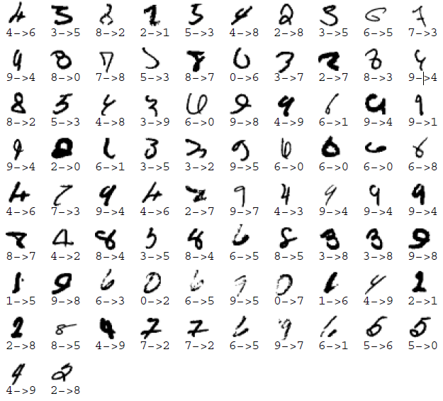
LeNet 5: MNIST Dataset
Character Recognition Data set
60,000 images (50,000 training / 10,000 testing)
Lenet5: 0.95% Test Error!
Enhance training set with 540,000 distortions examples
Lenet5: 0.80% Test Error!
82 Misclassified example

Slide 10

Winter...
Src: http://www.picgifs.com/clip-art/activities/sleeping/clip-art-sleeping-111411.jpg

Slide 11
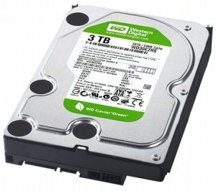
Then....large storges
Src: http://www.videomaker.com/sites/videomaker.com/files/styles/blog_post_primary/public/videonews/2010/10/wd_caviar_green_3tb_hdd-300x266_1.jpg?itok=4J8sXNxP

Slide 12
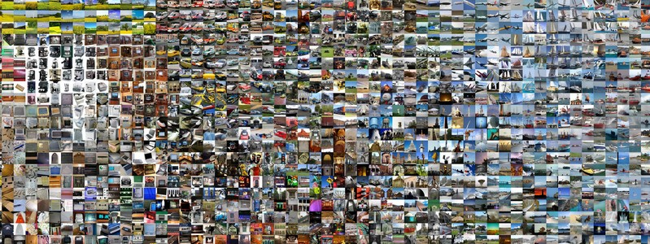
And....big datasets
Src: http://karpathy.github.io/assets/cnntsne.jpeg

Slide 13
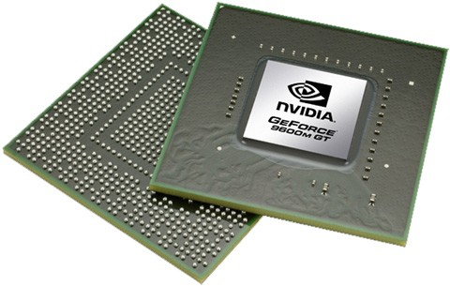
And....GPUs
Src: http://www.blogcdn.com/www.engadget.com/media/2008/07/7-25-08-nvidia_geforce_9m_9600m_gt.jpg

Slide 14
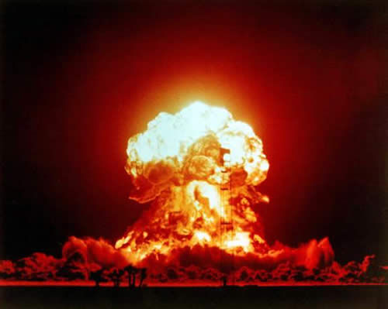
Deep Learning
Src: http://i3.kym-cdn.com/entries/icons/original/000/000/521/nuclear_explosion.jpg

Slide 15
Plus....some brilliant ideas
Better architectures?
Tackling over fitting?
Speeding processing?
Faster Activation function?
Powerful hardward
Faster parralized 2D convolution code
...

Slide 16
In Computer Vision: Images
Krizhevsky 2012, made a big jump in performance in image classification
Using Image net
ILSVRC-2010
Worked on ~ 1M images / 1K Category
Challenges
Overfitting? Dropout
Time Complexity? Relu / 2 GPUs / Faster Impl

Slide 17
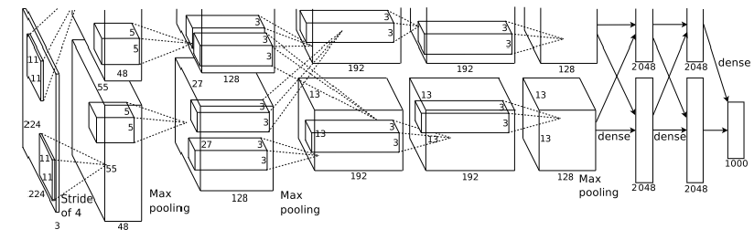
Krizhevsky Network
Many Layers
Major: 5 Convolution + 3 Fully Connected Layers
Others: 8 ReLu + 3 Max Pooling (sub-smapling) +2 Dropout + 1 Soft Max
2 GPUs

Slide 18
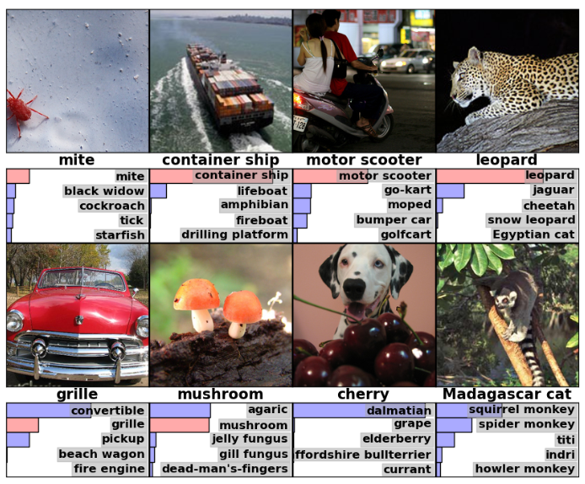
Krizhevsky Performance

Slide 19
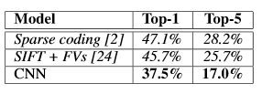
Krizhevsky Performance

Slide 20
In Computer Vision: Images
There are other work that tackled other problems
Girshick et al 2014: R-NN => Object Recognition

Slide 21
In Computer Vision: Videos
Temporal Dimension increases complexity
4 appraoches
Ignore this dimension: losing the motion information
Shuiwang Ji 2010: 3D Convolutional
Karpathy 2014: Join the 2 streams
Karen and Andrew 2014: two seperate stream convolutional + Late Fusion

Slide 22
Tricks - Concens
Tricks
Dropout
Rectified Linear Function max(0, sum)
Norm Constraint
Machine Specs: GPU / RAM
Resizing / Cropping Data
Normalizing Data

Slide 23
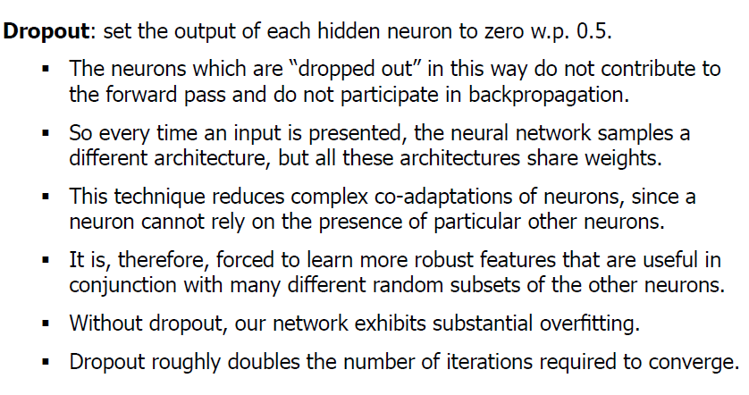
Avoid Overfitting: Dropout
Src: http://www.cs.cmu.edu/~aarti/Class/10701_Spring14/slides/DeepLearning.pdf

Slide 24
Raw input vs some processing
We mainly depend on Deep Learning to learn features for us
Then, normally give it raw data (e.g. Image pixels) and let it learn features
Sometimes, better to do little more work
E.g. In videos, instead of driect raw pixels, feed flow vectors from an optical flow algorithm

Slide 25
What if no much data?
Say we need to do video classification...but available videos are in termls 40 K videos?
We need really much data or the network complexity will be so large for data
Trick
Pre-train the network: E.g. Use image net dataset
Fine-tune netowrk: update weights for 40 K videos

Slide 26
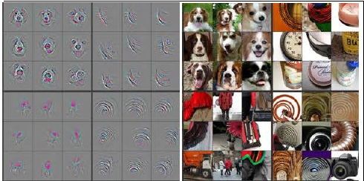
Visualizing CNN
Mattew and Rob 2014
Layer 4

Slide 27
Using Caffe
Different from other libraries in constructing network
You provide text file describing layers
So I won’t present code but configuration files.
3 steps
Convert Dataset format to leveldb
Parameters Configuration (e.g. LR, CPU/GPU?)
The layers architecture (text modelling)

Slide 28
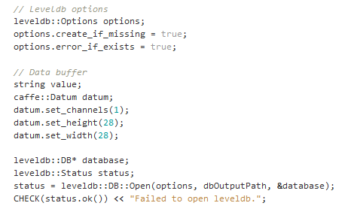
Using Caffe: Conversion
Define the DB

Slide 29
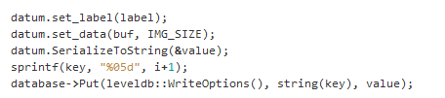
Using Caffe: Conversion
For each image, read and save

Slide 30
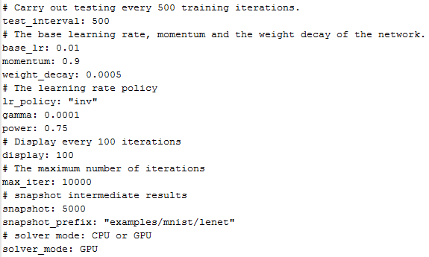
Using Caffe: Configuration

Slide 31
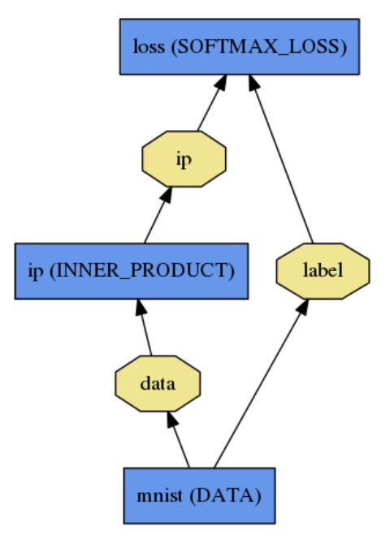
Using Caffe: Layers
Layer (loss)
Define ur network in text file
Blob (4d array)
(N, K, W, H)
Src: http://caffe.berkeleyvision.org/tutorial/fig/logreg.jpg

Slide 32
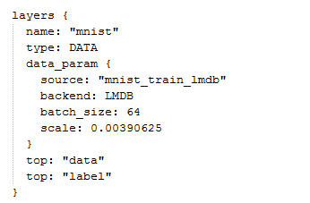
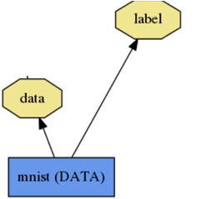
Using Caffe: Layers
We converted MIST images to leveldb
64 images per batch
1 / 255 = 0.0039

Slide 33
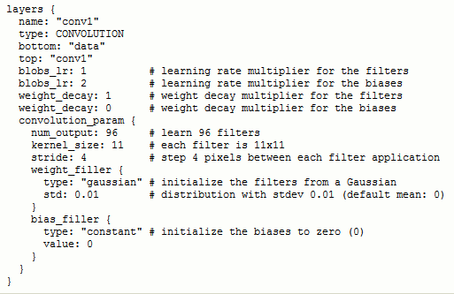
Using Caffe: Conv Layers Krizhevsky

Slide 34
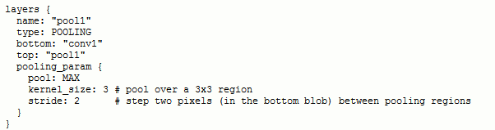
Using Caffe: Pooling Layer

Slide 35
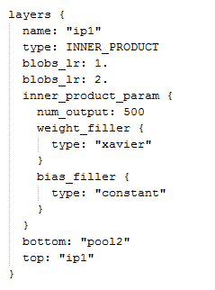
Using Caffe: Fully connected Layer

Slide 36
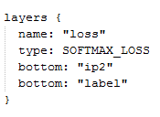
Using Caffe: Loss Layer

Slide 37
References
Krizhevsky et al 2012: ImageNet Classification with Deep Convolutional Neural Networks
Girshick et al 2014: Rich feature hierarchies for accurate object detection and semantic segmentation
Shuiwang Ji 2010 - 3D Convolutional Neural Networks for Human Action Recogniton
Karen and Andrew 2014 - two-stream-convolutional-networks-for-action-recognition-in-videos
Karpathy 2014: Large-scale Video Classification with Convolutional Neural Networks
Mattew and Rob 2014 - Visualizing and Understanding Convolutional Networks

Slide 38

Src: http://espei.com/wp-content/uploads/2013/05/equipmentprotection3.png

