Slide 1

Computer Vision Arabic Webinar Series Let’s share our knowledge: Vision, Machine Learning and Others
Object Tracking: Intro
Mostafa Saad Ibrahim
PhD Student @ Simon Fraser University

Slide 2
Acknowledgement
I have ~2 months experience in tracking
Info mentioned is not the big pictuer
Some info may be wrong due to little experience
However...I like to share ☺

Slide 3
Agenda
What is tracking? Challenges?
Notes on datasets
Inputs to tracking approach
Visual Features Tracking Approach
Some Background on features
Approach
Blob Tracking Approach
Terminologies
Approach
Kalman Filter Enhancement
State-of-the-art Algorithms

Slide 4
What is Video tracking?
Given a video, Identify moving object (s).
Video = Much data => Time Consuming Process
May depend on other challenging problems (e.g. Object Recognition)
Applications:
Surveillance, traffic control, players tracking...

Slide 5
Tracking Challenges & Concerns
Is it Stationary Camera (no moving)? Or not
Occlusions? Disappearing for a while?
Any moving objects? Or specific category (e.g. Persons)?
Object speed relative to frame rate
Fixed object’s orientation?

Slide 6
Datasets Challenges
Annotating 1 video is time consuming process
A 120 sec video with 20 fps = 2400 image!
Shortage in annotations.
Typically 1 object of interst is annotated. High shortage for annotating multiple objects
Unorganized (Google for papers data).
Good collection link (77 from literature)

Slide 7
Input nature
Given video: Identify moving objects and track them.
Many algorithms will work for stationary camera
Given video + Shape (e.g. bounding box, circle..): keep tracking this particular shape.
Example: Watch seconds from this video.
Algorithms may work too in non-Stationary Camera

Slide 8
Visual features tracking
A Visual feature: Some special patches in an image
Patch: (e.g. Pixel (20, 34), radius = 1.5, angle 60)
Special? e.g. For scale, rotation, etc.
Feature Detector: Detect special features.
Feature Descriptor: Describe feature (e.g. In vector of 128 real number).

Slide 9
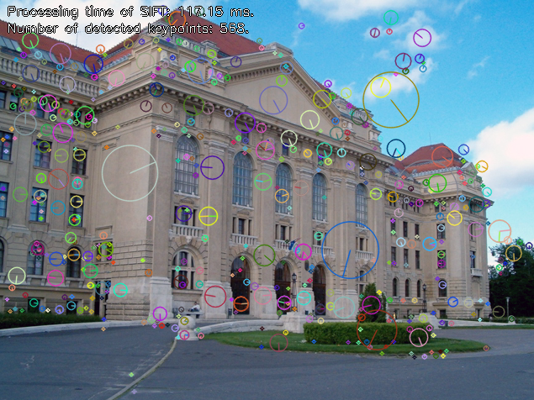
Background: SIFT Points
Notes:
Source: http://huro-sift.googlecode.com/svn/trunk/ScreenShoots/sift.png

Slide 10
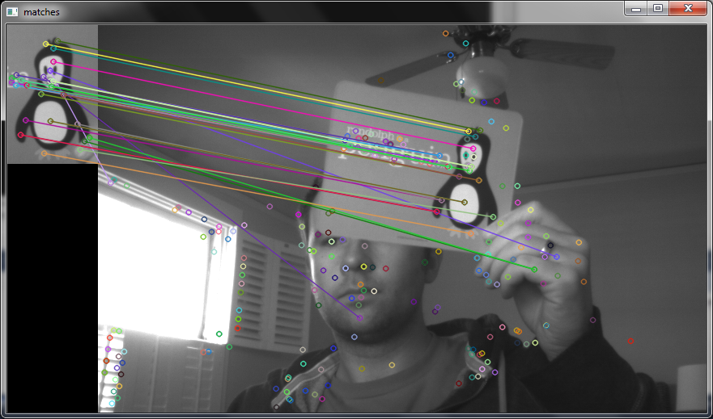
Background: Scene Matching
Notes:
https://chrisjmccormick.files.wordpress.com/2013/01/siftmatching.png

Slide 11
Visual features tracking
Scenarios
Either given a bounding box to track it.
Classifier to do initial object detection to track
None..use features to guess objects locations
Approach
Detect “good” features in this box
Track from frame to another using optical flow

Slide 12
Blob Tracking Approach
Terminologies:
Track
Observations
Observations to Track assignments
Background Subtraction

Slide 13
Terminologies
Track
Each detected object may appear in several frames
These locations represent its track
Statsitcs:
Age, total visbility, consecutive disappearance
Observations
Typically some algorithm will guess/observe some objects in the new frame.

Slide 14
Terminologies
Observations to Track assignments (Data association)
Each track has the location of last frame
We have many observed locations
For each track, which observation (location) is the next for this track?
Bipartite graph (tracks locations, observations)
Define cost function (e.g. Eculidan over centroid)
Solve Assignment problem (e.g. Using Munkres)

Slide 15
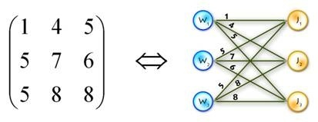
Observations to Track assignments
Let left be centroids of current objects
Let right be centroids of guessed new objects
Define cost function - Build matrix
Solve the assignment problem.
Tracks size != New Detected Objects
Source: http://qph.is.quoracdn.net/main-qimg-8558c1b524332fc661dec74c96315f91?convert_to_webp=true
Notes:
Source: http://qph.is.quoracdn.net/main-qimg-8558c1b524332fc661dec74c96315f91?convert_to_webp=true

Slide 16
Observations to Track assignments
Concerns: If we have O x T matrix
O < T
Some tracks won’t be matched
When should we remove them?
May object appear again in future?
O > T
Some new locations won’t be matched
Purely new objects = Create new tracks (intial position is the observation location) for them

Slide 17
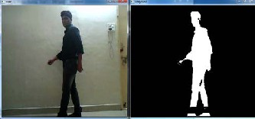
Background Subtraction = Foreground Detection
Challenging in images, easier in Vidoes (Stationary)
Video intution: Same pixels in consective frames.
Notes:
Source: http://www.ijser.org/paper/REAL-TIME-ABANDONED-BAG-DETECTION-USING-OPENCV/Image_015.jpg

Slide 18
Blob Tracking Approach
Do background Subtraction
Using the binary image
Find all connected componenes
Compute bounding box and centroid
Filter any tiny boxes
Assign the tracks to boxes

Slide 19
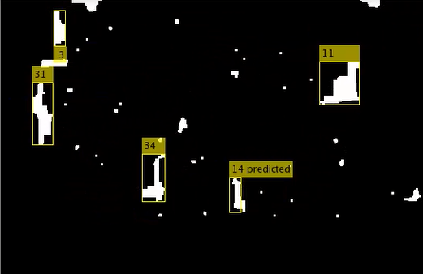
Results Example: 4 persons observed ... 1 perdicted

Slide 20
Blob + Kalman For predcition
Think for a while, if car is moving, then entered a tunnel for 3 seconds and went out.
The blob will consider 2 cars, one before enter tunnel..and one went out
We need some algorithm to “predict” the object location when it is invisible.
It may actually disappear forever
Or may comeback and better recognize that

Slide 21
Kalman Filter
Simple Article
Estimation Theory..Practical..Many Apps
“Theoretically, a Kalman filter is an estimator for what is called the linear quadratic Gaussian (LQG) problem, which is the problem of estimating the instantaneous “state” of a linear dynamic system perturbed by Gaussian white noise, by using measurements linearly related to the state, but corrupted by Gaussian white noise. The resulting estimator is statistically optimal with respect to any quadratic function of estimation error. R. E. Kalman introduced the “filter” in 1960 (Kalman 1960).”
Notes:
Source of above statement:
http://link.springer.com/referenceworkentry/10.1007%2F978-3-642-04898-2_321

Slide 22
Kalman Filter
It tries to model the moving object (linearly)
Object has state (e.g., position, velocity for a car)
Covariance matrix (between state elements)
Controls that affect object (braking force)
State transition matrix, control matrix, noise
We have some measurement source to correct kalman model.
E.g. Some devise estimating the state
2 extensions to introduce non-linearity

Slide 23
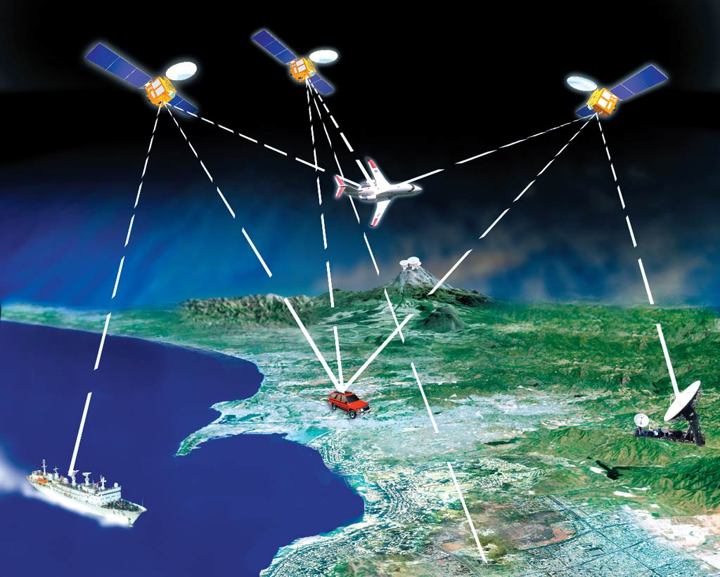
Kalman Filter Example
We have a moving Car
3 Satllites together try to guess location
Measurement will be noisy
Signal may be lost too (short vs long period)!
We need Predicator to esimate better
Notes:
http://cdn.fieldtechnologies.com/wp-content/uploads/2012/01/gps-satellite-tracking-system.jpg

Slide 24
Kalman Filter Example
Algo:
Predict Step: Using Linear model, estimate state
Correct Step: use measurement to correct estimation
Notes:
http://cdn.fieldtechnologies.com/wp-content/uploads/2012/01/gps-satellite-tracking-system.jpg

Slide 25
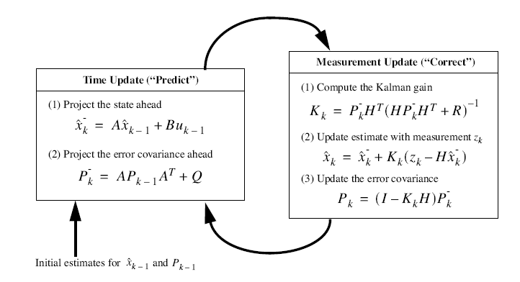
Kalman Filter Algorithm
Notes:
https://www.calvin.edu/~pribeiro/courses/engr315/samples/GPS%20Navigation%20with%20Kalman%20Filter%20Integration.ppt

Slide 26
Kalman Filter Implementation
The algorithm is set of linear and simple steps
Matlab / OpenCV provide this framework
The real Challegnge:
Understand motion equations.
Define the matrices correctly.
In practice:
We may do assumptions (e.g. No relation between state elements, Covariance = 0) for easy impl.

Slide 27
Blob + Kalman For predcition
We use Kalman as helper when object don’t appear in this frame (leave/disappear/noise)
Use blobs to find observations...do assignments
If track was matched, use observation location. Inform Klaman model (correct step)
If track was not matched, use Kalman Prediction
If we exceeded threshold of not matching...remove object
Blob Tracking + Kalman Source Code
Kalman could be used as major algorithm

Slide 28
More
Particle filter tracking: a hypothetical tracker, that approximates the filtered posterior distribution by a set of weighted particles.
It weighs particles based on a likelihood score and then propagates these particles according to a motion model.
Handle highly nonlinear and non-Gaussian models in Bayesian Filtering
Slow in computations

Slide 29
State-of-the art
It is hard to list all yet!
CCV Library has C++ implementation to one of state-of-the-art algorithms
TLD (a.k.a. “Predator” algorithm) in C.
Given window => Track it for a moving camera.

Slide 30
تم بحمد الله
علمكم الله ما ينفعكم
ونفعكم بما تعلمتم
وزادكم علماً

