Slide 2
Table of contents
I. Introduction to the problem and our goal
II. Data exploration
III. Data pre-processing
IV. Approaches
V. Feature Engineering

Slide 3
Introduction
New users on Airbnb can book a place to stay in 34,000+ cities across 190+ countries. By accurately predicting where a new user will book their first travel experience, Airbnb can share more personalized content with their community, decrease the average time to first booking, and better forecast demand.
The challenge is to predict in which country a new user will make his or her first booking.
Data available: test_users.csv and train_users.csv : contains basic information and destination of past users. Sessions.csv : contains additional web log informations generated when user use Airbnb website.

Slide 4
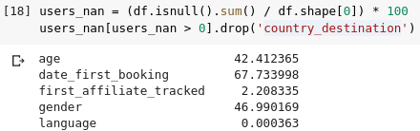
Data exploration
Check for NULL values in features
We have quite a lot of NaN in the age and gender wich will yield in lesser performance of the classifiers we will build. The feature date_first_booking has a 67% of NaN values because this feature is not present at the tests users, and therefore, we won't need it at the modeling part.

Slide 5
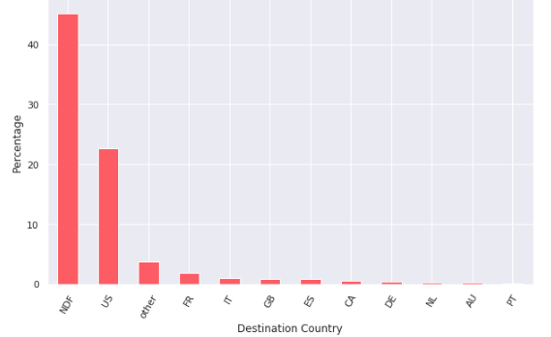
Distribution of data over destination country(target variable):
It’s obvious that dataset is heavily unbalanced

Slide 6
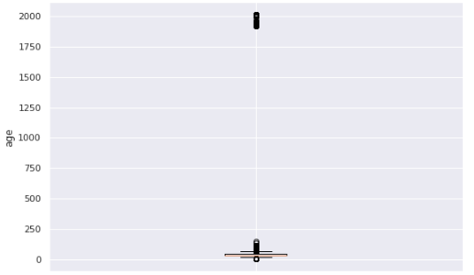
Outliers in numerical variables:
Here is a boxplot of the age variable showing that there are some outliers far away from the logical age interval.

Slide 7
Data pre-processing
Processing date columns. For date columns (date_account_created, date_first_active) we separate them to new columns that express meaningful time values ​​like days of the week, month, and day of the month. we do that as these new columns should reflect specific habits or user behavior in specific times at the week or month.

Slide 8
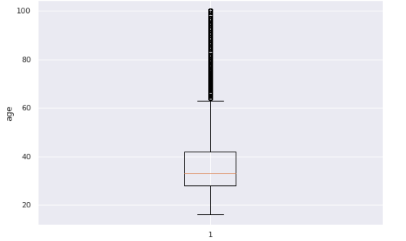
Handling outliers. We remove age values that are greater than 100 or less than 16
Here is a boxplot showing age distribution after removing outliers

Slide 9
Missing values.
For numerical variables, we fill any missing value with the mean of it's variable. and for categorical variables, we fill it with the most frequent category.
another technique could be used with numerical columns, is to predict those missing values of the variable using other variables that are highly correlated with it.
So we draw a heatmap showing correlation of the variables with each other.

Slide 10
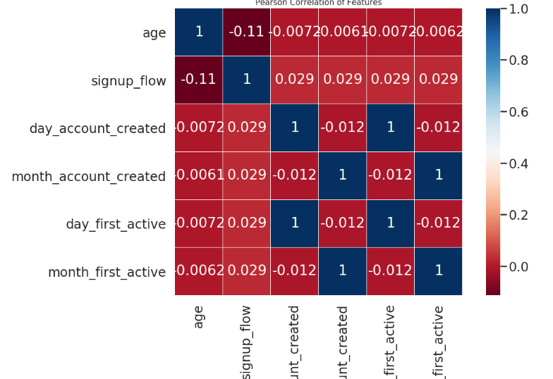

Slide 11
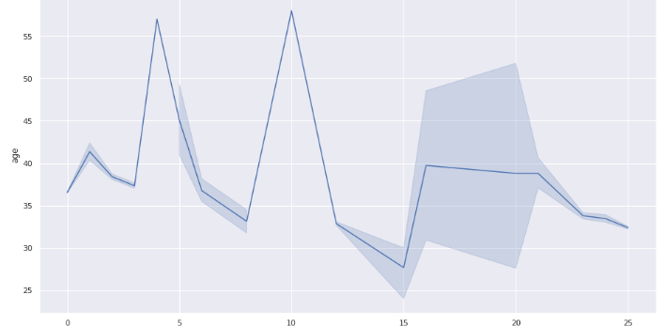
The heatmap showed that ‘signup_flow’ is the most correlated variable to ‘age’.
drawing the relation between ‘signup_flow’ and ’age’.
It’s showing a non-linear relation that can be captured by a decision tree or random forest regressor.

Slide 12
Handling Imbalanced Data.
imbalanced data may lead to unstable training and low score when dealing with scoring metrics such as precision, recall or NDCG.
we can handle this issue with either under-sampling to the most represented classes or oversampling to the least ones.
- under-sampling could be done randomly by removing random samples, or using algorithms like Tomek links or Cluster Centroids.
- oversampling could be done by repeating minority class samples or using an algorithm like SMOTE
As we saw earlier that our data is imbalanced, So, I have used Tomeklinks to under-sample majority classes: 'NDF', 'US'. and SMOTE to oversample minority classes

Slide 13
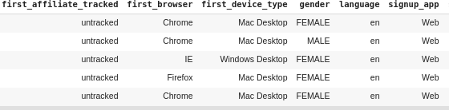
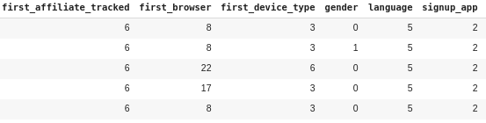
Convert categories to numbers
The next step is to convert all categories variables to numerical values so we can input to our models

Slide 14
Approaches
I ‘ve implemented three approaches to solve this problem
XGBoost
Random forest classifier
Neural network
XGBoost:
XGBoost is a decision-tree-based ensemble Machine Learning algorithm that uses a gradient boosting framework.

Slide 15
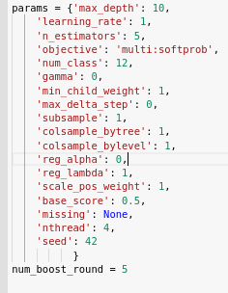

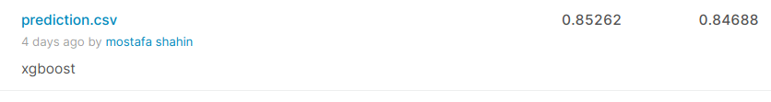
I've implemented an XGBoost model with
these hyperparameters.
It got NDCG score = 0.837 on training data
And got NDCG = 0.852 on kaggle submission

Slide 16

Random forest classifier
I've implemented an rf classifier with 100 trees.
split training data into two sets, training and validation. to test model performance during implementation
it did well on training-data, but it's not the case for validation-data.

Slide 17


then I set 'minimum samples per leaf' to 3
validation score had slightly increased.
Kaggle submision NDCG = 0.851

