Slide 1
Population Genetic Project (BINP29) The Z curve method By: Mostafa Torbati

Slide 2
Introduction
GC content → Algebraic method (2D)
Z curve → Geometrical method(3D)

Slide 3
Z curve approach
puRine | R = A, G | aMino | M = A, C | Weak hydrogen bonds | W = A, T
pYrimidine | Y = C, T | Keto | K = G, T | Strong hydrogen bonds | S = G, C
Xn = (An+Gn) - (Cn+Tn)
Yn = (An+Cn) - (Gn+Tn)
Zn = (An+Tn) - (Cn+Gn)

Slide 4
Methodology
Length of sequence = 40
Window size = 20
Step = 20
Xn = (An+Gn) - (Cn+Tn)
Yn = (An+Cn) - (Gn+Tn)
Zn = (An+Tn) - (Cn+Gn)
>Seq1
ATGCATTTTTCCGCTTGTCTTCCTGAGCCGACTCCCTATA
X1 = (2+3) – (5+10) = -10
Y1 = (2+5) – (3+10) = -6
Z1 = (2+10) – (5+3) = 4
X2 = (4+3) – (8+5) = -6
Y2 = (4+8) – (3+5) = 4
Z2 = (4+5) – (8+3) = -2
Node1
Node2

Slide 5
The Z curve has been extremely used in:
Identify protein coding genes
ab initio gene prediction
Isochore identification
Phylogenetic tree
Genome visualization
Comparative genomics

Slide 6
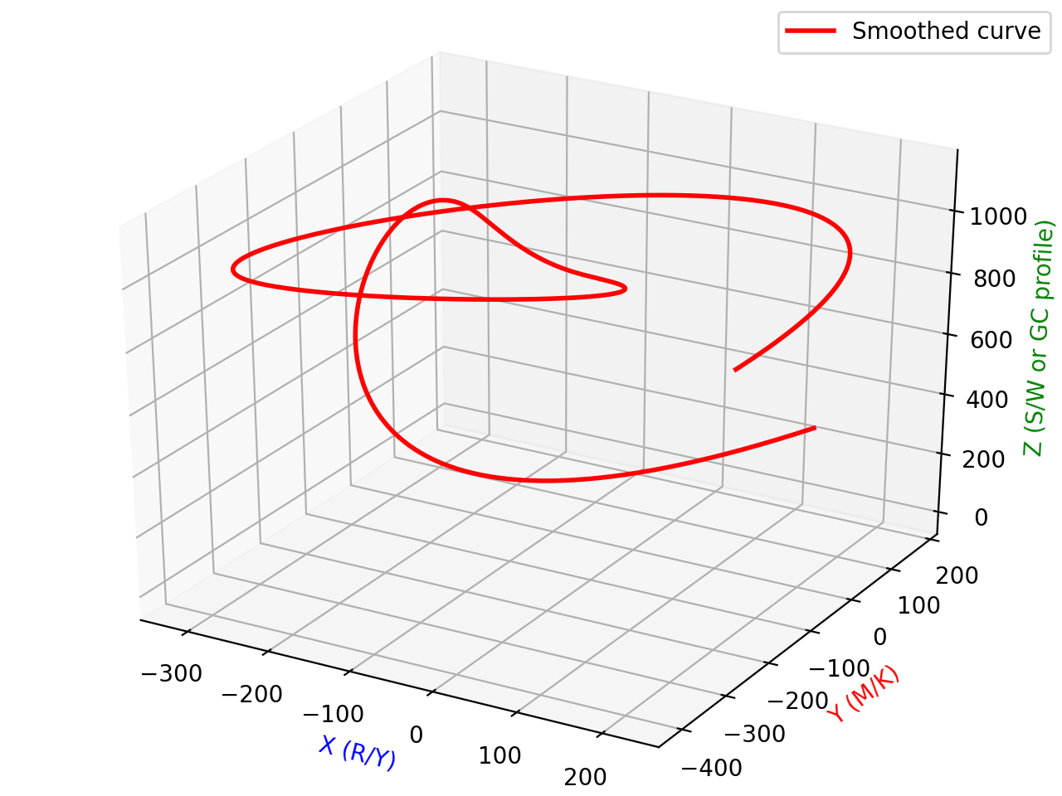

COVID-19
Length = 30277
WinSize = 4000
Step = 4000
SARS-CoV-2
Length = 30332
WinSize = 4000
Step = 4000

Slide 7
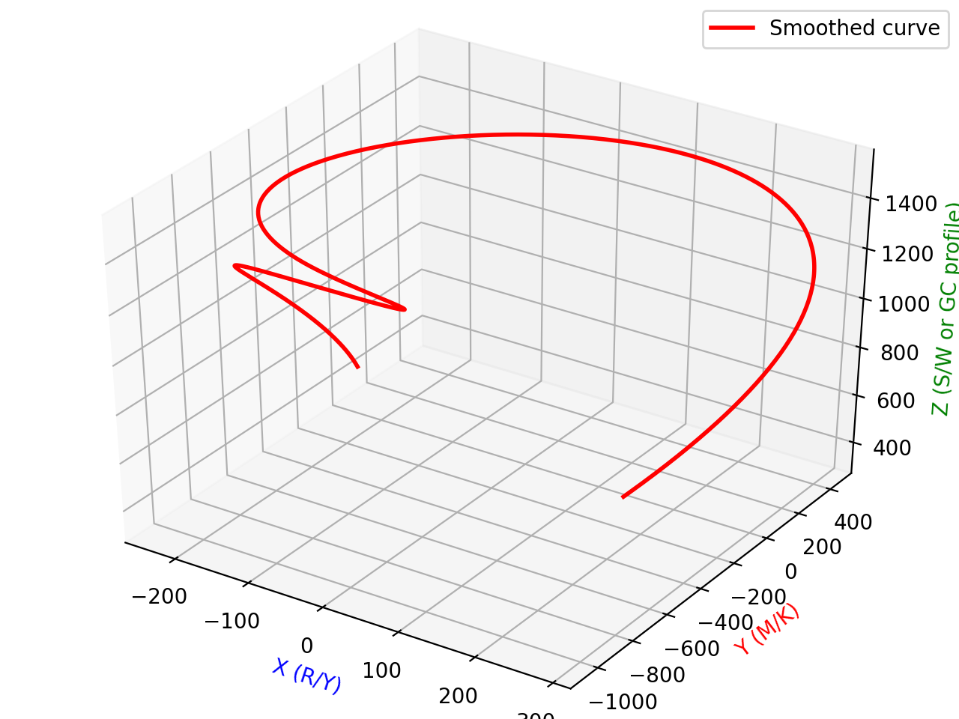
BCoV
Length = 31473
WinSize = 4000
Step = 4000

Slide 8
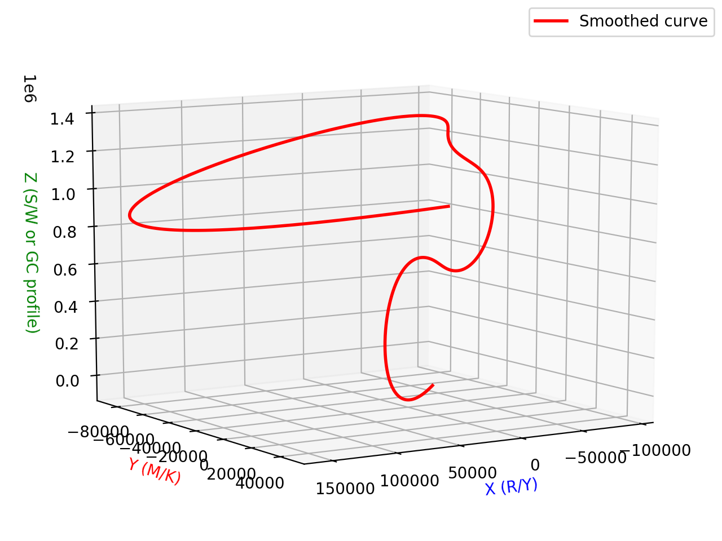
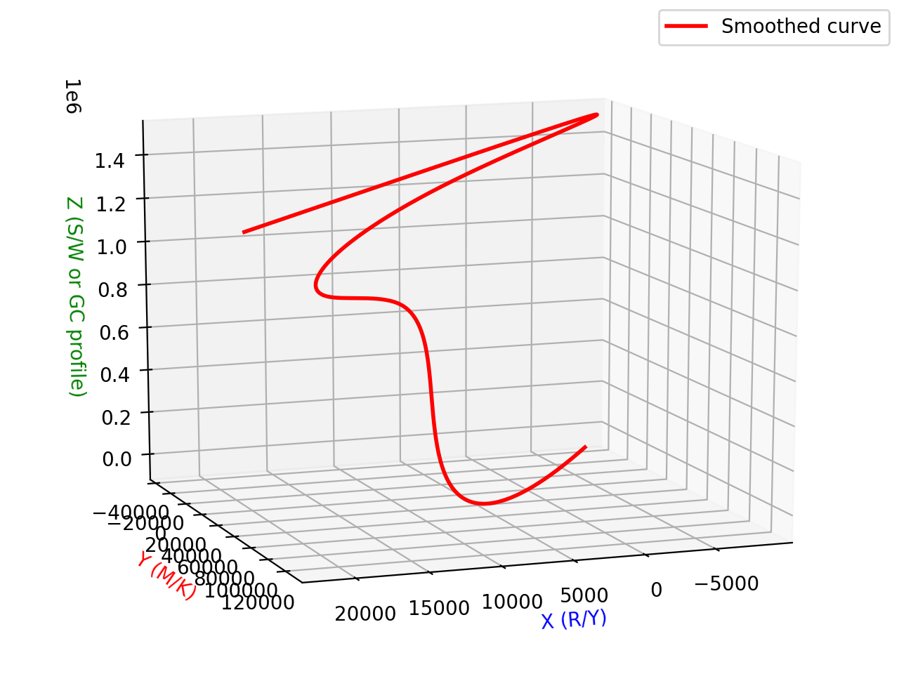
Human chr21
GC% 42.2
Chimpanzee chr21
GC% 41.01

Slide 9
Summary:
Studies of genome domain structures.
Identification of promotores and translational sites.
Visualization of genomes three-dimentionally.
Looking through all the information that the corresponding DNA sequence caries.

Slide 10

Thank you!

