Slide 1

MACHINE LEARNING / PROJECT 09
Customer Segmentation
using Machine Learning
Understanding customer behavior through data
I analyzed credit-card usage patterns, built customer segments, and tested whether those labels could be reproduced by supervised models.
MOSTAFA MOHAMED
Customer behavior · Clustering · Classification
CC GENERAL.csv
MOSTAFA MOHAMED / MACHINE LEARNING PROJECT
1

Slide 2
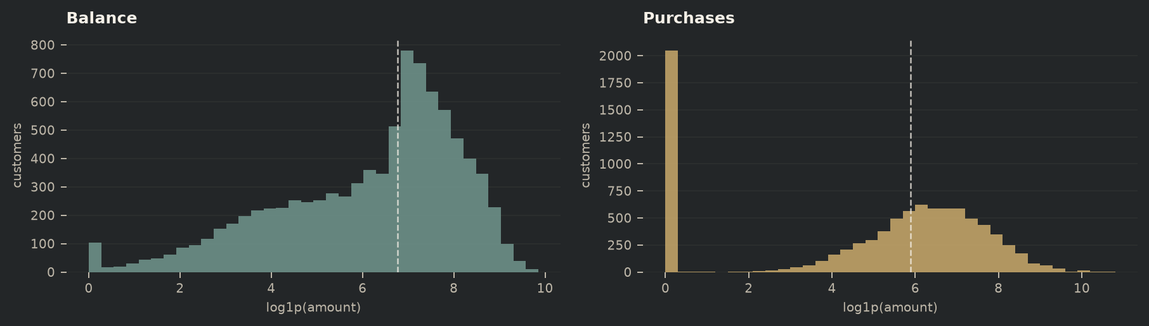
01 / DATA
02 / 05
Understanding the Customer Data
Each row is one credit-card customer. The 17 usable variables capture balances, purchases, cash advances, payments, credit limits, transaction frequency, and account tenure.
PREPROCESSING
median imputation → standardization → CUST_ID removed
8,950
18
17
CUSTOMERS
COLUMNS IN SOURCE
MODEL FEATURES
FEATURE GROUPS
spending · cash access · payments · credit capacity · frequency
Missingness is concentrated in MINIMUM_PAYMENTS (313) plus one CREDIT_LIMIT value — 314 cells in total.
The segmentation model uses numeric behavior only; the customer identifier is never treated as a signal.
What the raw data says
Monetary variables are long-tailed: median purchases are $361, while the mean is $1,003. The chart uses log1p only to make that spread readable.
MOSTAFA MOHAMED / MACHINE LEARNING PROJECT
2

Slide 3
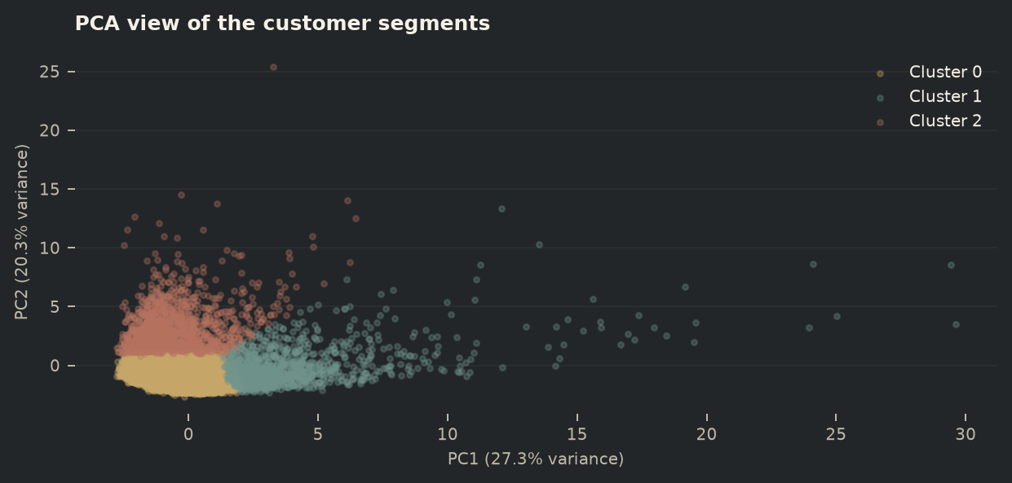
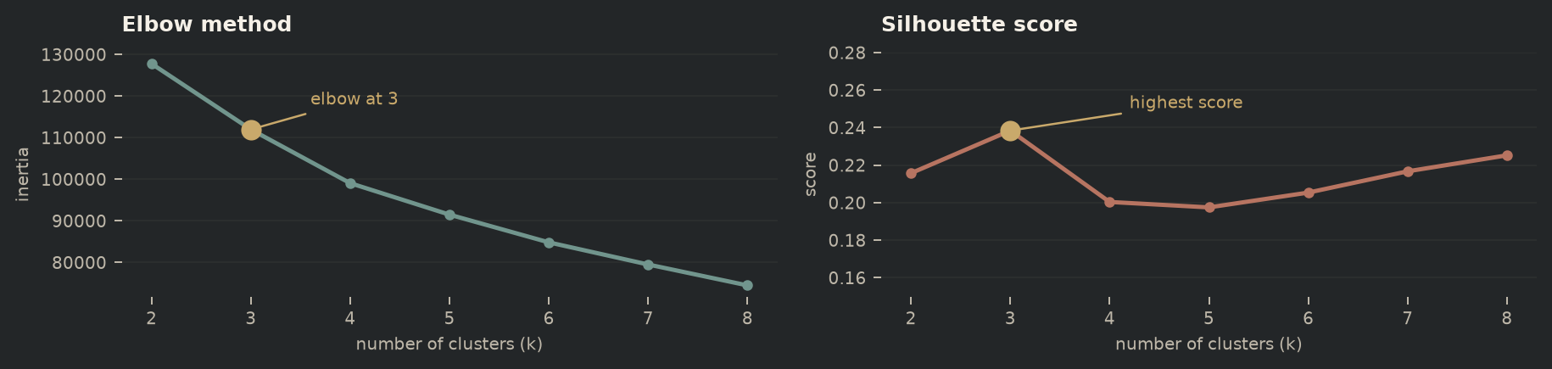
02 / UNSUPERVISED LEARNING
03 / 05
Customer Segmentation with K-Means
The evidence points to three usable segments.
The elbow bends at k = 3, and the silhouette score is highest there (0.238 on a 2,000-customer sample). I kept the simpler three-cluster solution rather than adding small, less stable groups.
SELECTED K · 3 CLUSTERS
PCA is used here as a visual summary, not as the clustering input.
68.4% lower-activity · 13.8% purchase-active · 17.8% cash-advance dominant
MOSTAFA MOHAMED / MACHINE LEARNING PROJECT
3

Slide 4
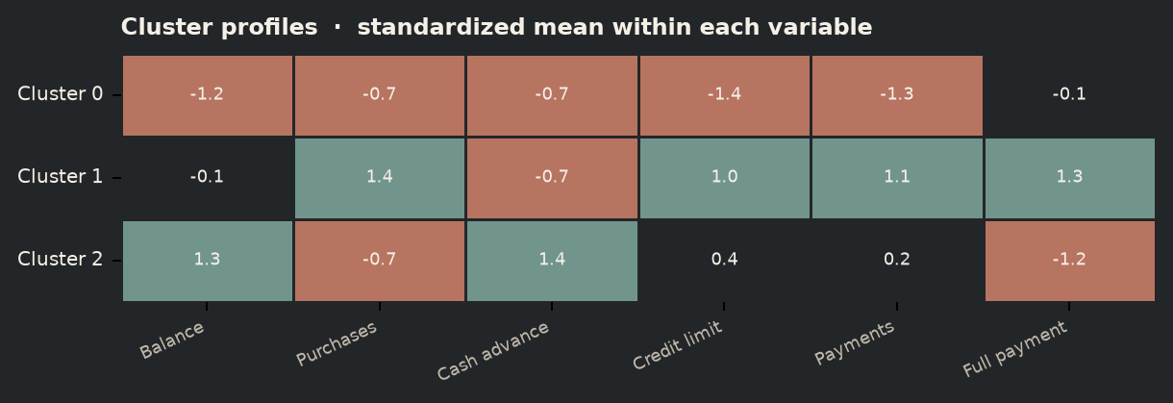
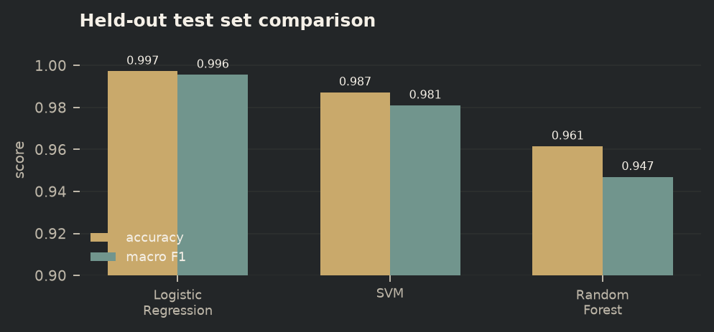
03 / INTERPRETATION
04 / 05
Customer Segments & Model Comparison
Three behavioral profiles
Supervised follow-up
I reused the cluster labels as targets, then compared three classifiers on a stratified 20% hold-out set.
0 / Lower activity
avg purchases $506 · avg balance $800 · 68.4% of customers
1 / Purchase-active
avg purchases $4,269 · 56 transactions · avg credit $7,734
2 / Balance + cash advance
avg cash advance $3,866 · avg balance $3,989 · low purchase frequency
BEST MODEL · LOGISTIC REGRESSION
GridSearchCV selected C = 10 → 99.78% test accuracy
The high score means the classifier can reproduce these assigned labels; it is not, by itself, proof that the original clusters are meaningful.
MOSTAFA MOHAMED / MACHINE LEARNING PROJECT
4

Slide 5

04 / CONCLUSION
05 / 05
Results & Key Takeaways
What I learned from the segmentation
CONNECT WITH ME
01
The customer base is not uniform: a large lower-activity group sits alongside smaller, clearly different usage profiles.
Mostafa Mohamed
02
Purchase-active customers combine high purchase frequency, transaction count, credit limits, and payments.
Machine Learning Project
03
The cash-advance group stands out through high balances and cash advances but low purchase activity and full-payment behavior.
04
Logistic Regression was the strongest classifier here, but cluster quality still needs unsupervised evidence such as silhouette and PCA separation.
DATA → PREPROCESSING → K-MEANS → ELBOW / SILHOUETTE → PCA
→ INTERPRETATION → CLASSIFICATION → COMPARISON → GRIDSEARCHCV
linkedin.com/in/mostafa-elsharkawi-30023b357
MOSTAFA MOHAMED / MACHINE LEARNING PROJECT
5

