Slide 1
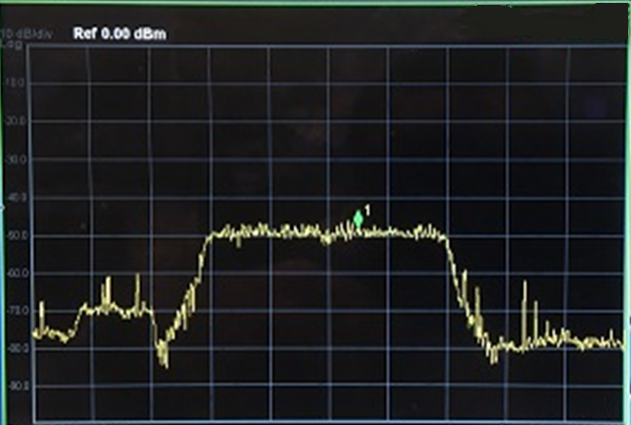
Mkr1 2.401 81 GHz
-48.529 dBm

Slide 2
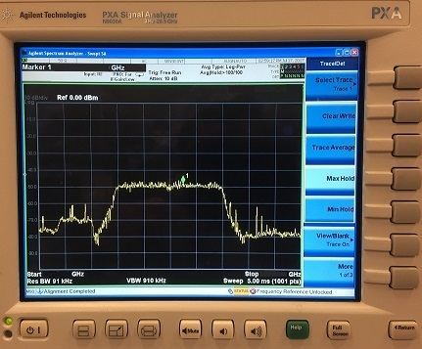
2.400620000000
Mkr1 2.400 62 GHz
-48.529 dBm
2.393750
2.406250

