Slide 1
LEXICAL ANALYSIS
Simple Python Lexir
Using (RE) library

Slide 2
OUTLINE (structure )
Defining our grammar :
Regular Expression for Identifiers , Numbers , Keywords … etc.
Read the file containing the Code :
Reads a file into an Array Line by Line .
Parsing the lines into tokens :
Cuts a Line into series of tokens following a defined pattern .
Matching the tokens with our ER , language grammar :
Matching the token to know its type .
Creating a dictionary with each token and type :
Assigning a type to each token .

Slide 3
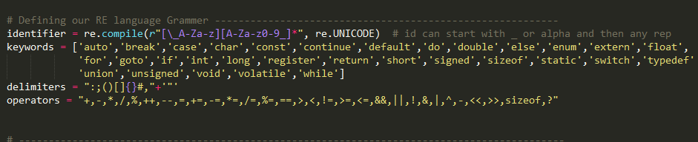
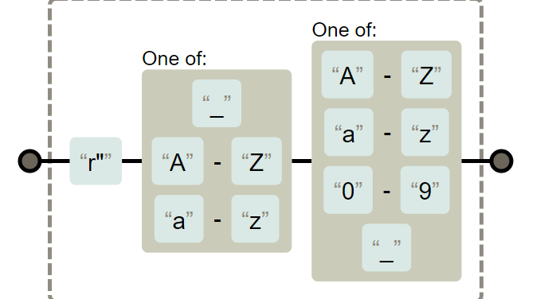
Defining our grammar
1’st
Specify our Keywords , Delimiters , Operators Using array of strings
Specify our Identifiers Regular expression by :

Slide 4
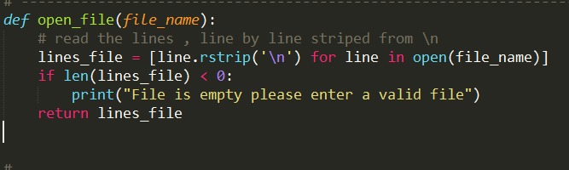
Read the file containing the Code
2nd

Slide 5
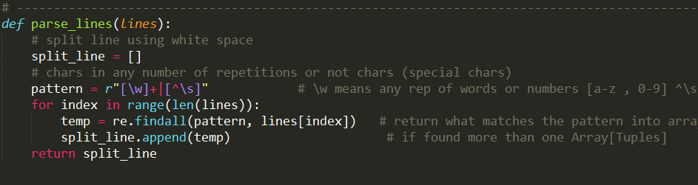
Parsing the lines into tokens
3rd
Creating a pattern for every token in the line using the regular expression :
\w == > pick every character [a-zA-Z0-9_]
\s == > all white spaces and taps [\t\n\r\f\v]
^\s == > all other tokens avoiding taps and spaces
After all using the find all re function to pick the token according to the pattern

Slide 6
Matching the tokens with our ER , language grammar
4th
CODE editor

Slide 7
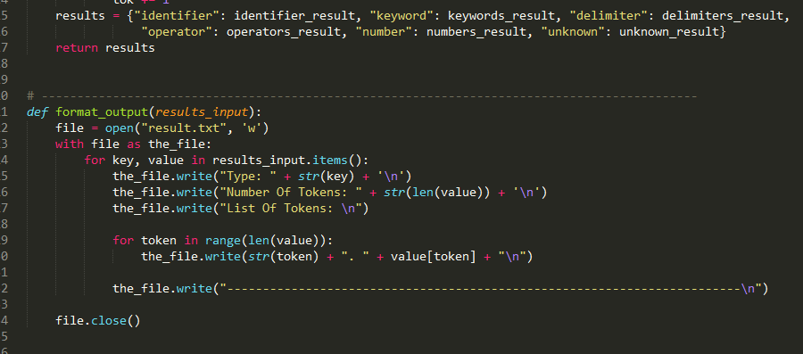
Creating a dictionary with each token and type :
5th
Creating a dictionary holding the type as a key and the token it self as a value

Slide 8
Team Members :
Walid Mohamde Maher ElSoby.
Aly Mohamed Mohamed Badr.
Islam Mohamed Amar.
Mohammed Abdel-El Menaem Elaskary.
Mostafa Alaa Elkholy.
THANK YOU

