Slide 1
BookShop app

Slide 2
Team members :-
1-محمود محمد حامد
2-مصطفي اشرف مأمون
3- مصطفي علي محمد علي
4- مصطفي مرسي اسماعيل

Slide 3
introduction
- The project “BookShop” is developed in Java language and android. Which mainly focuses on viewing books information and buying it.

Slide 4
System overview
Online Shopping.
Checking books details is very easy .
Buy new book is very easy .
Deleting books from cart before buying is simple .
To use the app you must create a new account first.

Slide 5
Classes….
The app includes the following classes :
1-MainActivity (LoginActivity) .
2- NewAccount .
3-DBAdapter (Database Adapter) .
4-Books .
5-BookActivity .
6-BookAdapter .
7-CartActivity.
8-CartAdapter.

Slide 6
PROJECT FORMS
Login.
Sign-up.
BooksList.
Cart & Confirmation.
Buying History.

Slide 7
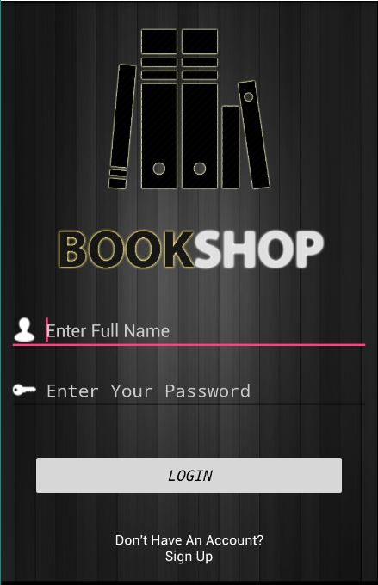
PROJECT FORMS
login

Slide 8
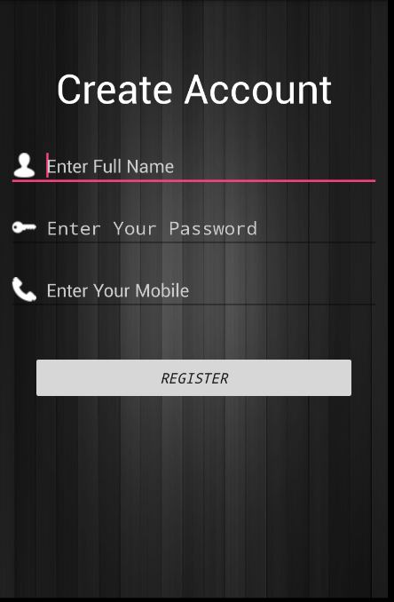
PROJECT FORMS
Sign-up

Slide 9
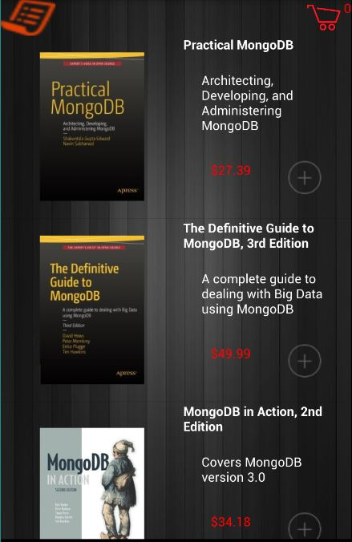
PROJECT FORMS
BooksList (works with internet connection)

Slide 10
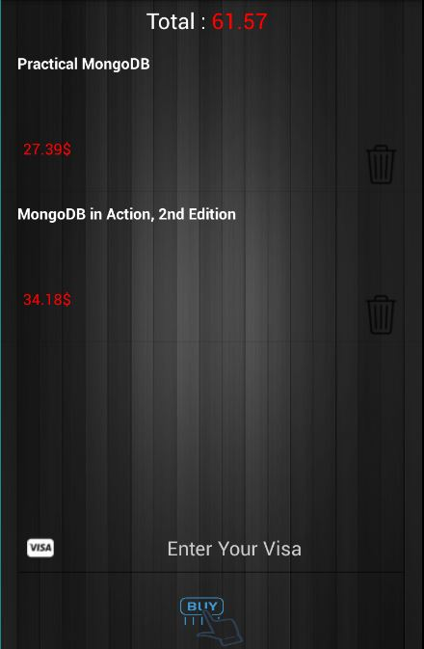
PROJECT FORMS
Cart & Confirmation

Slide 11
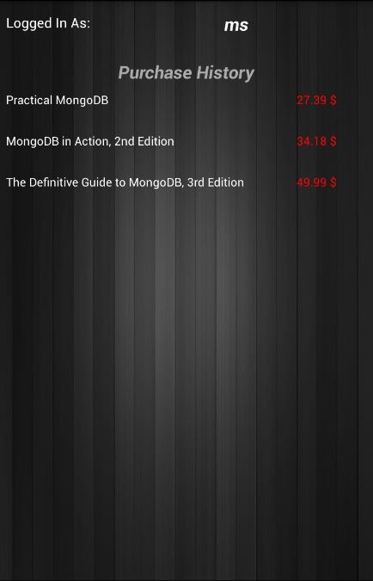
PROJECT FORMS
Buying History (only before closing the app)

