Slide 1
Cinema Gohina
Reservation website

Slide 2
idea: -online website to reservation a cinema ticket functions: -five pages shows to users to reservation by name and credit card code technology: -html,css, javascript, php code - xamp apache - bootstrap -mysql database

Slide 3
Github link:
https://github.com/mostafaameenelsyed/web_cinema.git

Slide 4
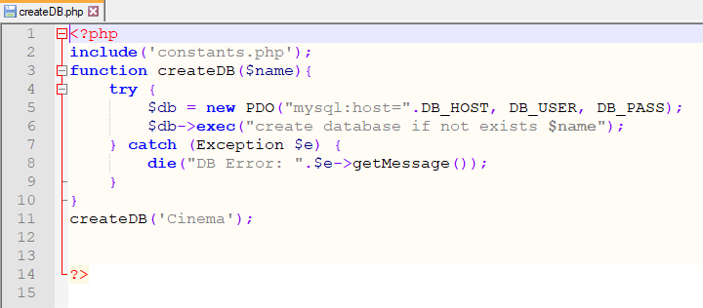
Code: - this a code to create a database in “my phpadmain” by Wamp64 Server apache

Slide 5
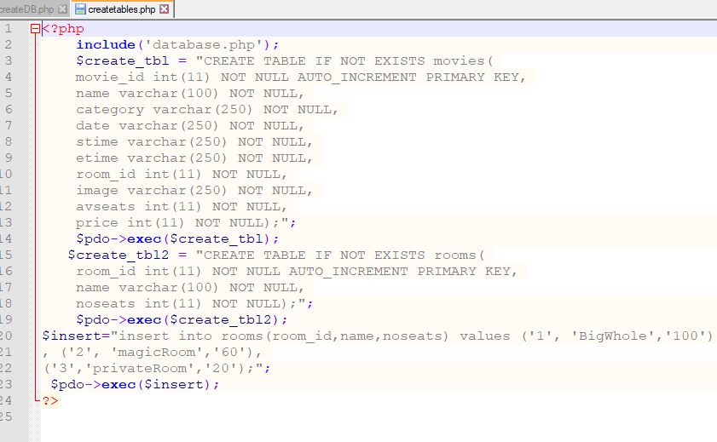
Code: - create tables in database called cinema

Slide 6
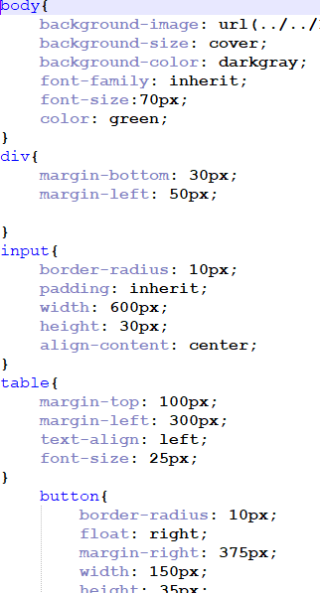
Code -Some of CSS code from add.php Page.

Slide 7
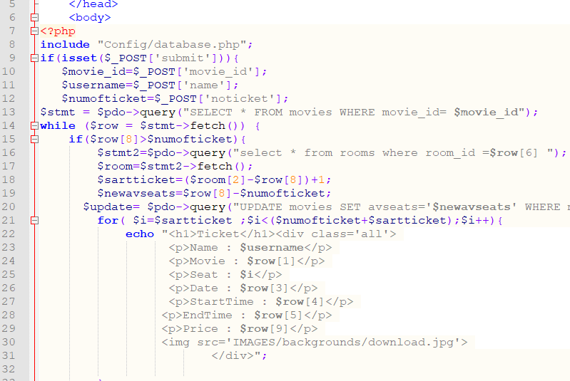
Code - a some code from ticket.php

Slide 8
-Name:Mostafa Ameen Mohamed
GPA: 2.02 -Dept: IT
-Gmail:mostafaameen427@gmail.com -phone:012 0 357 157 0

Slide 9
Development : - we can use more and more security ways to protect our website -

