Slide 1






UNIEATS
PHASE 1 · TEAM PRESENTATION
Your campus, your food.
Order food from campus outlets, choose a pickup time and skip the queue.
Rital Edam
Esraa Ahmed
Abdelrahman Dahiss
Hamza Kandil
Begad Ahmed
Mustafa Attia
Notes:
Introduce Uni Eats and the team: a campus food app where students order ahead and pick a pickup time.

Slide 2







Meet Team 4
INTRODUCTION · THE TEAM
Rital Edam
Esraa Ahmed
Abdelrahman Dahiss
Hamza Kandil
Begad Ahmed
Mustafa Attia
Notes:
Introduce the six team members: Rital Edam, Esraa Ahmed, Abdelrahman Dahiss, Hamza Kandil, Begad Ahmed and Mustafa Attia.

Slide 3
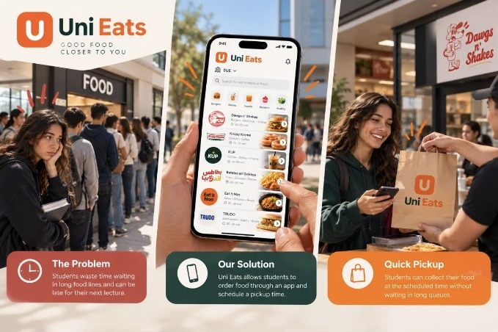



The problem
CUSTOMER & PROBLEM
Intended users
The campus community and college food vendors.
The issue
Students have short breaks, and a lot of that time goes on waiting in food lines. Some end up late to their next lecture.
Our proposal
Students order food and drinks in the app, pick a pickup time, and collect it without waiting in line.
Notes:
Users are the campus community and food vendors. Students waste short breaks in long food lines and arrive late. Uni Eats lets them order and schedule a pickup time.

Slide 4



Our 3 ideas
3 APP IDEAS CONSIDERED
OUR PICK
Uni Eats
Study Spot
GymMind AI
Order campus food within a scheduled period.
Find available study spaces around campus.
An AI fitness coach for workouts and progress.
FOR
FOR
FOR
University students and food vendors
Students looking for a place to study
Gym-goers and lifters
KEY FEATURES
KEY FEATURES
KEY FEATURES
Browse campus outlets and menus
Pick a pickup time
Skip the queue
Live space availability
Quiet, group and nearby filters
Campus map
Workout and PR tracking
Smart weight suggestions
Plateau detection and analytics
It fixes a problem students have every day
It saves time and helps students get to lectures
Ordering food gets easier
Not many ways to pre-order food on campus
Notes:
We looked at three ideas: Uni Eats, Study Spot and GymMind AI. We picked Uni Eats because it fixes a problem students have every day.

Slide 5


Our survey
CUSTOMER SURVEY
Video survey: street interviews filmed by Team 4
Is waiting in a food queue a real problem?
Would they order ahead and pick a time?
▶ Click the video to play the interviews (1 min 24 s).
Notes:
Play the video: street interviews filmed by Team 4 with potential users. It stands in for the written survey. Click the video to play it in slideshow mode.

Slide 6
What is missing today?
COMPARISON MATRIX
IDEA | WHAT EXISTS NOW | WHAT IS MISSING | HOW OUR APP HELPS
Uni Eats | University cafeterias and food outlets | Students waste time waiting in long queues and may be late to lectures. | Allows students to order ahead and choose a pickup time.
Study Spot | Libraries and study-space booking systems | Students may not know which study areas have available spaces. | Shows available study spaces around campus.
GymMind AI | Notebooks, general fitness apps and personal trainers | Most people log workouts by hand and get no personal advice on how they are doing. | The AI suggests weights, notices when progress stalls, and keeps workouts, records and food in one app.
Notes:
For each idea: what exists today, what is missing, and how our app fills the gap. Uni Eats targets a daily frustration with long queues.

Slide 7

Why we picked Uni Eats
DECISION MATRIX
CRITERION | WEIGHT | UNI EATS | STUDY SPOT | GYMMIND AI
User need | 30% | 5 | 4 | 3
Feasibility | 25% | 4 | 5 | 4
Gap left | 20% | 5 | 3 | 3
Mobile fit | 15% | 5 | 5 | 5
Risk (5 = low) | 10% | 4 | 5 | 4
Weighted total | 100% | 4.65 / 5 | 4.30 / 5 | 3.65 / 5
Highest score
Uni Eats got the highest score. It fixes a problem students have every day: wasting time in food queues.
Students order ahead and choose a pickup time, and the same idea can work at other universities.
Total = score × weight, added up for the five criteria.
Notes:
Weighted scoring: user need 30%, feasibility 25%, gap left 20%, mobile fit 15%, risk 10%. Uni Eats scores 4.65 out of 5, Study Spot 4.30 and GymMind AI 3.65.

Slide 8
SWOT analysis
SWOT ANALYSIS · UNI EATS
S
Strengths
W
Weaknesses
Solves a daily, relatable student problem
Saves time: order ahead and pick a slot
One app can serve many universities
A focused MVP, achievable this semester
Needs restaurants to join and manage pickup slots
Depends on accurate menus and prep times
Payments are not in the first version
Outlets must be onboarded one by one
O
Opportunities
T
Threats
Expand to more universities and campuses
Add payments, discounts, ratings and loyalty
Partner with campus vendors and student unions
Peak-time data can help vendors plan
Vendors may be slow to adopt the app
Existing food-delivery and ordering apps
Late preparation can break student trust
Campus rules or low student adoption
Notes:
SWOT for Uni Eats. Strengths: a daily problem and time saved. Weaknesses: needs vendors and accurate prep times. Opportunities: more universities and payments. Threats: slow vendor adoption and existing ordering apps.

Slide 9
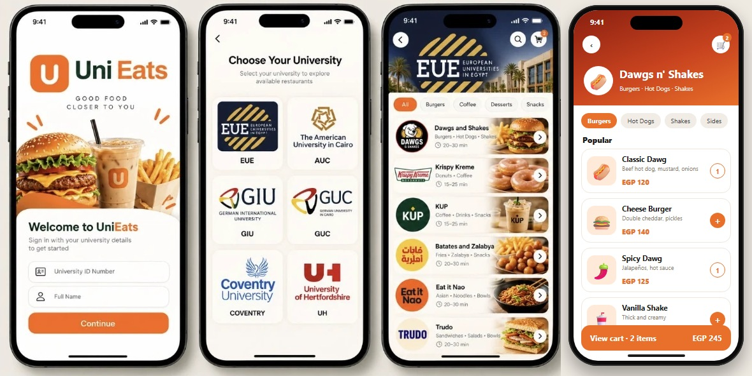
App screens
APP DESIGN IDEA
1
Welcome: sign in with your university ID
2
Choose your university: EUE, AUC, GIU, GUC, Coventry, UH
3
Browse campus restaurants by category
4
Open a menu, pick your food and add it to the cart
Notes:
Four key screens: welcome and sign-in with university ID, choose your university, browse that campus restaurants by category, then open a menu and add food to the cart.

Slide 10
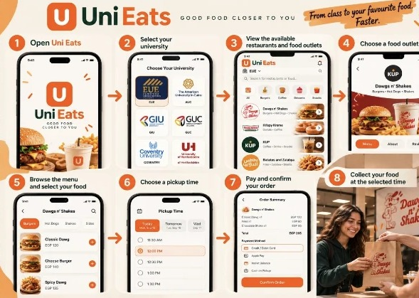
How the app works
HOW THE APP WORKS
1
Open Uni Eats
2
Select your university
3
View the available restaurants and food outlets
4
Choose a food outlet
5
Browse the menu and select your food
6
Choose a pickup time
7
Pay and confirm your order
8
Collect your food at the selected time
Notes:
Walk through the eight steps, from opening the app to collecting food at the chosen time.

Slide 11














App features
APP FEATURES
Must-have features
Nice-to-have features
University selection
Online payment
List of available food outlets
Student discounts
Digital food menus
Food rating and reviews
Add items to cart
Favourite restaurants
Schedule pickup time
Special offers and promotions
Confirm orders
Order history
Order status updates
Notes:
Seven must-have features make the core ordering flow work; the nice-to-have features can come later.

Slide 12

Our app:
Uni Eats
UNI EATS
Thank
you!
Uni Eats saves students time and makes ordering food easier.
Questions?
Notes:
Wrap up: Uni Eats saves time, makes ordering easier and gets students to lectures on time. Invite questions.

