Slide 1






UNIEATS
WEEK 6 PROJECT · MOBILE PROGRAMMING
Skip the queue. Enjoy your break.
A multi-university food ordering and scheduled pickup platform.
Rital Edam
Esraa Ahmed
Abdelrahman Dahiss
Hamza Kandil
Begad Ahmed
Mustafa Attia
Notes:
Introduce UniEats and the team. One line pitch: students order ahead, pick a pickup time, and skip the queue.

Slide 2
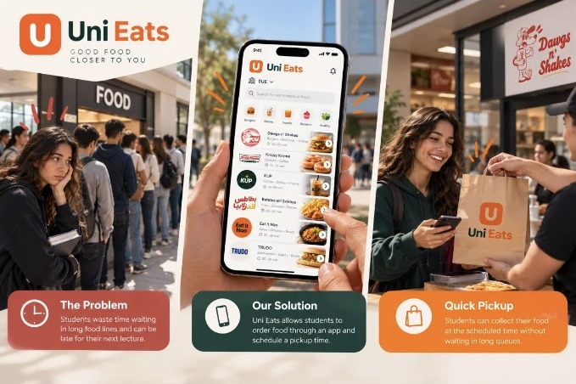

Short breaks. Long queues.
THE PROBLEM
01
Short breaks between lectures
Students only have a few minutes to grab food.
02
Queues eat the break
At busy times, waiting takes most of that free time.
03
Late to class, or no food at all
Students arrive late or skip buying food entirely.
Notes:
Students have short breaks between lectures. At busy times the queue eats most of that break, so they arrive late or skip food.

Slide 3




Order ahead. Grab & go.
THE SOLUTION
Order before you arrive
Schedule your pickup
Collect, no queue
Browse your campus outlets and place your order from anywhere.
Choose an available time slot that fits between your lectures.
Walk in at your time, grab your food and get back to class.
“Order ahead, choose your pickup time and collect your food without spending your break in a queue.”
One app, many campuses. Pick a university and see only its restaurants and menus.
Notes:
UniEats lets students order before reaching the outlet and pick a collection slot. One app serves many universities.

Slide 4



Who we're building for
CUSTOMER DISCOVERY
Primary customers
Secondary users
Context
University students, especially those with limited time between lectures.
Campus cafeterias, cafés and restaurant staff who receive and prepare orders.
University campuses with food outlets and predictable busy periods.
PROBLEM STATEMENT
Students need a faster and more predictable way to buy food on campus, because long queues make them late for lectures and cut the time they have to eat and rest.
Notes:
Primary customers are students with little time between lectures; secondary users are the outlet staff who prepare orders.

Slide 5





Talking to real students
CUSTOMER INTERVIEWS
How often do you buy food on campus between lectures?
Interview evidence
How long do you usually wait during busy periods?
Customer
[Student A, name withheld with permission]
University & year
[Add university and year]
Have you been late, or skipped food, because of the queue?
Date & method
[Date · in person / phone / online]
Would you use an app to order ahead and pick a time? Why?
Main issue
[Their own experience with queues]
Impact
[Late to lectures, skipped meals…]
What would make you trust the pickup time shown in the app?
Reaction to UniEats
[Their opinion on ordering ahead]
Notes:
REPLACE the yellow bracketed placeholders with your team's real interview before presenting. Do not present sample answers as real evidence.

Slide 6



3 ideas. 1 winner.
APP IDEAS & SELECTION
CHOSEN
UniEats
UniStudy
UniRide
Order food from campus outlets and schedule pickup.
Find and reserve available study spaces on campus.
Find transport options and coordinate student rides.
Strong fit: a frequent campus problem, and a focused MVP is achievable.
Useful, but availability data and room access are hard to integrate.
Useful, but safety, driver checks and coordination add complexity.
A clear, relatable and time-sensitive student problem
Easy to explain and to demonstrate
First version limited to essential ordering and pickup
Expands to more universities with the same purpose
Notes:
We compared three ideas. UniEats won: a frequent, relatable problem with an MVP we can actually build this semester.

Slide 7


Two sides. One flow.
TARGET USERS & OPERATING MODEL
Student user
Restaurant user
Chooses a university → Browses outlets → Adds to cart → Picks a pickup slot → Gets confirmation
Receives new orders → Confirms or rejects → Prepares → Marks ready for pickup
Multi-university model: every food outlet is linked to one university. Students pick their university first, and the app filters restaurants and menus to match.
Key assumption: each restaurant controls its own pickup slots, so the app only shows times the outlet can really prepare and hand over the order.
Notes:
Students order; restaurants confirm, prepare and mark orders ready. Each outlet belongs to one university and controls its own pickup slots.

Slide 8

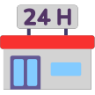


Must-have MVP
PRIORITISED FEATURES
The MVP shows the full core journey, from choosing a university to collecting a scheduled order.
University selection
Registration / login
Restaurant listings
Digital menus
Choose your campus and see its food outlets.
A basic student account and order history.
Participating cafés and outlets at your university.
Available food, descriptions and prices.
Cart & summary
Pickup scheduling
Order confirmation
Restaurant order view
Review items and quantities before ordering.
Pick from restaurant-approved collection slots.
Order number, pickup time and instructions.
Staff receive orders and update their status.
Notes:
These eight features cover the whole core journey, from choosing a university to collecting a scheduled order.

Slide 9








Nice-to-have, later.
FUTURE DEVELOPMENT
Card or wallet payments
Live status & push alerts
Scope for the semester
Ratings & reviews
Favourites & repeat orders
Build now: university selection, restaurant browsing, menu viewing, cart, pickup slot selection and confirmation.
Discounts, promos & loyalty
Dietary & allergen filters
Propose later: advanced payments, loyalty programmes and live tracking.
Pickup QR code so staff can verify orders
Notes:
Not in the first version. The semester scope stays on the core ordering and pickup flow.

Slide 10
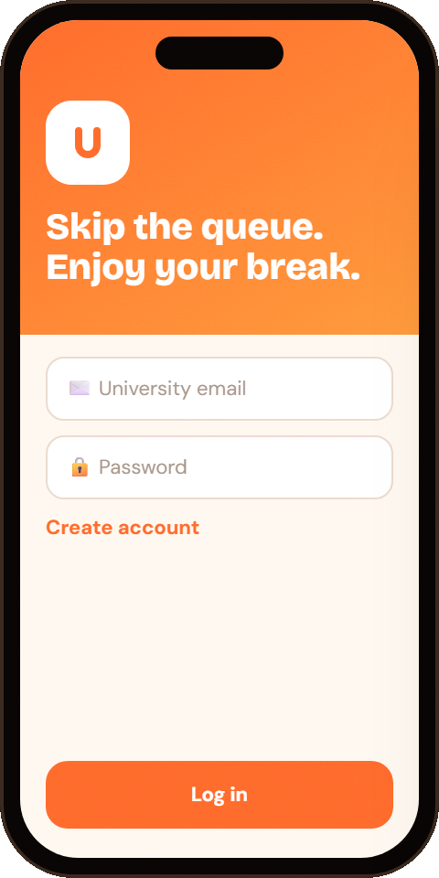
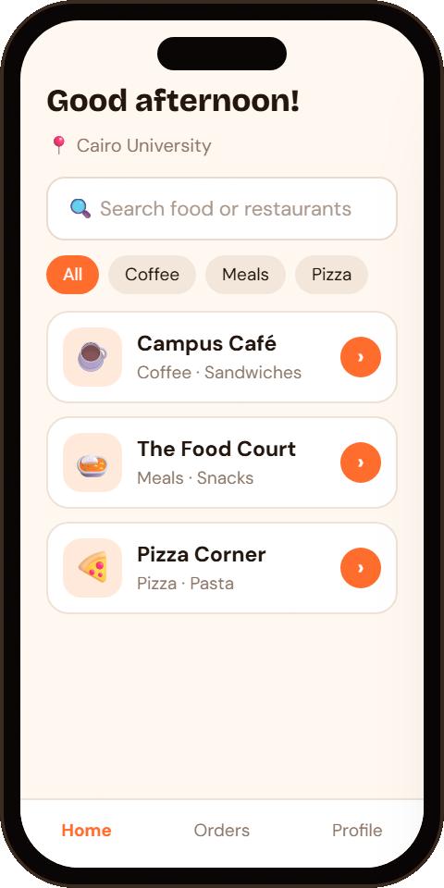
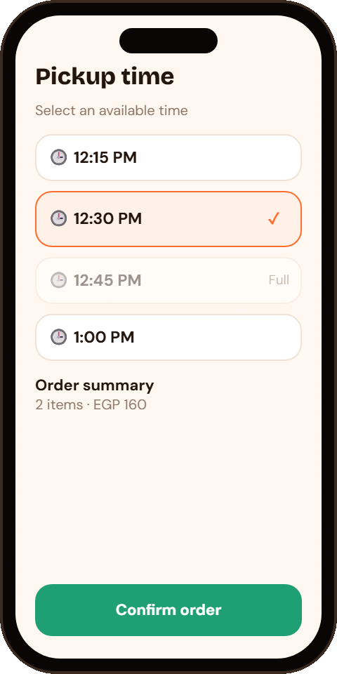
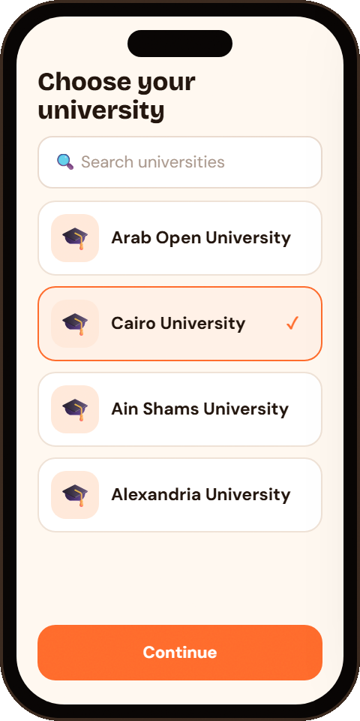
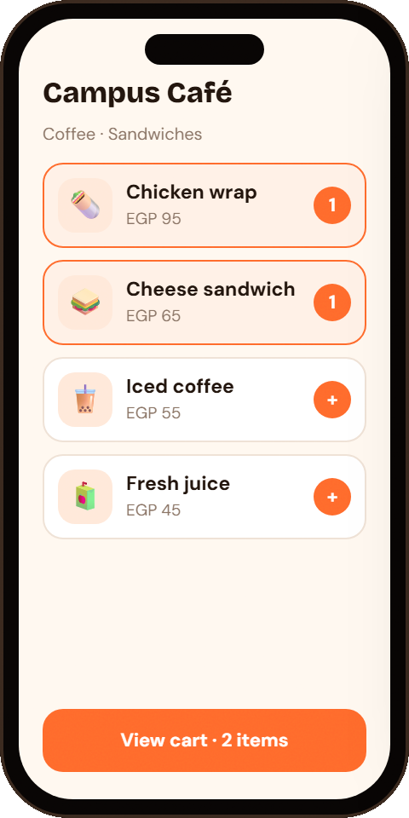
Five screens, one smooth order.
MAIN SCREEN DESIGNS
1 · Welcome
3 · Home
5 · Pickup
Sign in or sign up
2 · University
Outlets on your campus
4 · Menu & cart
Pick a slot, confirm
Filters campus outlets
Add items, see prices
Notes:
Low-fidelity concept screens: welcome, university, home, menu and cart, then pickup. A full slot (12:45) can't be selected.

Slide 11


7 taps to lunch.
USER JOURNEY & NAVIGATION
Open UniEats
Select university
Choose a restaurant
Add food to cart
Choose pickup time
Confirm order
Collect food
Shows the welcome and login screen.
Loads restaurants linked to it.
Shows its menu and availability.
Updates the order summary and total.
Shows restaurant-approved slots.
Creates an order number and sends it to the outlet.
Student picks up at the outlet.
Welcome / Login → Select University → Home → Restaurant → Menu → Cart → Pickup Time → Confirmation → Collection
Key UX rule: the pickup time is always visible before confirming, and full or unavailable slots can't be selected.
Notes:
Walk through the seven steps. Key rule: the pickup time is visible before confirming, and full slots can't be picked.

Slide 12
From idea to working app
PROPOSED DEVELOPMENT PLAN
01
02
03
Validate
Design
Build core screens
Interview students and at least one campus outlet to confirm the queue and pickup problem.
Finalise the user flow, wireframes, screen labels and visual style.
Login, university selection, restaurant list, menu, cart and pickup selection.
04
05
06
Add order logic
Test
Improve
Connect the cart, pickup slots, confirmation and the restaurant order view.
Students complete a sample order; record confusion, timing and usability issues.
Fix issues and prioritise improvements based on feedback.
Notes:
Six stages: validate with real interviews, design, build the core screens, add order logic, test with students, improve.

Slide 13
Risks & our answers
RISKS & CONSIDERATIONS
Restaurant can't meet the pickup time
→
Outlets manage capacity and publish their own pickup slots.
Wrong menu or price information
→
Staff can update menus and mark items unavailable.
Student picks the wrong university
→
Show the selected university clearly and let users change it.
Late order preparation
→
Realistic preparation buffers, and outlets update order status.
Low adoption by restaurants
→
Start with a small pilot of one or two outlets, then expand.
Notes:
Each risk has a concrete response; the biggest one, restaurant adoption, is handled with a small pilot first.

Slide 14

Less waiting.
More break.
CONCLUSION
Thank
you!
UniEats is a practical, student-centred answer to long campus queues. Its multi-university structure leaves room to grow, while a focused MVP keeps the first version achievable this semester.
Questions?
Success = a student orders, then collects at the chosen time with less waiting and without missing their next lecture.
Notes:
Wrap up: a practical, student-centred fix for campus queues with room to grow. Success = order, then collect on time without missing the next lecture. Invite questions.

