Slide 1
Irrationality in game theory
Mostafa derispour

Slide 2
Outline
Introduction
Reasons for irrationality
Two main approaches for modeling
Solutions & Explanation: 1. Failure of Common Knowledge of Rationality 2. Reputation and Imperfect Information 3. Bounded Complexity

Slide 3
Introduction
What is irrationality in the context of game theory?
Why is it important?
Ultimatum game example
Notes:
The study of irrationality in game theory seeks to understand and model these deviations from rationality, and how they affect the outcomes of strategic interactions between individuals or groups
as it can lead to outcomes that are different from those predicted by traditional rational models.
One well-known example of irrational behavior in game theory is the Ultimatum Game. In this game, one player (the proposer) is given a sum of money and must propose a division of the money between themselves and another player (the responder). The responder can either accept or reject the proposal. If the proposal is accepted, both players receive the proposed division of the money. If the proposal is rejected, neither player receives any money. According to rational economic theory, the responder should accept any positive offer, as it is better to receive some money than none. However, experimental studies have shown that responders often reject unfair offers, even if it means receiving nothing. This behavior is considered irrational from a purely economic perspective, as it leads to suboptimal outcomes for both players.

Slide 4
Why is there irrationality?
Preferences that go beyond monetary payoffs
Limited cognitive abilities
Notes:
may have a sense of fairness or a desire to punish unfair behavior, even at a personal cost.
limited attention, which can prevent them from fully optimizing their decisions. Additionally, emotions and social norms can also play a role in shaping behavior in games.

Slide 5
How to model irrationality?
Psychological factors
Experimental studies
Notes:
There are different approaches to modeling irrational behavior in game theory. One approach is to incorporate psychological factors, such as cognitive biases or emotions, into the traditional rational models. This can be done by introducing additional parameters or constraints that capture the deviations from rationality. Another approach is to use experimental methods to study how individuals actually behave in strategic situations. Experimental studies can provide insights into the prevalence and nature of irrational behavior, as well as the underlying motivations and mechanisms. These studies often involve conducting experiments with human participants playing games in laboratory settings.

Slide 6
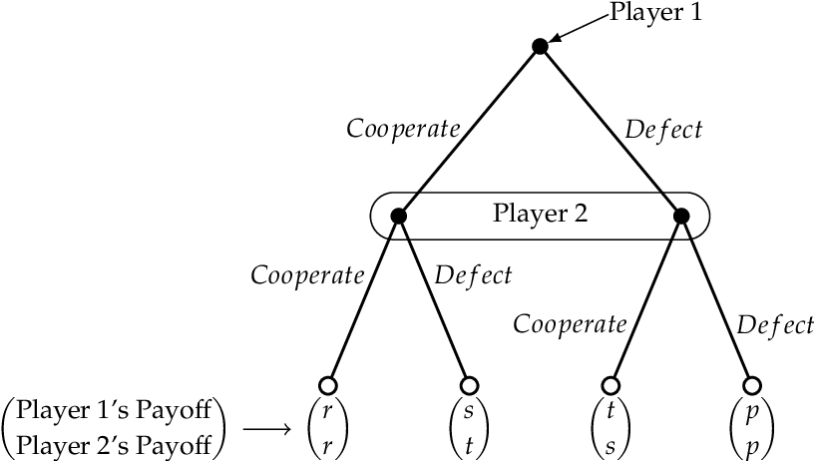
Case study: Prisoner dilemma in extensive form
 | D | C
D | (1,1) | (4,0)
C | 0,4 | (3,3)

Slide 7
Solutions & Explanation
Failure of Common Knowledge of Rationality
Reputation and Imperfect Information
Bounded Complexity
Notes:
economists have explored solution concepts, which can reflect the reality and explain the observed results of the experiments [5, 2, 3, 4, 7]. In this section, some explanations or solutions to the backward induction paradox are described.

Slide 8
Failure of Common Knowledge Of Rational
Common knowledge of rationality
“all players know that they are rational, all know that all know it, and so on ad infinitum.”[1]
Notes:
Common knowledge of rationality means all players know that they are rational, all know that all know it, and so on ad infinitum (or at least, for a number of levels no less than the maximum duration of the game)

Slide 9
Reputation and Imperfect Information
There is a small amount of incomplete information
A sufficient high probability of other players being irrational can lead to cooperative approaches such as tit for tat.

Slide 10
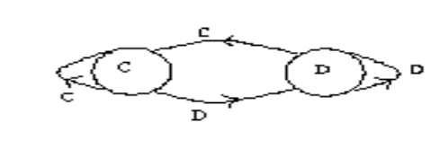
Bounded Complexity
Theorem: For any integer k, there is an N0 such that if N > N0 and N1/k ≤ min(l1,l2) ≤ max(l1,l2) ≤ Nk , then there is a (mixed strategy) equilibrium in which the payoffs to each player are at least 3 - 1/k [4]

Slide 11
References
[1]https://en.wikipedia.org/wiki/Behavioral_game_theory
[2]https://www.cs.ubc.ca/~kevinlb/teaching/cs532a%20-%202005-6/Projects/YaminHtun.pdf
[3]https://www.semanticscholar.org/paper/Quantum-Conditional-Strategies-for-Prisoners%27-Under-Giannakis-Theocharopoulou/6c9f039236cb36c7d5b17b5c153750fb3a4f3657/figure/0
[4]https://www.sciencedirect.com/science/article/abs/pii/0165176585900266

