Slide 1
Zend Framework in 2009
Alan Seiden – Strategic Business Systems
alan@alanseiden.com
New York PHP
24-Feb-2009

Slide 2
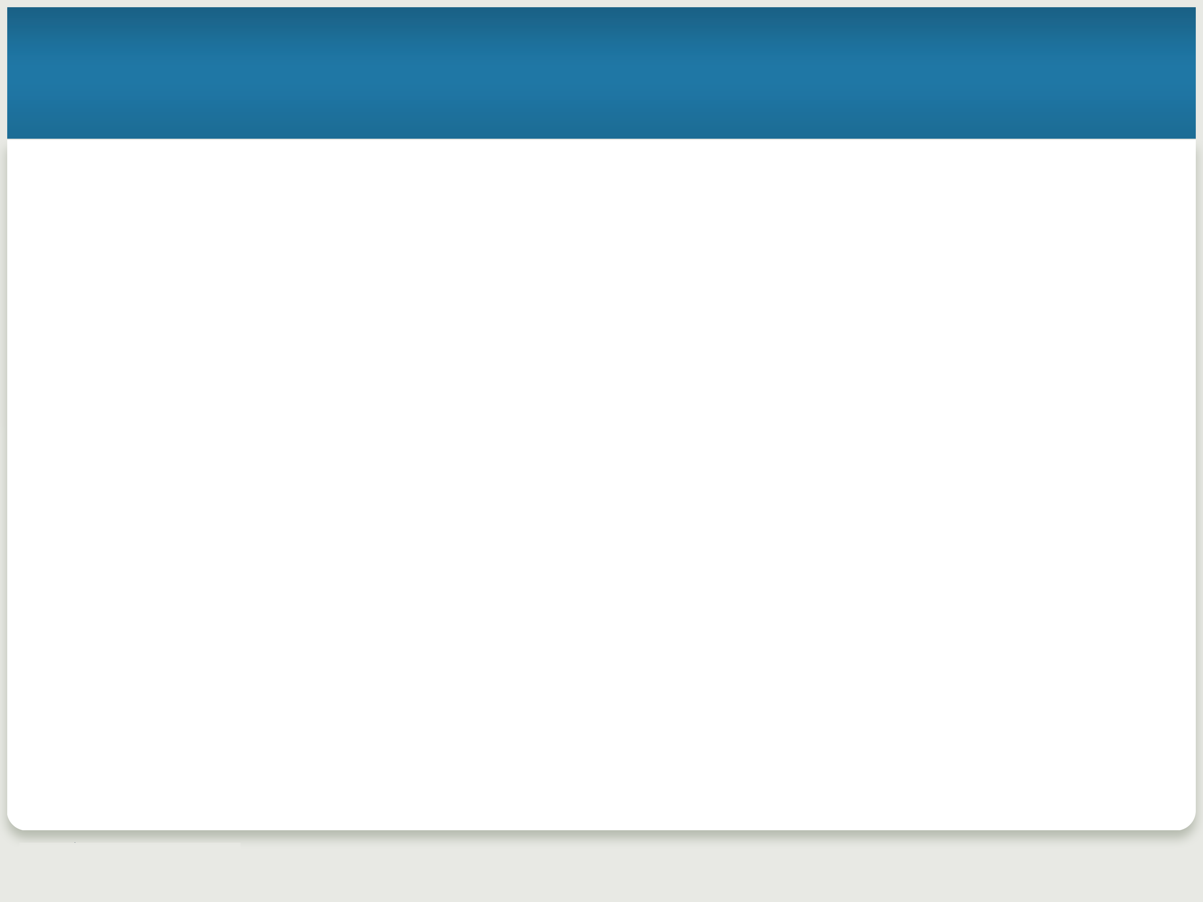

Speaker
Alan Seiden: alan@alanseiden.com
PHP and Zend Framework Consultant
Strategic Business Systems, Inc.
Zend Certified Engineer—Zend Framework
Contributor: Mantis/400 & IBM’s Zend Core for i5/OS
Writer about PHP for IBM i5 community
Mentor for teams learning Zend Framework

Slide 3
Tonight we will cover:
Zend Framework (ZF) basics
  What, why, how
ZF’s flexible model-view-controller (MVC) implementation
  Keeps your code organized logically and handles “plumbing”
Components (libraries)
  Including classes to access web services
What’s new and what’s next

Slide 4
What is ZF?
An open source, MVC-based PHP framework
Is it a framework? Yes
  "Glue" to build applications
  Components developed, tested, distributed together
But loosely coupled
  “Use at will” architecture
  Dependencies documented in manual
    Section A.1.4. Zend Framework Dependencies

Slide 5
Birth and early years
2005: PHP Collaboration Project at ZendCon
  Started as collection of components but coalesced
  PHP 5, object oriented (OO) from the start
  Set example of OO design patterns and practices
July 2007: GA version 1.0
February 17, 2009: version 1.75
Frequent minor releases

Slide 6
What’s it made of?
Robust, high quality object-oriented PHP 5 libraries
  Test-driven development
    80+% code coverage
  Peer review of all code
  Coding standards
    http://framework.zend.com/manual/en/coding-standard.html
  Components not released until documented in manual and inline
    phpDocumentor format: http://phpdoc.org

Slide 7
Flexible License
“New BSD” license
  http://framework.zend.com/license
  Use code however you like
Apache-like contributor license agreement (CLA)
  Safety for users/corporations
  All original code; no patent claims

Slide 8
Why I use it
As I learn what it can do, the less boring code I write
  At first, I reinvented the wheel
  Realized that ZF already provided functionality
  I can write less “plumbing” code
Can customize and extend
  Numerous integration points
  Interfaces and small methods give you control
It keeps up with trends and APIs
  Compatibility with diverse database systems, authentication and other APIs
  Including IBM i (AS/400)’s unique version of db2
  Web services

Slide 9
Community
Contributors include individuals and companies. Companies include:
  Zend (of course)
  IBM
  OmniTI
Technology partners:
  Adobe, Google, IBM, Microsoft, nirvanix, StrikeIron
Help available at zfforum.com, e-mail lists, #zftalk IRC

Slide 10
Requirements for Zend Framework 1.75
Required:
  PHP 5.2.4+
Optional:
  mod_rewrite
    Recommended; route URLs through bootstrap file
  Extensions as needed. Examples:
    ext/session in Zend_Session
    ext/gd in Zend_Captcha
  PHPUnit 3.3.0 if use Zend_TestPHPUnit
Full list of reqs and dependencies:
  framework.zend.com/manual/en/requirements.html

Slide 11
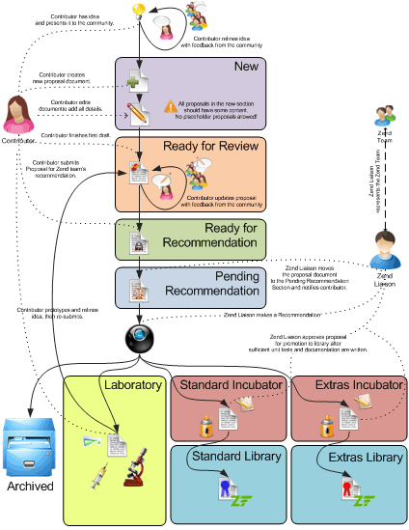
How it’s developed

Slide 12
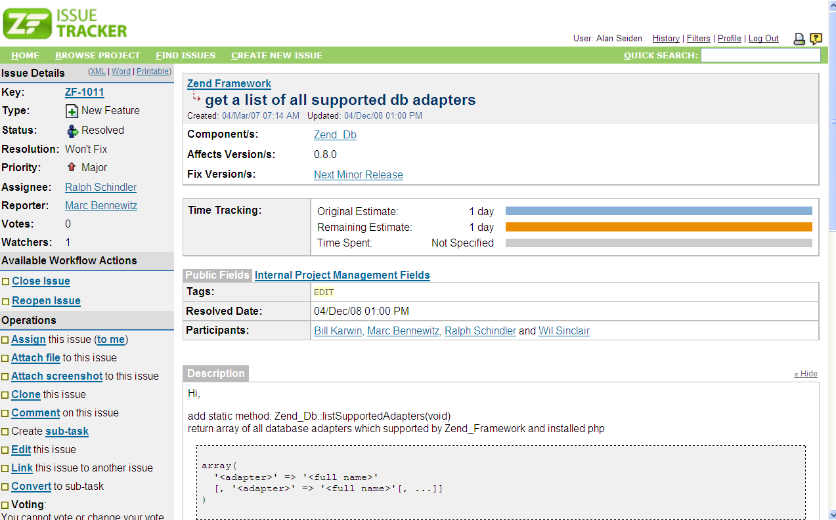
Issue tracker

Slide 13
Timesaving conventions
Autoloader
  PEAR convention for class/file names
    Example: Search_Product = Search/Product.php
    Put this in bootstrap file:
    require_once 'Zend/Loader.php';
    Zend_Loader::registerAutoload();
    Now you can do:
    $prod = new Search_Product();
Fluent interface
  $select = $db->select()
    ->from( ...specify table and columns... )
    ->where( ...specify search criteria... )
    ->order( ...specify sorting criteria... );

Slide 14
Model-View-Controller

Slide 15
Model – View – Controller design pattern
Model
  Classes that access your data
View
  Templates to present that data (e.g. HTML for browser)
Controller (action controller)
  Application flow
  Connects model and view
(Bonus: front controller!)

Slide 16
Front Controller

Slide 17
Front controller pattern
Front controller sits in front of MVC
All PHP requests funneled through index.php (bootstrap file)
Front controller gets your application started
  Initializes request/response objects
  Can handle common settings and functionality
    “Include” paths
    Configurations
    Location of MVC components (if necessary)
    Logging, db (perhaps), authentication/authorization
  Converts URL to a “request” object with distinct parts
  Routes requests to appropriate action controllers
Receives exceptions

Slide 18
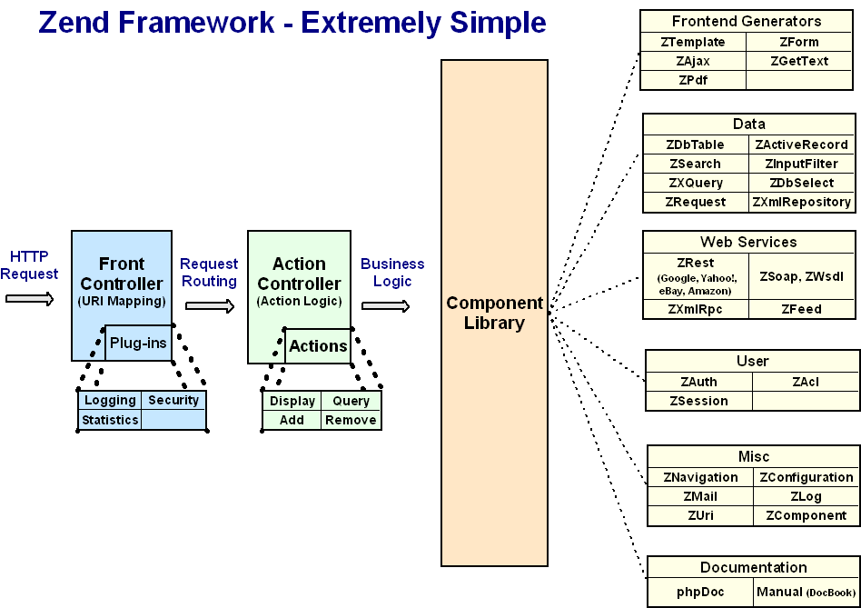
Front controller to action controller

Slide 19
Routes URL request
Default routing convention:
  http://example.com/controller/action/param1/value1...
Controller maps to class name
Param/value pairs are passed to action
Action maps to method name
http request
Controller1
action1()
action2()
Bootstrap:
index.php
Front
Controller
Controller2
action1()
action2()

Slide 20
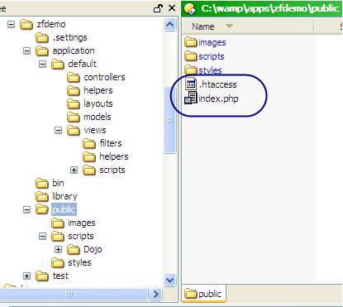
Front controller needs two files in public folder
In document root (public folder):
.htaccess
redirects requests to bootstrap script (index.php)
index.php
instantiates
Front Controller

Slide 21
Front controller file #1: .htaccess
RewriteEngine on
# funnel all requests to index.php
# except requests for static resources
RewriteRule !\.(js|ico|gif|jpg|png|css)$ index.php

Slide 22
Front controller file #2: index.php
<?php
// bootstrap file
setincludepath('.' . PATHSEPARATOR . '../library' . PATHSEPARATOR . '../application/default/models/' . PATHSEPARATOR . getincludepath());
// Prepare the front controller
$frontController = Zend_Controller_Front::getInstance();
// Dispatch the request using the front controller
$frontController->dispatch();

Slide 23
Action Controller

Slide 24
Action Controller
Controller classes handle groups of request URLs
  http://example.com/controller/action
  Default: IndexController
  Organizes and groups functionality
  One class (extending Zend_Controller_Action) for each controller
Action methods in each controller class handle requests
  http://example.com/controller/action
  Default: indexAction()
  Named like actionAction()
    Example: If action is “edit” then method is editAction()

Slide 25
More controller functionality
Several standard methods help organize and control the flow
  init() – called by the constructor
  preDispatch() – called before the action’s method
  postDispatch() – called after the action’s method
Utility methods
  forward(), redirect(), getParam(), getRequest(), getResponse(), render()
Action helpers add functionality
  Built-in helpers. Example: gotoSimple()
  Your own helpers
  Avoids the need to build your own base controller class

Slide 26
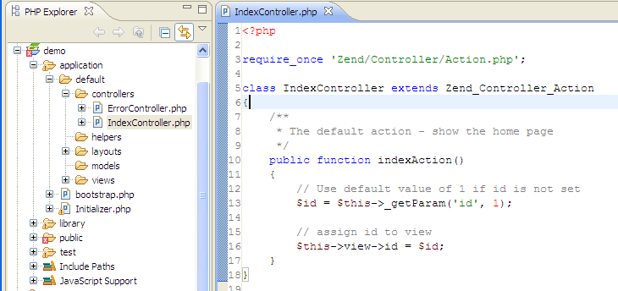
Controller example

Slide 27
Action helpers
They extend Zend_Controller_Action_Helper_Abstract
Built-in action helpers
  ActionStack
  AjaxContext
  AutoComplete: Dojo, Scriptaculous
  ContextSwitch
  FlashMessenger
  Json
  Redirector
  Url
  ViewRenderer
Create your own
  Place in the "My/Helper/" directory of your library (or any directory on your includepath)

Slide 28
Action helper example: Redirector gotoSimple()
class Forward_Controller extends Zend_Controller_Action
{
protected $redirector = null;
public function init()
{
$this->redirector = $this->helper->getHelper('Redirector');
}
public function myAction()
{
/* do some stuff */
// Redirect to 'my-action' of 'my-controller' in the current
// module, using the params param1 => test and param2 => test2
$this->redirector->gotoSimple('my-action',
'my-controller',
null,
array('param1' => 'test',
'param2' => 'test2'
)
);
}
}

Slide 29
View

Slide 30
View
Scripts (templates)
  PHP-based script templates to present data
  Should contain only display logic, not business logic
  Default naming: “myaction.phtml”
Helpers
  Classes and methods that provide reusable view functionality
    Examples of built in view helpers: escape(), formText(), partial(), partialLoop(), headTitle()
    Write your own, too
Output filters
Layout
Placeholders

Slide 31
Controller (again)…leads to view

Slide 32
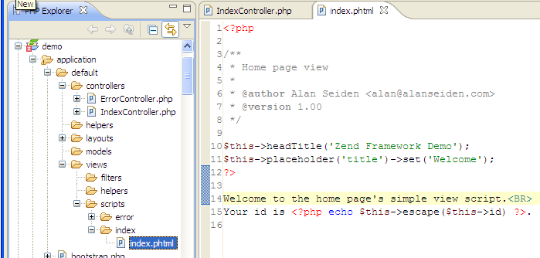
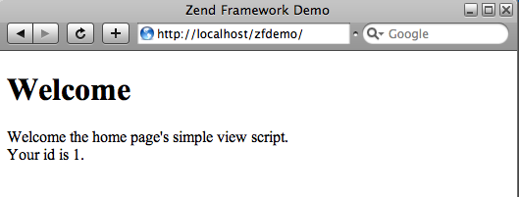
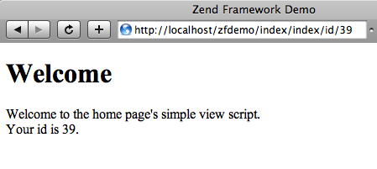
View script automatically rendered

Slide 33
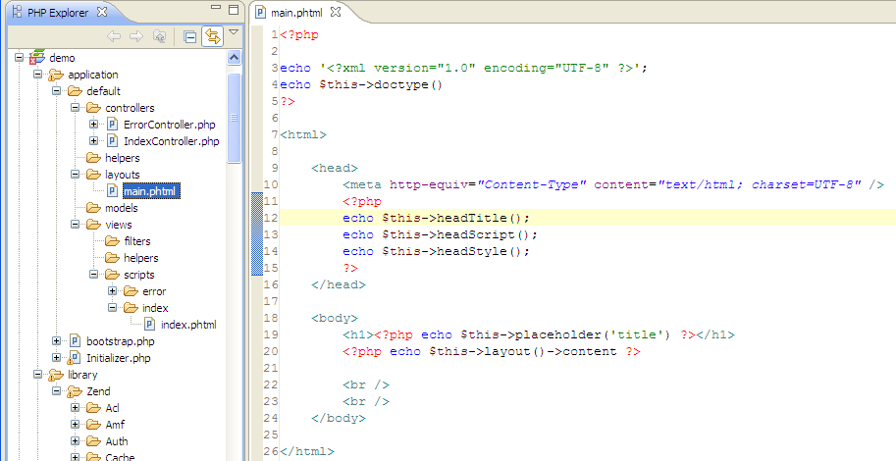
Zend_Layout

Slide 34
Zend_Layout
Two-step view pattern
  Uses Zend_View for rendering
Placeholders useful for setting javascript, titles, other variable data
Layout view helper
  shortcut to layout placeholder
  These are equivalent:
  // fetch 'content' key using layout helper:
  echo $this->layout()->content;
  // fetch ‘content' key using placeholder helper:
  echo $this->placeholder('Zend_Layout')->content;
Enable in bootstrap
  // accept default path
  Zend_Layout::startMvc();
  // or specify path
  $layoutPath = realpath(dirname(__FILE__) . '/../application/layouts');
  Zend_Layout::startMvc(array("layoutPath“ => $layoutPath));

Slide 35
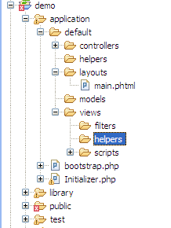
My own view helper: TitleCase.php
<?php
Require_once 'Zend/View/Interface.php';
/**
* TitleCase helper
*/
class Zend_View_Helper_Title_Case {
public $view;
public function titleCase($string = '')
{
// convert incoming string so that
// first letter of each word is capitalized/
// but all other letters are lowercase.
// Also trim the string.
return ucwords(strtolower(trim($string)));
} //(public function titleCase())
public function setView(Zend_View_Interface $view) {
$this->view = $view;
}
}
Usage:
echo $this->titleCase(‘mozilla firefox’);
// Mozilla Firefox

Slide 36
Model

Slide 37
Model
Models are abstract representations of data
  Can be extended from:
    Zend_Db_Table_Row – For database abstraction
    Zend_Feed_Element – For RSS abstraction
    Yahoo_Result – For Yahoo abstraction
    Or any other class that fits your needs
    Or build your own own abstract representations of your data

Slide 38
Models (more)
Model classes contain business logic to prepare complex data for presentation
I stuff any “weird” code in models so that controllers/views are clean

Slide 39
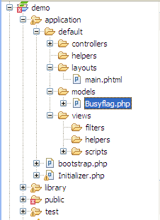
Model: example
<?php
// model: Busyflag.php
class Busyflag
{
// The table name
protected $name = ‘SYSFLAGS'; // old-fashioned “System 36” table
// isSiteUp: return true if up, false if down
public function isSiteUp() {
// one record, with key "B"
$sql = "select BZYFLG from {$this->name} where RECID = 'B'";
$row = SBSDbhelp::getOneRow($sql);
// true if Y, false otherwise.
return $row['BZYFLG'] == 'Y';
} //(public function isSiteUp())
} //(class Busyflag)
// usage (from a preDispatch front controller plugin)
$busyFlag = new Busyflag();
if (!$busyFlag->isSiteUp()) {
// Take user to "site down" page.
$request->setControllerName("Down");
$request->setActionName("index");
} //(if (!$busyFlag->isSiteUp()))

Slide 40
Controller + Model + View: traditional
<?php
// Controllers/SearchController.php
require_once 'Zend/Controller/Action.php';
class SearchController extends Zend_Controller_Action
{
public function indexAction()
{
$prodid = $this->_getParam('prodid');
// look up product data in model
$products = new Search_Products();
$results = $products->find($prodid);
// assign results to view
$this->view->results = $results;
}
}
<?php
// views/scripts/search/index.phtml
?>
Products found:<ul>
<?php
foreach ($this->results as $result) {
echo "<li>{$this->escape($result->prodname)}</b>{$this->escape($result->available)}</li>";
}
?>
</ul>

Slide 41
MVC your way: custom routing rules
Can declare custom routing rules with Zend_Controller_Router_Route classes
  Not limited to “controller/action/param” format
  Example: “year/month/day/title” as in a blog posting:
  URL: http://myblog.com/2008/02/24/i-like-routers
  $route = new Zend_Controller_Router_Route(
  ':year/:month/:day/:title',
  array(
  'year' => 2009,
  'controller' => ‘articles',
  'action' => 'show'
  ),
  array(
  'year' => '\d+‘,
  ‘month' => '\d+‘,
  ‘day‘ => '\d+‘,
  )
  );
  $router->addRoute(‘posts', $route);

Slide 42
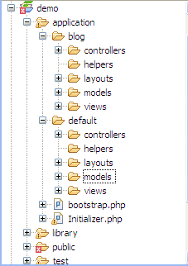
MVC your way: multi-MVC
Can separate app sections into modules (Mitch P.’s “atomic MVC”)
  $front->setControllerDirectory(array(
  'default' => '/demo/application/controllers',
  'blog' => '/demo/application/blog/controllers' ));
Blog_IndexController is class name of index action controller within blog app/module
  URL: example.com/blog or /blog/index or /blog/index/index
IndexController is still class name within default app/module
  URL: / or /index or /index/index

Slide 43
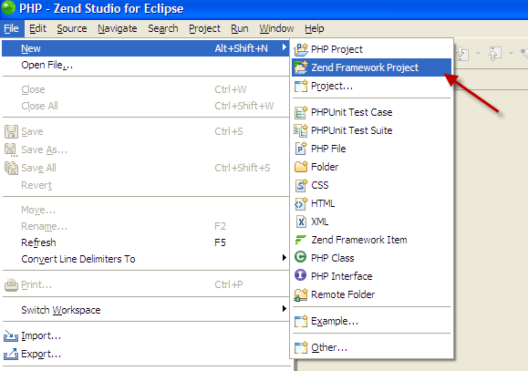
Tools can help get you started
Zend Studio for Eclipse creates default directory structures and classes for you
  Free trial: http://www.zend.com/en/products/studio/

Slide 44
Components

Slide 45
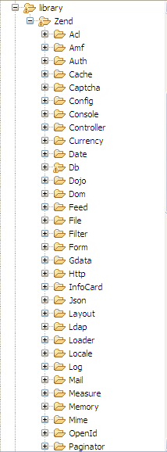
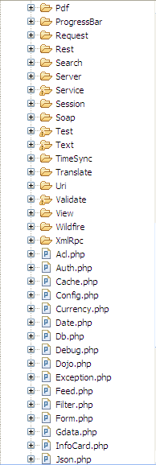
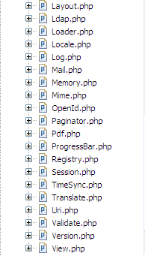
Library of Zend components
Reminder:
Zend/Db.php = Zend_Db
Zend/Db/Table.php = Zend_Db_Table

Slide 46
Components vs. straight PHP
Additional functionality
  Zend_Session vs. straight $_SESSION
  Zend_Debug::dump() vs. vardump
Thread-safety
  Zend_Translate vs. gettext
  Zend_Locale vs. setlocale
OO
  OO Syntax
  May be extended with custom functionality
  ZF components reduce coding when used together
They’ve been tested and integrated for you

Slide 47
Components in 1.75
Zend_Acl Zend_Amf Zend_Auth Zend_Cache Zend_Captcha Zend_Config Zend_Config_Writer Zend_Console_Getopt Zend_Controller Zend_Currency Zend_Date Zend_Db Zend_Debug Zend_Dojo Zend_Dom Zend_Exception Zend_Feed Zend_File Zend_Filter Zend_FilterInput Zend_Form Zend_Gdata Zend_Http | Zend_Infocard Zend_Json Zend_Layout Zend_Ldap Zend_Loader Zend_Locale Zend_Log Zend_Mail Zend_Measure Zend_Memory Zend_Mime Zend_OpenId Zend_Paginator Zend_Pdf Zend_ProgressBar Zend_Registry Zend_Rest Zend_Search_Lucene Zend_Server_Reflection Zend_Akismet Zend_Amazon Zend_Audioscrobbler Zend_Delicious | Zend_Flickr Zend_Nirvanix Zend_ReCaptcha Zend_Simpy Zend_SlideShare Zend_StrikeIron Zend_Technorati Zend_Twitter Zend_Yahoo Zend_Session Zend_Soap Zend_Test Zend_Text Zend_Timesync Zend_Translate Zend_Uri Zend_Validate Zend_Version Zend_View Zend_Wildfire Zend_XmlRpc Zend_XConsoleProcessUnix Zend_XJQuery

Slide 48
Component categories
MVC
Formatting
Ajax
Identity, Authentication, and Authorization
Forms
Datastore
Web Services
Enterprise
Debugging, Logging, and Testing
I18n and L10n
Mail
Infrastructure

Slide 49
MVC components (you already know these)
Zend_Controller
Zend_Layout
Zend_View

Slide 50
Formatting
Zend_Text
Zend_Paginator

Slide 51
Ajax
Zend_Dojo
Zend_Json

Slide 52
Identity, authentication, and authorization
Zend_Acl
Zend_Auth
Zend_Infocard
Zend_OpenId
Zend_Session

Slide 53
Form and input validation
Zend_Captcha
Zend_Form
Zend_Validate
Zend_Filter

Slide 54
Database access
Zend_Db
Zend_Db_Table
Zend_Db_Profiler

Slide 55
Web services
Zend_Feed
Zend_Gdata
Zend_Http
Zend_Rest
Zend_Server_Reflection
Zend_Soap
Zend_Uri
Zend_XmlRpc

Slide 56
Zend_Service_* clients
Akismet
Amazon
Audioscrobbler
Delicious
Flickr
Nirvanix
ReCaptcha
Simpy
SlideShare
StrikeIron
Technorati
Twitter
Yahoo

Slide 57
Additional categories
Zend_Ldap
Zend_Search_Lucene
Zend_Pdf

Slide 58
Debugging, logging, and testing
Zend_Debug
Zend_Log
Zend_Test
Zend_Wildfire

Slide 59
I18n and L10n
Zend_Currency
Zend_Calendar
Zend_Date
Zend_Locale
Zend_Measure
Zend_TimeSync
Zend_Translate

Slide 60
Mail
Zend_Mail
Zend_Mime

Slide 61
Infrastructure
Zend_Cache
Zend_Config
Zend_Console
Zend_File
Zend_Loader
Zend_Memory
Zend_Registry
Zend_Version

Slide 62
Registry

Slide 63
Registry
Store global data without polluting the global scope
  Zend_Registry::set(‘key’, $value);
  Zend_Registry::get(‘key’);
  Useful for storing sessions, configuration data or any data that could potentially be important on a per-request basis

Slide 64
Logging

Slide 65
Logging
Structured, flexible logging class
Zend_Log has several backends
  Stream (write to a file)
  Firebug
  Mail
  Db
Example of logging to file system
  $writer = new Zend_Log_Writer_Stream('/path/to/logfile');
  // Only email warning level entries and higher.
  $writer->addFilter(Zend_Log::WARN);
$logger = new Zend_Log($writer);
  // later…
  $logger->info('Informational message');
  $logger->err(‘Error message');
  // “Error message”

Slide 66
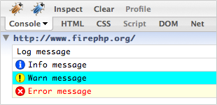
Logging: Firebug backend
Zend_Log_Writer_Firebug, Zend_Db_Profiler_Firebug
Install Firebug and FirePHP in Firefox
// in bootstrap
$logger = new Zend_Log();
$writer = new Zend_Log_Writer_Firebug();
$logger->addWriter($writer);
Zend_Registry::set('logger',$logger);
// in action controller or anywhere
$logger = Zend_Registry::get('logger');
$logger->log(‘Log message', Zend_Log::DEBUG);
$logger->log(‘Info message', Zend_Log::INFO);
$logger->log(‘Warn message', Zend_Log::WARN);
$logger->log(‘Error message', Zend_Log::ERR);

Slide 67
Config

Slide 68
Zend_Config
OO syntax for reading/writing config files
Internally it’s an array
Multiple backends
  INI
  XML
Divide sections with [ ], good for dev/prod
  And hierarchichy with periods after that
    db.params.username = xxxx
Many components accept Zend_Config object as well as array
  Db
  Forms

Slide 69
Config + Registry
Config.ini:
[dev]
db.adapter = PDO_MYSQL
db.params.username = admin
db.params.password = xxxx
db.params.dbname = appdb
db.params.host = 192.168.9.1
log.filename = /appdev/logs/app.log
$config = new Zend_Config_Ini(realpath(dirname(__FILE__) . '/../application/config.ini'), 'dev');
$registry = Zend_Registry::getInstance();
$registry->set('config', $config);
$db = Zend_Db::factory($config->db);
Zend_Db_Table::setDefaultAdapter($db);
$registry->set('db', $db);
// create logger; store it in registry
$logFile = $registry->get('config')->log->filename;
$writer = new Zend_Log_Writer_Stream($logFile);
$logger = new Zend_Log($writer);
$registry->set('logger', $logger);

Slide 70
Sessions

Slide 71
Sessions
Zend_Session does more than PHP’s ext/session
  Namespaces let multiple applications (or sections of application) run in the same $_SESSION without risking key name collision
  Used by Zend_Auth by default
  Can set data to expire based on time or clicks/requests
    $s = new Zend_Session_Namespace(‘myNamespace');
    $s->a = 'apple';
    $s->p = 'pear';
    $s->o = 'orange';
    $s->setExpirationSeconds(5, 'a'); // expire only the key "a" in 5 seconds
    // expire entire namespace in 5 "hops"
    $s->setExpirationHops(5);
    $s->setExpirationSeconds(60);
    // The "expireAll" namespace will be marked "expired" on
    // the first request received after 60 seconds have elapsed,
    // or in 5 hops, whichever happens first.

Slide 72
Authentication

Slide 73
Authentication
Built over an adapter that implements Zend_Auth_Adapter_Interface
  Must have an authenticate() method that returns a Zend_Auth_Result object
Several pre-defined adapter classes can authenticate against common data stores
  Zend_Auth_Adapter_Db_Table, Digest, Http, Ldap, Openid
Zend_Auth_Storage_Session uses a session namespace of "Zend_Auth" by default

Slide 74
Authentication example
// created db adapter earlier
$dbAdapter=Zend_Registry::get('db');
$authAdapter = new Zend_Auth_Adapter_DbTable($dbAdapter);
$authAdapter
->setTableName('users')
->setIdentityColumn('username')
->setCredentialColumn('password')
;
// Perform the authentication query, saving the result in $_SESSION
$result = $authAdapter->authenticate();
if($result->isValid) {
echo ‘logged in’;
} else {
echo ‘failed’;
}
// Print the result row
print_r($authAdapter->getResultRowObject());
/* Output:
my_username
Array
(
[id] => 1
[username] => my_username
[password] => my_password
[real_name] => My Real Name
)
*/

Slide 75
Authorization

Slide 76
Authorization
Classes used
  Zend_Acl_Role
  Zend_Acl_Resource
Three concepts
  Role
    Assigns particular groups of access to an individual
  Resource
    An object to which access is controlled
    Resources can have privileges (e.g., "create", "read", "update", "delete")
  Access Control List (ACL)
    A hierarchical list that connects role/resource permissions

Slide 77
Authorization
$acl = new Zend_Acl();
$acl->addRole(new Zend_Acl_Role('guest'))
->addRole(new Zend_Acl_Role('member'))
->addRole(new Zend_Acl_Role('admin'));
$parents = array('guest', 'member', 'admin');
$acl->addRole(new Zend_Acl_Role('someUser'), $parents);
$acl->add(new Zend_Acl_Resource('someResource'));
$acl->deny('guest', 'someResource');
$acl->allow('member', 'someResource');
echo $acl->isAllowed('someUser', 'someResource') ?
'allowed' : 'denied';

Slide 78
Forms

Slide 79
Zend_Form
Flexible solution for building forms
Create in code
  Put it in a model class
Or create in config file
Factory pattern lets you determine element type at runtime
Pass $form to view script, where it’s output
  echo $form; or
  echo $form->ordernum; or
  echo $form->getElement(‘ordernum’);
Decorators

Slide 80
Zend_Form example
class My_Form extends Zend_Form
{
$form->addElement('text', 'username', array(
'validators' => array(
'alnum',
array('regex', false, '/^[a-z]/i')
),
'required' => true,
'filters' => array('StringToLower'),
));
}
// in your controller…
$form = new My_Form();
$this->view = $form
// in your view…
cho $this->form;

Slide 81
AJAX/Dojo

Slide 82


Dojo Integration
+
Since May 2008
Integration points:
JSON-RPC Server
dojo.data Envelopes
Dojo View Helper
Dijit integration with Zend_Form & Zend_View
Dojo Library Re-distribution
Also JQuery in extras folder

Slide 83
Zend_Dojo_Form
class My_Form extends Zend_Dojo_Form
{
protected $_selectOptions = array(
'red' => 'Rouge',
'blue' => 'Bleu',
'white' => 'Blanc',
'orange' => 'Orange',
'black' => 'Noir',
'green' => 'Vert',
);
$this->addElement(
'FilteringSelect',
'filterselect',
array(
'label' => 'FilteringSelect (select)',
'value' => 'blue',
'autocomplete' => false,
'multiOptions' => $this->_selectOptions,
)
)
}

Slide 84
Databases

Slide 85
Databases
Adapters for various database drivers
  IBM DB2/informix (PDO)
  IBM DB2 and DB2/i5 (IBM i) (non-PDO)
  Firebird/Interbase (non-PDO)
  MS SQL (PDO)
  MySQL (PDO) and MySQLi (non-PDO)
  Oracle (PDO and non-PDO)
  PostgreSQL (PDO)
  SQLite (PDO)
  or build your own by extending Zend_Db_Adapter_Abstract

Slide 86
Databases: connect
$db = new Zend_Db_Adapter_Pdo_Mysql(array(
'host' => '127.0.0.1',
'username' => 'webuser',
'password' => 'xxxxxxxx',
'dbname' => 'test'
));

Slide 87
Databases
Several classes give you a good start
  Zend_Db_Adapter_Abstract
    Abstract class for all adapters
    You will most likely use this or concrete implementations (such as Zend_Db_Adapter_Pdo_Mysql) for your database access
  Zend_Db_Table
    Gateway class for doing queries on a given table
  Zend_Db_Table_Row
    An instance of a given row
  Zend_Db_Statement

Slide 88
Zend_Db examples
  // Using "select" method to select and display records
  $rows = $db->select()->from('CUSTOMERS')
  ->where('CUSTNO >= 0');
  // or write your own SQL with parameters
  $sql = 'SELECT * FROM CUSTOMERS WHERE CUSTNO > ? and CUSTNO < ?';
  $rows = $db->fetchAll($sql, array(100, 2000));
  // either way, output results
  foreach ($rows as $row) {
  echo $row['CUSTNO'] . ' ' . $row['CUSTNAME'];
  }

Slide 89
Zend_Db_Table example
  class Orders extends Zend_Db_Table_Abstract
  {
  protected $_name = ‘orders';
  }
  // instantiating your class
  $db = Zend_Db::factory('PDO_MYSQL', $options);
  // don’t need to specify db if used setDefaultAdapter method earlier
  // Zend_Db_Table_Abstract::setDefaultAdapter($db);
  $table = new Orders(array('db' => $db));
  $data = array(
  ‘custid' => ‘12345',
  ‘custname' => ‘Irving Jones’,
  );
  $table->insert($data);

Slide 90
Caching

Slide 91
Caching
Frontend
  Core
  Output
  Function
  File
  Class
Backend
  Apc
  File
  Memcached
  Sqlite
  ZendPlatform

Slide 92
Caching
  $frontendOptions = array(
  'lifetime' => 7200
  );
  $backendOptions = array(
  'cache_dir' => '../application/cache/'
  );
  $cache = Zend_Cache::factory(‘Output’, ‘File’, $frontendOptions, $backendOptions);
  if (!($cache->start(‘name-of-cached-item’)) {
  // produce output
  $cache->end();
  }

Slide 93
Unit Tests

Slide 94
Zend_Test_PHPUnit
Extend Zend_Test_PHPUnit_ControllerTestCase
class User_Controller_Test extends Zend_Test_PHPUnit_ControllerTestCase
{
// ...
public function testCallWithoutActionShouldPullFromIndexAction()
{
$this->dispatch('/user');
$this->assertController('user');
$this->assertAction('index');
}
public function testLoginFormShouldContainLoginAndRegistrationForms()
{
$this->dispatch('/user');
$this->assertQueryCount('form', 2);
}
}

Slide 95
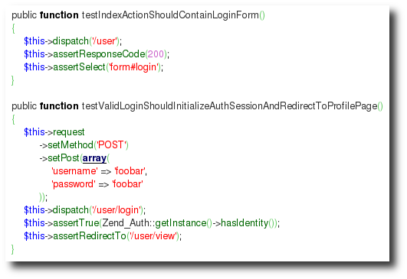
More testing examples
Valid response codes and login

Slide 96
Validation

Slide 97
Validation
Uses the Zend_Validate* classes
    $check = new Zend_Validate_Alnum();
    if ($check->isValid($GET[‘data’])) {
    // do stuff
    }
Each class extends the Zend_Validate_Interface interface
  You can use the internal validation classes or build your own

Slide 98
Validation
Pre-defined classes
Alnum Alpha Between Ccnum Date Digits EmailAddress Float GreaterThan | Hex Hostname InArray Int Ip LessThan NotEmpty Regex StringLength

Slide 99
Web Services

Slide 100
Client for web services
Interfaces into web service providers
  Example: Google data
Calendar Docs Exif Feed Gapps Gbase | Geo Media Photos Query Spreadsheets YouTube

Slide 101
Client classes for web services
Akismet
Amazon
Audioscrobbler
Delicious
Flickr
Nirvanix
ReCaptcha
Simpy
SlideShare
StrikeIron
Technorati
Twitter
Yahoo

Slide 102
Zend_Service_Yahoo
Search the web with Yahoo
  Get your application ID from http://developer.yahoo.com/wsregapp/
  Class uses Zend_Rest_Client under the covers
  Returns Zend_Service_Yahoo_WebResultSet containing instances of Zend_Service_Yahoo_WebResult $yahoo = new Zend_Service_Yahoo("YAHOO_APPLICATION_ID");
  $results = $yahoo->webSearch('IBM PHP',
array('results' => ‘10',
'start' => 1));
foreach ($results as $result) {
echo '<b>' . $result->Title . '</b> ' . $result->Url . '<br />';
}

Slide 103
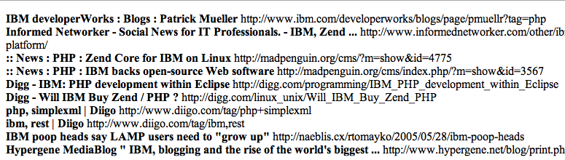
Results from $yahoo->webSearch

Slide 104
Other Yahoo search methods
$yahoo->imageSearch
$yahoo->videoSearch
$yahoo->localSearch
$yahoo->newsSearch

Slide 105
News Feeds

Slide 106
Importing news feeds
Usage
  $feed = Zend_Feed::import($url);
  Returns an instance of Zend_Feed_Abstract
    Implements the Iterator interface
Understands
  RSS 1.0
  RSS 2.0
  Atom

Slide 107
What’s New?

Slide 108
New in ZF 1.7x
Just a few of the enhancements:
  Performance enhancements in Zend_Loader, Zend_Controller, and server components
  Zend_Amf component
  Dojo Toolkit 1.2.1
  ZendX_JQuery component
  Zend_Tool in incubator
  Google book search API in Zend_Gdata
  Zend_Db_Table_Select support for Zend_Paginator

Slide 109
What’s Next?

Slide 110
Near future
From ZF wiki:
  framework.zend.com/wiki/display/ZFPROP/Home
  In Standard Library Incubator
Zend_Action_Controller Directory Tree: Christopher Thompson Zend_Crypt: Pádraic Brady Zend_Db Firebird-Interbase support Zend_MailRead Proposal: Nico Edtinger Zend_Server Proposal: Davey Shafik Zend_Uri Improvements: Shahar Evron Zend_Validate_BarcodeISBN13: Andries Seutens Zend_Mail_TransportQueue: Simon Mundy Zend_Controller_Action_Helper_MultiPageForm: Jurriën Stutterheim Zend_Db_Table_Plugin: Simon Mundy, Jack Sleight Zend_Queue: Justin Plock Zend_ Framework Default Project Structure: Wil Sinclair Zend_FilterStripNewlines: Martin Hujer Zend_Ascii: Ben Scholzen Zend_CryptRsa: Pádraic Brady Zend_Yadis: Pádraic Brady Zend_Oauth: Pádraic Brady Zend_View_Helper_Cycle: Kamil Nowakowski Zend_Gravatar Proposal: Wojciech Naruniec | Zend_RememberTheMilk Zend_Feed_Reader: Pádraic Brady & Jurriën Stutterheim Zend_Image_Barcode: Mickael Perraud & Julien Pauli Twitter Zend_Log factory(): Martin Roest Zend_LogWriterSyslog: Thomas Gelf Zend_Json_Expr to allow Javascript Expressions (functions) to be encoded using Zend_Json Extended Zend_Ldap Proposal: Stefan Gehrig Zend_Service_Digg: Luke Crouch Zend_LogWriterMail Zend_TagCloud: Ben Scholzen Zend_LoaderAutoloader: Ralph Schindler Zend_Markup: Pieter Kokx Zend_Validate_Db_RecordExists: Zend_Validate_Db_NoRecordExists: Ryan Mauger Zend_Controller_Router_Route_Rest: Luke Crouch Zend_Loader_Autoloader_Resource: Matthew Weier O'Phinney

Slide 111
Further out in the future
Emphasis on tooling to create and deploy projects
Look here: framework.zend.com/wiki/display/ZFPROP/Home

Slide 112
My goals
For my own apps
  Write more view helpers
  Refactor pre-1.6 piecemeal Dojo code with ZF’s built-in Dojo view helpers and form elements
  Replace homegrown database code with Zend_Db classes
    Consistent quoting, escaping, prepared statements, profiler
    And to provide feedback to developers
  Use more of Zend_Form’s power with Zend_Filter and Zend_Validate.
    My controller actions now do too much
ZF
  Contribute to Zend_Db_Adapter_Db2

Slide 113
In conclusion…

Slide 114
Zend Framework is…
A use-at-will component framework that is:
built with OO, PHP 5
intended to set a high standard for enterprise PHP
flexible with MVC to put you on right track
full of components that handle drudgery for you, and web services, too
always improving. You can contribute

Slide 115





Resources: books
Books in Japanese, German, Portuguese:

Slide 116
Resources: online
On the web:
  framework.zend.com/docs/quickstart
  survivethedeepend.com/pdf/survivethedeepend.pdf
  zfforums.com
Send me your thoughts:
  alan@alanseiden.com
  http://alanseiden.com (my blog)

Slide 117

Questions?
  alan@alanseiden.com
  See you at TGIF!

