Slide 1
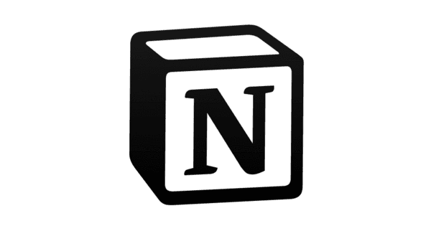

PROJECT PROPOSAL · ITI – INTENSIVE CODE CAMP – FAYOUM BRANCH
Open Notion Hub
FinStream
Project workspace Notion Engineering Hub
Click or scan: docs, roles, timeline, execution plan
Real-Time Financial Intelligence Platform
"From raw transaction to real-time decision in milliseconds."
10,000+
<100ms
6
3
Transactions / sec
Fraud Latency Target
Engineers
Real-life Problems
Streaming Analytics · Lakehouse Architecture · Real-Time ML · Fraud Detection

Slide 2
Meet the Team
FinStream · Team of 6 Engineers
E1
E2
E3
Mostafa Gamal Hamed
Khalid Mohamed Mohamed
Saleh Rabei Sayed
E4
E5
E6
Omar Mohamed Abdelaziz
Amira Yasser Mohamed
Al-Amir Mohamed Alaa Eldin

Slide 3
Executive Summary
FinStream is an end-to-end, production-grade data engineering platform that processes high-velocity financial events through real-time and batch pipelines, stores them in a medallion lakehouse, and surfaces actionable fraud detection, risk scoring, and market intelligence.
Real-Time Fraud Detection
Dynamic Risk Scoring
Every transaction scored for fraud within <100ms using live ML models embedded in the Flink pipeline.
Risk profiles updated per transaction — not per day — using rolling aggregates stored in Redis.
Market Intelligence
Full Audit & Observability
Live market signals from Polygon.io, news sentiment, and FX data processed into decisioning signals.
Immutable Bronze layer, Prometheus metrics, Grafana dashboards, and Great Expectations quality gates.

Slide 4
FinStream turns raw financial events into decisions while they are happening.
Real-time streams and batch Lakehouse features connect to fraud, risk, and market intelligence use cases.
Business Problems Delayed fraud detection Outdated risk scores Slow market awareness Scattered raw data
Data We Use Transactions Customer/card/merchant data Historical fraud outcomes Market ticks and news sentiment
Decisions We Produce Fraud score and action Updated risk profile Market signal and exposure alert Dashboards and audit trail
BUSINESS CASE
pitch: FinStream turns raw financial events into real-time fraud decisions, dynamic risk profiles, and market intelligence signals using a governed streaming lakehouse architecture.

Slide 5
Delayed financial decision-making is the business problem.
WHAT WE SOLVE
Each source is mapped to an explicit operational decision, not just stored for tooling practice.
Business Problem
Why It Matters
FinStream Response
Fraud is detected too late
Money may already be transferred before fraud is found
Score every transaction in real time using Flink plus ML/rules
Risk changes continuously
Daily batch risk scores become outdated
Update profiles from live behavior plus historical Gold features
Market/news events move exposure quickly
Price drops, negative sentiment, or volatility create risk
Convert ticks and sentiment into market intelligence signals
Raw data is scattered
Analysts and ML teams cannot trust inconsistent sources
Store events in governed Bronze/Silver/Gold lakehouse layers
Users need live and historical insight
Dashboards must show current alerts and trends
Serve real-time and curated data through ClickHouse/Superset

Slide 6
Every ingested dataset earns its place by producing a decision.
DATA LOGIC
This answers why transactions, market data, and news belong in the same financial data platform.
Data We Ingest
What We Extract
Decision / Output
Bank transactions
Amount patterns, velocity, merchant behavior, country/device anomalies
Fraud score, risk level, approve/review/block decision
Reference data
Customer profile, card history, merchant risk, country risk
Better fraud scoring and dynamic risk scoring
Historical transactions
30/60/90-day behavior, fraud rate, average amount, abnormal patterns
Gold features for ML training and risk profiles
Market ticks / FX / price data
Price spikes, volume anomalies, volatility
Market signals and exposure alerts
News / sentiment feeds
Sentiment plus topic/entity signals
Market intelligence and optional risk context
Raw Bronze event history
Immutable audit trail
Replay, debugging, compliance, model retraining

Slide 7
The architecture converts streaming events into live decisions and trusted Gold features.
DECISION FLOW
Real-time scoring and batch enrichment share the same governed lakehouse foundation.
Raw Financial Events Transactions | reference | market ticks | news
Kafka ingestion Live event transport
Flink processing Enrichment, scoring, rules
Real-time decisions fraud_score | risk_level | market_signal | alert/action
MinIO + Iceberg Bronze/Silver/Gold audit lakehouse
Spark/dbt enrichment Curated features and history
Serving layer ML training | Redis | ClickHouse | Superset

Slide 8
The technologies form one decision system across fraud, risk, and market intelligence.
USE-CASE MATRIX
Each layer contributes a specific business capability and avoids tool sprawl.
Capability
Fraud Detection
Dynamic Risk
Market Intelligence
Chosen Tools
Live event capture
Every transaction arrives as an event
Behavior changes arrive continuously
Ticks/news arrive continuously
Kafka + Schema Registry
Real-time scoring
Score transaction before settlement
Update risk after behavior changes
Detect volatility/sentiment signals
Flink + Redis
Audit + replay
Replay suspicious cases
Rebuild profiles from history
Replay market/news windows
MinIO + Iceberg
Historical features
Fraud rates, velocity, averages
30/60/90-day profiles
Volatility and sentiment history
Spark + dbt
Dashboards
Fraud alerts and outcomes
Risk profile trends
Market/exposure signals
ClickHouse + Superset
Production trust
SLAs, quality gates, run history
Reliable feature publishing
Healthy jobs and metrics
Airflow + Docker + GX + Prom/Grafana

Slide 9
Project Description & Core Idea
What is FinStream?
The Core Idea
FinStream is a production-grade, end-to-end data engineering platform designed to ingest, process, store, and serve high-velocity financial and transactional data in real time.
It combines a streaming speed layer (Apache Flink), a batch enrichment layer (Apache Spark), and a unified medallion lakehouse (MinIO + Apache Iceberg) to deliver a single source of truth for fraud detection, risk scoring, and market intelligence.
The platform processes synthetic bank transactions, live market ticks, and social sentiment feeds simultaneously, making it a realistic simulation of an enterprise-grade financial intelligence system.
1
Traditional financial platforms process data in hourly or daily batches — fraud is detected only after money is already moved. Bad Risk Scoring and far from market analysis
2
FinStream eliminates this lag using a Lambda Architecture: a real-time speed layer (Flink) and a batch layer (Spark) running in parallel.
3
Every transaction is scored within milliseconds using ML models trained on historical Gold data and served live inside Flink.
4
Three Flink output paths run simultaneously: raw storage to MinIO Bronze, live scores to ClickHouse, and high-risk alerts to Kafka.
5
The medallion lakehouse (Bronze → Silver → Gold) ensures all consumers share one governed, high-quality source of truth.

Slide 10
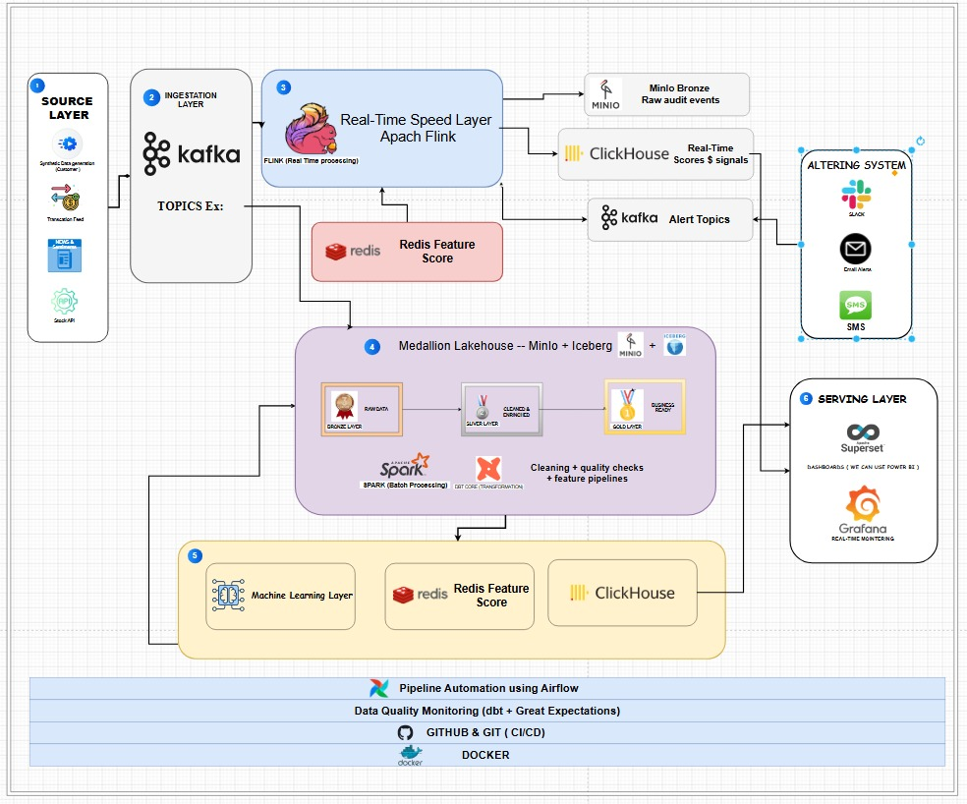
Data Flow Diagram “Sketch Using Draw.io”
FOR CLAIRTY PURPOSE

Slide 11



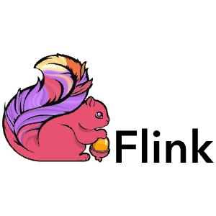
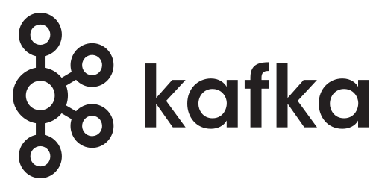






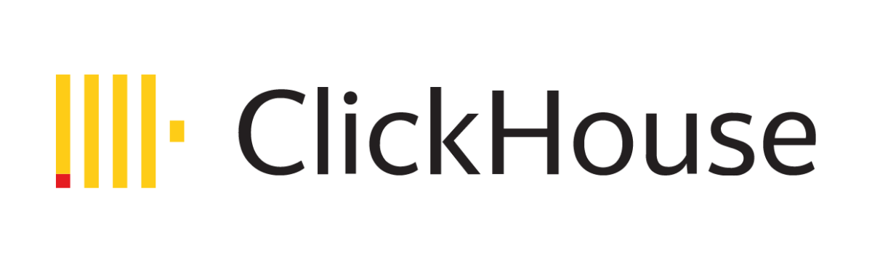
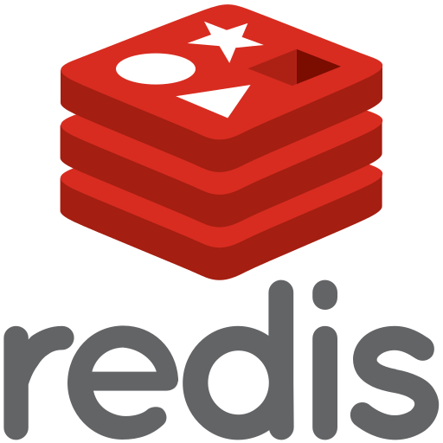

Tech Stack – Tools

Slide 12
Benefits & Target Outcomes
Business Outcomes
Technical / Portfolio Outcomes
Fraud Detection
Full-Stack Data Engineering
Transactions scored and flagged before they complete settlement.
Streaming, batch, lakehouse, MLOps, and DevOps — in one coherent system.
Dynamic Risk Scoring
Production-Grade Patterns
Risk profiles updated on every event — not on a daily batch schedule.
Exactly-once semantics, schema evolution, data quality contracts, model governance.
Market Intelligence Signals
Enterprise-Transferable Stack
Real-time decisioning signals from prices, FX, and sentiment data.
Every tool is industry-standard and in active use at Fortune 500 companies.
Immutable Audit Trail
CI/CD Driven Platform
Every raw event preserved permanently in the Bronze layer for compliance.
GitHub Actions, Docker, and Airflow deliver automated testing and deployment.
Automated Actions
End-to-End Observability
Card blocking and Slack/email alerts triggered without human intervention.
Prometheus metrics and Grafana dashboards cover every layer of the platform.

Slide 13
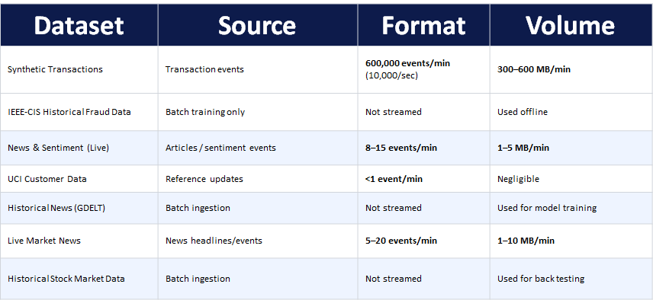
Datasets & Sources
All datasets are either open-source, freely accessible via API, or synthetically generated for portfolio and educational use.

Slide 14


Pipeline Sequence — Steps 1 to 5
1 of 2
# | Step Name | Layer | Tools | Description
1 | Data Generation | Source Layer | Python, Faker, Polygon.io, NewsAPI, Reddit API | Python scripts simulate 10K tx/sec. Market ticks pulled from Polygon.io. News sentiment fetched from NewsAPI and Reddit. Acts as the live event source.
2 | Event Ingestion | Ingestion Layer | Apache Kafka, Confluent Schema Registry, Kafka Producer | Events published to 5 Kafka topics. Schema Registry validates all messages against Avro schemas. Bad messages routed to a Dead Letter Queue topic.
3 | Stream Processing | Real-Time Layer | Apache Flink, Redis, PyFlink | Flink validates, enriches, and scores events in milliseconds. Redis provides sub-ms feature lookups. Outputs fan out to 3 parallel paths simultaneously.
3a | Path 1 — Raw Store | Flink Output | Flink Sink, MinIO, Parquet / Avro | All raw events written immutably to MinIO Bronze layer the moment Flink processes them. Creates permanent audit record for compliance and replay.
3b | Path 2 — Analytics | Flink Output | Flink Sink, ClickHouse | Real-time fraud scores and market signals written directly to ClickHouse. Enables sub-second dashboard queries without waiting for batch jobs.

Slide 15

Pipeline Sequence — Steps 6 to 9
2 of 2
# | Step Name | Layer | Tools | Description
3c | Path 3 — Alerts | Flink Output | Flink Sink, Kafka fraud_alerts | High-risk events emitted to the fraud_alerts Kafka topic. Downstream consumers read this topic to trigger automated alerting and card-blocking actions.
4 | Lakehouse Storage | Storage Layer | MinIO, Apache Iceberg, dbt Core | Bronze → Silver → Gold medallion on MinIO with Iceberg as open table format. dbt Core manages SQL transformation logic between tiers.
5 | Batch Processing | Batch Layer | Apache Spark, dbt Core, Airflow | Airflow-scheduled Spark jobs build customer profiles, risk features, and Gold marts. Great Expectations validates quality at each tier boundary.
6 | ML Training | ML Layer | MLflow, scikit-learn, XGBoost, Feature Store | Models trained on Silver/Gold features, tracked in MLflow. Registered models deployed live into the Flink scoring pipeline via the Model Registry.
7 | Serving & Analytics | Serving Layer | ClickHouse, Apache Superset, Grafana | ClickHouse serves real-time and historical OLAP queries. Superset for dashboards. Grafana for system health. APIs expose scores to applications.
8 | Alerting System | Alerting Layer | Python consumer, SMTP, Slack API, Card Management API | Python consumer reads fraud_alerts topic and dispatches email, Slack, and SMS notifications. Automated card-blocking via mock API.
9 | Infrastructure | DevOps Layer | Docker, Airflow, GitHub Actions, Prometheus, Grafana | All services containerized in Docker. GitHub Actions CI/CD. Airflow orchestrates batch jobs. Prometheus + Grafana cover full observability.

Slide 16
Kafka, Flink, and Redis fit the fraud decision path.
SPEED LAYER
This is the part of FinStream that must act while the transaction is still fresh.
Kafka Event backbone
Schema Registry Validated contracts
Flink Stateful scoring
Action approve/review/block
Redis Feature lookup
Tool
Use Case Fit
Advantages
Kafka
Transactions, market ticks, news
Durable event stream; decouples producers from processors and sinks.
Schema Registry
Financial event contracts
Prevents silent schema drift across topics.
Flink
Fraud + risk scoring
Stateful event-time windows, joins, and low-latency enrichment.
Redis
Online features
Fast customer/card/merchant risk lookup during scoring.
Sources: Apache Kafka introduction; Apache Flink stateful stream processing docs; Redis docs.

Slide 17
Distribution of Work — Team of 6
Data Ingestion Engineer
Batch Processing & Analytics Eng.
E1
Python data producers, Kafka topic design & partitioning, Schema Registry setup, DLQ monitoring
E4
Spark batch jobs, ClickHouse schema & ingestion, Superset dashboard development, ad-hoc SQL analytics
Python · Kafka · Avro · Schema Registry
Spark · ClickHouse · SQL · Superset
Stream Processing Engineer
ML & Feature Engineering
E2
All 3 Flink output paths, Redis feature store integration, real-time fraud/risk scoring, stateful ops & exactly-once semantics
E5
Feature pipelines from Silver/Gold, model training & evaluation, MLflow tracking, model registry, live Flink inference integration
Apache Flink · Redis · PyFlink · Java
Python · MLflow · scikit-learn · XGBoost
Lakehouse & Transformation Eng.
Platform Engineering & DevOps
E3
MinIO setup, Iceberg table design, dbt models (Bronze→Silver→Gold), Great Expectations quality checks
E6
Docker Compose setup, GitHub Actions CI/CD, Airflow DAGs, Prometheus & Grafana monitoring, alerting system
MinIO · Iceberg · dbt Core · SQL
Docker · Airflow · GitHub Actions · Grafana

Slide 18
Project Category
Big Data
Qualifies on all three Vs: Volume (10K tx/sec), Velocity (sub-second processing), and Variety (transactions, market ticks, news, FX).
Lambda Architecture
Speed layer (Flink real-time) + batch layer (Spark) run in parallel and reconcile in ClickHouse — the textbook Lambda pattern.
Lakehouse Architecture
MinIO + Apache Iceberg + Bronze/Silver/Gold medallion pattern combines data lake flexibility with data warehouse governance.
MLOps Platform
MLflow tracking, feature store, model registry, and live Flink inference make this a full MLOps system, not just a data pipeline.
DataOps / Platform Eng.
CI/CD with GitHub Actions, Airflow orchestration, Great Expectations quality gates, and full Prometheus + Grafana observability.
Portfolio positioning: "A production-grade Lakehouse + Lambda architecture with an embedded MLOps layer, designed for real-time financial intelligence at enterprise scale."

Slide 19
MinIO, Iceberg, Spark, and dbt make the raw data trustworthy.
LAKEHOUSE LAYER
The goal is not only storage; it is replay, audit, feature building, and repeatable business logic.
Bronze Raw immutable events MinIO stores event history in S3-compatible object storage.
Silver Cleaned + conformed Iceberg gives open analytic tables, snapshots, schema evolution, and engine interoperability.
Gold Trusted features Spark and dbt build model features, risk profiles, aggregations, and dashboard-ready marts.
MinIO S3-compatible object storage
Iceberg Open analytic table format
Spark Distributed batch enrichment
dbt Tested SQL business models
Sources: MinIO docs, Apache Iceberg docs, Apache Spark docs, dbt documentation.

Slide 20
ClickHouse and Superset serve business users; Prometheus and Grafana serve engineers.
SERVING LAYER
FinStream needs two visibility surfaces: financial intelligence dashboards and platform health dashboards.
Business analytics ClickHouse receives curated/live analytics tables for fast SQL over alerts, fraud outcomes, risk profiles, and market signals. Superset turns those tables into analyst-facing dashboards.
Operational observability Prometheus captures service and pipeline metrics: throughput, lag, failures, latency, and resource health. Grafana visualizes whether the platform is meeting the <100ms target.
ClickHouse Real-time analytics
Superset Business dashboards
Prometheus Pipeline metrics
Grafana Ops dashboards
Sources: ClickHouse real-time analytics page; Apache Superset docs; Prometheus/Grafana project documentation.

Slide 21
Airflow, Docker, and Great Expectations turn the project into a repeatable platform.
PRODUCTION CONTROL
This is what moves the proposal from a demo pipeline toward an enterprise-style data engineering system.
Airflow Schedule and monitor batch workflows, backfills, dbt runs, quality checks, and training jobs.
Docker Package services consistently so Kafka, Flink, Spark, MinIO, Redis, ClickHouse, and Superset run as one reproducible environment.
Sources: Apache Airflow docs; Docker docs; Great Expectations documentation.

Slide 22
Thank You
FinStream — Real-Time Financial Intelligence Platform
Real-time fraud detection at <100ms
Full MLOps with MLflow model registry
Medallion lakehouse with Iceberg + MinIO
CI/CD, Docker, Airflow, Prometheus
Lambda architecture: Flink + Spark
Team of 6, clearly distributed ownership
Project workspace Notion Engineering Hub
Click or scan: docs, roles, timeline, execution plan
Questions & Discussion

