Slide 1

Fast and Parallel Algorithms for Finding Top K Frequent Elements
Mostafa Hosseini
COMP 5704
FALL 2022

Slide 2
Contents
Introduction & Problem Definition
Solutions: Exact Algorithm & Approximate Algorithm
Asketch
Topkapi
Proposed Method
Parallelism
Implementation Setup & Results
Conclusion
Questions

Slide 3


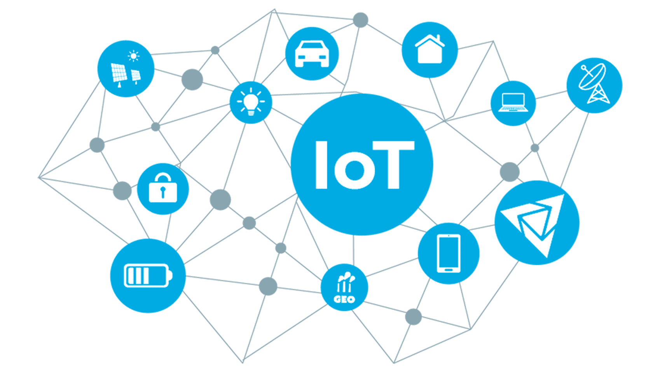


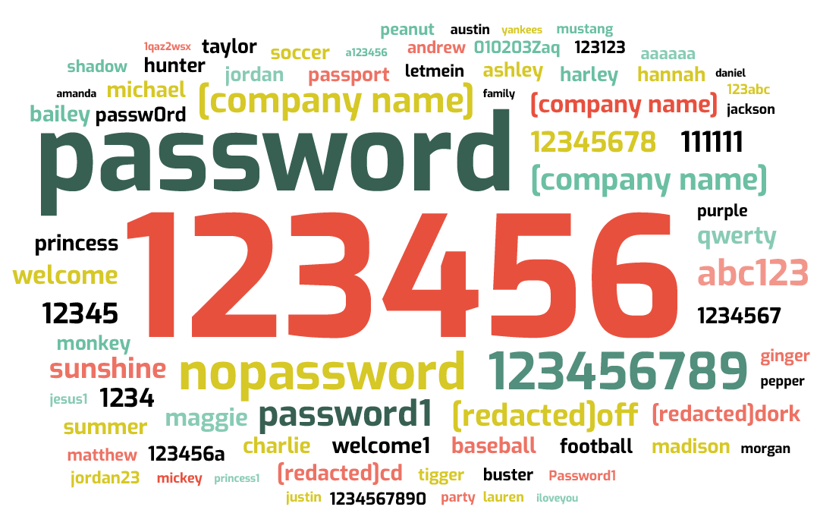

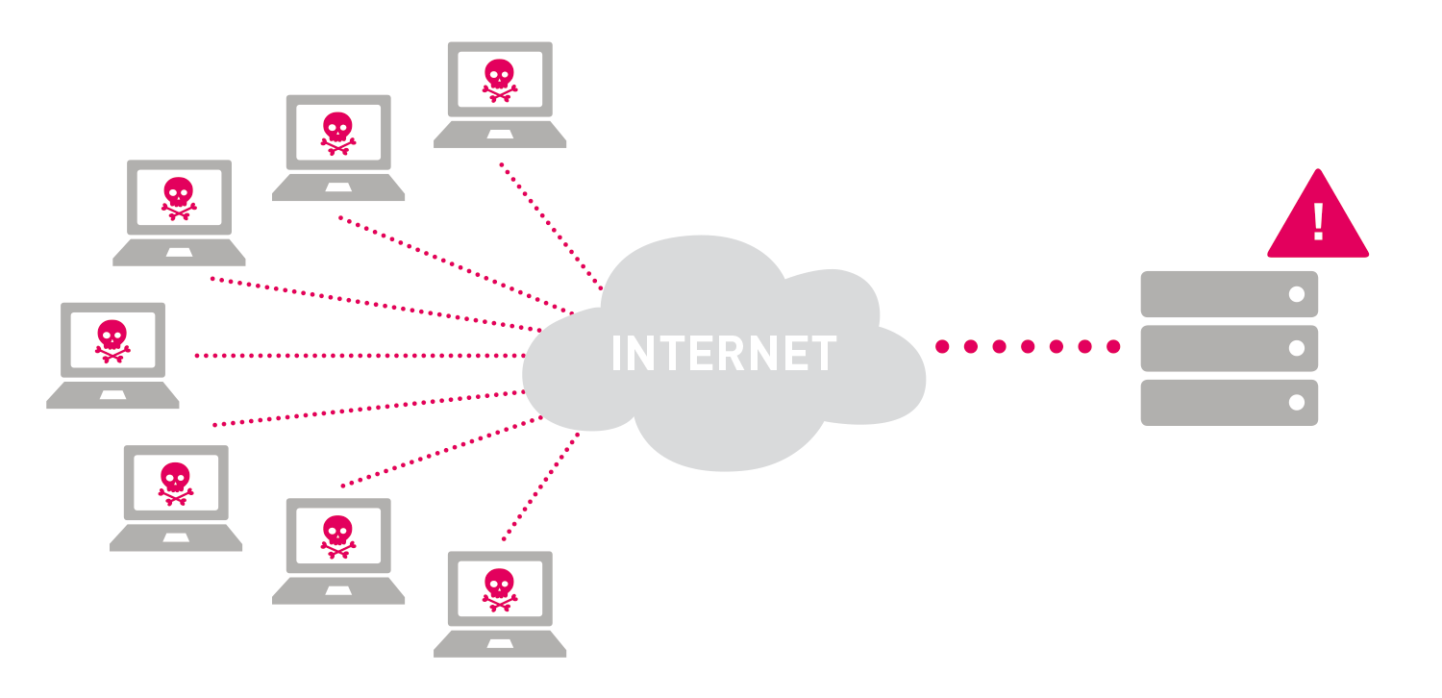
Introduction
Finding top-K frequent elements over the massive data stream
Popular Password Attack
High Traffic IPs
Best Selling products

Slide 4
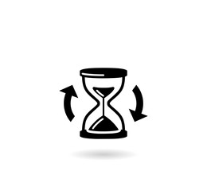
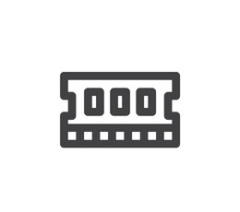



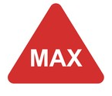

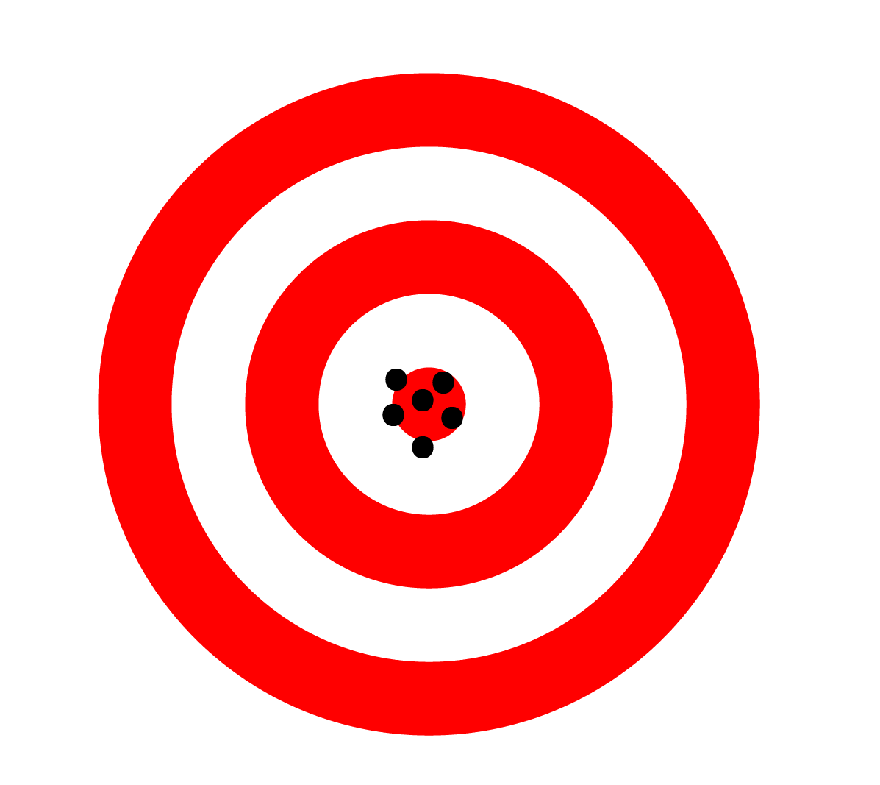


Solution
Limitations
Processing Time
Memory Space
Exact Algorithm:
$$\text{runtime} \text{complexity}= O\left(nlogn\right)$$
$$\text{memory} \text{space}= O\left(n\right)$$
Data Stream (n items)
Approximate Algorithm:
$$\text{runtime} \text{complexity}≪O\left(nlogn\right)$$
$$\text{memory} \text{space}≪O\left(n\right)$$
High Performance
High Accuracy

Slide 5
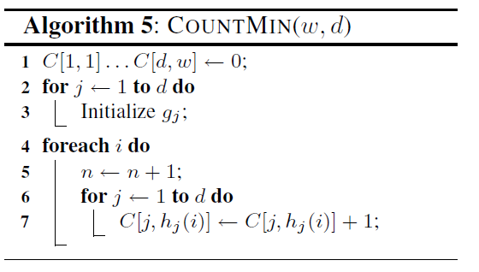
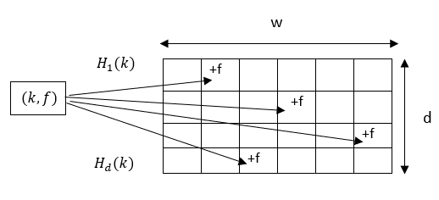
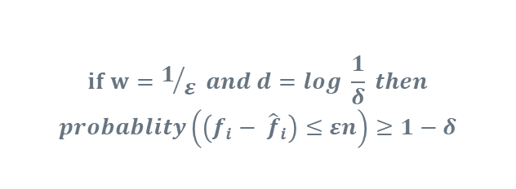

Sketch-based algorithms
Count Min Sketch (CMS)
${\hat{f}}_{i}= \min_{1≤j≤d} C[j,h_{j}(i)]$
$$if w=1/ε and d=log \frac{1}{δ} then$$
$$probablity\left(\left(f_{i}− {\hat{f}}_{i}\right)≤εn\right)≥1−δ$$

Slide 6
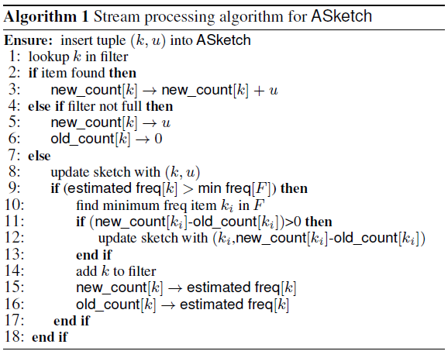
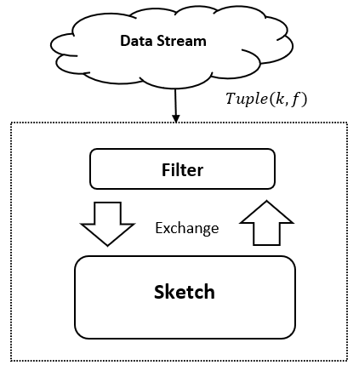
Augmented Sketch (ASketch)

Slide 7
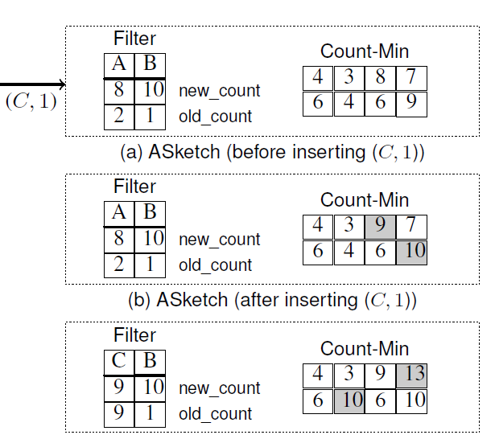
Augmented Sketch (ASketch)

Slide 8
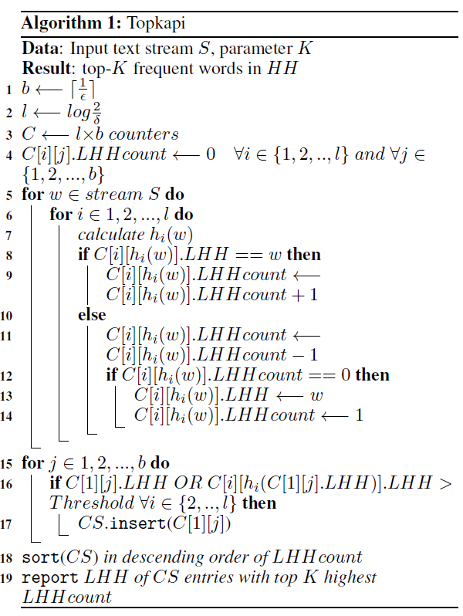
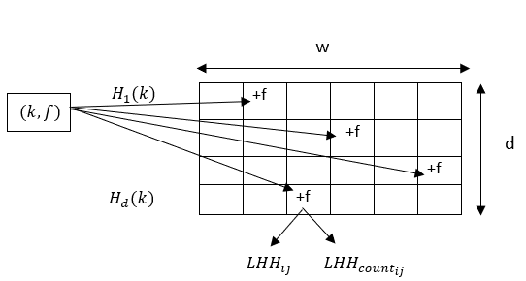
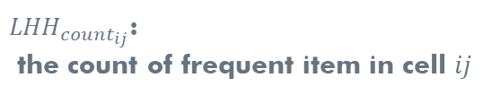
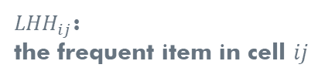
Topkapi
${LHH}_{ij}$:
the frequent item in cell $ij$
${LHH}_{{count}_{ij}}$:
the count of frequent item in cell $ij$

Slide 9

Proposed Method
Computation Time in the filter
searching an item
Finding minimum item

Slide 10
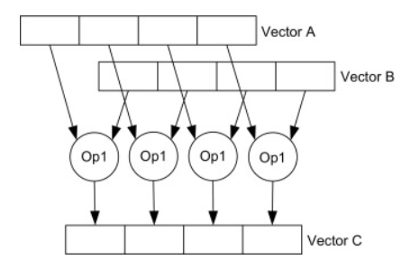
SIMD Intrinsic
128-bit vector register
Byte0 | Byte1 | Byte2 | Byte3 | Byte4 | Byte5 | Byte6 | Byte7 | Byte8 | Byte9 | Byte10 | Byte11 | Byte12 | Byte13 | Byte14 | Byte15
int16 |  | int16 |  | int16 |  | int16 |  | int16 |  | int16 |  | int16 |  | int16
Int32/float32 |  |  |  | Int32/float32 |  |  |  | Int32/float32 |  |  |  | Int32/float32
float64 |  |  |  |  |  |  |  | float64
256-bit vector register
SIMD Instruction Set:
SSE -128
AVX -256
AVX-512
B | B | B | B | B | B | B | B | B | B | B | B | B | B | B | B | B | B | B | B | B | B | B | B | B | B | B | B | B | B | B | B
int16 |  | int16 |  | int16 |  | int16 |  | int16 |  | int16 |  | int16 |  | int16 |  | int16 |  | int16 |  | int16 |  | int16 |  | int16 |  | int16 |  | int16 |  | int16
Int32/float32 |  |  |  | Int32/float32 |  |  |  | Int32/float32 |  |  |  | Int32/float32 |  |  |  | Int32/float32 |  |  |  | Int32/float32 |  |  |  | Int32/float32 |  |  |  | Int32/float32
float64 |  |  |  |  |  |  |  | float64 |  |  |  |  |  |  |  | float64 |  |  |  |  |  |  |  | float64

Slide 11
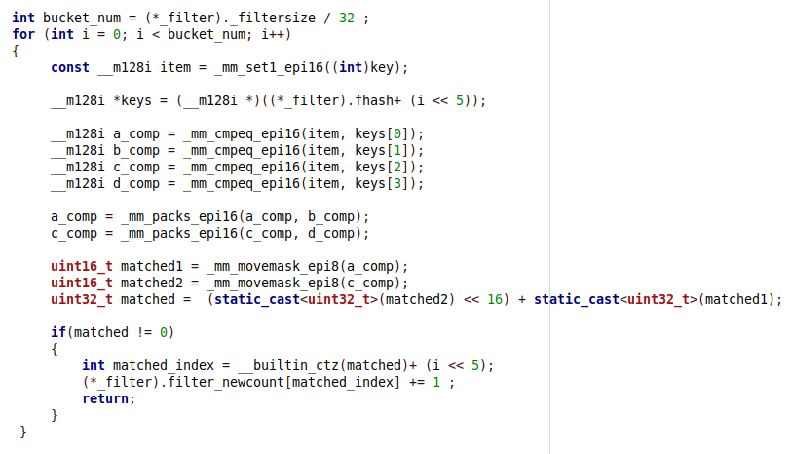
SIMD Intrinsic

Slide 12
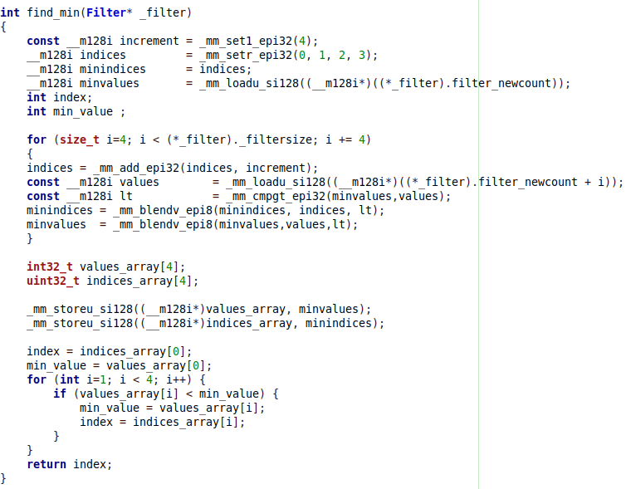
SIMD Intrinsic

Slide 13
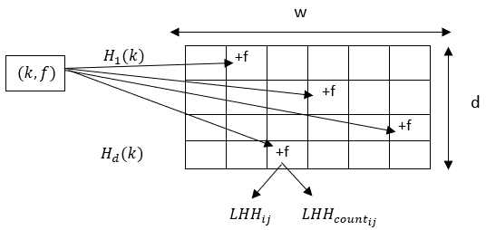
Multi-Core Parallelism
Topkapi
Merging all sketches
…
…
Thread 1
Thread i
Thread n

Slide 14
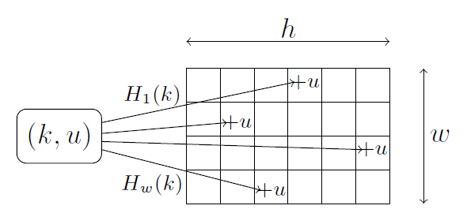
Multi-Core Parallelism
Asketch
Proposed Method
Merging all filters
…
…
Thread 1
Thread i
Thread n

Slide 15
Implementation Setup
CPU: AMD Ryzen 9 4900HS
8 cores – 16 threads
L1: 512KB- L2: 4MB- L3: 8MB
RAM: 16 GB
Implementation Language: C++
OpenMP API
Dataset: Project Gutenberg corpus
1.5 GB Text file
300,000,000 words
Number of buckets: 1024 , Number of hash functions: 4
Experimental results: averaged over 10 runs

Slide 16
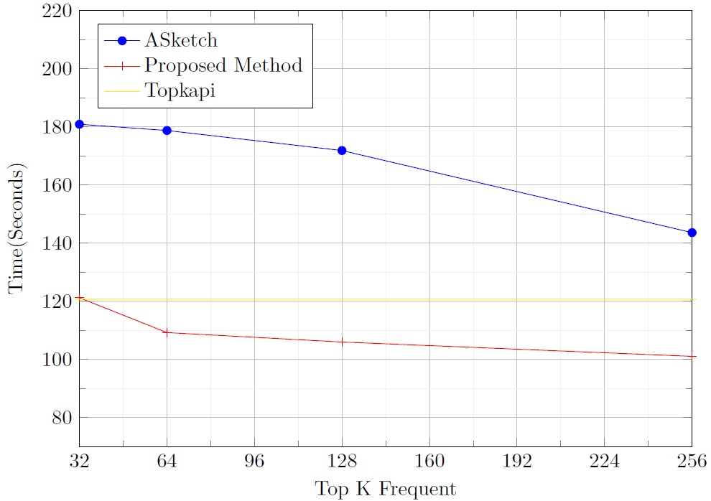
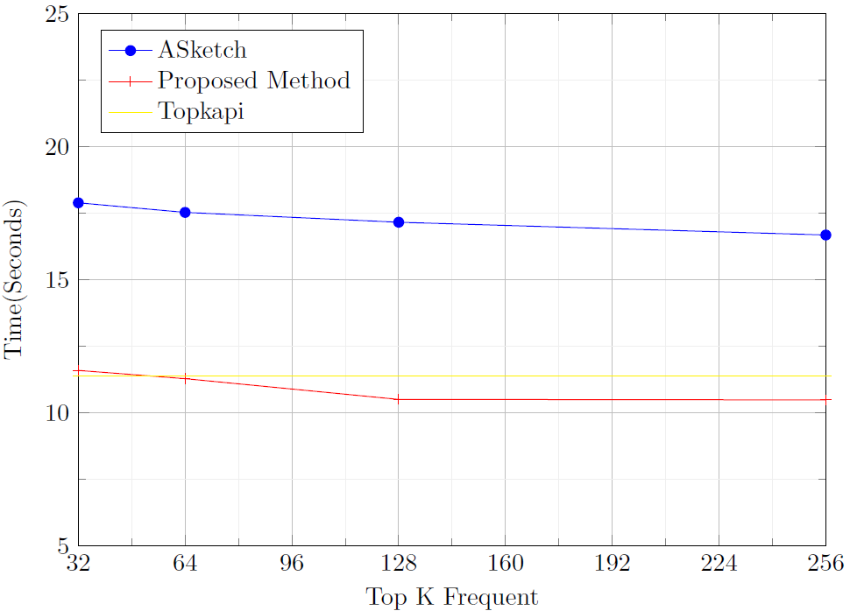
Result
Sequential Implementation
Parallel Implementation

Slide 17
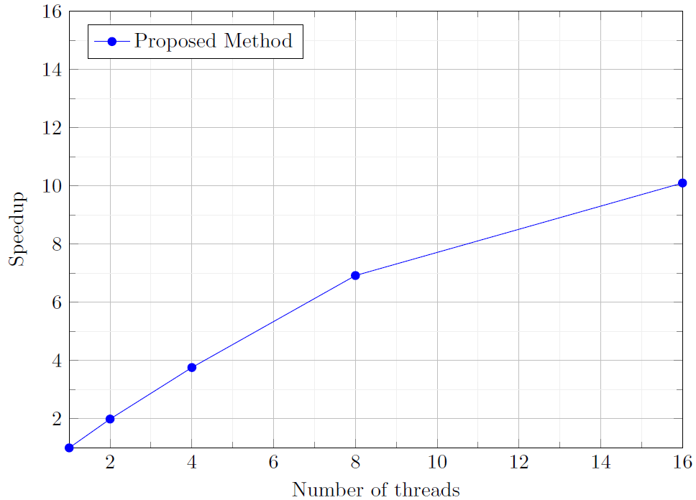
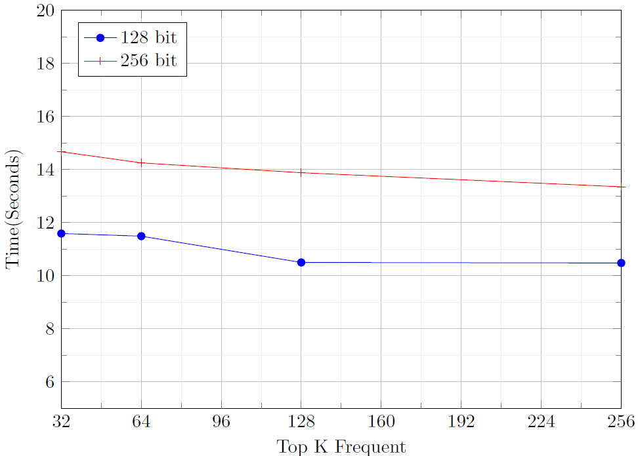
Result
Proposed Method Speedup
128-bit vector vs 256-bit vector

Slide 18
Conclusion
Using approximate algorithm for finding top frequent items
Comparing three methods
Topkapi
Asketch
the proposed method
Parallelizing the algorithms
SIMD for the filter part
Multi-Core parallelism for the sketch part
Future work: Implementing Distributed Parallelism

Slide 19
Question
Q1. What is the main difference between CMS and Asketch?
Q2. How we can increase the accuracy of Sketch-based
Algorithm?
Q3. In which part of proposed algorithm did we use SIMD intrinsic ?
And why do we use it?

Slide 20
Thanks

