Slide 1
Zero-Shot Nutrient & Quantity Association
Using OCR-GUIDED SEMANTIC GRAPH MATCHING
Recovering structured facts from label photographs — with no training labels.
Student
Supervisor
INSTITUTION · DATE
Moustafa Hamada
Prof. Dr. Andreas Fischer
THD · July 2026
Co-Supervisor
Prof. Dr. oec. troph. Claudia Osterkamp-Baerens

Slide 2
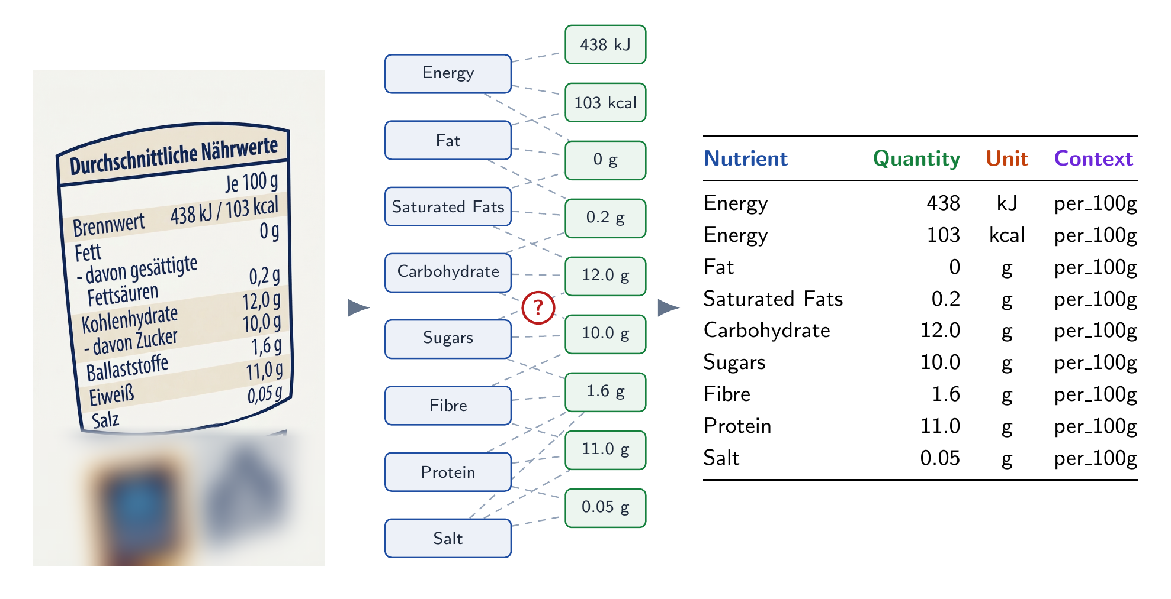
01 / THE PROBLEM
OCR-GUIDED SEMANTIC GRAPH MATCHING
A label is a picture. The facts inside it are not.
Which value belongs to which nutrient? — recover ⟨ nutrient, quantity, unit, context ⟩, zero-shot, across languages.
Zero-Shot Nutrient & Quantity Association
02 / 19

Slide 3
02 / THE OBVIOUS MOVE
OCR-GUIDED SEMANTIC GRAPH MATCHING
The obvious move: hand the photo to a model.
label photo
→
one opaque VLM call
→
⟨n, q, u, x⟩
Zero-shot and simple — but opaque, costly, and impossible to audit. When a tuple is wrong, nothing tells you which step failed.
Zero-Shot Nutrient & Quantity Association
03 / 19

Slide 4
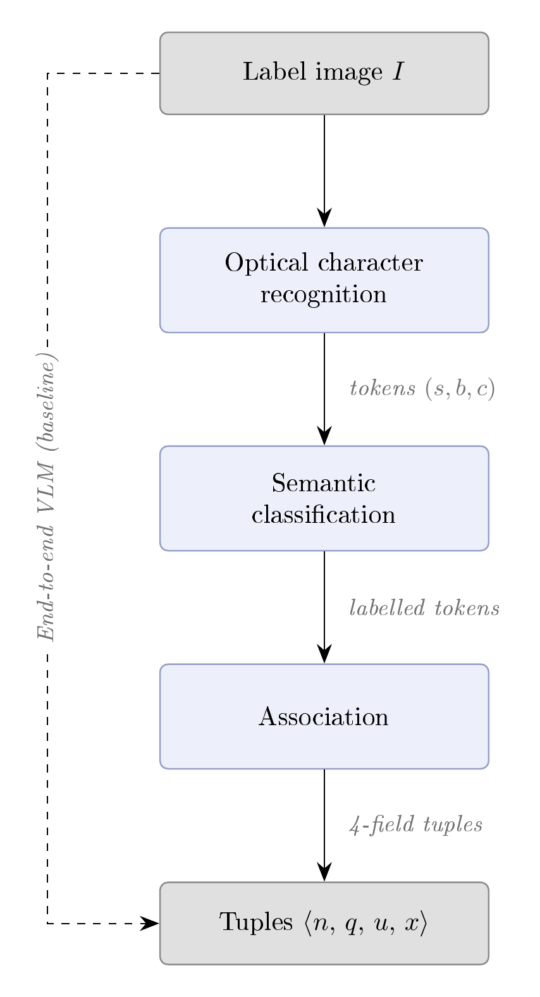
03 / OUR APPROACH
OCR-GUIDED SEMANTIC GRAPH MATCHING
Break the problem into stages you can read.
Instead of one opaque model, the task is split into three transparent stages — each stage swappable, every output you can inspect.
01
Read — OCR turns the label photo into located text tokens.
02
Label — classification gives every token a role.
03
Bind — association links tokens into ⟨n, q, u, x⟩ tuples.
No learned weights — every tuple is a path you can trace back to one stage.
Three stages, each swappable
Zero-Shot Nutrient & Quantity Association
04 / 19

Slide 5
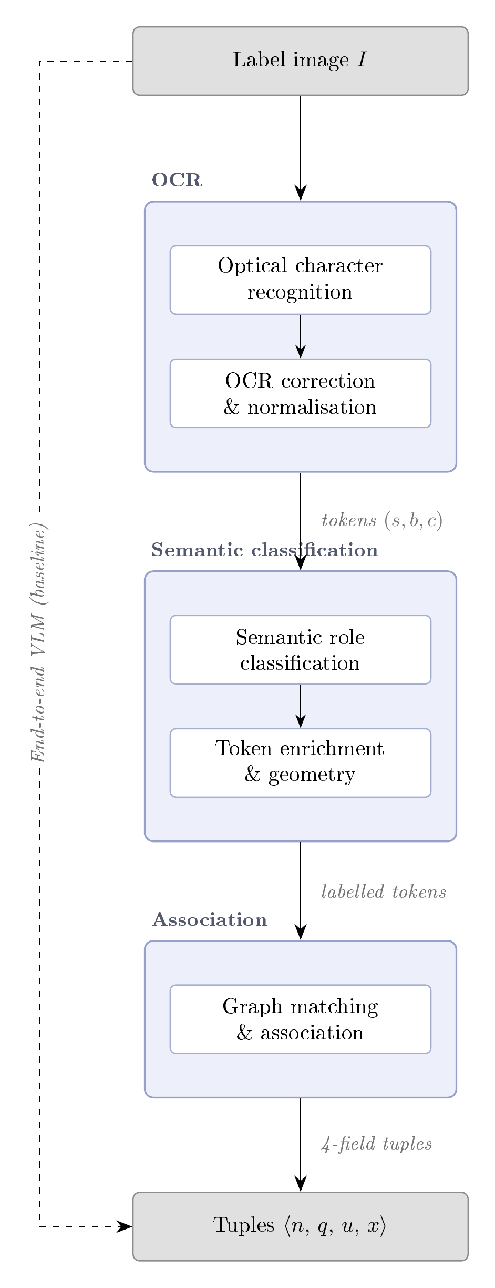
03 / CLOSER LOOK
OCR-GUIDED SEMANTIC GRAPH MATCHING
A closer look into the pipeline
OCR
Optical character recognition — OCR model reads the image into raw tokens (s, b, c). OCR correction & normalisation — OCR_corrector fixes misreads, merges tokens, fix fused tokens, canonicalises to English (C15).
SEMANTIC CLASSIFICATION
Semantic role classification —rule / BGE-M3 / GLiNER-biomed tags each token nutrient, quantity, unit or context. Token enrichment & geometry — TokenEnricher attaches column IDs, row/rank, dosage-stream and header info.
ASSOCIATION
Graph matching & association — Graph Constructor builds a typed graph (row / column / overlap edges), then links each nutrient to its quantity, unit and context.
Output — the four-field tuples ⟨n, q, u, x⟩. read → clean → label → add geometry → link → emit tuples
Zero-Shot Nutrient & Quantity Association
05 / 19

Slide 6
03 / STAGE 1 — OCR
OCR-GUIDED SEMANTIC GRAPH MATCHING
STAGE 1
TWO ENGINES WE COMPARE
Optical character recognition
EasyOCR
Popular open-source reader with broad, out-of-the-box language coverage — our baseline.
Turn the label photograph into machine-readable text — find every printed string and read it, in any language, with no assumptions about the layout.
PaddleOCR PP-OCRv5
Baidu's latest detection + recognition models; stronger on dense, multilingual label text.
OUTPUT — LOCATED TOKENS
{ "Kohlenhydrate", box, conf 0.93 }
Compared head-to-head in Q1.
Each token carries its text, its position on the label, and a confidence — the ⟨s, b, c⟩ that feeds classification.
Zero-Shot Nutrient & Quantity Association
06 / 19

Slide 7
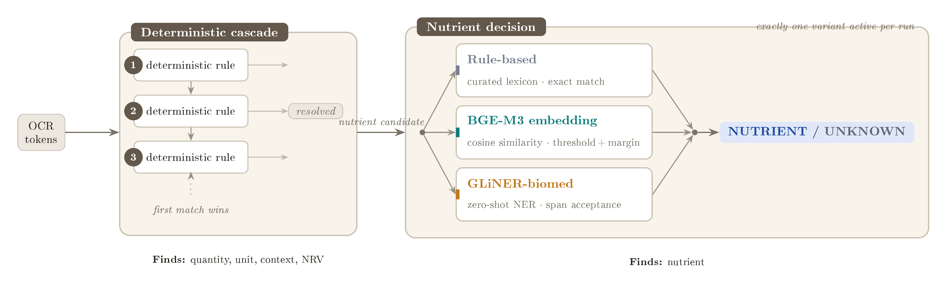
03 / STAGE 2 — CLASSIFICATION
OCR-GUIDED SEMANTIC GRAPH MATCHING
STAGE 2
Semantic classification
Give every token a role. A deterministic cascade resolves the easy ones — quantity, unit, context, NRV — while the hard open-vocabulary call, “is it a nutrient?”, is decided by one of three interchangeable variants.
Zero-Shot Nutrient & Quantity Association
07 / 19

Slide 8
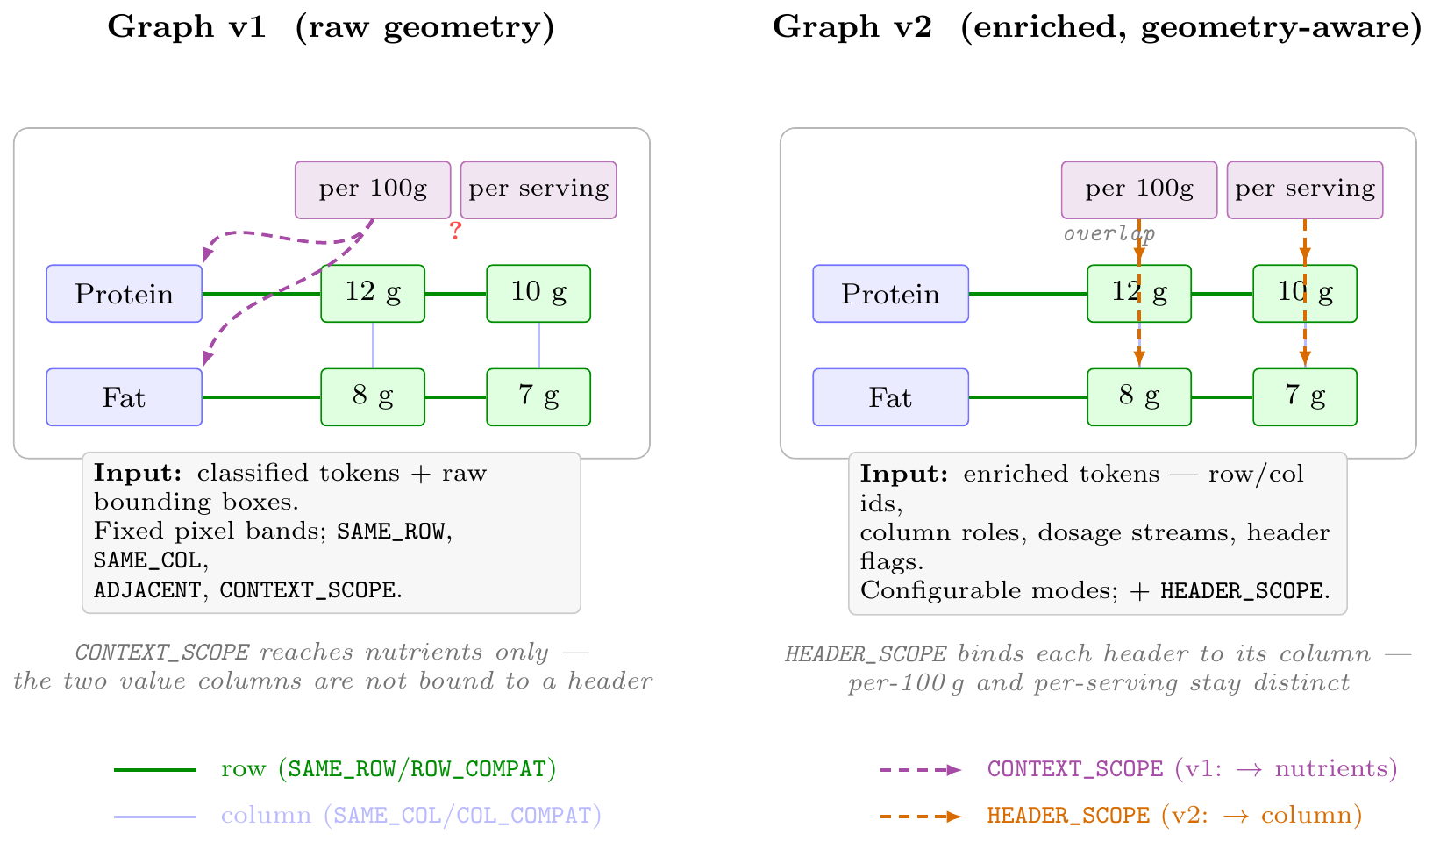
03 / STAGE 3 — ASSOCIATION
OCR-GUIDED SEMANTIC GRAPH MATCHING
STAGE 3
Association
Each token is a node; typed edges link them by geometry into one tuple per nutrient. Two variants — graph v1 (raw) and graph v2 (geometry-aware), below.
EDGE TYPES
ROW_COMPAT nutrient ↔ quantity
Primary axis — links each nutrient to the quantity on its row, pulling that value into the tuple.
COL_COMPAT sub-nutrient fallback
A sub-nutrient with no value of its own inherits the quantity from the parent above it in the column.
DIRECTIONAL_ADJ unit recovery
Reaches a unit sitting near a number but not grouped with it, so a detached unit still reaches its quantity.
CONTEXT_SCOPE + HEADER_SCOPE context
Carry a context header down to the values beneath — per 100 g / per serving / per daily dose.
Zero-Shot Nutrient & Quantity Association
08 / 19

Slide 9
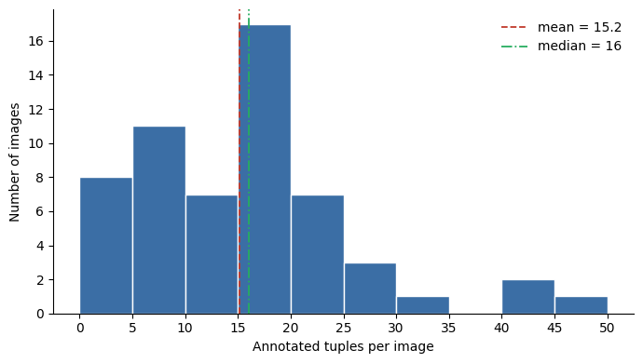
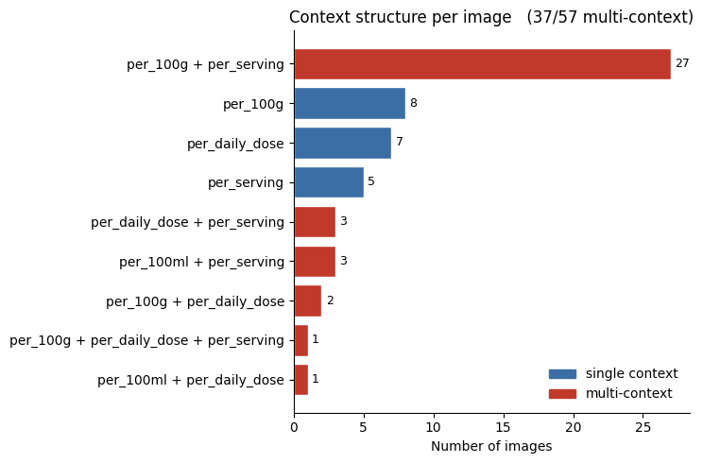
04 / DATASET & EVALUATION
OCR-GUIDED SEMANTIC GRAPH MATCHING
Dataset & evaluation
57 label images
866 gold tuples
0 training labels — zero-shot
Tuples per image — mean 15.2; a few dense tables carry a third of all tuples.
65% of labels mix two+ contexts — why a value needs its column, not just its row.
Scored on the four-field tuple ⟨n, q, u, x⟩ — correct only if all four fields match. A deterministic scorer reports precision / recall / F1 pooled over all 866 tuples; 4F-F1 is the headline.
Zero-Shot Nutrient & Quantity Association
09 / 19

Slide 10
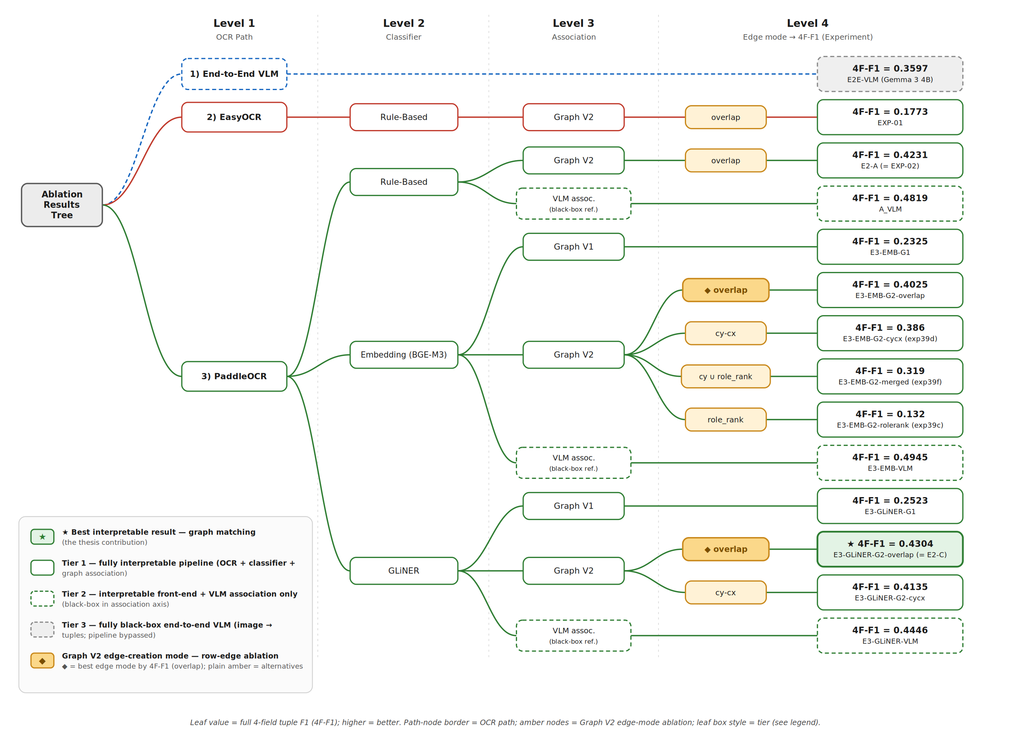
05 / THE ABLATION Tree
OCR-GUIDED SEMANTIC GRAPH MATCHING
Zero-Shot Nutrient & Quantity Association
10 / 19

Slide 11
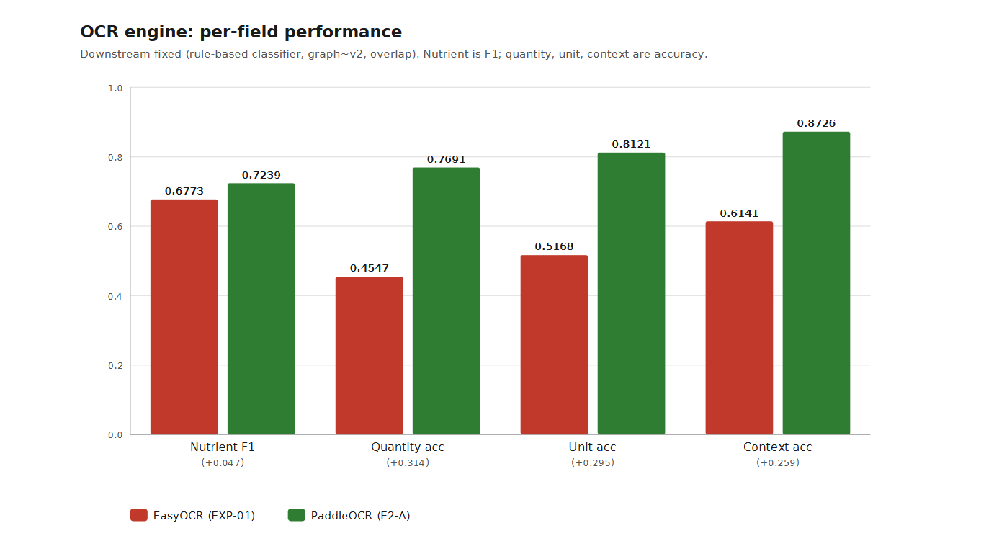
Q1 / OCR ENGINE
OCR-GUIDED SEMANTIC GRAPH MATCHING
Q1 Which engine reads the labels best? EasyOCR · PaddleOCR
Reading values — not names — decides the tuple.
Per-field accuracy over matched nutrients · downstream fixed (rule-based · graph v2 · overlap)
Names tie; PaddleOCR wins the values — 4F-F1 .177 → .423
Zero-Shot Nutrient & Quantity Association
11 / 19

Slide 12
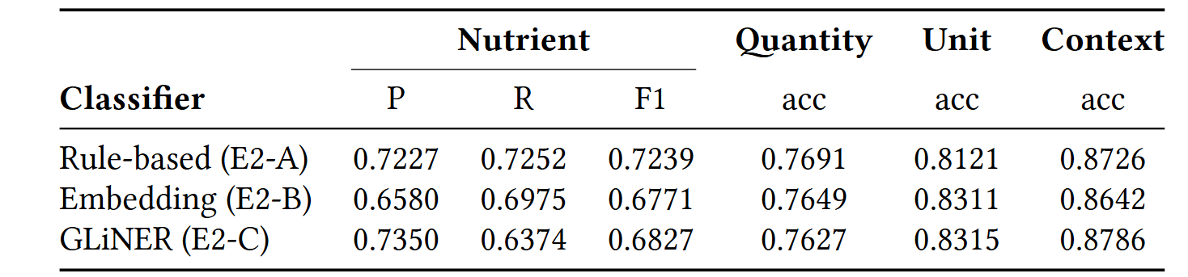
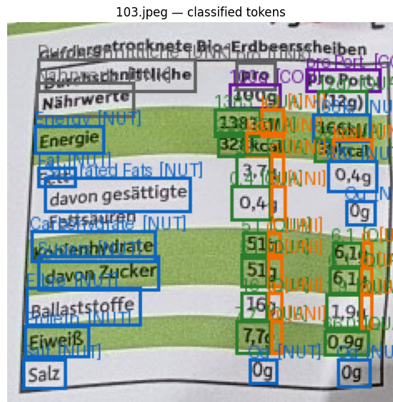
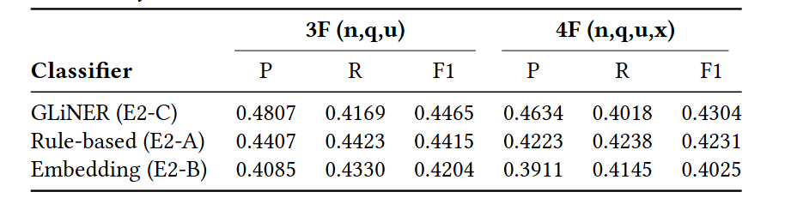
Q2 / NUTRIENT DECISION
OCR-GUIDED SEMANTIC GRAPH MATCHING
Q2 How do we decide “is this a nutrient?” rule · embedding · GLiNER
Precision wins the tuple — GLiNER leads.
The graph binds whatever it is given — so fewer false positives beat higher recall.
Zero-Shot Nutrient & Quantity Association
12 / 19

Slide 13
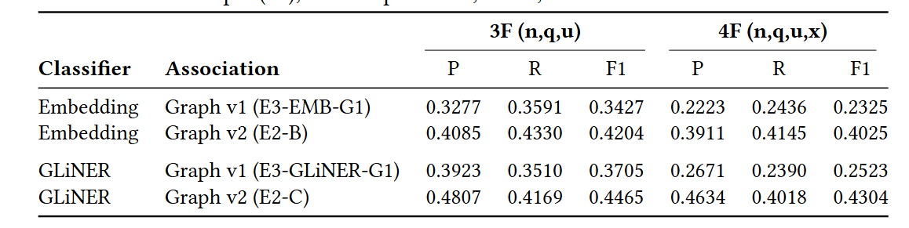
Q3 / ASSOCIATION ①
OCR-GUIDED SEMANTIC GRAPH MATCHING
Q3 Does a geometry-aware graph beat raw geometry? graph v1 · v2
Geometry-aware binding nearly doubles the naïve graph v1.
4F recall · upstream held fixed (PaddleOCR · classifier ) — only the graph changes
Zero-Shot Nutrient & Quantity Association
13 / 19

Slide 14
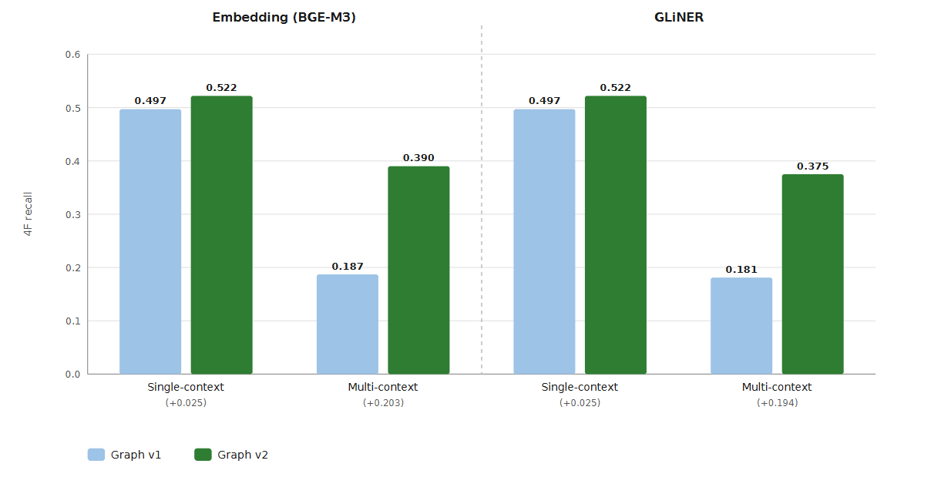
Q3 / ASSOCIATION ①
OCR-GUIDED SEMANTIC GRAPH MATCHING
Q3 Does a geometry-aware graph beat raw geometry? graph v1 · v2
Geometry-aware binding nearly doubles multi-context recall.
4F recall · upstream held fixed (PaddleOCR · classifier · overlap edges) — only the graph changes
Single-context barely moves (+0.025); multi-context nearly doubles — v1 .187 → v2 .390 (embedding), .181 → .375 (GLiNER).
Zero-Shot Nutrient & Quantity Association
13 / 19

Slide 15
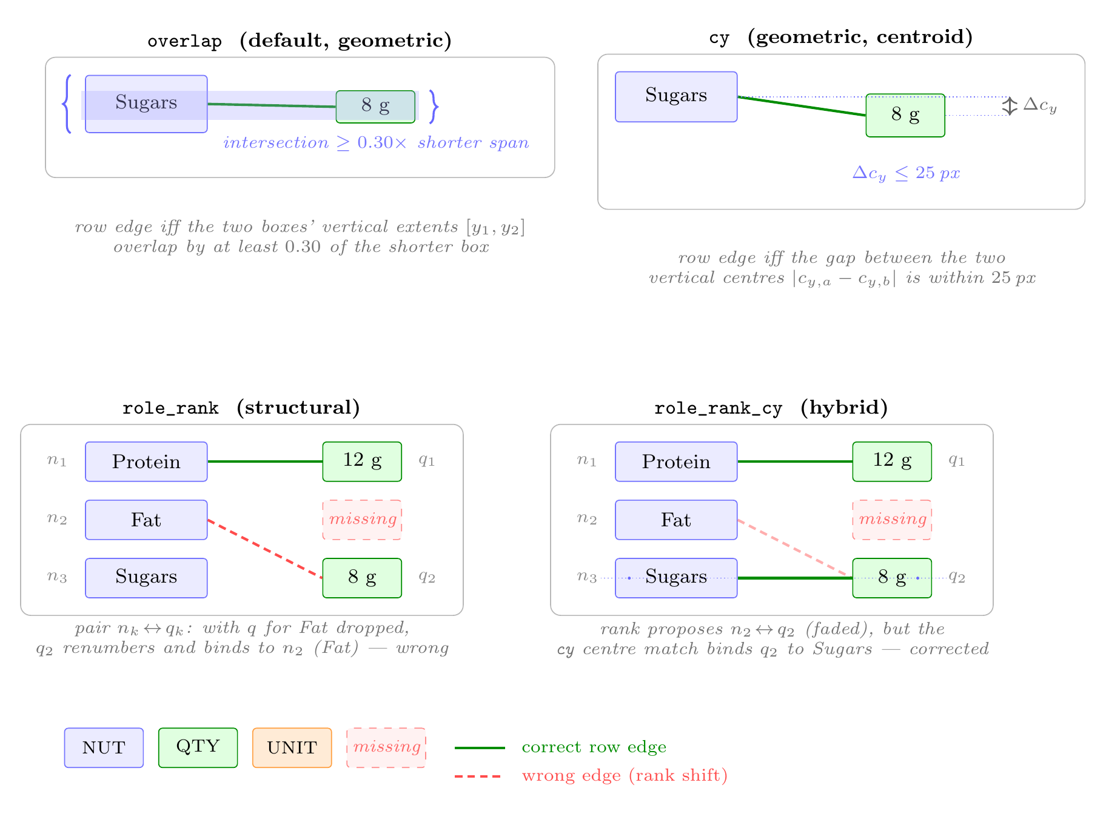
Q4 / ASSOCIATION ②
OCR-GUIDED SEMANTIC GRAPH MATCHING
Q4 Which way builds the row edges best? overlap · cy-cx · cy∪role_rank · role_rank
Zero-Shot Nutrient & Quantity Association
14 / 19

Slide 16
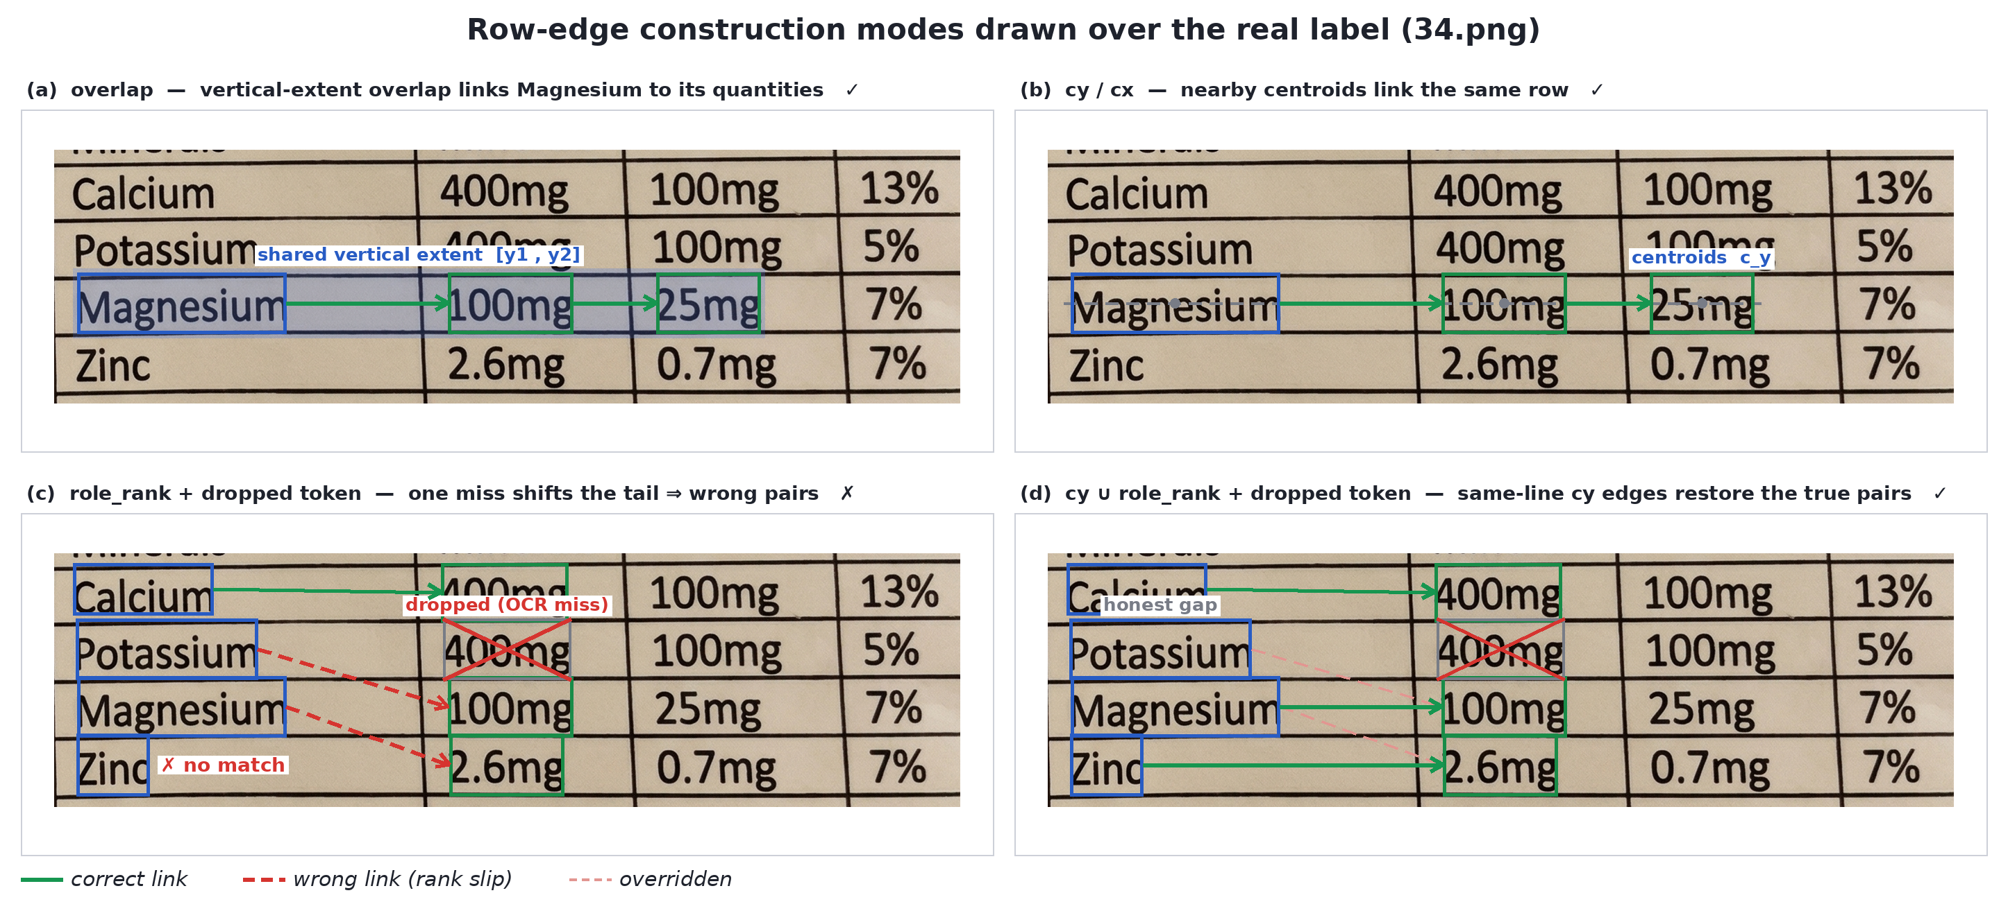
Q4 / ASSOCIATION ②
OCR-GUIDED SEMANTIC GRAPH MATCHING
The same four modes, drawn over a real label.
overlap & cy link Magnesium to its values; role_rank slips when a token is dropped; cy ∪ role_rank restores the true pairs
Zero-Shot Nutrient & Quantity Association
14 / 19

Slide 17
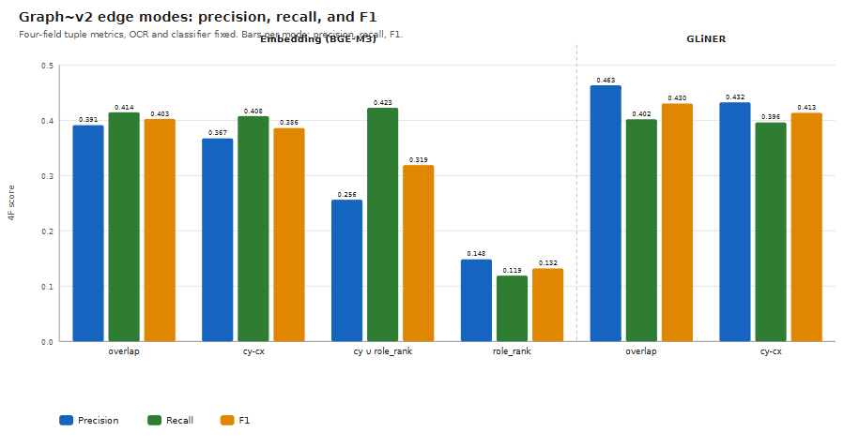
Q4 / ASSOCIATION ②
OCR-GUIDED SEMANTIC GRAPH MATCHING
Q4 Which way builds the row edges best? overlap · cy-cx · cy∪role_rank · role_rank
Overlap wins — geometry beats rank.
4F precision / recall / F1 · OCR and classifier held fixed — only the row-edge rule changes
cy ∪ role_rank pushes recall to .423 but precision collapses to .256 — it adds a few true hits and far more false ones.
Zero-Shot Nutrient & Quantity Association
14 / 19

Slide 18
Q5.1 / ASSOCIATION ④
OCR-GUIDED SEMANTIC GRAPH MATCHING
Q5.1 Is this Comparable to using the VLM end to end? · end-to-end
4-field tuple F1 · Interpretable Pipeline “Gliner + Graph v2
-Overlap mode” vs model (Gemma 3 4B)
.43
.36
vs
Interpretable Pipeline
raw image → VLM
Zero-Shot Nutrient & Quantity Association
15 / 19

Slide 19
Q5.2 / ASSOCIATION ③
OCR-GUIDED SEMANTIC GRAPH MATCHING
Q5.2 Can a VLM binder beat the graph? graph v2 · VLM-assoc
A VLM binder buys precision.
Four-field tuple · OCR = PaddleOCR fixed · graph v2 vs VLM-association (Gemma 3 4B)
Classifier | Association | 4F-P | 4F-R | 4F-F1
Rule-based | Graph v2 | .422 | .424 | .423
Rule-based | + VLM | .573 | .416 | .482
Embedding | Graph v2 | .391 | .415 | .403
Embedding | + VLM | .605 | .418 | .495
GLiNER | Graph v2 | .463 | .402 | .430
GLiNER | + VLM | .527 | .385 | .445
The VLM raises precision in every case while recall holds — best overall .495 (embedding → VLM), at ~13.7 s/image vs ~4.5 s for the graph.
Zero-Shot Nutrient & Quantity Association
16 / 19

Slide 20
Q6 / ASSOCIATION ④
OCR-GUIDED SEMANTIC GRAPH MATCHING
Q6 Is structuring before binding worth it? VLM-assoc · end-to-end
Structure first, then bind.
4-field tuple F1 · same model (Gemma 3 4B) binds in both
.49
.36
vs
token table → VLM
raw image → VLM
Same model. A clean token table beats the raw image by +0.13 — structuring the problem is worth more than one big model.
Zero-Shot Nutrient & Quantity Association
17 / 19

Slide 21
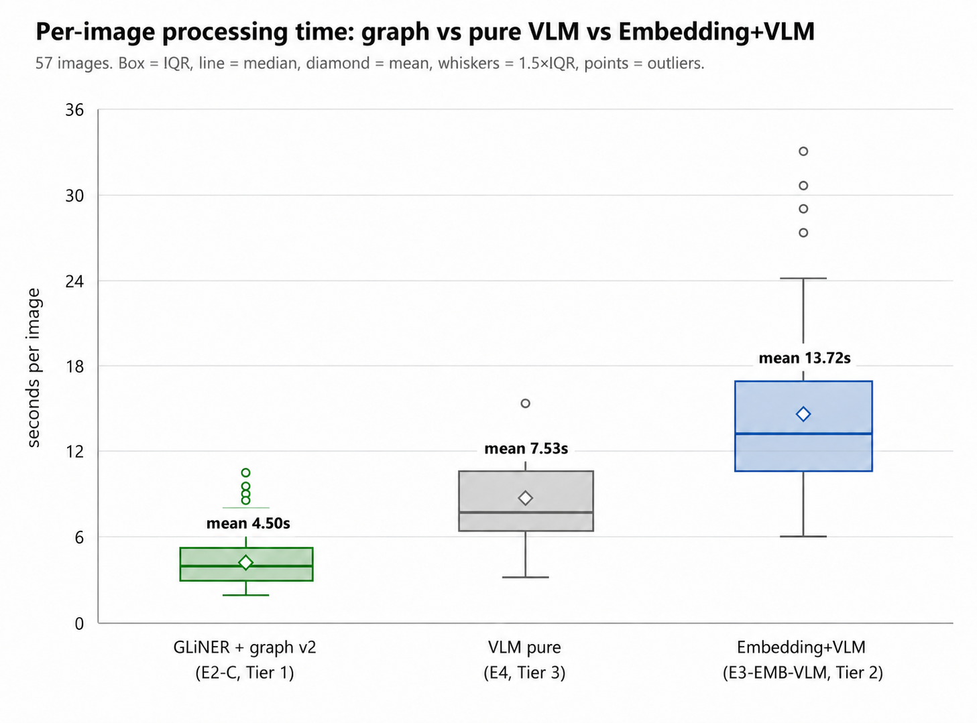
07 / THE Conclusion
OCR-GUIDED SEMANTIC GRAPH MATCHING
More accurate — and you can read it.
4-field tuple F1 (all four fields must match) · time = median per-image processing over the 57 images
43.0% ~4.5 s
Ours · fully interpretable
PaddleOCR → GLiNER → graph v2 · 0 VLM calls
49.5% ~13.7 s
Best overall · embedding → VLM-association
VLM binds the last step · buys precision
36.0% ~7.5 s
End-to-end VLM baseline
Per-image processing time — the interpretable pipeline is also the fastest.
+7.1 points over the baseline with no VLM in the loop. Adding a VLM binder to the embedding front-end reaches the best overall 49.5% — but at roughly 3× the time.
Zero-Shot Nutrient & Quantity Association
18 / 19

Slide 22
08 / WHAT TO SHIP
OCR-GUIDED SEMANTIC GRAPH MATCHING
Thank you.
DEFAULT · INTERPRETABLE
MAX ACCURACY
PaddleOCR → GLiNER → graph v2
PaddleOCR → embedding → VLM-assoc
43.0% 4F-F1 · ~4.5 s · 0 VLM
49.5% 4F-F1 · ~13.7 s
Questions & discussion welcome. · Moustafa Hamada · THD
Zero-Shot Nutrient & Quantity Association
19 / 19

