Slide 1
MASTER'S THESIS ·SEMINAR
Zero-Shot Nutrient & Quantity Association
OCR-Guided Semantic Graph Matching
Recovering structured facts from label photographs — with no training labels.
STUDENT
SUPERVISOR
CO-SUPERVISOR
INSTITUTION · DATE
Moustafa Hamada
Prof. Dr. Andreas Fischer
Prof. Dr. oec. troph. Claudia Osterkamp-Baerens
THD · July 2026

Slide 2
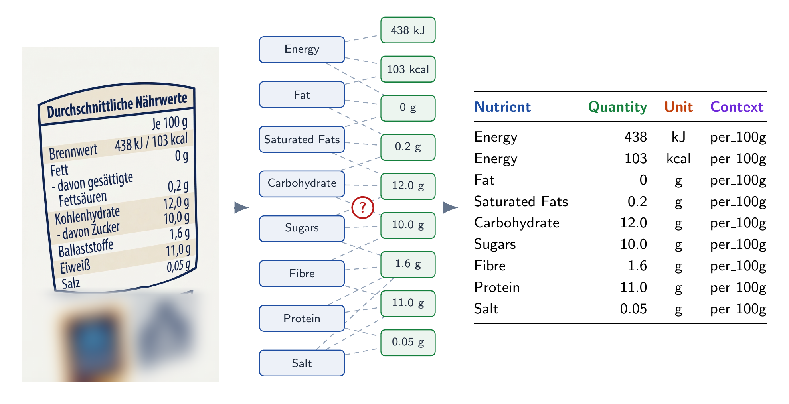
01 · THE PROBLEM
A label is a picture. The facts inside it are not.
Which value belongs to which nutrient? — recover ⟨ nutrient, quantity, unit, context ⟩, zero-shot, across languages.
2 / 18

Slide 3
02 · THE OBVIOUS MOVE
The obvious move: hand the whole photo to one model.
label photo
one opaque VLM call
⟨ n, q, u, x ⟩
Zero-shot and simple — but opaque, costly, and impossible to audit. When a tuple is wrong, nothing tells you which step failed.
3 / 18

Slide 4
03 · HYPOTHESIS & RESEARCH QUESTIONS
Hypothesis
Three Stages Pipeline For Extraction and Association Using OCR Guided Semantic Graph Matching
RQ1 · OCR
RQ2 · CLASSIFIER
Which OCR engine best supports tuple recovery?
How do we decide “is this a nutrient?”
RQ3 · ASSOCIATION
RQ4 · vs VLM
Does a geometry-aware graph improve binding?
Is the interpretable pipeline competitive with a VLM?
4 / 18

Slide 5
04 · Background
Background: the building blocks
Information Extraction
Optical character recognition (OCR)
Text embedding & cosine similarity
Named Entity Recognition (NER)
Graph Representation
Zero-shot throughout — no labelled training data at any stage of the pipeline.
5 / 18

Slide 6
04 · RELATED WORK
LM / VLM extraction
Graph document IE
OCR-Methods
Prompt one big model end-to-end. No annotation, any layout. (This thesis’s baseline.)
PICK (Yu 2020) · SPADE (Hwang 2021): IE as a graph over OCR tokens — the paradigm here. But supervised
HalalBench: OCR alone caps at F1 .193. Nagayi (food-OCR): PaddleOCR best coverage 98.3% on food labels.
Gap zero-shot • interpretable typed graph • no training labels — the space this thesis fills.
5 / 18

Slide 7
05 · OUR APPROACH
Break the problem into stages you can read.
01
02
03
Read
Label
Bind
OCR turns the label photo into located text tokens.
Classification gives every token a role.
Association links tokens into ⟨ n, q, u, x ⟩ tuples.
Each stage is swappable and separately measurable.
6 / 18

Slide 8
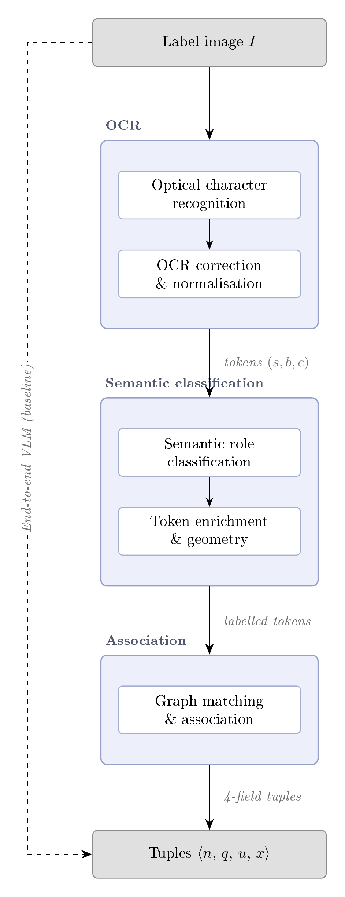
06 · THE PIPELINE, Closer Look?
Optical character recognition — OCR model reads the image into raw tokens (s, b, c). OCR correction & normalisation — OCR_corrector fixes misreads, merges tokens, fix fused tokens, canonicalises to English .
SEMANTIC CLASSIFICATION
Semantic role classification —rule / BGE-M3 / GLiNER-biomed tags each token nutrient, quantity, unit or context. Token enrichment & geometry — TokenEnricher attaches column IDs, row/rank, dosage-stream and header info.
ASSOCIATION
Graph matching & association — Graph Constructor builds a typed graph (row / column / overlap edges), then links each nutrient to its quantity, unit and context.
Output — the four-field tuples ⟨n, q, u, x⟩. read → clean → label → add geometry → link → emit tuples
7 / 18

Slide 9
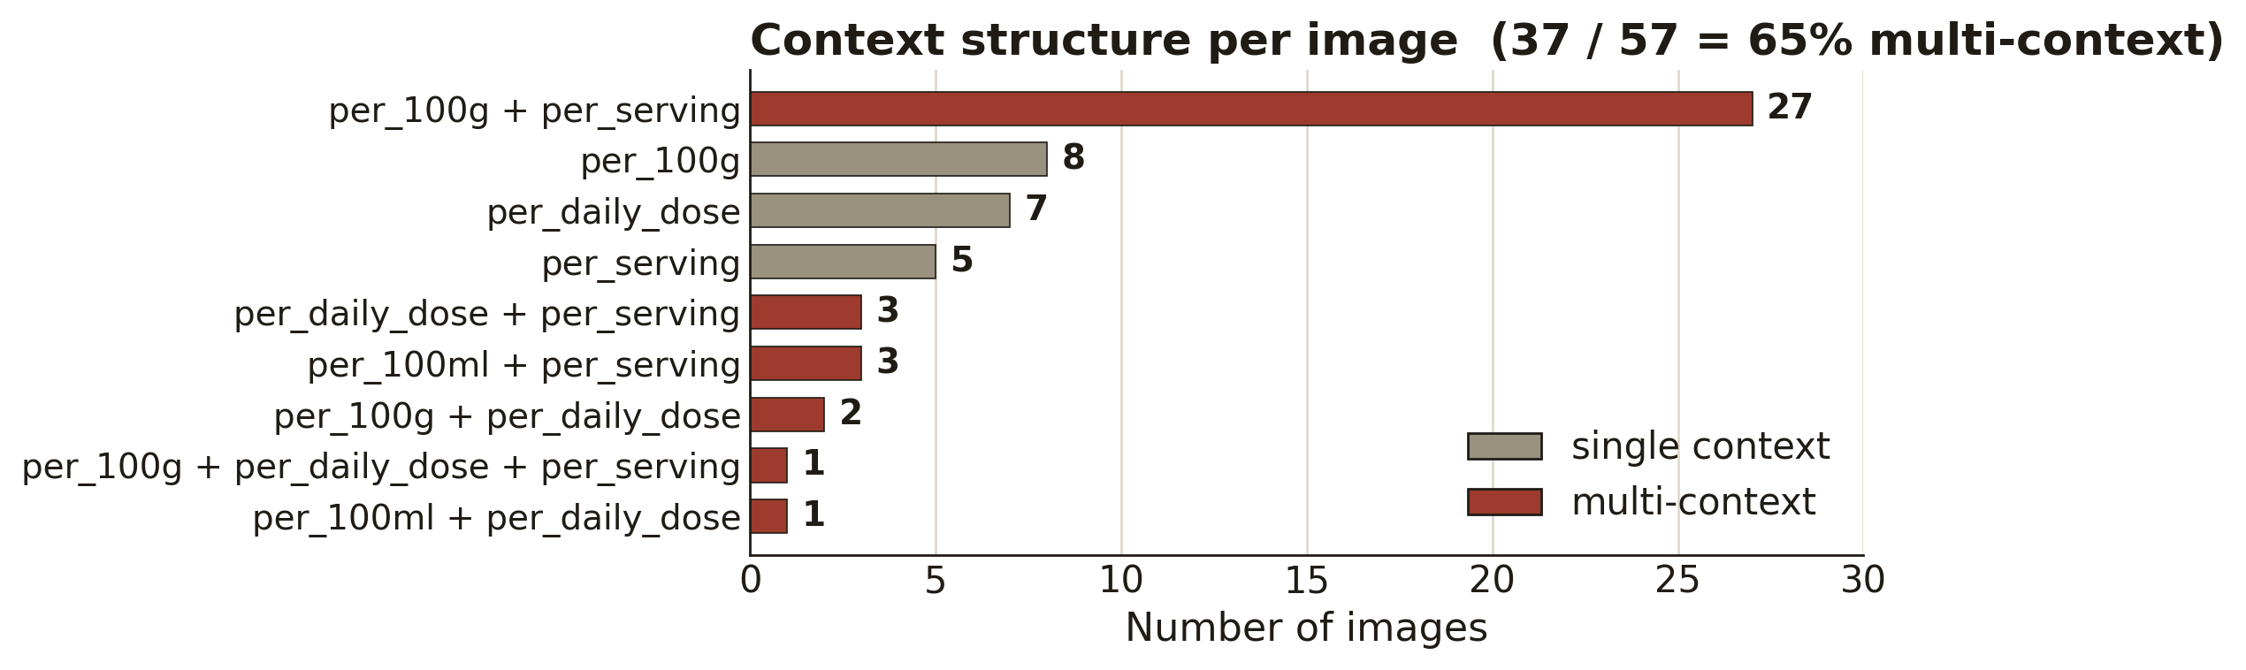
07 · DATASET & EVALUATION
57 labels, 866 gold tuples, zero training data.
57
866
0
label images
gold tuples
training labels
mean 15.2 tuples / image
range 0 – 50 per image
fully zero-shot
Scored on the four-field tuple ⟨ n, q, u, x ⟩ — correct only if all four match; deterministic 4F-F1 pooled over 866 tuples. 65% of labels mix ≥2 contexts — why a value needs its column, not just its row.
8 / 18

Slide 10
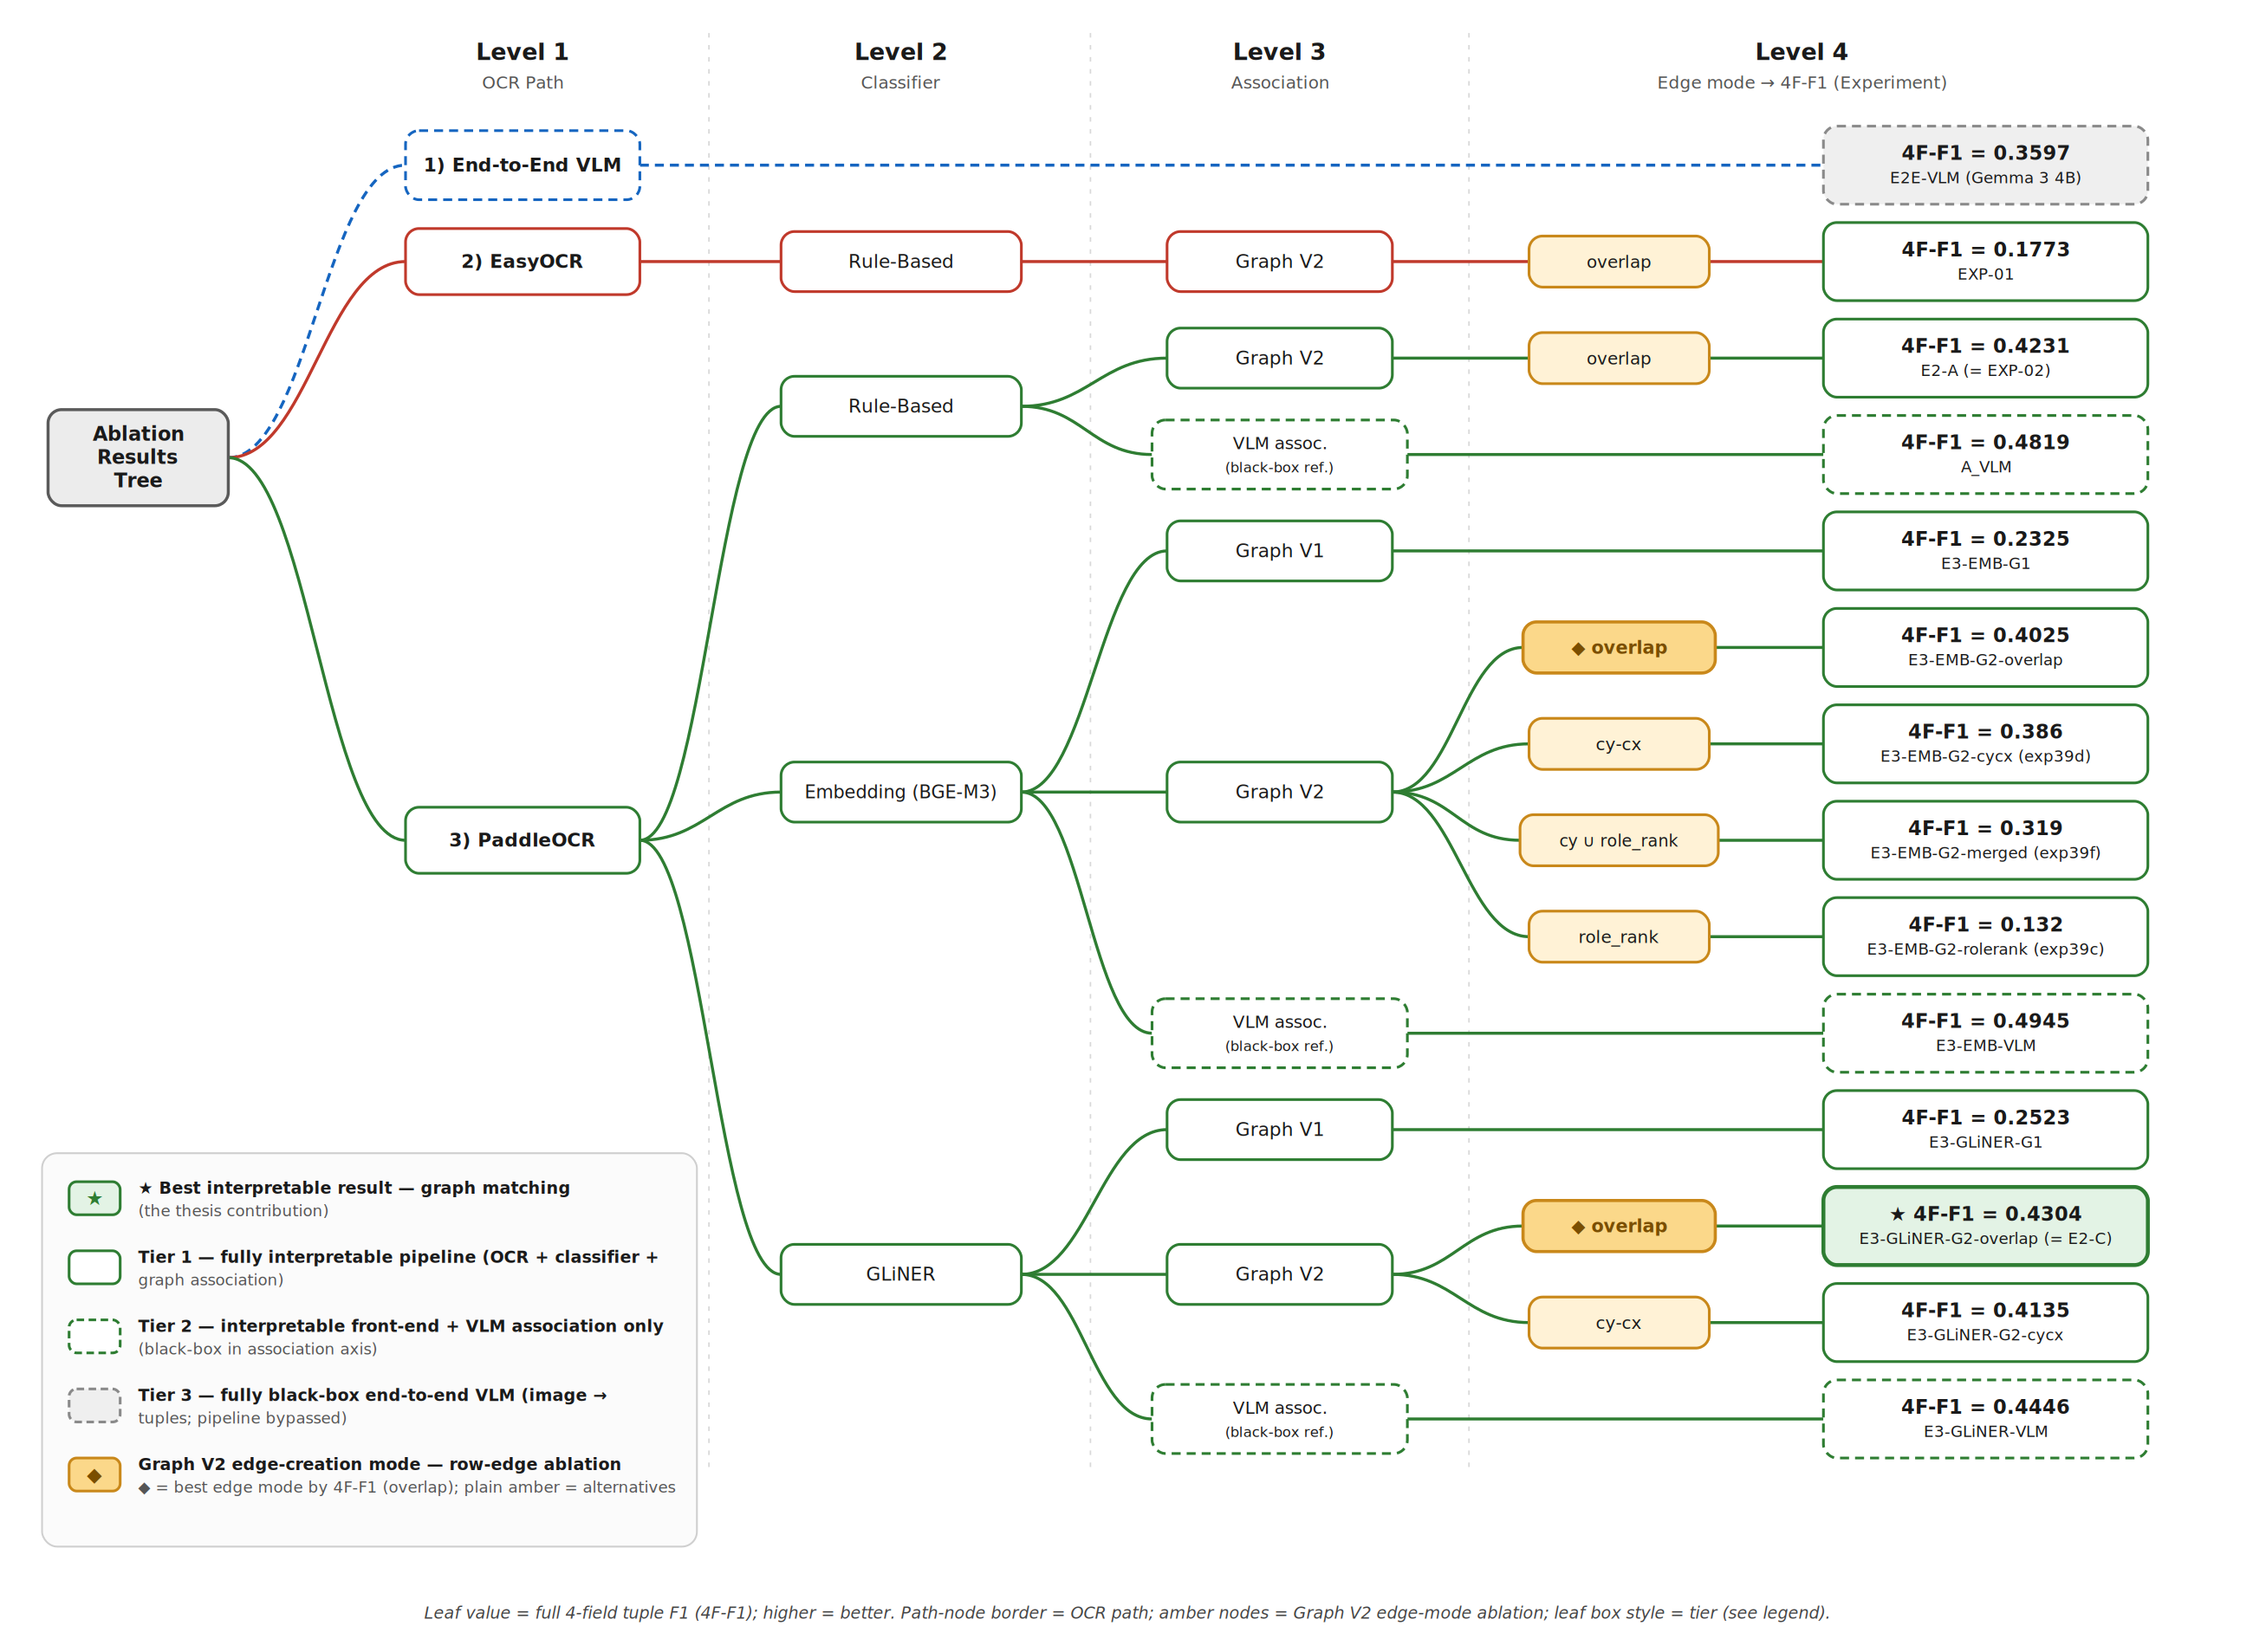
Four questions, one map.
08 · RESULTS ROADMAP
9 / 18

Slide 11
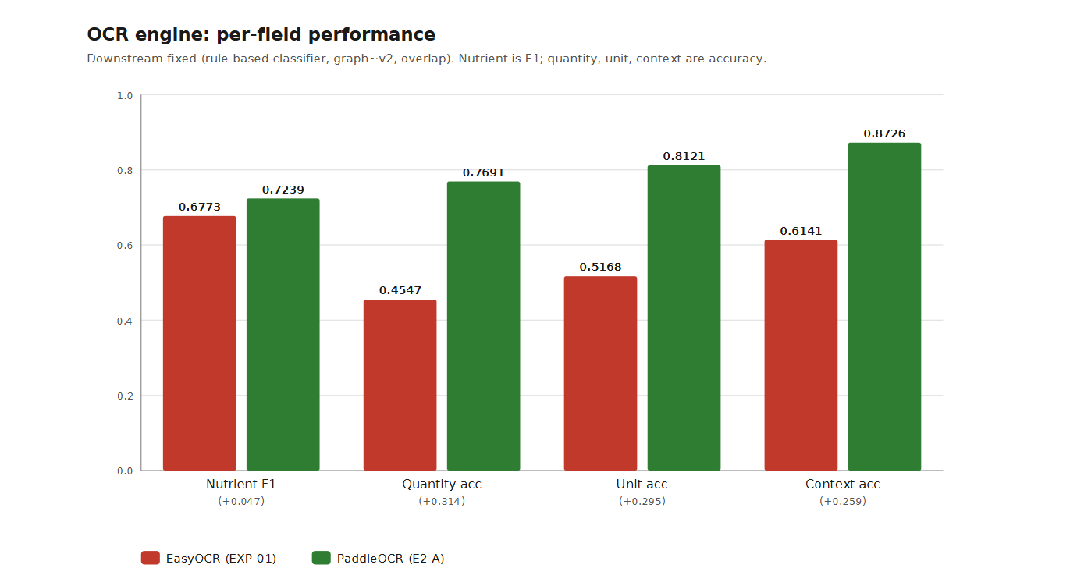
RQ1 · OCR ENGINE
Reading values — not names — decides the tuple.
Names nearly tie (+.047); PaddleOCR wins the values — quantity, unit, context. 4F-F1 .177 → .423.
10 / 18

Slide 12
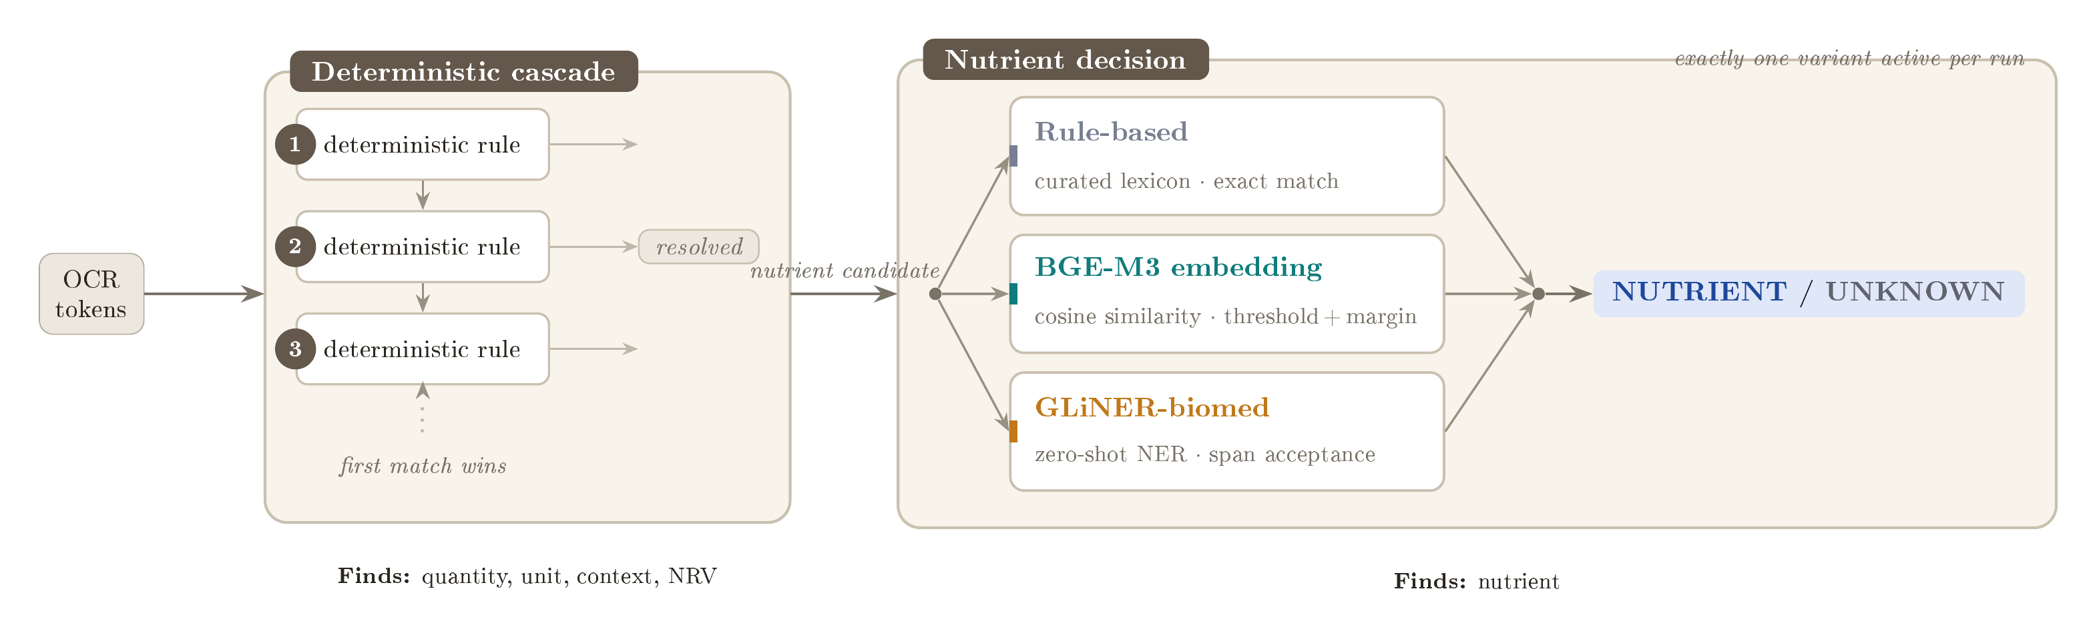
RQ2 · NUTRIENT DECISION
Give every token a role. A deterministic cascade resolves the easy ones — quantity, unit, context, NRV — while the hard open-vocabulary call, “is it a nutrient?”, is decided by one of three interchangeable variants.
11 / 18

Slide 13
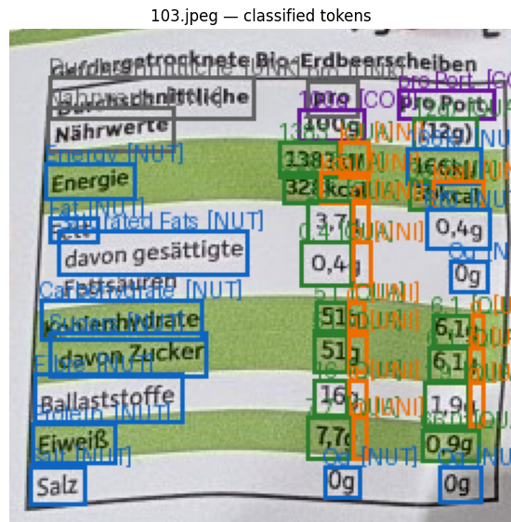
RQ2 · NUTRIENT DECISION
Precision wins the tuple — GLiNER leads.
Classifier | 4F Prec | 4F Recall | 4F F1
Rule-based (E2-A) | .422 | .424 | .423
Embedding (E2-B) | .391 | .415 | .403
GLiNER (E2-C) | .463 | .402 | .430
4-field tuple; OCR = PaddleOCR, graph v2 · overlap held fixed.
NUT (blue) · QUAN (green) · UNIT (orange) · CO (purple)
The graph binds whatever it is given — so fewer false positives beat higher recall. GLiNER’s precision (.463) carries the tuple.
11 / 18

Slide 14
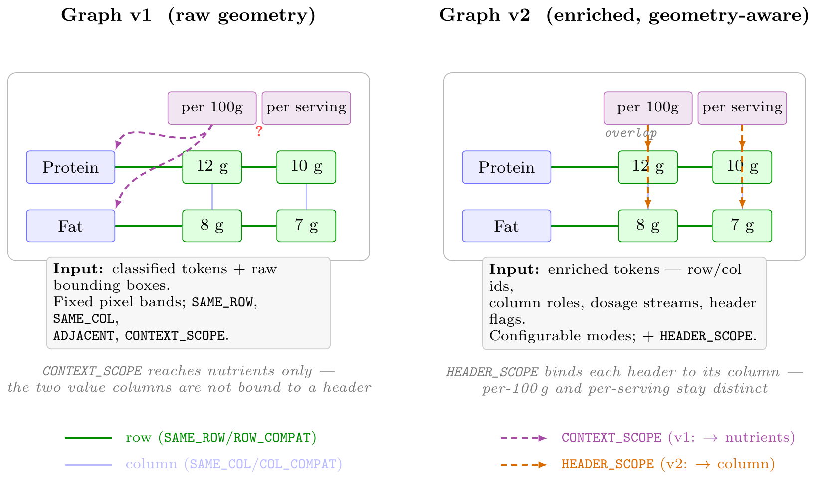
RQ3 · GEOMETRY-AWARE GRAPH
STAGE 3
Association
Each token is a node; typed edges link them by geometry into one tuple per nutrient. Two variants — graph v1 (raw) and graph v2 (geometry-aware), below.
EDGE TYPES
ROW_COMPAT nutrient ↔ quantity
Primary axis — links each nutrient to the quantity on its row, pulling that value into the tuple.
COL_COMPAT sub-nutrient fallback
A sub-nutrient with no value of its own inherits the quantity from the parent above it in the column.
DIRECTIONAL_ADJ unit recovery
Reaches a unit sitting near a number but not grouped with it, so a detached unit still reaches its quantity.
CONTEXT_SCOPE + HEADER_SCOPE context
Carry a context header down to the values beneath — per 100 g / per serving / per daily dose.
12 / 18

Slide 15
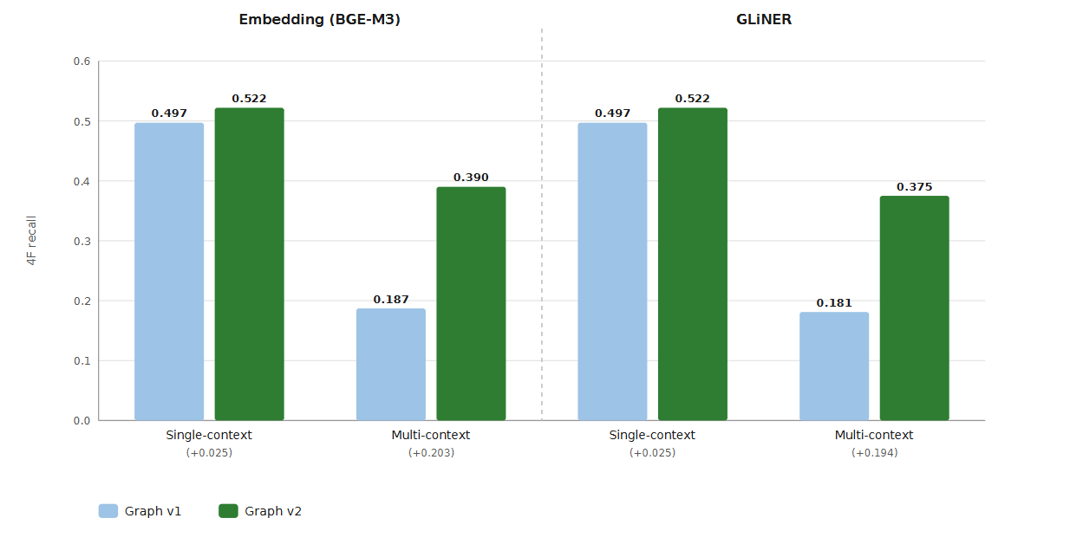
RQ3 · GEOMETRY-AWARE GRAPH
Geometry-aware binding nearly doubles multi-context recall.
Single-context barely moves (+.025); multi-context nearly doubles — v1 .187 → v2 .390 (embedding), .181 → .375 (GLiNER).
12 / 18

Slide 16
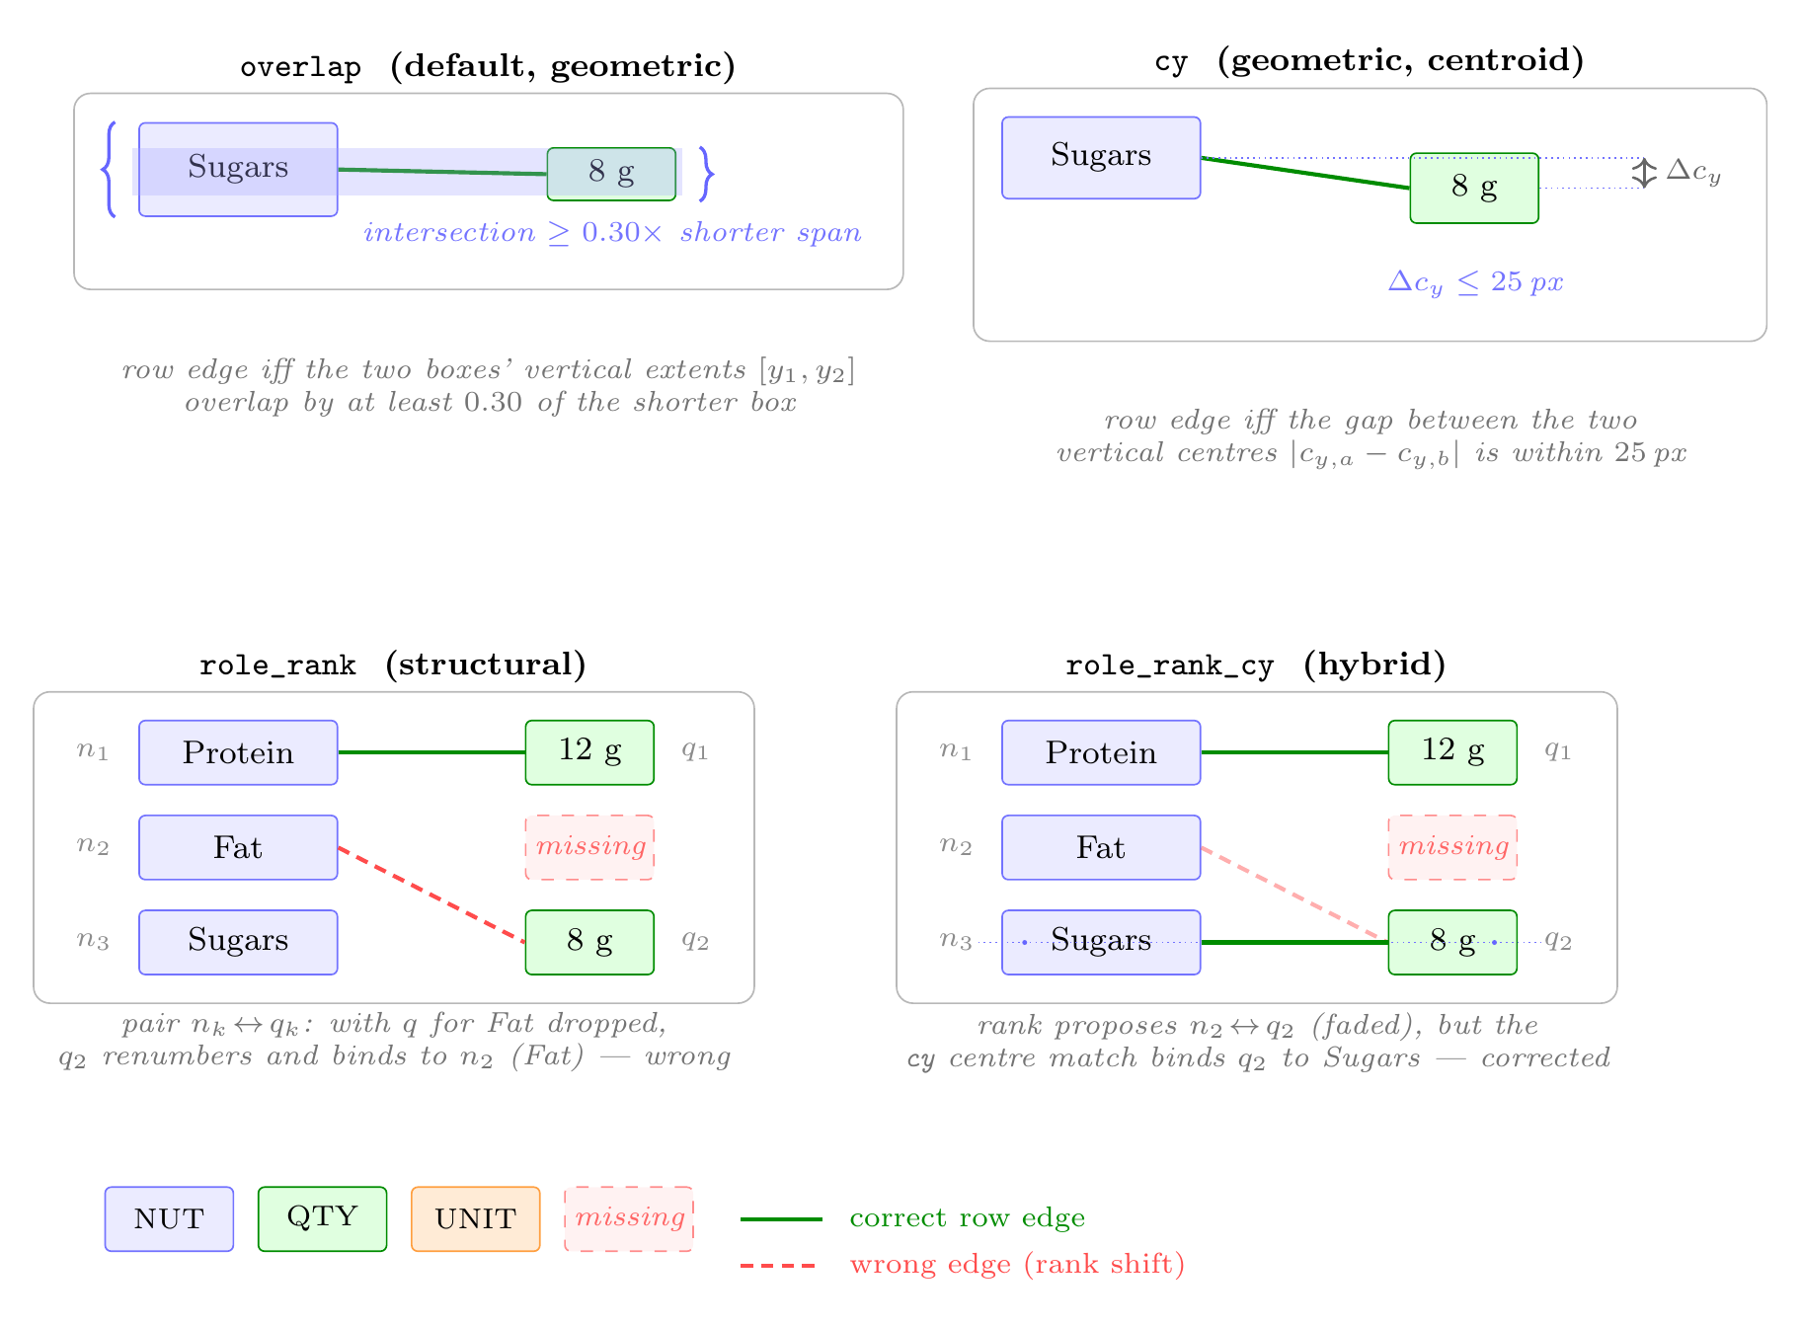
RQ3 · ROW-EDGE MODE
13 / 18

Slide 17
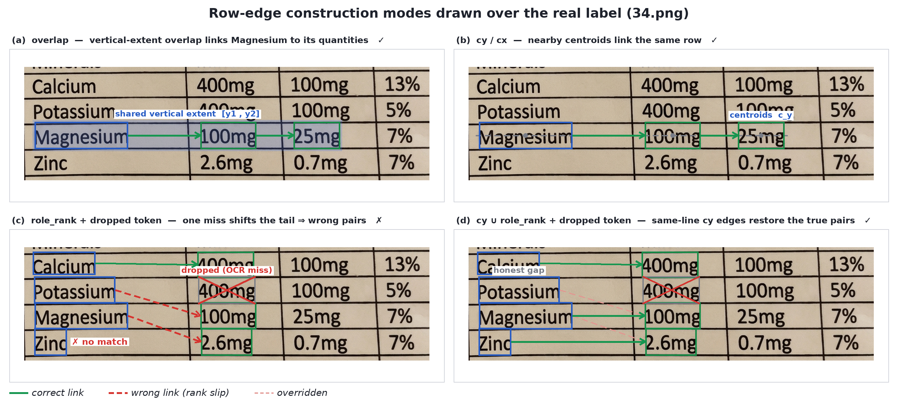
RQ3 · ROW-EDGE RULE
Overlap wins — geometry beats rank.
Row-edge mode | Embed F1 | GLiNER F1
overlap | .403 | .430
cy-cx | .386 | .413
cy ∪ role_rank | .319 | —
role_rank | .132 | —
cy ∪ role_rank pushes recall to .423 but precision collapses to .256.
Four row-edge modes drawn over a real label (34.png)
Geometric row edges (overlap) beat rank-based ordering in both classifiers — OCR dropout breaks ordinal alignment.
13 / 18

Slide 18
RQ4 · VS END-TO-END VLM
Interpretable beats the end-to-end VLM.
.43
.36
vs
Interpretable pipeline
raw image → VLM
PaddleOCR → GLiNER → graph v2 · 0 VLM calls
Gemma 3 4B, end-to-end
4-field tuple F1 on the same 57 images. The fully interpretable pipeline clears the opaque baseline by +7 points — with zero VLM calls.
14 / 18

Slide 19
RQ4 · VLM AS BINDER
A VLM binder buys precision — best overall .495.
Classifier | Association | 4F-P | 4F-R | 4F-F1
Rule-based | graph v2 | .422 | .424 | .423
Rule-based | + VLM | .573 | .416 | .482
Embedding | graph v2 | .391 | .415 | .403
Embedding | + VLM | .605 | .418 | .495
GLiNER | graph v2 | .463 | .402 | .430
GLiNER | + VLM | .527 | .385 | .445
Best overall .495
embedding → VLM-association.
Precision jumps in every pairing; recall holds.
Cost: ~13.7 s / image vs ~4.5 s for the graph (≈3×).
15 / 18

Slide 20
RQ4 · STRUCTURE FIRST
Structure first, then bind — worth +0.13.
.49
.36
vs
token table → VLM
raw image → VLM
structured input
same Gemma 3 4B
The same model binds in both. A clean token table beats the raw image by +0.13 — structuring the problem is worth more than one big model.
16 / 18

Slide 21
09 · CONCLUSION
More accurate — and you can read it.
43.0%
49.5%
36.0%
Interpretable
Best overall (hybrid)
End-to-end VLM
~4.5 s · 0 VLM calls
~13.7 s · VLM binder
~7.5 s ·
baseline
Contribution
+7.1 points over the end-to-end VLM with no VLM in the loop — and the interpretable pipeline is also the fastest. Adding a VLM binder to the embedding front-end reaches the best overall 49.5%, at ~3× the time.
17 / 18

Slide 22
10 · WHAT TO SHIP (Contribution)
Two configurations
DEFAULT · INTERPRETABLE
MAX ACCURACY · HYBRID
PaddleOCR → GLiNER → graph v2
PaddleOCR → embedding → VLM-assoc
43.0% 4F-F1 · ~4.5 s · 0 VLM calls
Fully auditable — every tuple is traceable.
49.5% 4F-F1 · ~13.7 s · VLM binds last step
Trades interpretability + speed for precision.
Thank you.
Questions & discussion welcome. · Moustafa Hamada · THD
18 / 18

