Slide 1
Covid-19 Project
By Mostafa Ramadan

Slide 2
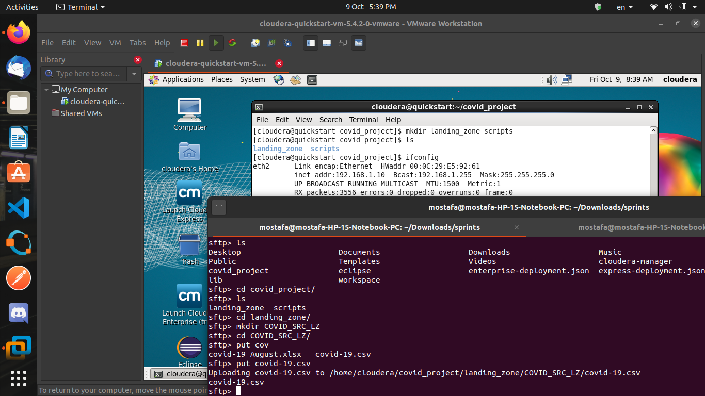
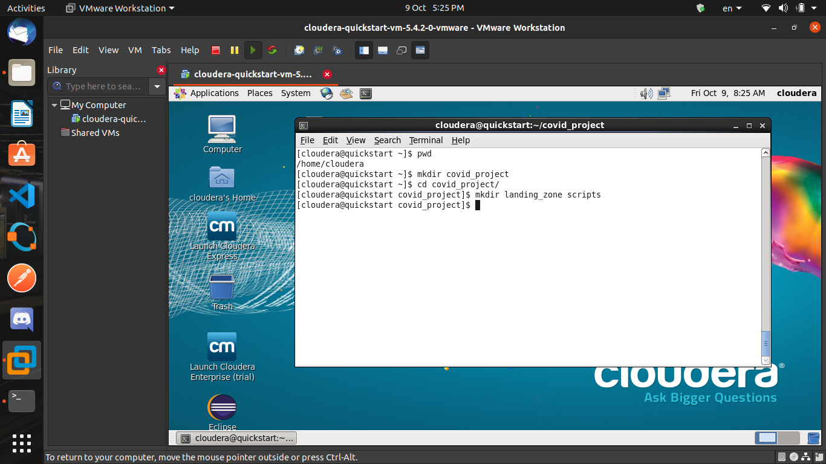
Transferring Data
Made Directories in Cloudera VM (covid_project)
Connected from Ubuntu to Cloudera VM
Used SFTP from terminal instead of WinSCP
Transferred file over SFTP

Slide 3
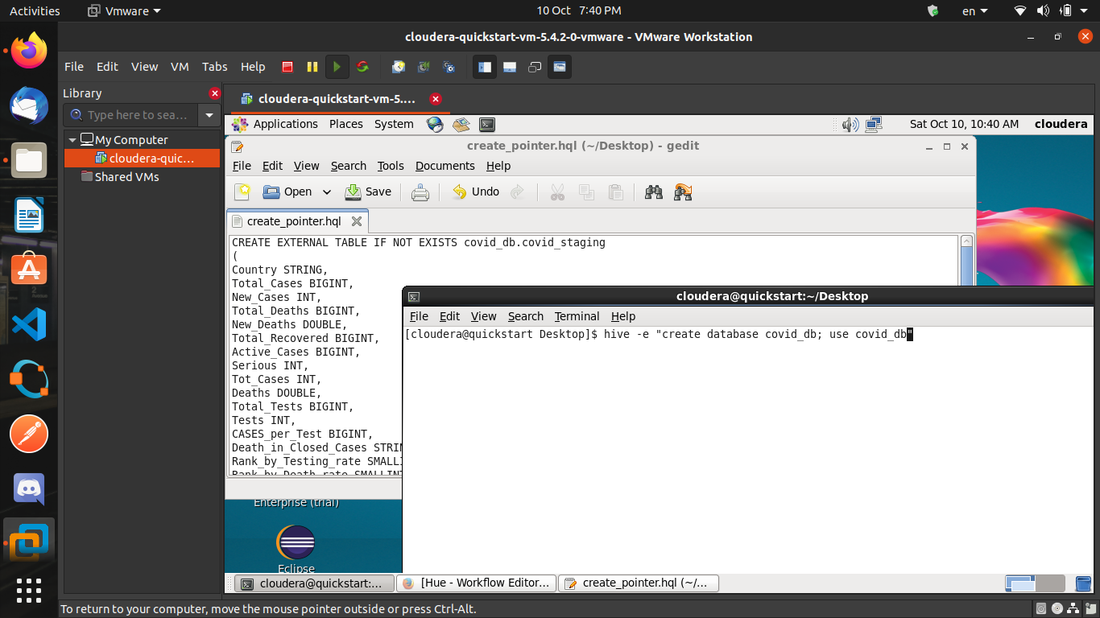
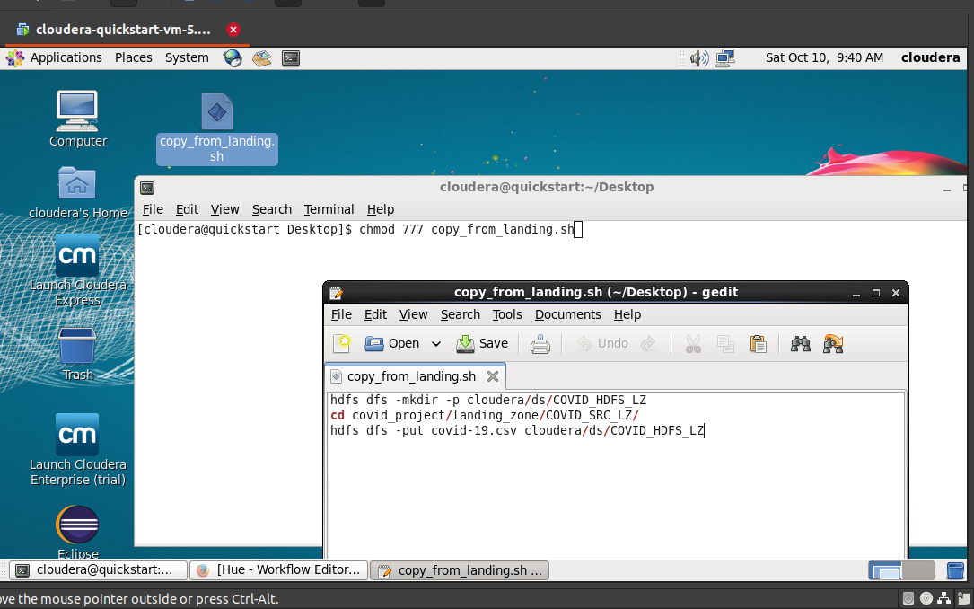
Creating tables and Shell Scripts
Made shell to copy from HDFS landing zone to working area
Made HQL files to be executed in workflow

Slide 4
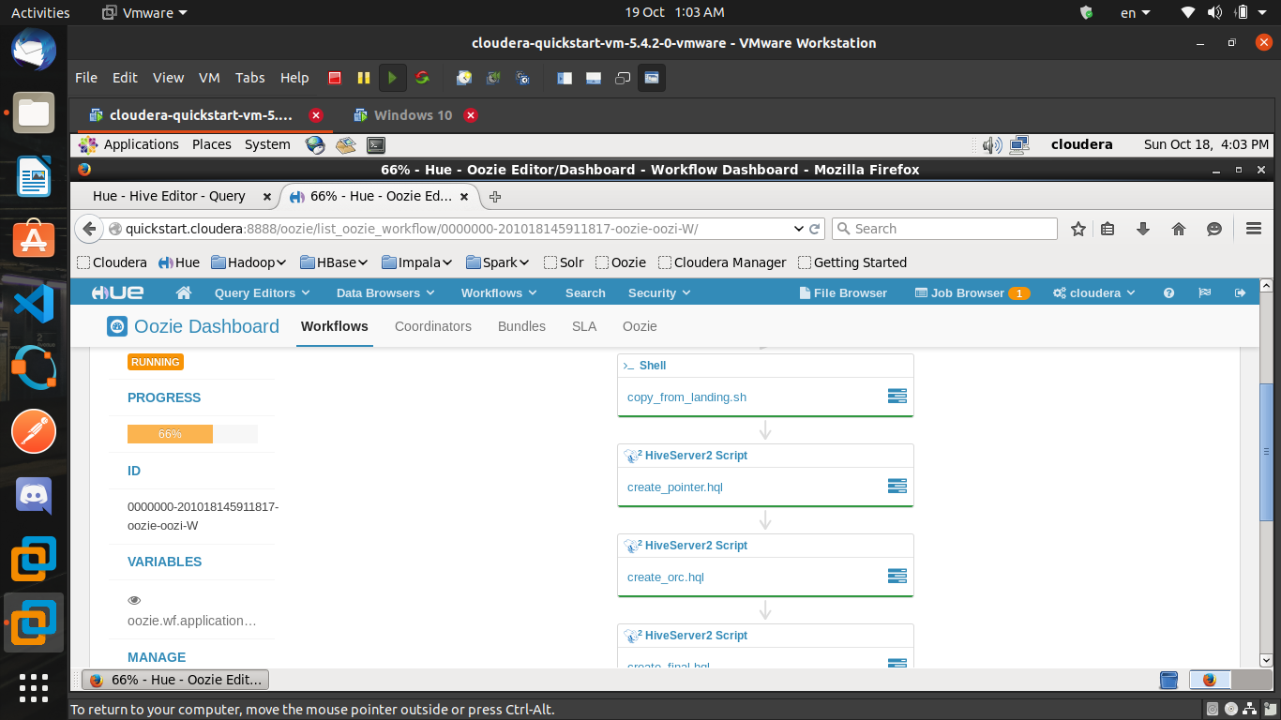
Creating Workflow
Adding scripts to HDFS to run them
It was just drag and drop

Slide 5
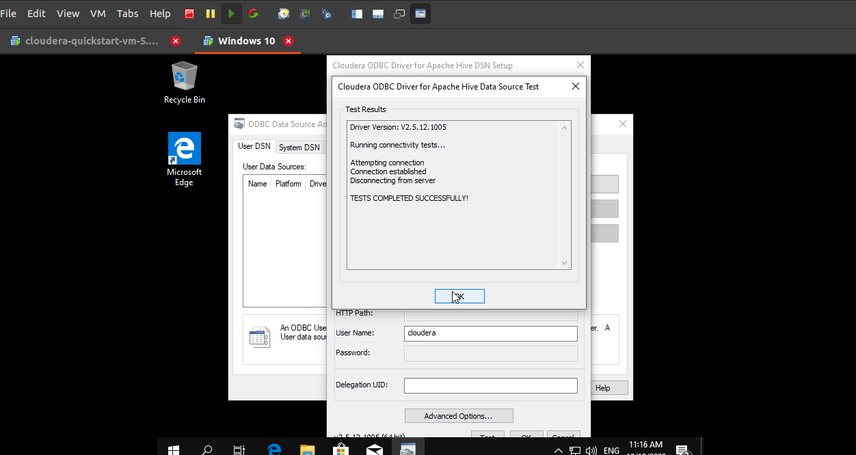
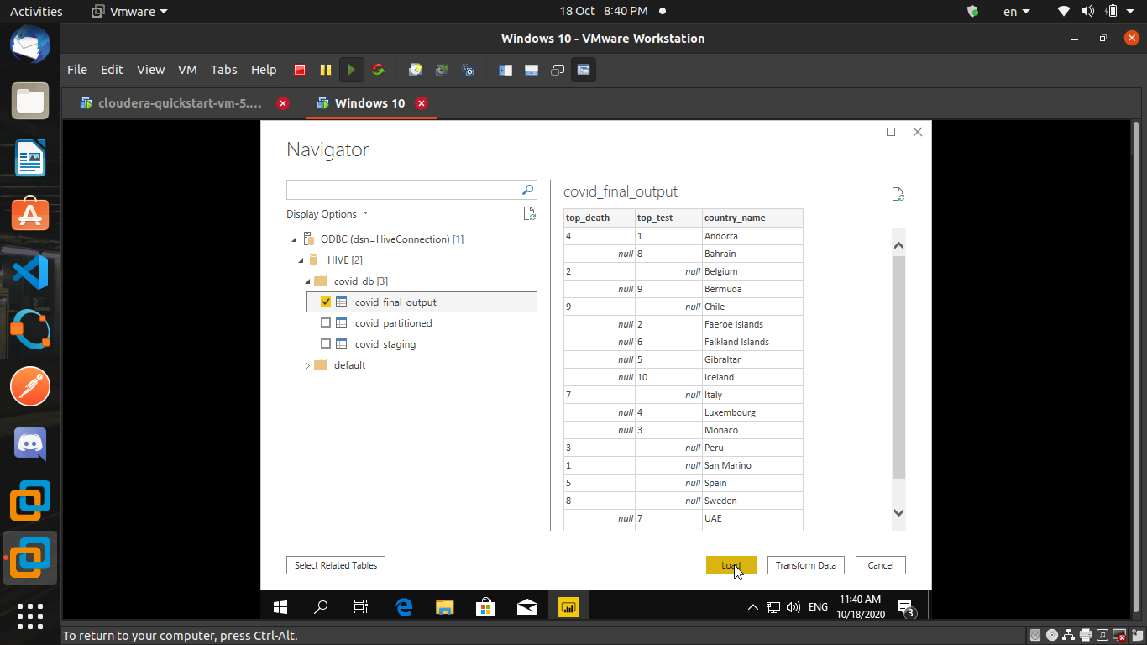
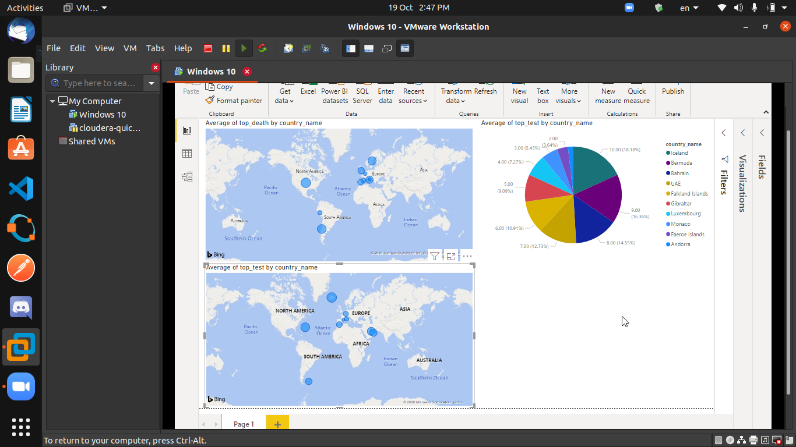
Visualization
Connecting to Cloudera VM from Windows VM through ODBC
Importing Data For Visualization in Power BI

Slide 6
Ending
Thank You

