Slide 1
AWS-Based Web Application Architecture
Designed by: Mostafa Mohamed Saber

Slide 2
Overview
This document outlines the architecture and components used to build a highly available, scalable web application on AWS, improving the performance of a student records web application during peak admissions periods.

Slide 3
Objectives
1. Create an architectural diagram illustrating AWS interactions
2. Estimate cost using AWS Pricing Calculator
3. Deploy functional web application
4. Ensure high availability and scalability
5. Secure the application

Slide 4
Architecture Components
Key AWS Components: VPC, EC2, RDS, Secrets Manager, Load Balancer, Auto Scaling, Cloud9, CloudWatch, WAF.

Slide 5
VPC & EC2
Virtual Private Cloud (VPC):
• Isolates the application in a secure network environment
• Uses public/private subnets across multiple Availability Zones for redundancy
EC2 Instances:
• Hosts the web application, providing compute power
• Scalable and flexible to handle varying loads

Slide 6
Database & Secrets Management
Amazon RDS:
• Manages the relational database independently
• Multi-AZ deployment ensures high availability
AWS Secrets Manager:
• Secures sensitive information such as database credentials
• Allows secure access without hardcoding credentials

Slide 7
Load Balancing & Auto-Scaling
Application Load Balancer:
• Distributes traffic across EC2 instances
• Maintains high availability and optimal performance
Auto Scaling Group:
• Automatically adjusts EC2 instances based on demand
• Optimizes resource usage and ensures performance

Slide 8
Implementation Phases
Phase 1: Planning Design & Cost Estimation
Phase 2: Creating Basic Functional Web Application
Phase 3: Decoupling Application Components
Phase 4: Implementing High Availability & Scalability

Slide 9

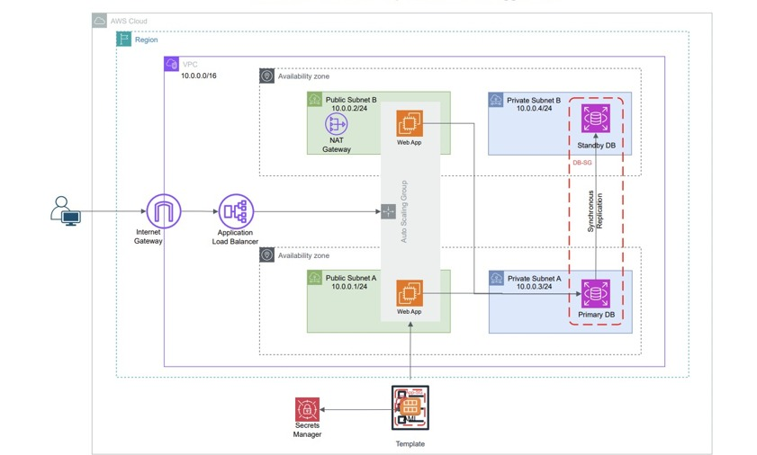
Design

Slide 10
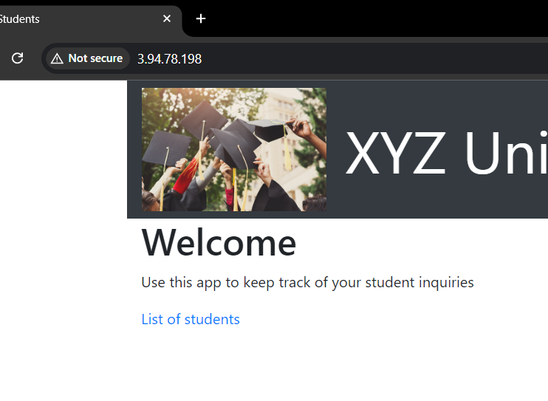
Implementation

Slide 11

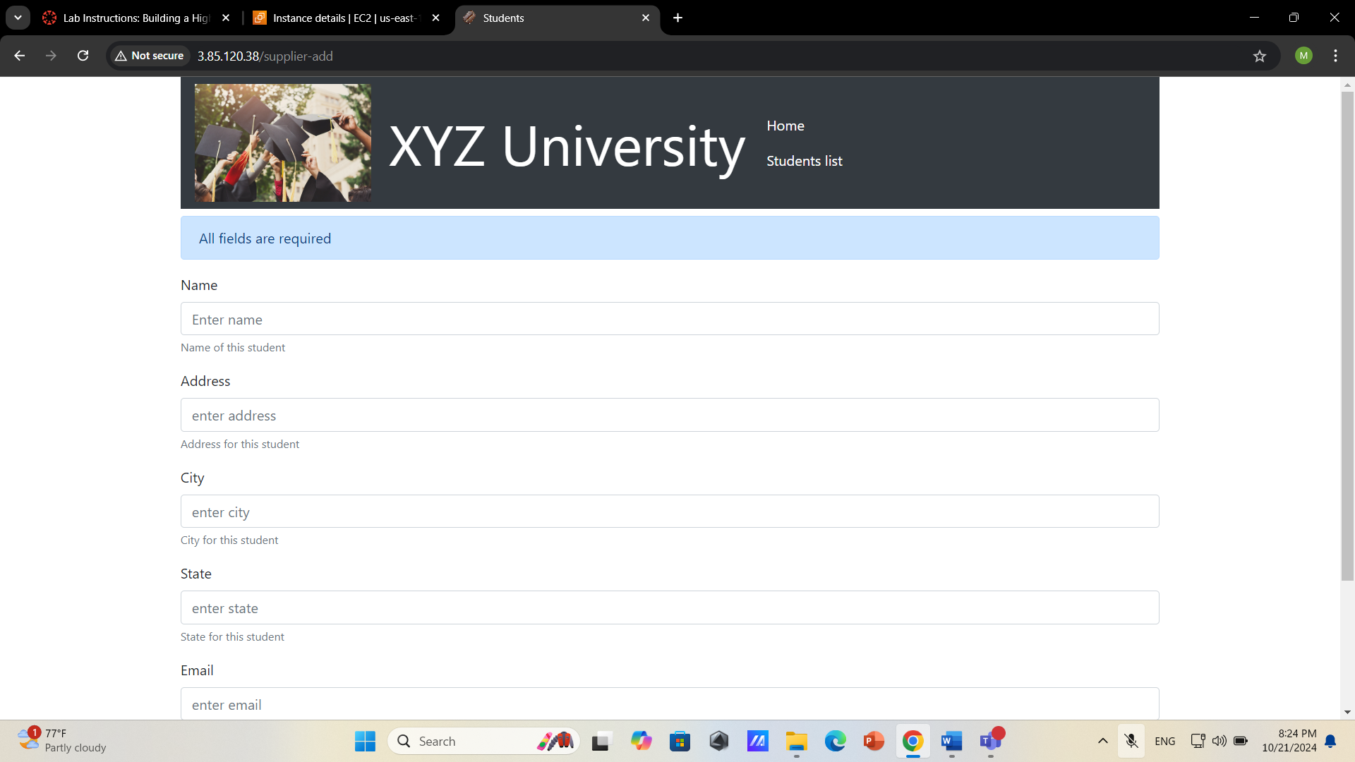


Slide 12
