Slide 1
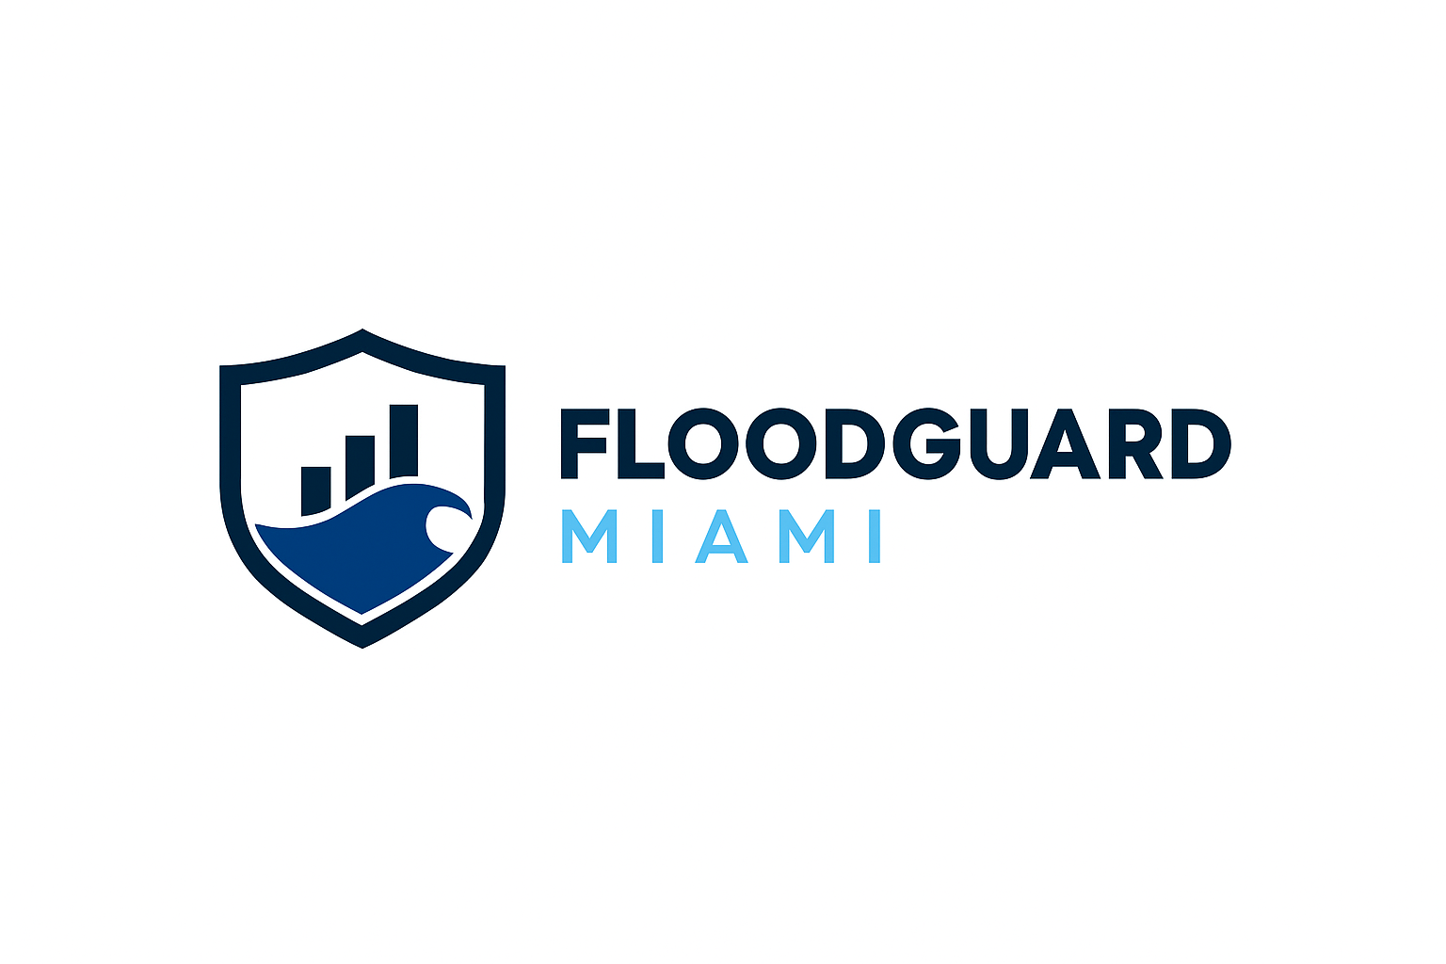


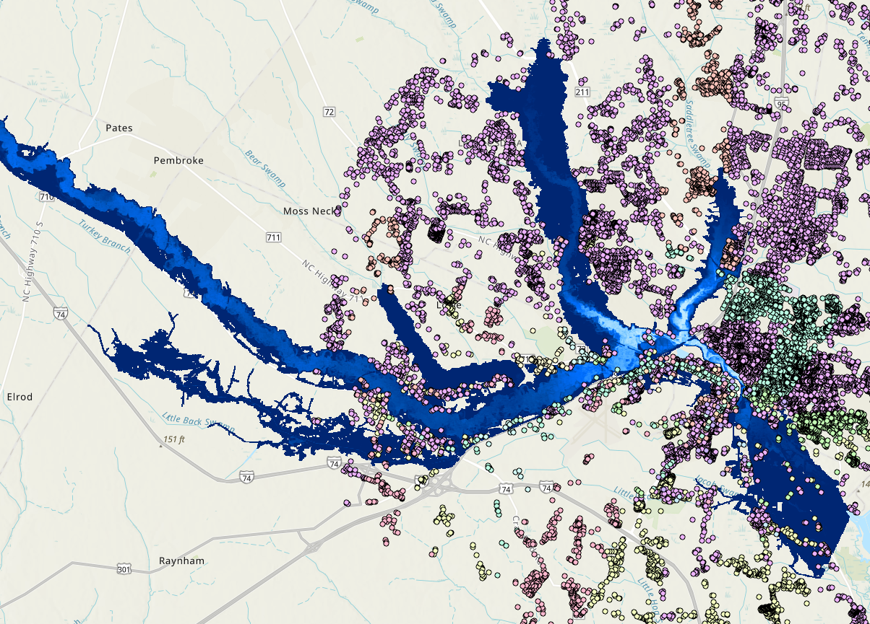

FloodGuard Miami
Predict. Prepare. Protect.
Smart, no-code flood risk platform for Miami’s communities
Presented by:
Mostafa Sameer — Civil Engineering Innovator
3

Slide 2
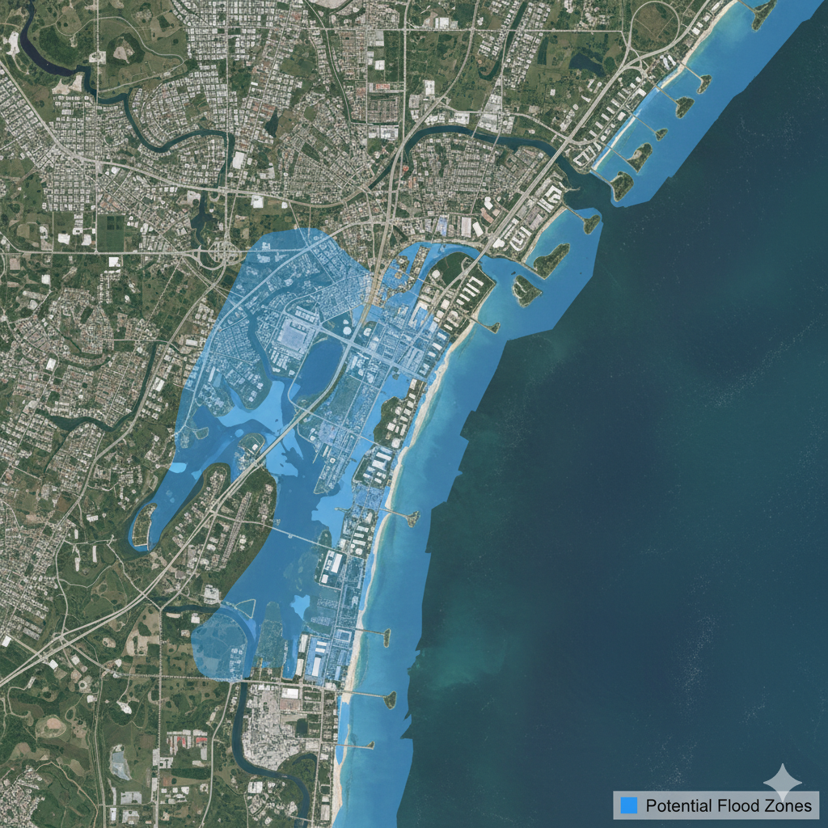
The Problem
Miami is one of the most flood-prone cities in the U.S.
Even sunny-day flooding affects neighborhoods like Brickell and Little River.
Existing FEMA maps are outdated, reactive, and not localized.
City planners, residents, and businesses lack real-time flood risk data.
4

Slide 3
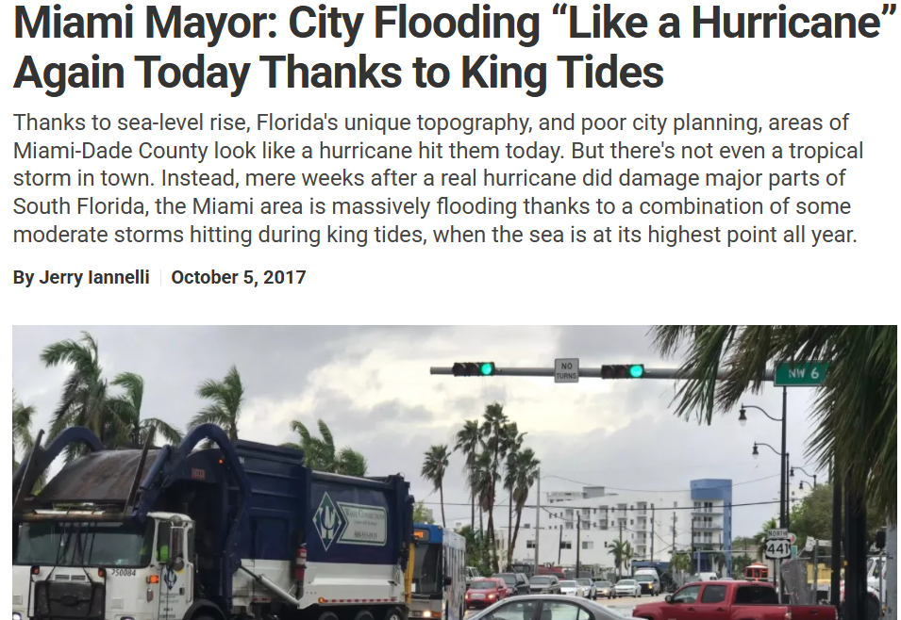
The Opportunity
Sea level projected to rise 14–26 inches by 2060.
Over $3B allocated to flood resilience in Miami-Dade 2030 Plan.
Demand for predictive, affordable flood tools is growing across South Florida.
6

Slide 4
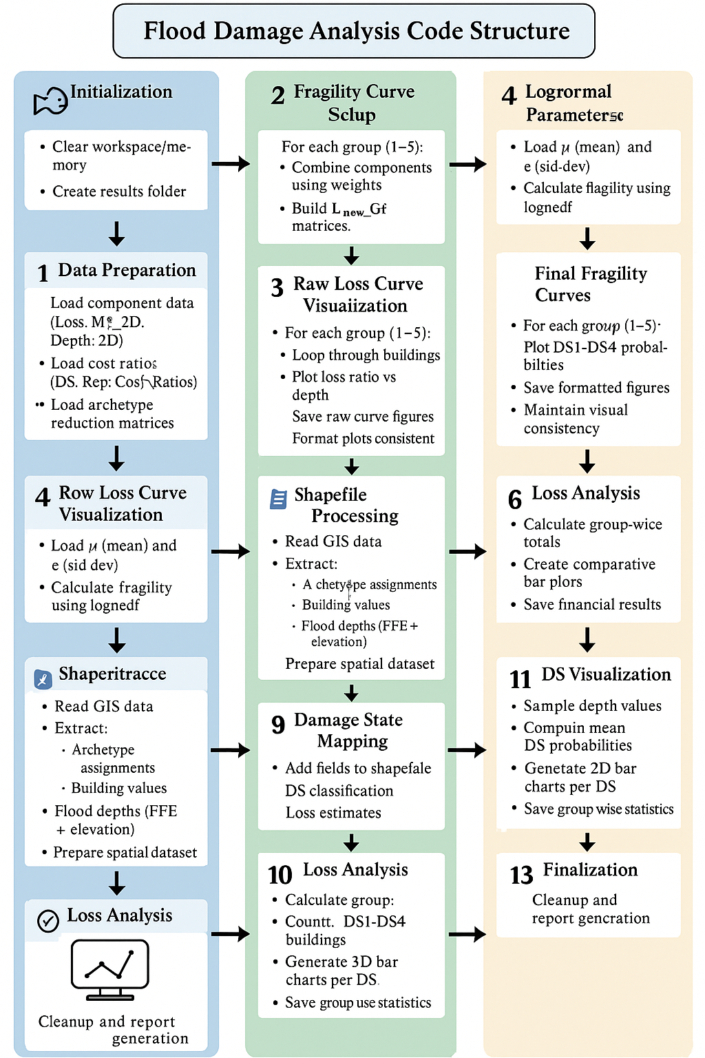
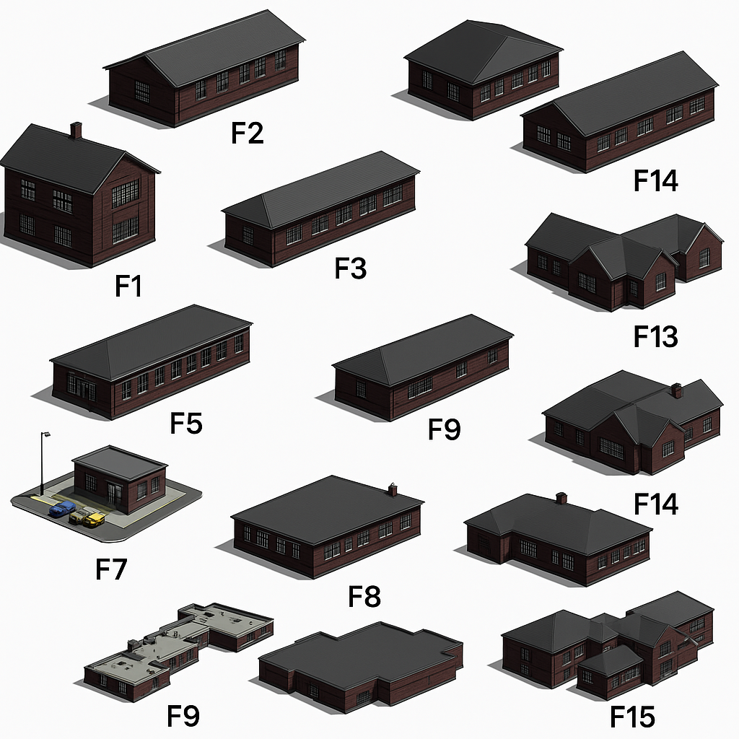
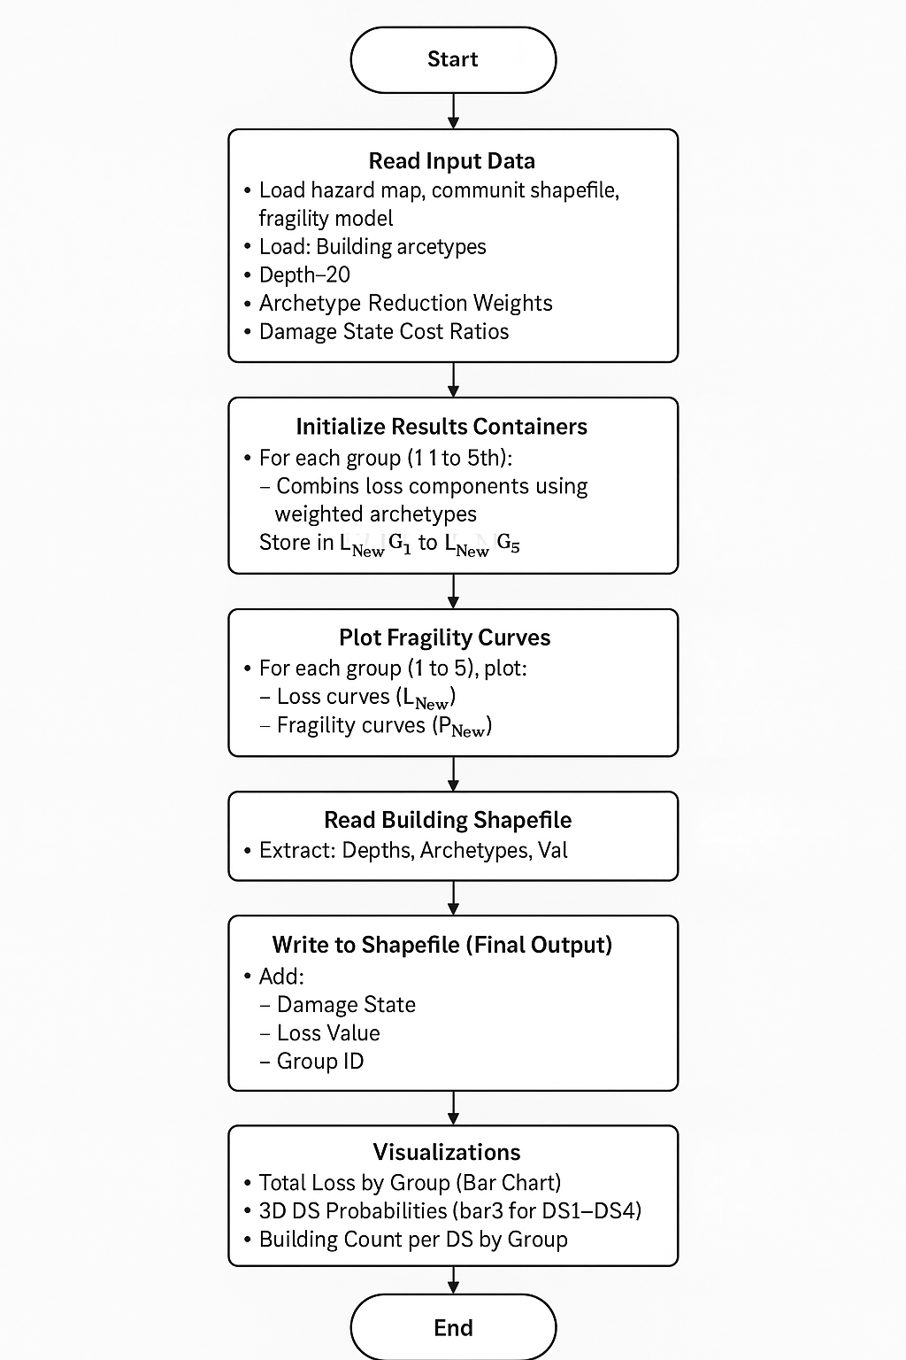
Methodology
This workflow outlines analyzing building damage by loading hazard and building data, combining loss components for different groups, and plotting fragility curves. The results, including damage states and loss values, are then added to the building shapefile for spatial analysis. Finally, visualizations such as total loss by group and damage state probabilities help summarize the findings.
5

Slide 5
Archetype Reduction for Flood Damage Analysis
Flood Damage Analysis (Archetype Reduction)
Group 1
(10 Building Archetypes)
Group 2
(7 Building Archetypes)
Group 3
(4 Building Archetypes)
Group 4
(3 Building Archetypes)
Group 5
(1 Building Archetypes)
Plot 1: F1 + F2
Plot 2: F3 + F4
Plot 3: F5 + F8
Plot 4: F6 + F7
Plot 5: F9
Plot 6: F10 + F13
Plot 7: F11
Plot 8: F12
Plot 9: F14
Plot 10: F15
Plot 1: F1 + F2
Plot 2: F3 + F4
Plot 3: F5 + F6 + F7 + F8
Plot 4: F9 + F15
Plot 5: F10 + F13
Plot 6: F11 + F12
Plot 7: F14
Plot 1: F1 + F2 + F3 + F4
Plot 2: F5 + F6 + F7 + F8 + F14
Plot 3: F9 + F10 + F13 + F15
Plot 4: F11 + F12
Plot 1: F1 + F2 + F3 + F4
Plot 2: F5 + F6 + F7 + F8 + F9 + F13 + F14 + F15
Plot 3: F10 + F11 + F12
Plot: F1 + F2 + F3 + F4 + F5 + F6 + F7 + F8 + F9 + F10 + F11 + F12 + F13 + F14 + F15
9

Slide 6
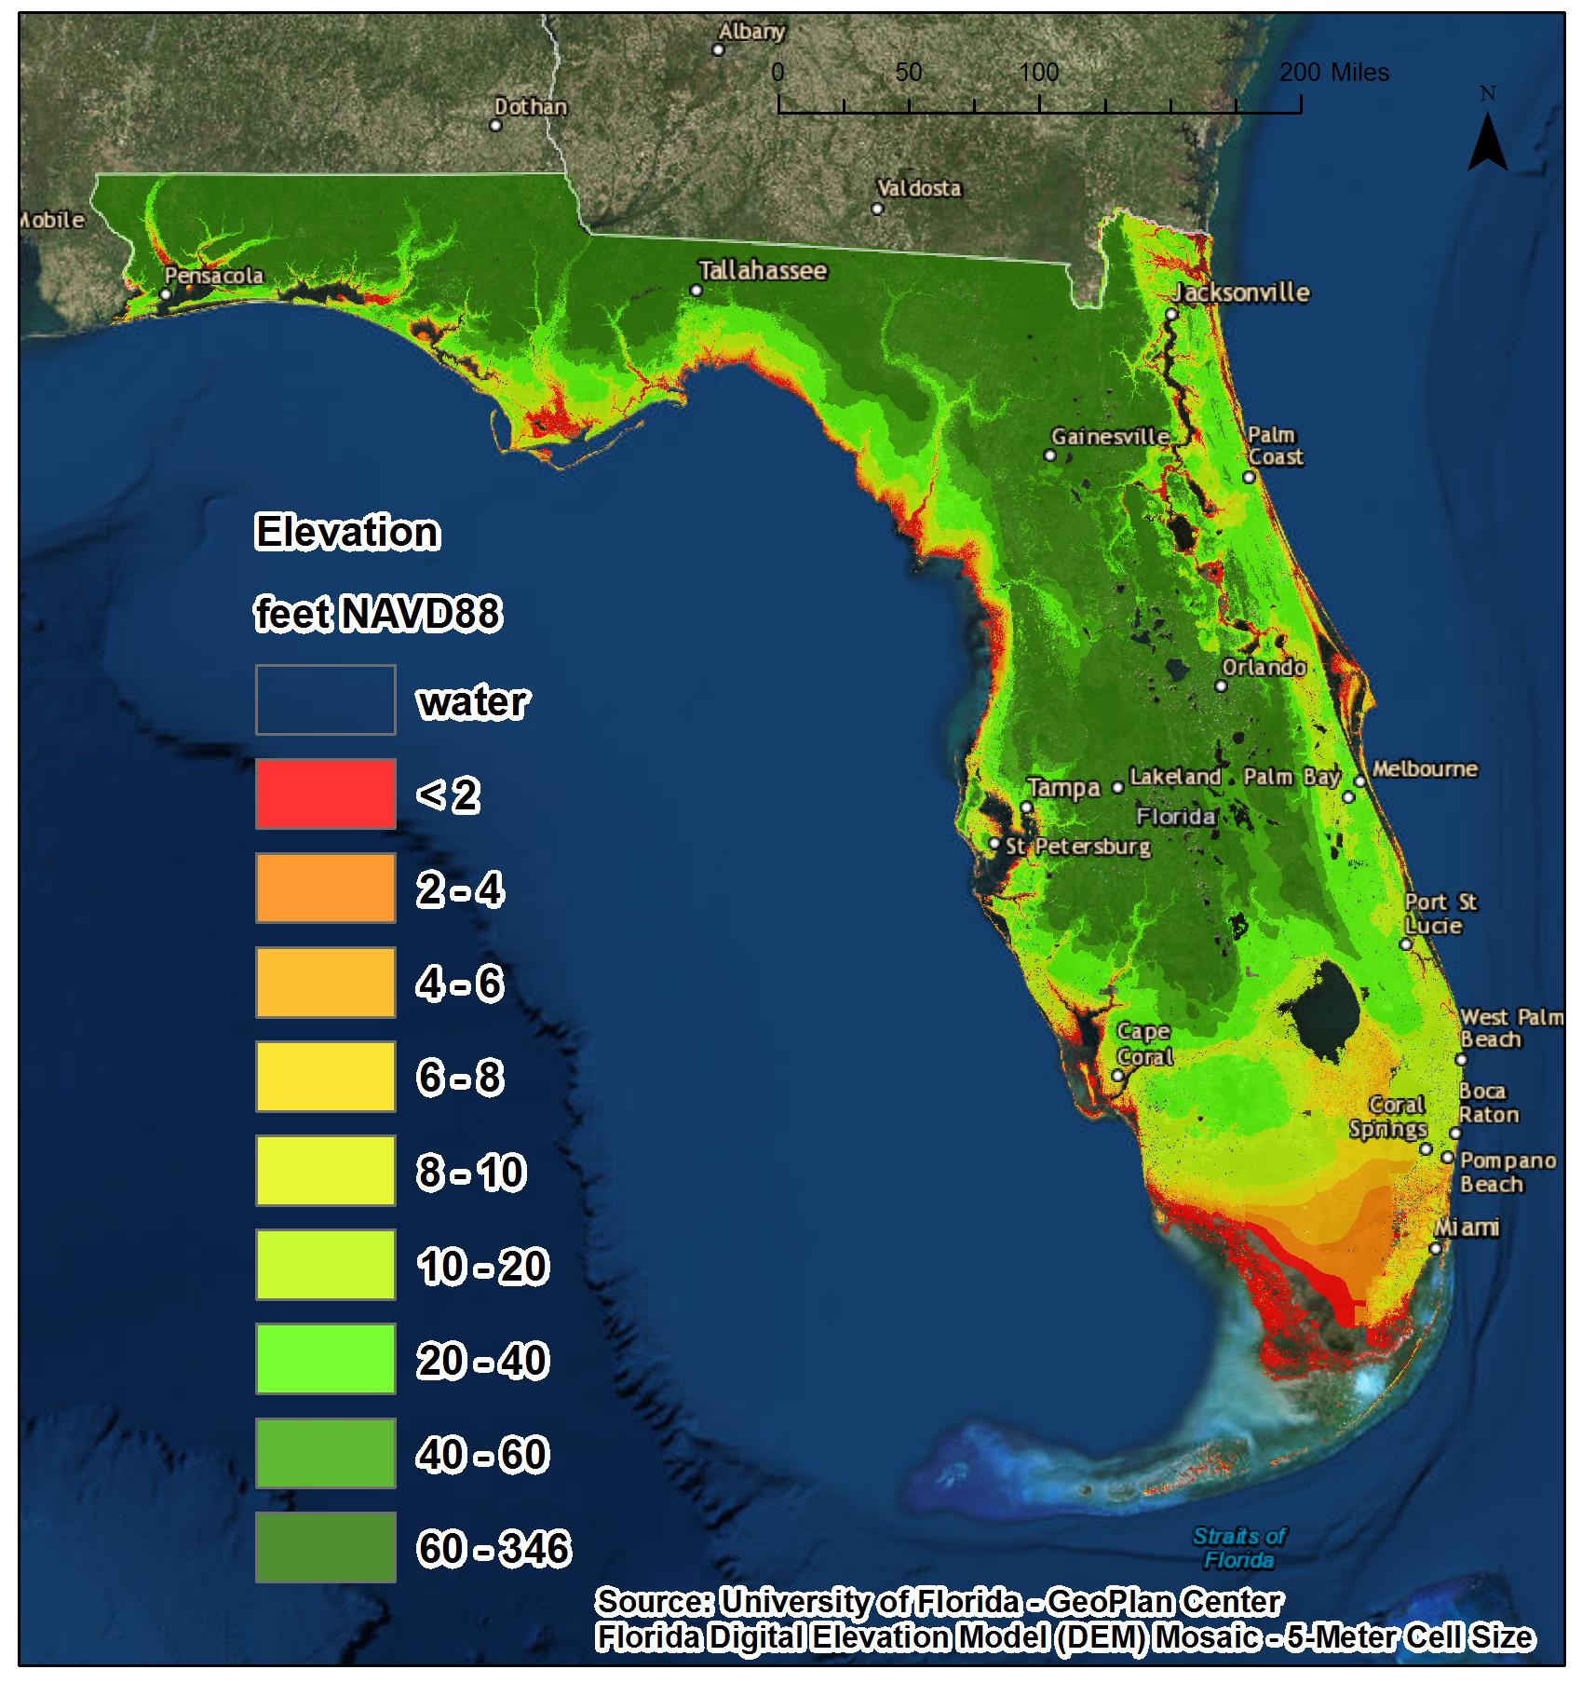
Our Solution: FloodGuard Miami
FloodGuard Miami is a no-code flood prediction and alert platform combining:
Real-time open data (NOAA, USGS, rain gauges)
Community flood reports via mobile app
AI-driven risk scoring for neighborhoods
Image Taken: https://climatecenter.fsu.edu/topics/sea-level-rise
7

Slide 7
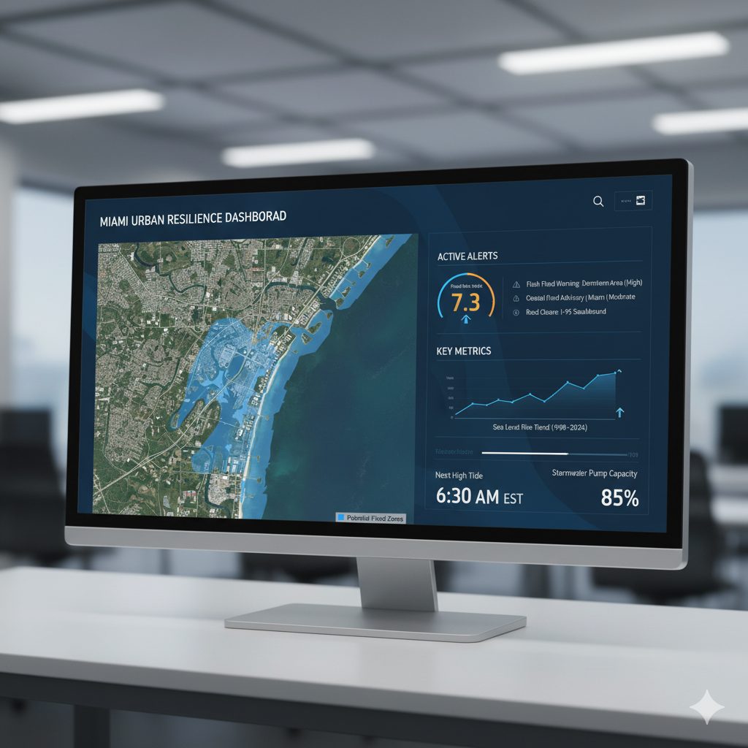
How It Works
Collects rainfall & tide data from open APIs
Integrates local flood reports from users
Predicts next 24–48 hr flood risks via simple no-code AI workflows
Displays alerts + visualization on a public map
8

Slide 8
Damage States (DS1 to DS4)
DS Level | Functionality | Description | Damage Scale | Damage Ratio
DS1 | Limited Occupancy | Water touches the floor joists, up to minor water entering the building. Damage to carpets, pads, baseboards, and flooring. Complete damage to the garage interior is below the first-floor elevation. No major mold or sewer backup. | Slight | 0.03 – 0.15
DS2 | Restricted Occupancy | Partial damage to drywalls, electrical components (base outlets), water heater, furnace. Complete damage to major equipment, appliances, and furniture on the first floor. Significant damage to the lower bathroom and kitchen cabinets. Potential for major sewer backup and mold issues. | Moderate | 0.15 – 0.5
DS3 | Restricted Use | Major damage to the non-structural components and interiors within the whole building. Includes drywall damage to upper stories and destruction of electrical switches, mid outlets, bathroom, and kitchen components. Major sewer backup with significant mold issues. | Extensive | 0.5 – 0.7
DS4 | Restricted Entry | Significant structural damage, including studs, trusses, and joists. Non-structural components destroyed, including drywall, appliances, cabinets, furniture, and more. Damage to rooftop units. The foundation could be compromised and may need to be demolished or replaced. | Complete | 0.7 – 1.0
16

Slide 9
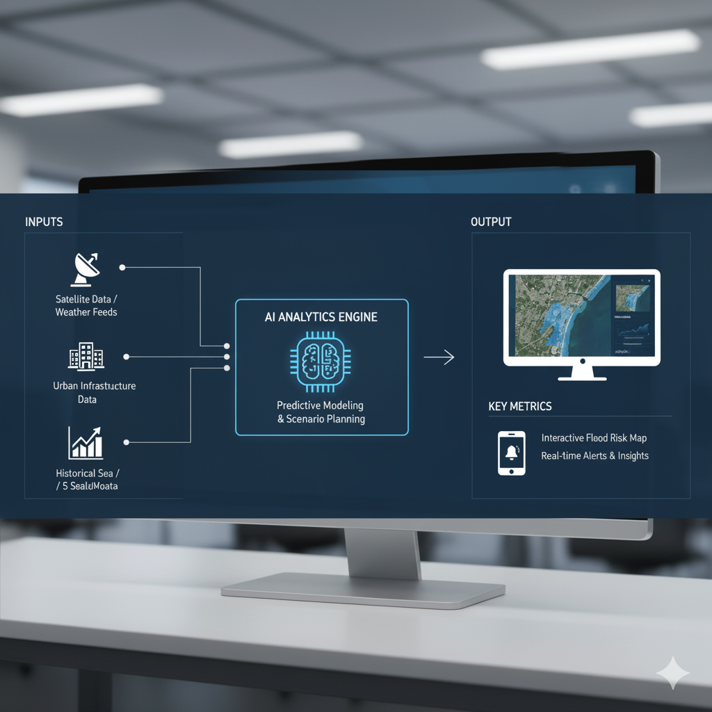
Market & Audience
Segment | Value | Target
City Governments | $10M+ in flood mapping contracts | Miami-Dade, Fort Lauderdale
Real Estate / Insurance | $1.5B+ market | Developers & agents
Residents / NGOs | Awareness + safety | General users
17

Slide 10
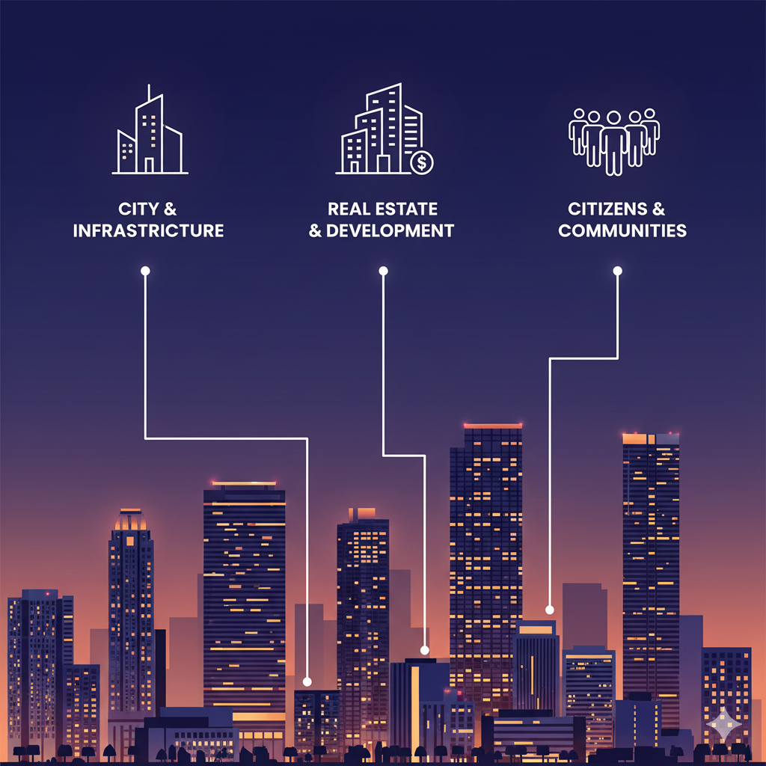
Business Model
Tier | Description | Pricing
Free Tier | Public flood alerts | $0
Pro Tier | City dashboard + predictive insights | $499/month
Enterprise Tier | Insurance + property API | Custom pricing
18

Slide 11
Go-to-Market Plan
Phase 1: Pilot with FIU Civil Engineering Dept. + test in Little River Phase 2: Partner with Miami-Dade Office of Resilience Phase 3: Expand to Broward & Palm Beach counties
This phase focuses on research and development, with a specific pilot test in the Little River area of Miami.
University-led research: FIU's Civil Engineering department would lead the development and testing of solutions for climate-ready infrastructure. FIU has existing research institutes, like the Institute for Resilient and Sustainable Coastal Infrastructure (InteRaCt), that are designed to find engineering solutions for aging and vulnerable infrastructure.
Testing site: The Little River Adaptation Action Area, located in Miami-Dade County, has been a key site for planning and pilot projects aimed at localized sea level rise strategies. Initiatives here include investigating septic-to-sewer conversion and creating "blue and green spaces" for water retention.
After a successful pilot, the project scales up through a formal partnership with the Miami-Dade Office of Resilience.
Expansion of scope: Miami-Dade County's Office of Resilience has a wide-ranging program to address climate change impacts like sea-level rise and extreme heat, and it already collaborates with FIU. This partnership would allow the solutions developed by FIU to be integrated into larger, county-wide resilience strategies.
Shared resources: The collaboration would leverage the resources of both organizations. The Tech Hub project, which FIU is part of, has received millions in grant funding from the U.S. Department of Commerce to support resilient infrastructure.
In the final phase, the initiative is expanded to cover the broader South Florida region.
Regional collaboration: The expansion would include Broward and Palm Beach counties, building on existing partnerships. These counties are part of the larger regional Risk and Resilience Tech Hub alongside Miami-Dade, and the program is designed to scale solutions across the entire region.
Large-scale implementation: By expanding, the project would transition from a localized pilot to a regional implementation effort. This would allow the tested technologies and strategies to be commercialized and scaled to benefit a much larger population.
19

Slide 12
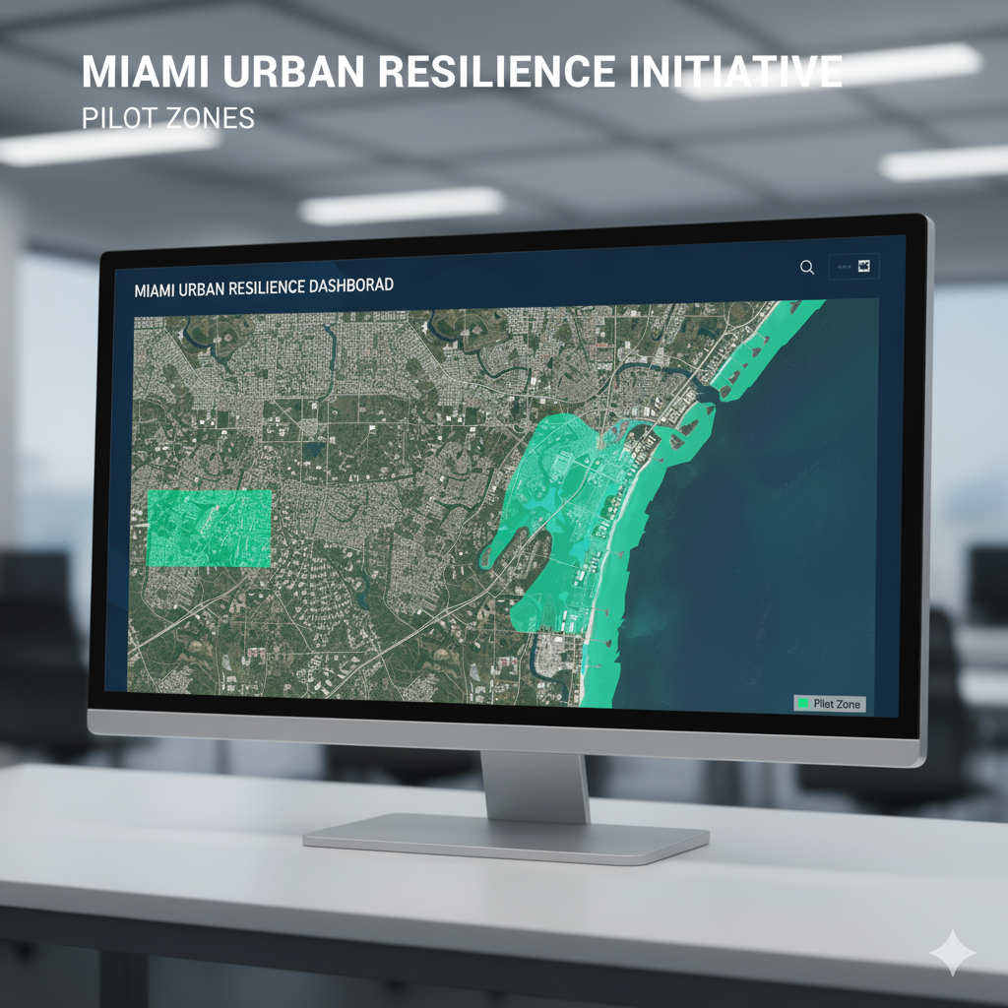
Competitive Advantage
✅ Localized data model — built for Miami ✅ Community-powered reports — real-time accuracy ✅ No-code & scalable — fast deployment ✅ Civil-engineering expertise — validated design
FEMA's disaster management tools are designed for the specific federal, state, and local government structure of the United States. Global tools, such as those used by the United Nations Office for the Coordination of Humanitarian Affairs (OCHA), are built to handle international coordination across diverse governmental and non-governmental actors.
20

Slide 13
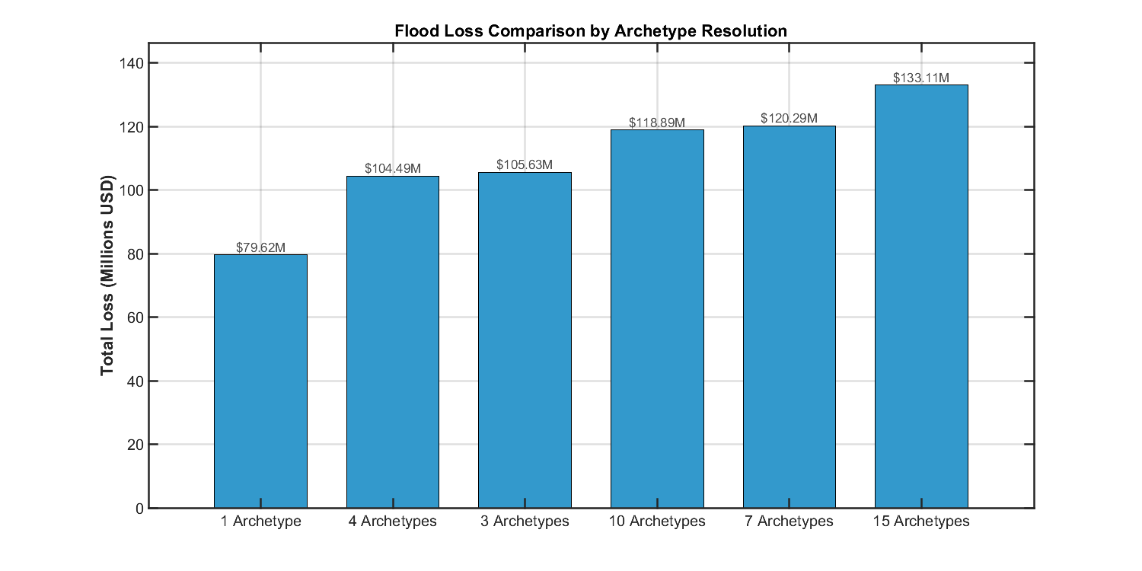
Impact
This chart compares flood loss estimates using different numbers of archetypes in the model. The highest loss is observed with 15 archetypes, showing the importance of detailed categorization for accurate loss assessment.
21

Slide 14
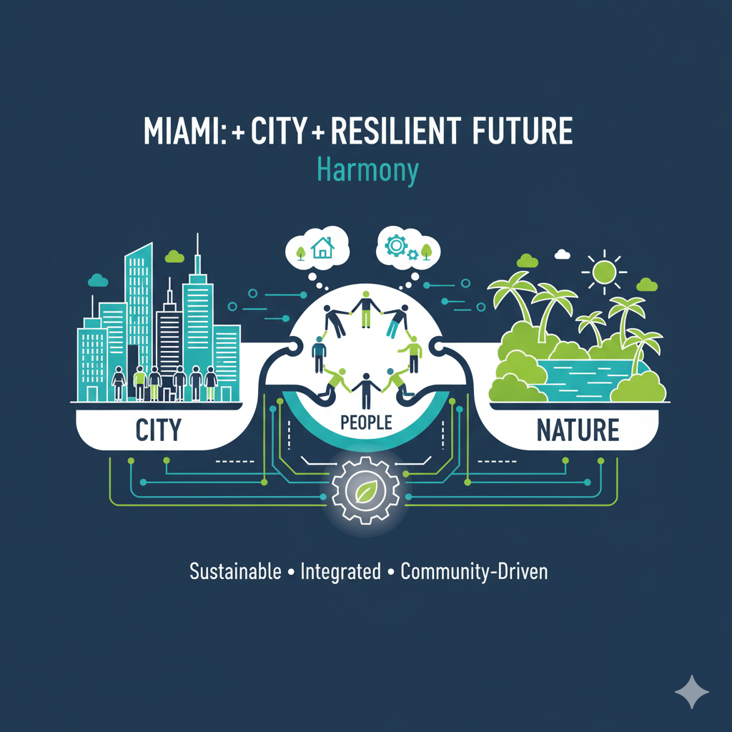
Reduce annual property losses by 10–20%
Protect 2.7M Miami residents
Support Miami’s 2050 climate adaptation goals
Bridge citizens, engineers, and policymakers

Slide 15
References
NOAA National Weather Service (NWS). (2024). Flood Safety and Data Resources. Retrieved from https://www.weather.gov/safety/flood
City of Miami Office of Resilience. (2023). Miami Forever Climate Ready Strategy. Retrieved from https://www.miamigov.com/ClimateReady
U.S. Geological Survey (USGS). (2024). Water Data for the Nation. Retrieved from https://waterdata.usgs.gov/nwis
Miami-Dade County Office of Resilience. (2023). Resilient305 Strategy. Retrieved from https://resilient305.com/
Florida International University (FIU) Extreme Events Institute. (2023). Flood and Hurricane Risk Research. Retrieved from https://eei.fiu.edu/
23

Slide 16
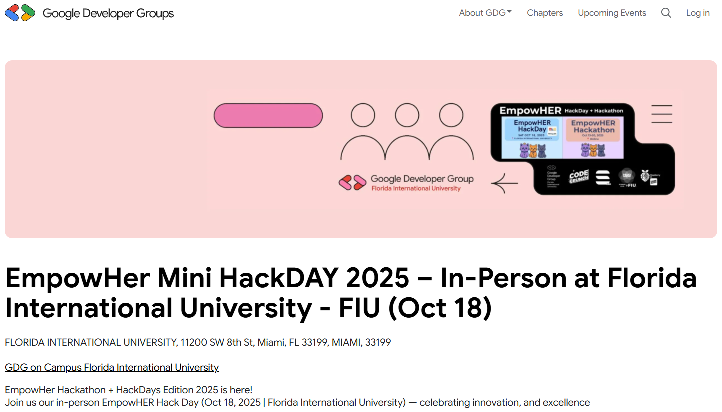
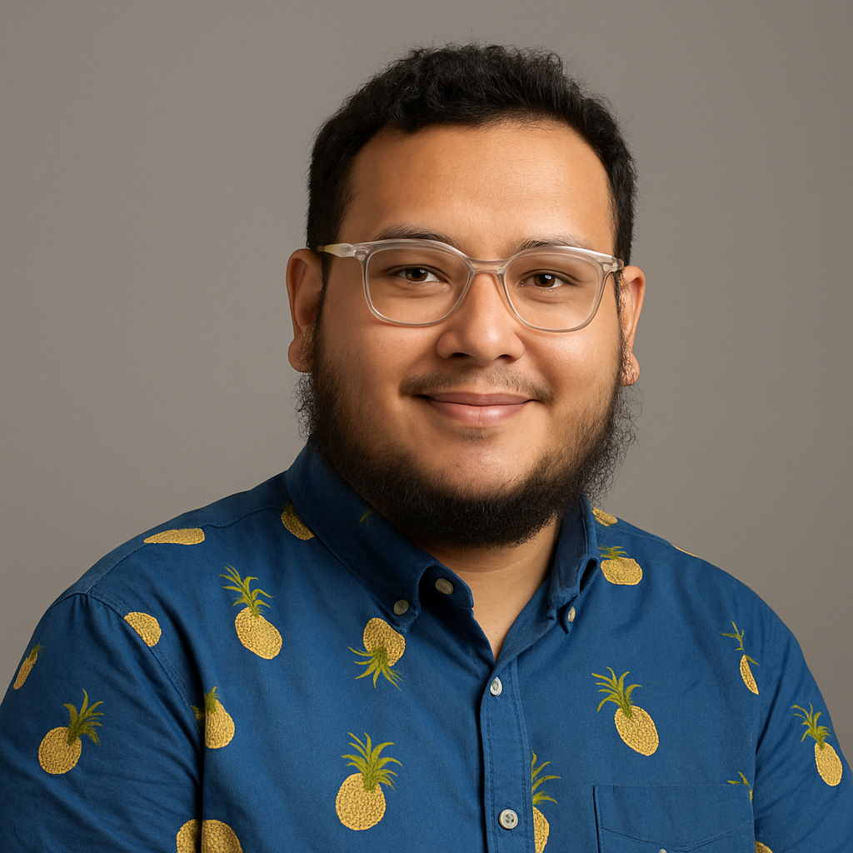
👤 About the Founder
Mostafa Sameer Graduate Research Assistant Department of Civil and Environmental Engineering Florida International University (FIU)
https://sites.google.com/site/mostafasameeraustprofile/topics-of-interests-research-based
Mostafa is a civil engineer and researcher specializing in flood risk mitigation, natural hazards, and resilient infrastructure. At FIU, he works on innovative approaches to urban resilience and community-based adaptation strategies for coastal cities like Miami.
He founded FloodGuard Miami to bridge the gap between scientific data and real-world preparedness — empowering residents and city planners to predict, prepare for, and prevent flood damage through data-driven solutions.

Slide 17
