Slide 1
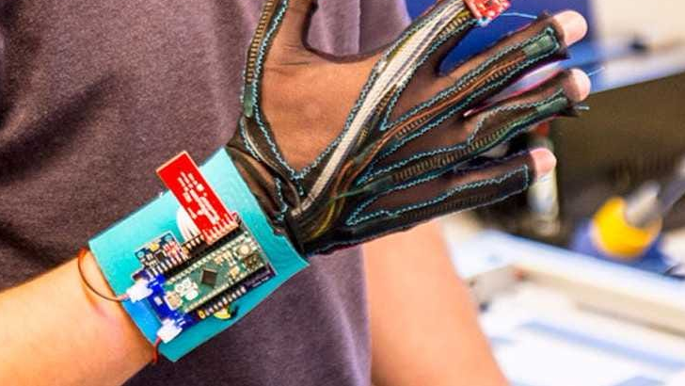
Glove for Deaf

Slide 2
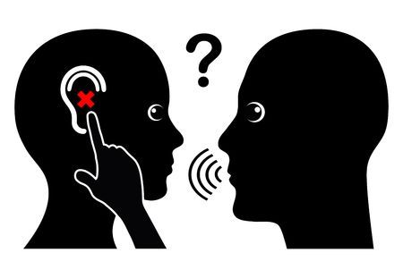
'Deaf' people mostly have profound hearing loss, which implies very little or no hearing.
Deaf individuals communicate with others by using sign language, which allows them to interact with people in their environment. However, in order for hearing individuals to effectively communicate with the Deaf, they need to learn and understand sign language.
we will implement a device that can transcript the sign word on LCD

Slide 3
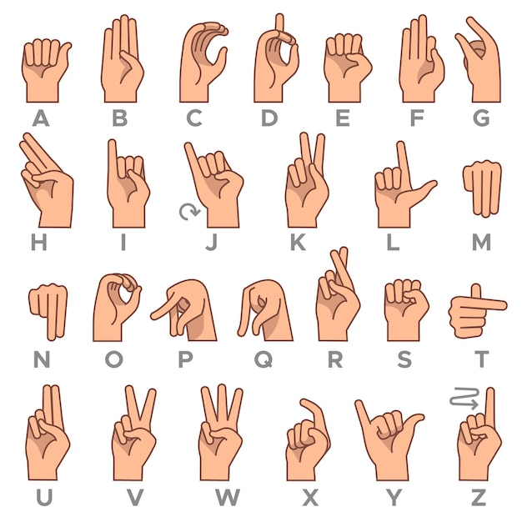
a project called "Glove for Deaf" that aims to create a device to help deaf individuals communicate by translating sign language gestures into text displayed on an LCD. You have shared several source files related to the implementation of this project.

Slide 4
Coding:
Layered architecture
Here's a breakdown of the files:
std.h: This file defines standard data types used in the project.
Clock.h: This file includes the necessary headers and defines the CPU frequency for the project.
Bit_Math.h: This file defines various bit manipulation macros.
ADC.h, ADC_Reg.h, and ADC_Types.h: These files provide the functionality for initializing and reading from an analog-to-digital converter (ADC).
DIO.h, DIO_Reg.h, DIO_Types.h, DIO_CFG.h, and DIO_CFG.c: These files implement the functionality for digital input/output (DIO) operations, including reading/writing to GPIO pins and configuring pin directions.
ExInt.h, ExInt_Reg.h, ExInt_Types.h, and ExInt.c: These files handle external interrupts (ExInt) and provide functions to enable/disable interrupts and set interrupt callbacks.
GINT.h and GINT_Reg.h: These files define global interrupt (GINT) related registers and functions for enabling/disabling interrupts.
LCD.h and LCD.c: These files contain functions to initialize and control an LCD display.
main.c: This is the main file that includes all the necessary headers and implements the logic for your project. It initializes various components, such as the ADC, LCD, and external interrupt, and contains the main loop where the sensor values are read and sign language words are recognized and displayed on the LCD.
By using these files together, the code can configure the ADC module, read analog values from the flex sensor pins using the ADC, and perform digital I/O operations to handle the flex sensor readings.

Slide 5

1-std.h: This header file defines standard types like s8, u8, s16, u16, s32, u32, and STD_LevelTypes (an enumeration for representing low and high levels).
2-Clock.h: This header file defines the CPU frequency (F_CPU) and includes the necessary delay functions (_delay_ms and _delay_us) from the util/delay.h library.
3-Bit_Math.h: This header file provides several macros for manipulating individual bits of a register, such as SetBit, ClearBit, ToggleBit, and GetBit.

Slide 6
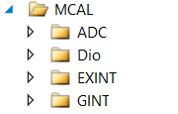
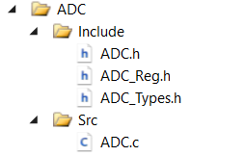
1-ADC.h: This header file contains function declarations and includes other necessary header files (ADC_Reg.h, ADC_Types.h, and Bit_Math.h) for using the Analog-to-Digital Converter (ADC) module.
2-ADC_Reg.h: This header file defines the ADC registers' addresses and includes the std.h header file.
3-ADC_Types.h: This header file defines enumeration types for ADC channel, ADC prescaler, and ADC voltage reference.
4-ADC.c: This source file contains the implementation of the ADC functions declared in ADC.h. It includes the necessary header files and provides functions to initialize the ADC module (ADC_Init) and read from a specific ADC channel (ADC_Read).

Slide 7
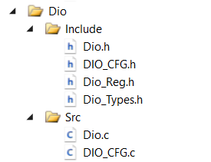
1-Dio.h: This header file contains function declarations and includes other necessary header files (std.h, Bit_Math.h, DIO_Reg.h, DIO_Types.h, and DIO_CFG.h) for manipulating Digital I/O (DIO) pins and ports.
2-Dio_Reg.h: This header file defines the DIO registers' addresses and includes the std.h header file.
3-Dio_Types.h: This header file defines enumeration types for DIO channel, DIO port, and DIO direction.
4-DIO_CFG.h: This header file includes other necessary header files (std.h, Bit_Math.h, DIO_Reg.h, DIO_Types.h, and DIO.h) and defines the DIO pin configurations (DIO_PinCfg) for the project. It also provides the DIO_Init function for initializing DIO pins based on the defined configurations.
5-Dio.c: This source file contains the implementation of the DIO functions declared in Dio.h. It includes the necessary header files and provides functions to write to a DIO channel (DIO_WriteChannel), read from a DIO channel (DIO_ReadChannel), toggle a DIO channel (DIO_ToggleChannel), configure a DIO channel direction (DIO_ConfigChannel), write to a DIO port (DIO_WritePort), read from a DIO port (DIO_ReadPort), and write to a group of DIO channels within a port (DIO_WriteChannelGroup).
6-DIO_CFG.c: This source file contains the implementation of the DIO_Init function declared in DIO_CFG.h. It includes the necessary header files and provides the pin configurations for the project using the DIO_PinCfg structure. The DIO_Init function initializes the DIO pins based on these configurations.

Slide 8
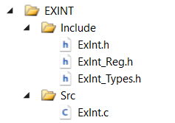
1-ExInt.h: This header file contains function declarations and includes other necessary header files (ExInt_Reg.h and ExInt_Types.h) for using External Interrupts.
2-ExInt_Reg.h: This header file defines the External Interrupt registers' addresses and includes the std.h header file.
3-ExInt_Types.h: This header file defines enumeration types for External Interrupts and their corresponding sensing modes.
4-ExInt.c: This source file contains the implementation of the External Interrupt functions declared in ExInt.h. It includes the necessary header files and provides functions to enable/disable External Interrupts (Ext_Interrupt_Enable and Ext_Interrupt_Disable), configure the sensing mode of an External Interrupt (Ext_Interrupt_Sncontrol), and set the callback function for an External Interrupt (Ext_Interrupt_SetCallBack). It also includes the interrupt service routines (ISRs) for each External Interrupt.

Slide 9
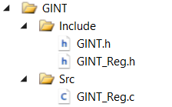
1-GINT.h: This header file contains function declarations and includes the necessary header file (GINT_Reg.h) for enabling and disabling global interrupts.
2-GINT_Reg.h: This header file defines the Global Interrupt registers' addresses and includes the std.h header file.
3-GINT.c: This source file contains the implementation of the GINT_EnableAllInterrupts and GINT_DisableAllInterrupts functions declared in GINT.h. It includes the necessary header file and provides functions to enable or disable all global interrupts.

Slide 10
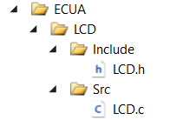
1-LCD.h: This header file contains function declarations and includes other necessary header files (Dio.h and Clock.h) for controlling an LCD (Liquid Crystal Display).
2-LCD.c: This source file contains the implementation of the LCD functions declared in LCD.h. It includes the necessary header files and provides functions to initialize the LCD module (LCD_Init), send commands to the LCD (LCD_Cmd), display a character on the LCD (LCD_Char), display a string on the LCD (LCD_String), set the cursor position on the LCD (LCD_SetPos), define custom characters on the LCD (LCD_Custome_Char), and clear the LCD screen (LCD_Clear).

Slide 11

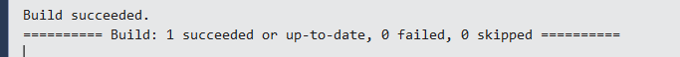
main.c: This is the main source file of the project. It includes all the necessary header files (std.h, Dio.h, ADC.h, LCD.h, ExInt.h, and GINT.h). The init function initializes the system components. The updateSensorValues function reads the sensor values from the ADC. The recognizeWord function determines the word based on the active sensors' values. The main function initializes the system, displays the project title on the LCD, and continuously updates the sensor values and recognized word on the LCD screen.
The output of the building process to all files in the project:

Slide 12
flowchart:
A flowchart is a graphical representation or diagram that illustrates the sequence of steps or activities in a process. It uses various symbols and shapes to represent different elements such as actions, decisions, inputs, outputs, and connectors.
In a flowchart, different shapes represent different types of actions or decisions. Here's a description of the common shapes used in flowcharts:
terminal/Start/End: Represent the beginning and end points of a flowchart. It is usually represented by an oval shape with the word "Start" or "End" written inside.
Process/Action: Represents a specific action or process in the flowchart. It is typically represented by a rectangle with rounded corners. The action or process is described inside the rectangle.
Decision/Conditional: This represents a decision point where a condition is evaluated. It is usually represented by a diamond shape. The condition or question is written inside the diamond, and arrows representing the possible outcomes or paths are connected to it.
Input/Output: Represents input or output operations in the flowchart. It is represented by a parallelogram shape. The input or output operation is described inside the shape.

Slide 13
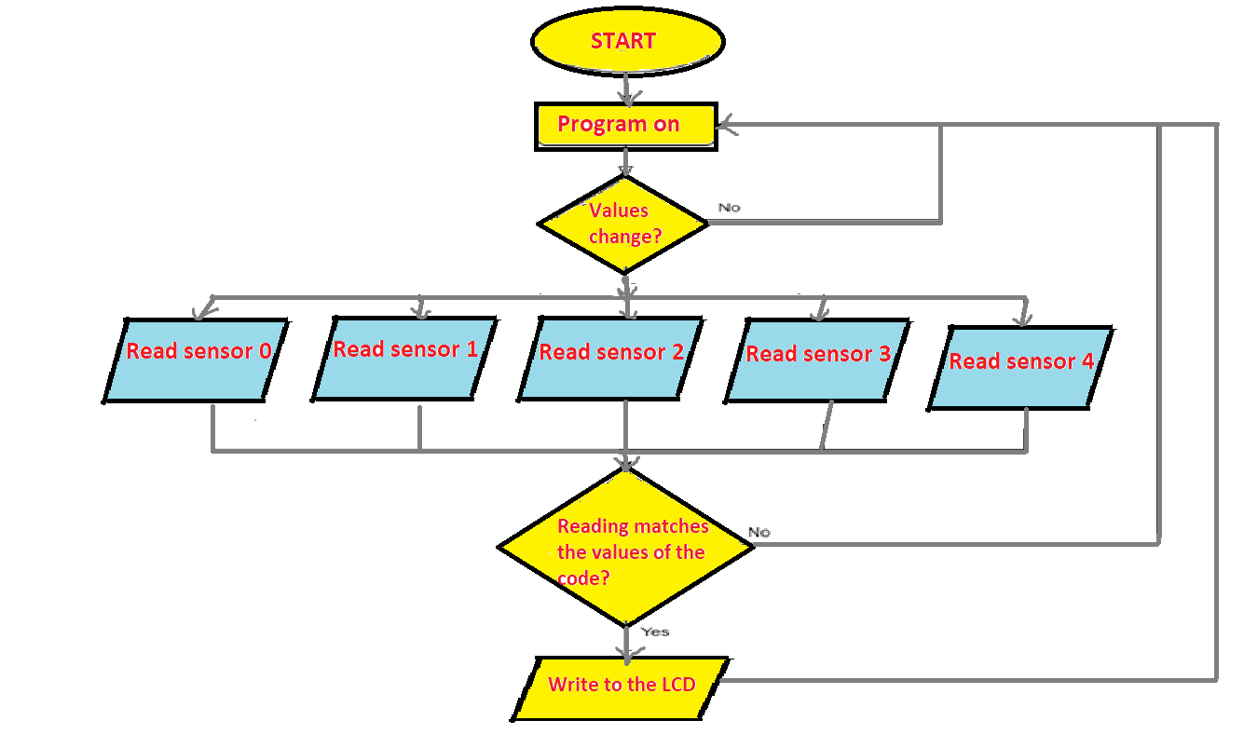

Slide 14
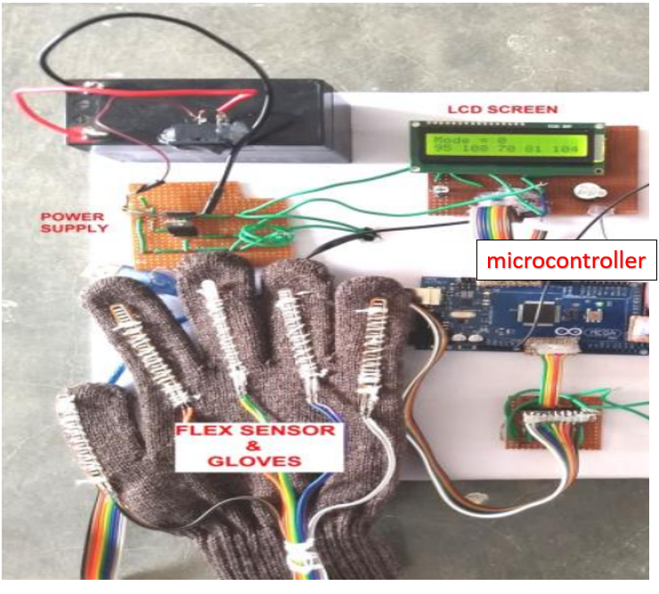
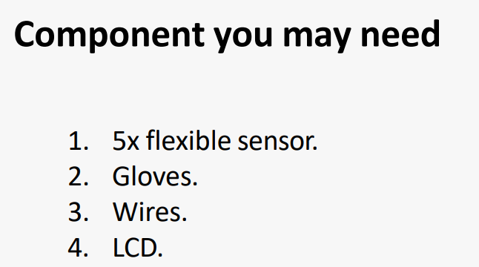
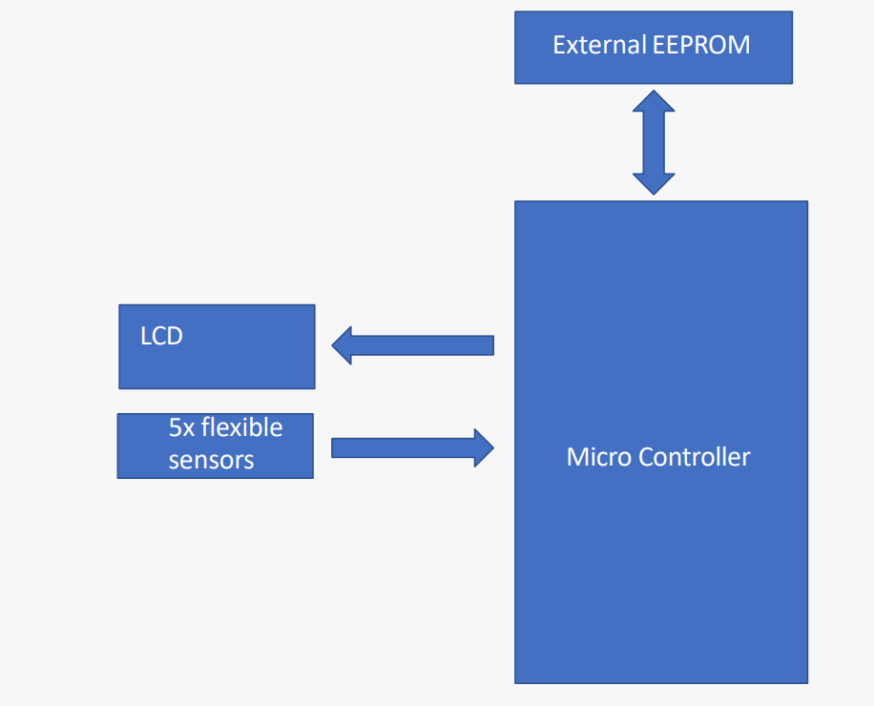
Glove for Deaf in hardware:

Slide 15

made by: Mostafa Sherif

