Slide 1

MagnoTricorder: What you Need To Do Before Leaving Home
Mostafa Uddin & Tamer Nadeem

Slide 2

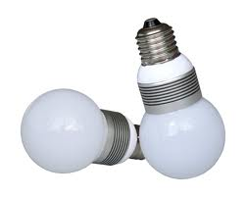
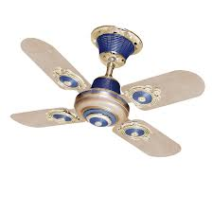
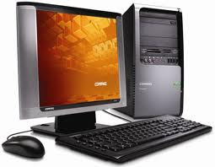
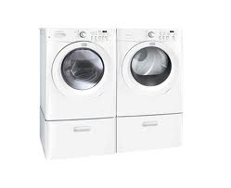
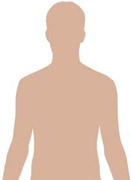
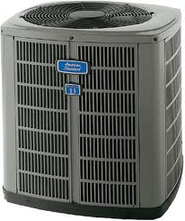
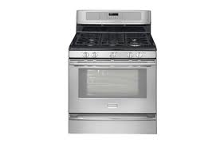
Smart Home
Monitoring the home devices for energy monitoring purpose is one of the corner stone of Smart Home research.
Home devices address any electric devices at home including home appliances, computing devices, non-computing devices etc.

Slide 3
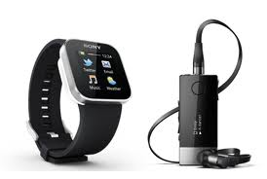
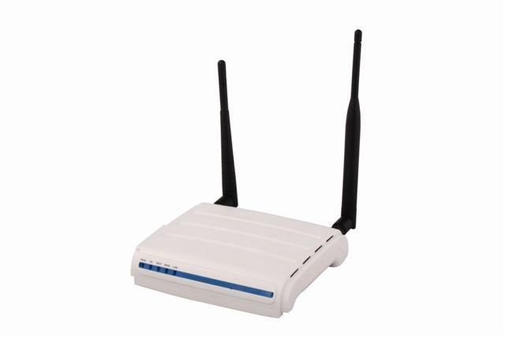
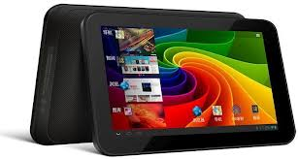
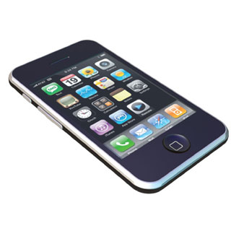
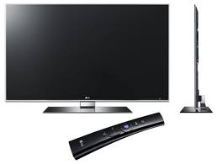
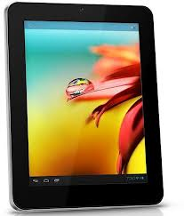
Smart Devices
We are equipped with number of smart device that has different sensing capabilities

Slide 4
Our Vision
Smart Devices
Sensing Capability
Sense Status of
the Home devices
Better Control Over
The home devices

Slide 5
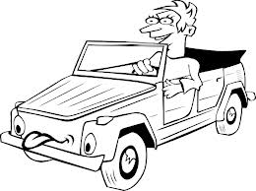
Scenario
Did I turn off the AC/Stove at home?
PROBLEM:
Bob is on his way to lab office

Slide 6
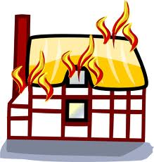

Scenario
PROBLEM:
Leaving home appliances or devices on while you are
not at home can have severe circumstances
Wasting Money
Home fatalities

Slide 7
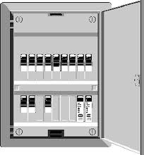
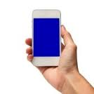
Scenario
SOLUTION:
Checklist Before leaving home
AC/Heating
Kitchen Stove
Kitchen Woven
Light/Lamp
PC/Laptop
Fan
OR
Bob can utilize the smartphone sensing capability to detect any on home devices/appliances from a single-point.

Slide 8
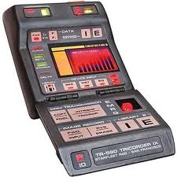
Our Solution:MagnoTricorder
Utilize the magnetic sensor in smartphone.
Leverages Electro Magnetic Interference of AC current in main power line.
Detect running home devices/appliances from a single point (Circuit Breaker Panel).
Name is inspired by StarTrek device: Tricorder.

Slide 9
MagnoTricorder: Usage
Bob can do the following on his way out home:
Action 1: He can run the MagnoTricorder application in his smartphone while he is holding it near the Circuit Breaker Panel(CBP).
Action 2: After few second MagnoTricorder will inform Bob which home device is still on.

Slide 10
Placement of CBP?
National Electric Code (NEC) is adapted by most buildings in USA.
NEC recommend to place CBP in a clear, easily accessible and safe place.
In some countries CBP is placed near the entrance.
Placing CBP near the entrance is a suitable place for single-point sensing.

Slide 11
Background
Multi-Sensing Framework: Exploit different modalities in smartphone to build a unique fingerprint profile of a machine.
Previously we have used sound sensing capability to build such profile for each home device.
Limitation with sound sensing:
Device that does not generate sound.
Device proximity requirement.

Slide 12

How idea evolved?
We want to overcome the limitation of sound sensing to detect home devices.
The flow of AC current depends on the load of running devices at home.
Conducting AC current in main power line generate Electro Magnetic Interference(EMI).
AC current → EMI
EMI induce magnetic field that fluctuates magnetic sensor reading in smartphone.

Slide 13
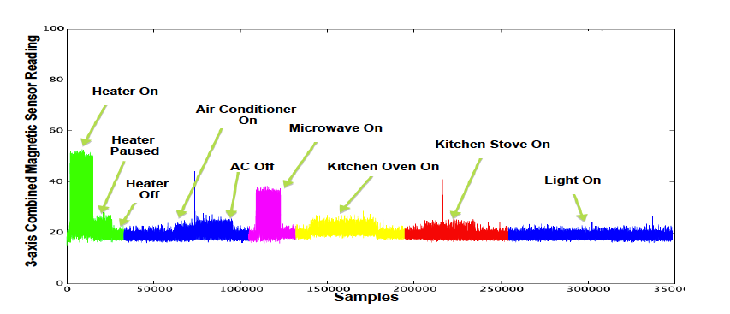
How idea evolved?
We took the Nexus S phone near the CBP in order to collect the magnetic sensor reading.
Magnetic sensor reading from the Nexus S phone while different devices were running.

Slide 14
Some challenges
Magnetic sensor in smartphone has very narrow bandwidth low pass filter.
Less sensitive to high frequency (60Hz) interference.
Can we still utilize the Interference over magnetic sensor reading in smartphone to detect running home devices/appliances?

Slide 15
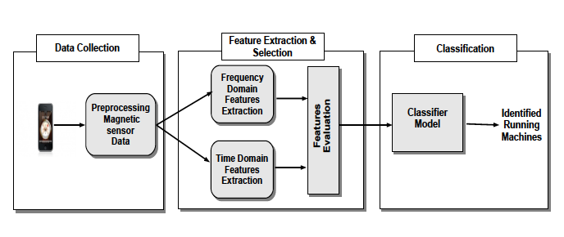
MagnoTricorder Framework
Data Collection: Collect and Preprocess raw magnetic sensing data.
Features Extraction & Selection: Extract and select both time and frequency domain features.
Classification: Training algorithm to build a classification model, later used for texting.

Slide 16
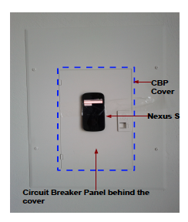
MagnoTricorder: Data collection
We place the Nexus S phone on the top of the CBP surface as above picture.
We have collect the data over 3 days period of time.
Each day we place the phone at different orientation.
We split the collected data to two set: training and testing data.

Slide 17
MagnoTricorder: Data collection
Collect magnetic sensor reading while no device is running.
Over 3 day period, we collect 15-20 minutes of data for each home devices.
We collect data for 1) Heating on 2) Heating Pause 3)Air Condition on 4) Oven on 5) microwave on 6)Light on 7)Laptop plugged in 8)All Off

Slide 18
MagnoTricorder: Feature Extraction
We have two main goals:
1) Features should be able to differentiate between different devices.
2) Selected features should not be sensitive to the smartphone's orientation
We extract both time domain and frequency domain features

Slide 19
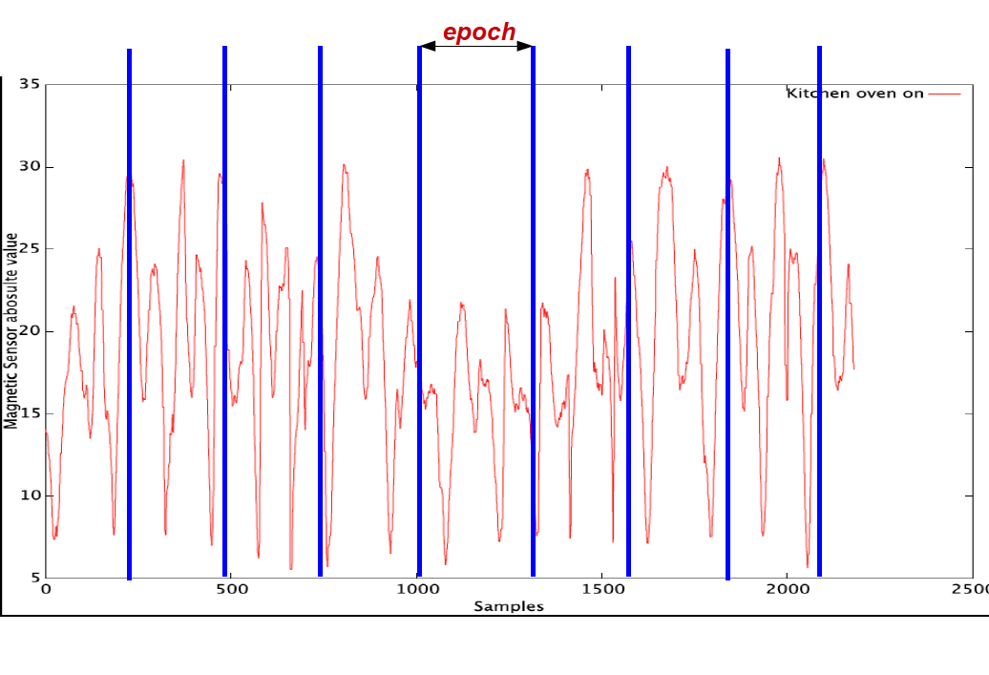
MagnoTricorder: Data Preprocess
Raw data preprocess:
Epoch: We split the magnetic sensor data samples into sequence of non-overlapped five second periods.
We apply feature extraction on each epoch.

Slide 20
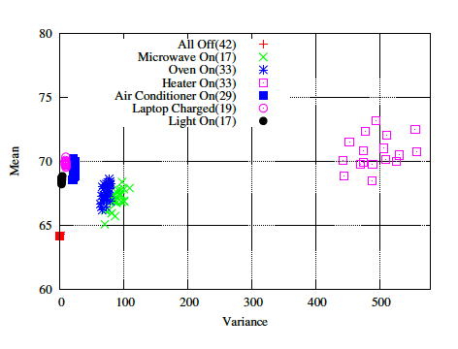

Feature Extraction: Time Domain
Each epoch has total 118*5= 590 sample.
Combine the 3-axis magnetic sensor reading for each sample.
Calculate the mean and variance for each epoch.

Slide 21
Feature Extraction: Time Domain
Highlights:
1. Calculated mean values are highly dependent on both the orientation and distance of smartphone with respect to CBP.
2. Variance values are not sensitive to the smartphone's orientation but sensitive to distance.
3. Actual position of the smartphone on CBP cover has some effects on the magnetic sensor reading.
We consider smartphone would be placed near the center of the CBP cover.

Slide 22
Feature Extraction: Frequency Domain
Applying FFT on the samples of each epoch.
Extract power, |FFT(x)|² values at different frequencies for different device.
Exclude the power values at frequency 0Hz.
Exclude the power values beyond frequency value 3.5Hz.
We extract power values for frequency bin 2 to 65.

Slide 23
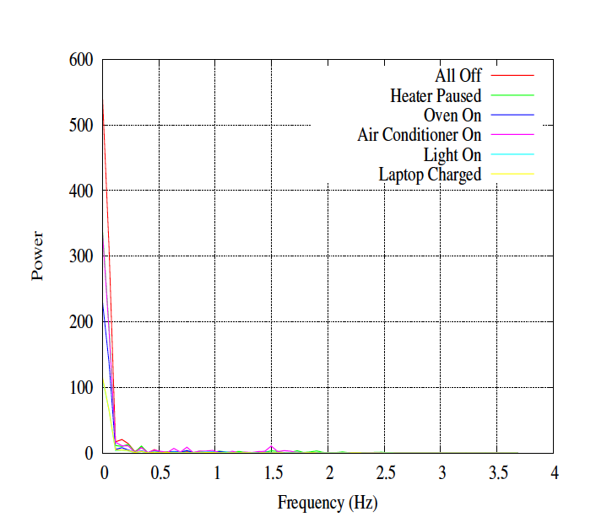
Feature Extraction: Frequency Domain
Figure shows the power values of different devices for the frequency range 0-3.5Hz.
Power values beyond 3.5Hz is negligible.
Power value at 0Hz represents the DC component which is sensible to the orientation and the position of the smartphone.

Slide 24
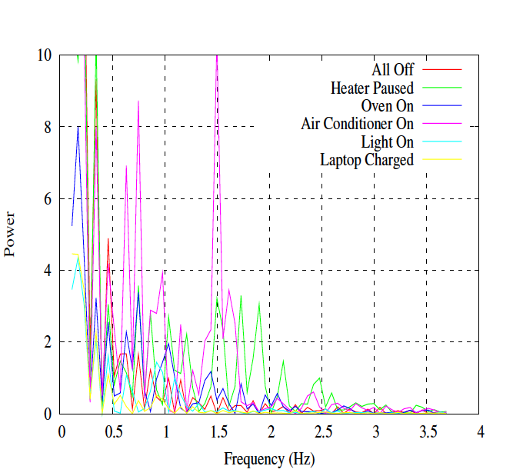
Feature Extraction: Frequency Domain
Figure shows the power values for the 64 frequency bins (from 2 to 65) for different devices.

Slide 25
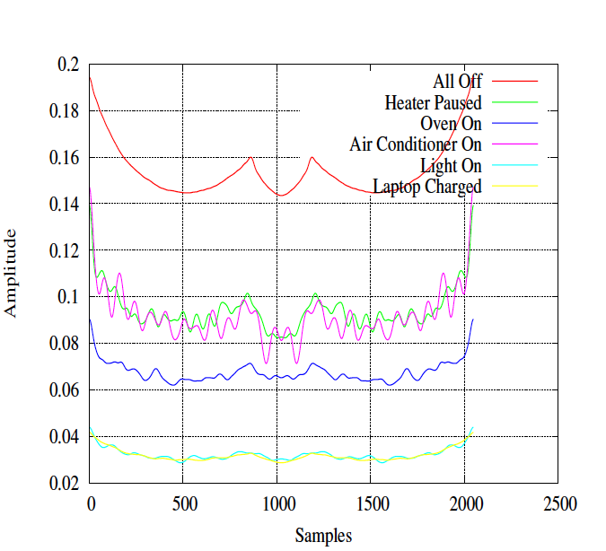
Feature Extraction: Frequency Domain
Figure shows the Inverse FFT signal of the power values when applied to the 64 frequency bin.
Each device shows a unique signal pattern

Slide 26
Feature Extraction: Features Evaluation
We rank the potential features based on Information gain.
We measure entropy value as a measure for Information gain with respect to training data.
We select top ten features with highest Information gain.

Slide 27
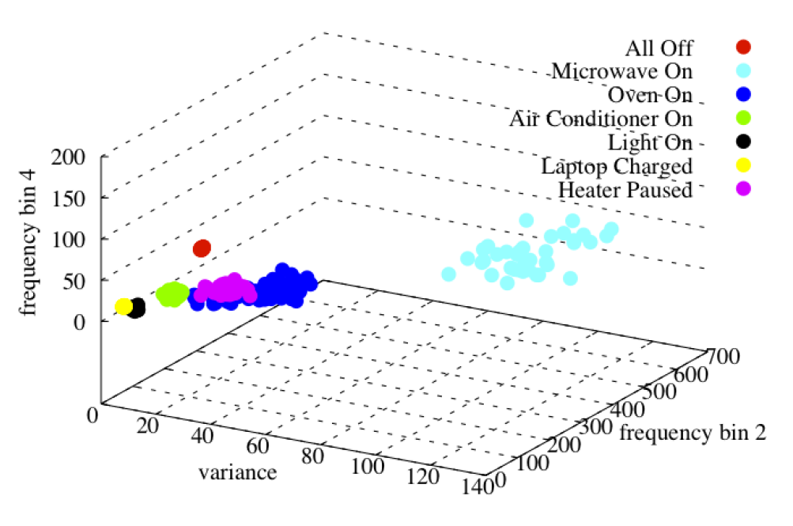
Feature Extraction: Features Evaluation
Scatter Plot of all training data with respect to to three features: Variance, Power at frequency bin 2 and 4.

Slide 28
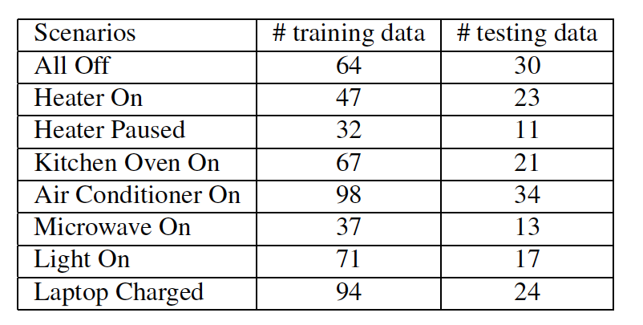
Training and Testing Data
We use first two days data as training data.
Third days data for testing data.
Number of epochs of the training and testing data.

Slide 29
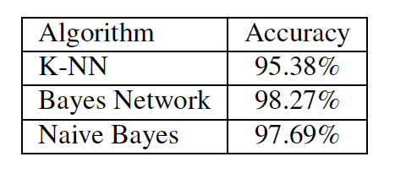
Classification Model
We use weka Software* to build the classification model.
We select the training algorithm with low-complexity implementation: Bayes Network, naïve Bayes and K-nearest neighbor.
* Weka Software: http://www.cs.waikato.ac.nz/ml/weka

Slide 30
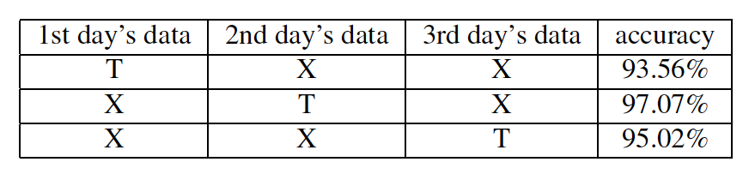
Robustness of the Selected Features
We one days data for training and other two days data for testing.
We use Bayes Network to build the classifier model.
T = Data is used for training
X = Data is used for testing

Slide 31
Robustness of the Selected Features
High accuracy results validates the robustness of the selected features.

Slide 32
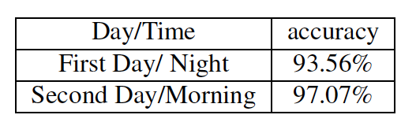
Evaluation: Different Days/Times
We use Bayes Network to build the classifier model.
We use first two days data for training.
We collect new testing data after two weeks period from the training data.
New testing data was collected over two days.
In first day, we collect the data from 8:00-8:30pm.
In second day, we collect the data from 10:00-10:30am.

Slide 33
Evaluation: Different Phones
We use Two Nexus S phones.
One phone is used to collect training data.
Other phone collect the testing data.
We use Bayes Network classifier.
We 10-fold cross validation over the testing data.
Overall accuracy is 95% over the testing dataset.

Slide 34
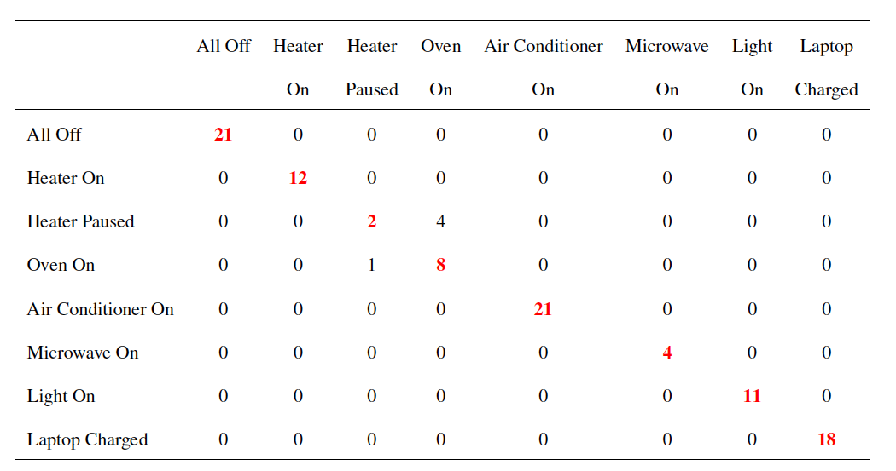
Evaluation: Different Phones
Features extracted from the Heater pause event almost overlap with the features extracted from the Oven event.

Slide 35
Related Work
Number of research work have focused on detecting and monitoring the running devices for energy monitoring.
Monitoring home energy requires continuous sensing.
Typically, we don’t require continuous sensing for our requirement.
Single-point sensing has been utilized in previous work to detect electric event.
Most work requires custom sensing hardware for continuous sensing.

Slide 36
Related Work: ElectricSense
Similarity:
ElectricSense is an example of single-point sensing.
It utilizes the high frequency Electro Magnetic Interference.
Dissimilarity:
It detects devices that uses Switch Mode Power Supply(SMPS).
Utilizes the EMI that is induced by the SMPS.
Requires additional sensors in order detect the electric event.

Slide 37
Related Work: At the Flick of a Switch
Similarity:
The system is an example of single-point sensing.
Dissimilarity:
The system use transient noise of the main power line to detect the electric event.
It requires complex Powerline interface connected with the power outlet.
HomeSys 2012
37

Slide 38
Future Work
Detecting multiple running devices:
How to detect two or more devices while they are on?
Evaluation different phone models:
How our system perform using different phone models?
Build continuous monitoring system:
How to utilize the sensing and communication capabilities of the smartphone to build a continuous monitoring system?

Slide 39

Thank You
Email: muddin@cs.odu.edu
Web: http://www.cs.odu.edu/~muddin

