Slide 1
ECE 366
Computer Architecture
Lecture 1-2
Shantanu Dutt (http://www.ece.uic.edu/~dutt)
Adapted from (with adds and deletes):
CS152
Computer Architecture and Engineering
Lecture 1
August 27, 1997
Dave Patterson (http.cs.berkeley.edu/~patterson)
lecture slides: http://www-inst.eecs.berkeley.edu/~cs152/
Notes:
Give qualifications of instructors:
DAP
teaching computer architecture at Berkeley since 1977
Co-athor of textbook used in class
Best known for being one of pioneers of RISC
currently author of article on future of microprocessors in SciAm Sept 1995
RY
took 152 as student, TAed 152,instructor in 152
undergrad and grad work at Berkeley
joined NextGen to design fact 80x86 microprocessors
one of architects of UltraSPARC fastest SPARC mper shipping this Fall

Slide 2
Overview
Intro to Computer Architecture
Administrative Matters
Course Style, Philosophy and Structure
Organization and Anatomy of a Computer
Notes:
credential:
bring a computer
die photo
wafer
:
This can be an hidden slide. I just want to use this to do my own planning.
I have rearranged Culler’s lecture slides slightly and add more slides. This covers everything he covers in his first lecture (and more) but may
We will save the fun part, “ Levels of Organization,” at the end (so student can stay awake): I will show the internal stricture of the SS10/20.
Notes to Patterson: You may want to edit the slides in your section or add extra slides to taylor your needs.

Slide 3
What is “Computer Architecture”
Computer Architecture =
Instruction Set Architecture +
Machine Organization

Slide 4
Instruction Set Architecture (subset of Computer Arch.)
... the attributes of a [computing] system as seen by the programmer, i.e. the conceptual structure and functional behavior, as distinct from the organization of the data flows and controls the logic design, and the physical implementation. – Amdahl, Blaaw, and Brooks, 1964
SOFTWARE
-- Organization of Programmable
Storage
-- Data Types & Data Structures:
Encodings & Representations
-- Instruction Set
-- Instruction Formats
-- Modes of Addressing and Accessing Data Items and Instructions
-- Exceptional Conditions

Slide 5
The Instruction Set: a Critical Interface
software
instruction set
hardware

Slide 6
Example ISAs (Instruction Set Architectures)
Digital Alpha (v1, v3) 1992-97
HP PA-RISC (v1.1, v2.0) 1986-96
Sun Sparc (v8, v9) 1987-95
SGI MIPS (MIPS I, II, III, IV, V) 1986-96
Intel (8086,80286,80386, 1978-96
80486,Pentium, MMX, ...)

Slide 7
MIPS R3000 Instruction Set Architecture (Summary)
Registers
Instruction Categories
  Load/Store
  Computational
  Jump and Branch
  Floating Point
    coprocessor
  Memory Management
  Special
R0 - R31
PC
HI
LO
3 Instruction Formats: all 32 bits wide
OP
rs
rt
rd
sa
funct
OP
rs
rt
immediate
OP
jump target
Q: How many already familiar with MIPS ISA?

Slide 8
Organization
Capabilities & Performance Characteristics of Principal Functional Units (FUs)
  (e.g., Registers, ALU, Shifters, Logic Units, ...)
Advanced design and analysis of FUs for opt. (speed, power)
Ways in which these components are interconnected
Information flows between components
Logic and means by which such information flow is controlled.
Choreography of FUs to realize the ISA
Register Transfer Level (RTL) Description
Logic Designer's View
ISA Level
FUs & Interconnect
Notes:
Design state of art organization in 1990

Slide 9
Example Organization
TI SuperSPARC^{tm} TMS390Z50 in Sun SPARCstation20
MBus Module
SuperSPARC
Floating-point Unit
L2
$
CC
DRAM
Controller
Integer Unit
MBus
L64852
MBus control
M-S Adapter
Inst
Cache
Ref
MMU
Data
Cache
STDIO
SBus
serial
Store
Buffer
SCSI
kbd
SBus
DMA
mouse
Ethernet
audio
RTC
Bus Interface
SBus
Cards
Boot PROM
Floppy

Slide 10
What is “Computer Architecture”?
Application
Operating
System
Compiler
Firmware
Instruction Set
Architecture
Instr. Set Proc.
I/O system
Datapath & Control
Digital Design
Circuit Design
Layout
Coordination of many levels of abstraction (mainly within the oval; NOTE: Arithmetic ckts fall into both architecture and digital design).
Under a rapidly changing set of forces
Design, Measurement, and Evaluation

Slide 11
Forces on Computer Architecture
Technology
Programming
Languages
Applications
Computer
Architecture
Operating
Systems
History
Notes:
History/Applications matters because
1) People buy computers to run programs
2) Most people don;’t write own programs
3) Documented IDA interface means people ship binary machine code

Slide 12
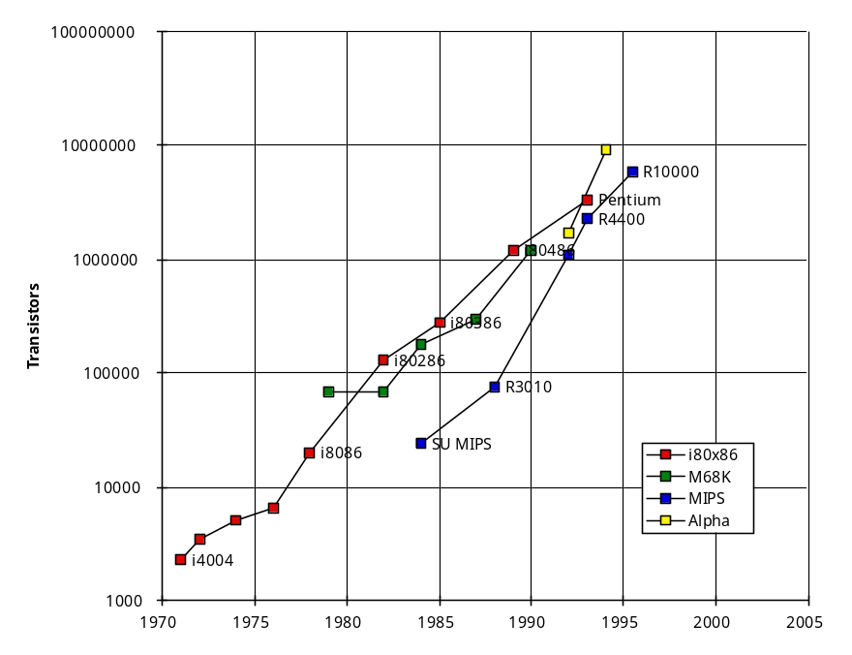
Technology
DRAM chip capacity
Microprocessor Logic Density
DRAM
Year Size
1980 64 Kb
1983 256 Kb
1986 1 Mb
1989 4 Mb
1992 16 Mb
1996 64 Mb
1999 256 Mb
2002 1 Gb
In ~1985 the single-chip processor (32-bit) and the single-board computer emerged
  => workstations, personal computers, multiprocessors have been riding this wave since
In the 2002+ timeframe, these may well look like mainframes compared single-chip computer (maybe 2 chips)

Slide 13
Technology => dramatic change
Processor
  logic capacity: about 30% per year
  clock rate: about 20% per year
  So… advanced functions (e.g., multimedia functions in some Pentiums) and high-speed features (multiple pipelines, larger caches)
Memory
  DRAM capacity: about 60% per year (4x every 3 years)
  Memory speed: about 10% per year
  Cost per bit: improves about 25% per year
  So… larger memory => more challenging applications (e.g., atmospheric modeling, astrophysics modeling)
Disk
  capacity: about 60% per year
  So … huge disk capacities => large data storage (video, music files, large data for various applications)

Slide 14
Performance Trends
Supercomputers
Mainframes
Minicomputers
Log of Performance
Microprocessors
Y
ear
1970
1975
1980
1985
1990
1995

Slide 15
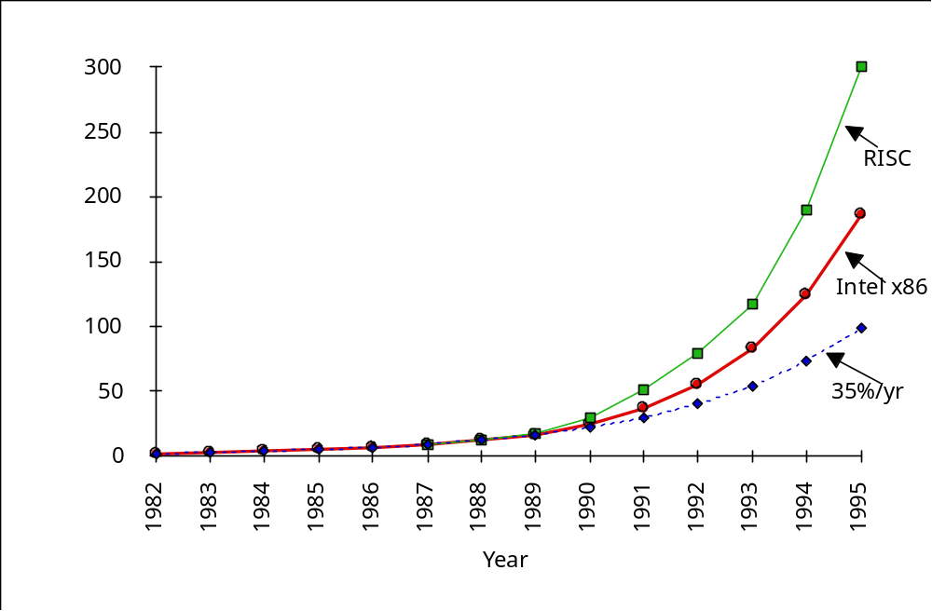
Processor Performance (SPEC)
  performance now improves ­ 50% per year (2x every 1.5 years)
RISC
introduction
Did RISC win the technology battle and lose the market war?

Slide 16
Applications and Languages
CAD, CAM, CAE, . . .
Lotus, DOS, . . .
Multimedia, . . .
The Web, . . .
JAVA, . . .
Large Scientific Computations
???

Slide 17
Measurement and Evaluation
Architecture is an iterative process
-- searching the space of possible designs
-- at all levels of computer systems
Design
Analysis
Creativity
Cost /
Performance
Analysis
Good Ideas
Mediocre Ideas
Bad Ideas

Slide 18
Why do Computer Architecture?
CHANGE
It’s exciting!
It has never been more exciting!
It impacts every other aspect of electrical engineering and computer science

Slide 19
ECE 366: Course Content
Computer Architecture
-Instruction Set -Computer Organization
-Hardware Components (Basic & Adv.)
-Hierarchy of Components -Interfaces bet. Components
-Data and Control Flow
-Logic Designer’s View (FSM, Arithmetic Ckts, Impl.)
­ “Building Architect” & “Construction Engineer”

Slide 20
CE 366: So what's in it for me?
In-depth understanding of the inner-workings of modern computers, their evolution, and trade-offs present at the hardware/software boundary.
  Insight into fast/slow operations that are easy/hard to implementation hardware
Experience with the design process in the context of a large complex (hardware) design.
  Functional Spec --> Control & Datapath --> Physical implementation
Notes:
We will take a break and talk about class philosophy.

Slide 21
My Goal
Show you how to understand modern computer architecture in its rapidly changing form.
Show you how to design by leading you through the process on challenging design problems
Show you how and why (rationale) of designs--v. important
Hopefully, be able to guide you to think about and analyze designs and alternatives
so...
  ask questions
  come to office hours
  go back and fully understand past lectures
  be prepared for the next lecture
  ...

Slide 22
Grading
Grade breakdown
  Final Exam: 40%
  Midterm Exam 20%
  CU Design Projects: 20%
  Homework Assignments 20%
No late homeworks or projects:
Grade deterination
  around average grade will be a B
  at least half to one-third std-devn above average will be A
  set expectations accordingly

Slide 23
Course Problems
Can’t make midterm
  only for before-the-fact demonstrable emergency
Forgot to turn in homework/ Dog ate computer
  need to be fair to the other students; no late hws
What is cheating?
  Studying together in groups is encouraged
  Work must be your own
  Common examples of cheating: running out of time on a assignment and then pick up output, take homework from box and copy, person asks to borrow solution “just to take a look”, copying an exam question, ...
  Better off to do the assignment for your own understanding
  Cheating on assignment, projects will be seriously detrimental to your understanding of material and thus on your midterm & final exam performance
  Plus penalties
  Do not do it; it is unethical, dishonest and not good for anyone, the perpetrator in particular

Slide 24
Class decides on penalties for cheating; staff enforces
HWs:
  0 for problem
  0 for homework assignment
  subtract full value for assignment
  subtract 2X full value for assignment
Projects (groups: only penalize individuals?)
  0 for problem
  0 for homework assignment
  subtract full value for assignment
  subtract 2X full value for assignment
Exams
  0 for problem
  0 for exam

Slide 25
Things We Hope You Will Learn fromProjects
Keep it simple and make it work
  Fully test everything individually and then together
  Retest everything whenever you make any changes
  Last minute changes are big “no nos”
Group dynamics. Communication is the key to success:
  Be open with others of your expectations and your problems
  Everybody should be there on design meetings when key decisions are made and jobs are assigned
Planning is very important:
  Promise what you can deliver; deliver more you promise
  Murphy’s Law: things DO break at the last minute
    Don’t make your plan based on the best case scenarios
    Freeze you design and don’t make last minute changes
Never give up! It is not over until you give up.
Notes:
Finally, I like to summarize this lecture with the things I hope you learn from your project.
Once again, planning is very important. Remember: plan you life and live your plan.
A rule to remember on planning is: always only promise what you can deliver but try to deliver more than you promise.
For example in the class project, you really did not promise anything. We kind of make the promise for you to deliver the minimum set of things we think you can do. Which you all do.
Now for those more ambitious groups, they deliver more than they promise, that is the extra credit parts of the project.
Also, when you are doing your planning, keep Murphy’s Law in mind. Things do tend to break at the last second.
So do not plan your schedule based on the best case scenario.
Finally, one thing we want you to learn is never give up. It is not over until you give up.
Professor Patterson is going to show you a video on what we mean by Never Give Up: the Berkeley Spirit!!!

Slide 26
What you should know from prereqs (see syllabus)
Read and write basic C programs
Read and write in an assembly language
Logic design
  logical equations, schematic diagrams, FSMs, components

Slide 27
Levels of Representation
temp = v[k];
v[k] = v[k+1];
v[k+1] = temp;
High Level Language Program
Compiler
lw $15, 0($2)
lw $16, 4($2)
sw $16, 0($2)
sw $15, 4($2)
Assembly Language Program
Assembler
0000 1001 1100 0110 1010 1111 0101 1000
1010 1111 0101 1000 0000 1001 1100 0110
1100 0110 1010 1111 0101 1000 0000 1001
0101 1000 0000 1001 1100 0110 1010 1111
Machine Language Program
Machine Interpretation
Control Signal Specification
ALUOP[0:3] <= InstReg[9:11] & MASK
°
°

Slide 28
Levels of Organization
SPARCstation 20
Computer
Workstation Design Target:
25% of cost on Processor
25% of cost on Memory
(minimum memory size)
Rest on I/O devices,
power supplies, box
Processor
Memory
Devices
Control
Input
Datapath
Output
Notes:
That is, any computer, no matter how primitive or advance, can be divided into five parts:
1. The input devices bring the data from the outside world into the computer.
2. These data are kept in the computer’s memory until ...
3. The datapath request and process them.
4. The operation of the datapath is controlled by the computer’s controller.
All the work done by the computer will NOT do us any good unless we can get the data back to the outside world.
5. Getting the data back to the outside world is the job of the output devices.
The most COMMON way to connect these 5 components together is to use a network of busses.

Slide 29
Execution Cycle
Obtain instruction from program storage
Instruction
Fetch
Instruction
Decode
Determine required actions and instruction size
Operand
Fetch
Locate and obtain operand data
Execute
Compute result value or status
Result
Store
Deposit results in storage for later use
Next
Instruction
Determine successor instruction; can generally be combined w/ Decode

Slide 30
The SPARCstation 20
SPARCstation 20
Memory
Controller
Memory SIMMs
SIMM Bus
MBus
Disk
MBus
Slot 1
SBus
Slot 1
SBus
Slot 3
Tape
MBus
Slot 0
SBus
Slot 0
SBus
Slot 2
SCSI
Bus
MSBI
SEC
SBus
MACIO
Keyboard
Floppy
External Bus
& Mouse
Disk
Notes:
Here comes the fun part of today’s lecture. We are going to open up this box and take a look at the internal organization of a real computer.
What we have here is a SUN SPARCstation 20. One of the best selling workstations in the market. Although this is called a workstation, it is still a pretty impressive computer.
As a matter of fact, depending on the application you run, this “pizza box” here probably has 50 to 100 times more compute power than the DEC VAX 780 machine that was shared by all CS graduate students 10 years ago.
Let’s open up the box and take a look. It looks complicated, doesn’t it?
In order to walk through this maze without getting lost, what we need is a map.
The block diagram here is the kind of map computer architects used when they described the organization of a computer.
Well, if one doesn’t know WHAT to look for, even a block diagram likes this can be more complicated than one wants.
In order to simplify the picture further, we need more abstraction.
This brings us to the most important thing we want you to remember from today’s lecture.

Slide 31
The Underlying Interconnect
SPARCstation 20
Memory
Controller
SIMM Bus
Standard I/O Bus:
Processor/Mem Bus:
MBus
SCSI Bus
Sun’s High Speed I/O Bus:
SBus
MSBI
SEC
MACIO
Low Speed I/O Bus:
External Bus
Notes:
For example, inside the SPARCstation 20, there are five major busses.
If you don’t know what a BUS is, don’t worry. You will learn about it in this class. For now just think of it as a group of electrical wires which you can attach some components onto.
For example, underneath these slots here is the Memory Bus and you can attach memory modules onto the Memory Bus by plugging them into these slots.
These chips with fancy names (MACIO, SEC ...) are bus adaptors connecting the different busses together.
You may want to ask WHY do we need five different busses? Can one bus do the job?
Well in theory, you can. But in practice, different buss fulfils different requirements.
Its kind of like for someone who does not have too much money, he or she will be happy with just one car.
But for someone who has more money, he or she may have two cars: one car that has high gas mileage for commuting and another bigger and stronger 4-wheel drive for weekend trips.
Anyway, let’s look at what is on the SPARCstation processor bus.

Slide 32
Processor and Caches
SPARCstation 20
MBus Module
Processor
MBus
MBus
Slot 1
Registers
Datapath
MBus
Slot 0
Internal
Cache
Control
External Cache
Notes:
For some strange reason that I do not know, the processor bus inside the SPARCstation 20 is called the Mbus.
There are two slots on the Mbus where we can plug in one of these MBus modules.
Each MBus module has a SPARC processor on it and for some more expensive MBus modules, they also have 1MB of external cache on the module.
The most expensive MBus module has two SuperSPARC processors on it so you can have up to four SuperSPARC processors in this pizza box.
Most users do not need the external cache because there are enough internal cache inside the SuperSPARC processor.
Register, cache, and memory all serve the same function. They provide data for the datapath to compute. The way to think about them is:
1. Register is like money in your pocket. You can get to it as soon as you want.
2. Cache is like money you keep under your mattress.
Not as good as money in your pocket but you can still get to it rather quick.
But you don’t want to put all your money under your mattress. You want to put all your “unused” memory in the bank.
As far as the computer is concerned, the bank is the memory system.

Slide 33
Memory
SPARCstation 20
Memory
Controller
Memory SIMM Bus
SIMM Slot 0
SIMM Slot 1
SIMM Slot 2
SIMM Slot 3
SIMM Slot 4
SIMM Slot 5
SIMM Slot 6
SIMM Slot 7
DRAM SIMM
DRAM
DRAM
DRAM
DRAM
DRAM
DRAM
DRAM
DRAM
DRAM
DRAM
Notes:
The SPARCstation 20 memory system is rather simple.
It consists of a Memory Controller and a Memory Bus that has 8 slots where you can plug in one of these memory modules.
The memory module is called SIMM: Single In-line Memory Module.
In-line because they all line up in the memory slots.
The most expensive SIMM has 16, 32, or 64 MB of memory on it so you can put up to 8 times 64 or 512 MB of memory in this computer. Memory costs $50 - $100 per 1MB. 0.5 GB of DRAM costs ~$30K to ~$50K! That’s why most of the cost of a work-station is in DRAM. 1:1:2 cost ratio in basic workstation (CPU/memory/peripherals+box+monitor).
To put things into perspective, the VAX 780 that serves the entire CS department 10 years ago ONLY has around 4MB of main memory, that is less than one module.

Slide 34
Input and Output (I/O) Devices
SCSI Bus: Standard I/O Devices
SBus: High Speed I/O Devices
External Bus: Low Speed I/O Device
SPARCstation 20
Disk
SBus
Slot 1
SBus
Slot 3
Tape
SBus
Slot 0
SBus
Slot 2
SBus
SCSI
Bus
SEC
MACIO
Keyboard
Floppy
External Bus
& Mouse
Disk
Notes:
The SPARCstation groups the I/O devices into three categories:
1. I/O devices that use the industry’s standard Small Computer System Interface or SCSI interface are placed on the SCSI bus.
2. For high speed I/O devices, SUN uses its own high speed SBus. (25Mhz @ 64b)
3. Finally, for slow seed I/O devices, they are placed on the External Bus.

Slide 35
Standard I/O Devices
SPARCstation 20
SCSI = Small Computer Systems Interface
A standard interface (IBM, Apple, HP, Sun ... etc.)
Computers and I/O devices communicate with each other
The hard disk is one I/O device resides on the SCSI Bus
Disk
Tape
SCSI
Bus
Notes:
First let's look at the standard I/O devices.
SCSI stands for Small Computer Systems Interface and it is a industry standard adopted by all major computer manufactures.
The advantage of the SCSI bus is that it is an industry standard so there are a lot of components you can buy to put on this bus.
The hard disk here is one components that sits on the SCSI bus and the way this SPARCstation is designed, it is very easy to assemble and disassemble the hard disk.
This allows you to swap disk very easily if for some reason you want to move all your data to another workstation or you want to upgrade the disk.
The disadvantage of the SCSI bus is that it is relatively slow.

Slide 36
High Speed I/O Devices
SPARCstation 20
SBus is SUN’s own high speed I/O bus
SS20 has four SBus slots where we can plug in I/O devices
Example: graphics accelerator, video adaptor, ... etc.
High speed and low speed are relative terms
SBus
Slot 1
SBus
Slot 3
SBus
Slot 0
SBus
Slot 2
SBus
Notes:
So for high speed I/O devices, SUN has its own high speed I/O bus called the SBus.
The SS 20 has 4 SBus slots where you can plug in some fancy high speed I/O devices.
One example of such high speed I/O device is a video adaptor where you can bring video images into the SPARCstation.
One thing I should point out is that high speed and low speed are relative terms.
Even though SBus is called the high speed I/O bus in the SS20, it is really not that fast.
One of the things I am working on at SUN is to find a even faster way to bring data in and out of the SPARCstation.

Slide 37
Slow Speed I/O Devices
SPARCstation 20
The are only four SBus slots in SS20--”seats” are expensive
The speed of some I/O devices is limited by human reaction time--very very slow by computer standard
Examples: Keyboard and mouse
No reason to use up one of the expensive SBus slot
Keyboard
Floppy
External Bus
& Mouse
Disk
Notes:
Recalled from the last slide that there are only four SBus slots on the SBus so we cannot afford to put too many I/O devices on the SBus.
For some I/O devices, such as keyboard and mouse, their speed is limited by human reaction time anyway, so there is no reason to use up one of the expensive SBus slot.
For these slow I/O devices, they are placed on the External Bus.

