Slide 1
Audio-WiFi: A cross-interface framework of communication for smartphones
Presenter: Mostafa Uddin

Slide 2





About me
Name: Mostafa Uddin
Advisor: Dr. Tamer Nadeem
Lab: SwimSys
3rd year PhD student (started Fall 2011)
www.cs.odu.edu/~muddin
B.Sc. In BUET(Bangladesh University of Engineering & Technology)
Worked in HP Labs(Palo Alto, CA.)
Worked as SE for 4 years.

Slide 3
Area of Research
Mobile Computing
  Mobile sensing
  Localization
  Smart Home
  Mobile health
Wireless Network
  WiFi energy efficiency
  Mobile Traffic Analysis
  Traffic Classification
  WLAN virtualization
  Mobile SDN extension
  Multi-interface

Slide 4

Motivation
Wi-Fi is one of the prominent network interface
for smart devices
Low cost + High throughput + Large range + Ubiquitous

Slide 5
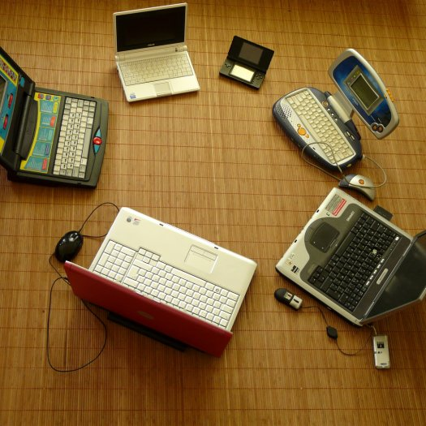
More Motivation
Direct communication (e.g. Wi-Fi Direct, Wi-Fi IBSS) between Wi-Fi peer devices is increasing
Peer-to-peer applications(e.g. File sharing, multiplayer games, media streaming)

Slide 6
Problem
Wi-Fi has several inefficiencies
Energy
Consumption
Unfairness
Bandwidth
Utilization

Slide 7
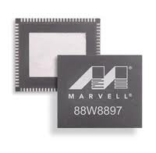
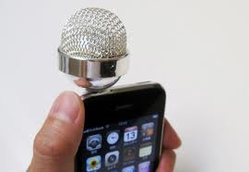
Vision
Wi-Fi
Interface
Audio
Interface
Audio-WiFi
Augmenting the audio Interface(mic/speaker) with the Wi-Fi to enhance and optimize the data communication over Wi-Fi interface.

Slide 8
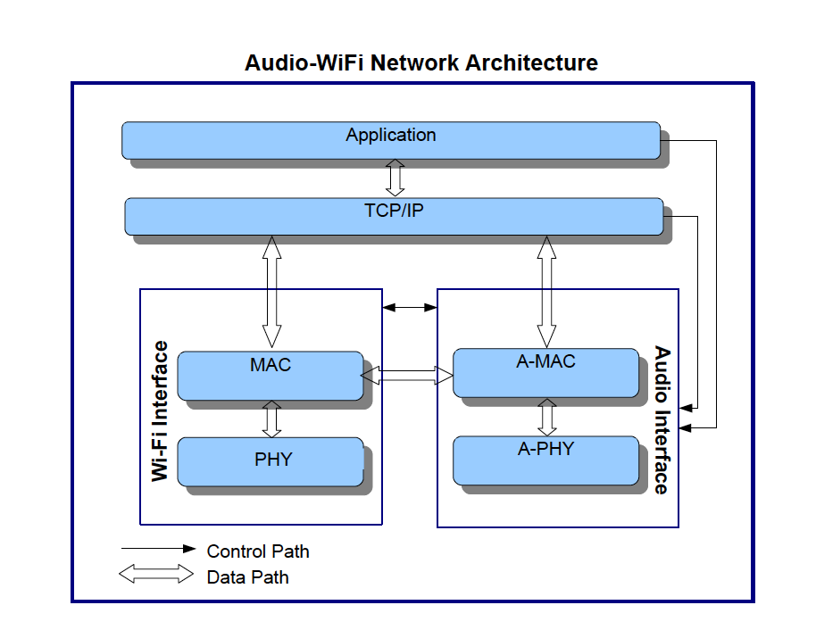
Audio-WiFi Architecture
A-PHY: responsible for signal processing and signal TX/RX using speaker/microphone.
A-MAC: responsible for generating/receiving the control frame over audio channel.
Wi-Fi MAC and upper layer utilize the audio interface to send/receive control frames over(e.g. Beacon frame) using A-MAC layer.

Slide 9
Why Audio Interface
The audio interface is open and flexible in smart devices
Easy to integrate with the Wi-Fi interface at MAC and PHY layers

Slide 10
Introducing to A2PSM
Audio channel assisted Wi-Fi power saving mechanism
for smart devices
We use the audio channel as a parallel channel.
We exploit the audio frequency band beyond the human ear's perception.
We use the off-the-shelf smart devices to implement the A2PSM scheme.

Slide 11
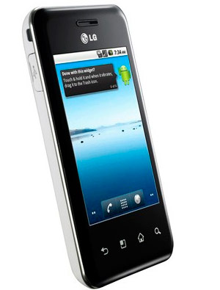
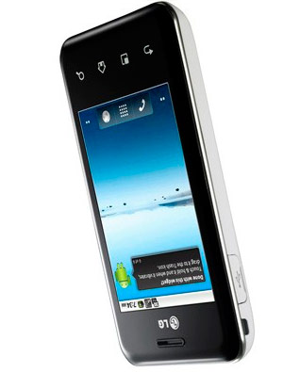
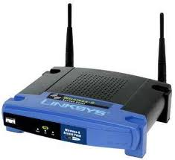
Use Cases
SoftAP
STA
AP
STA
Wi-Fi Direct
Wi-Fi Infrastructure
We assume both STA and AP has audio interface
A2PSM focuses on Wi-Fi infrastructure mode.
Wi-Fi Direct works more like Wi-Fi Infrastructure mode.

Slide 12
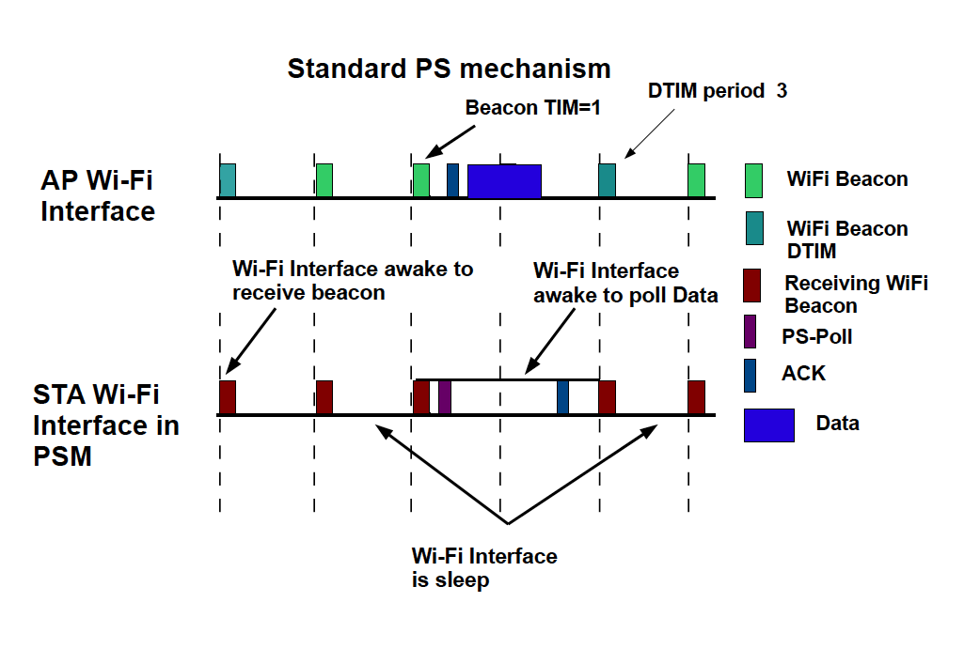
Power Management
Wi-Fi interface has two power management modes: i) CAM and ii)PSM
Commonly used Power Saving Mode(PSM) Static PSM (SPSM).
In SPSM, the STA needs to wake up periodically even no data to exchange between AP and STA.

Slide 13
A2PSM: Core Concept
Use the audio interface as parallel channel to the Wi-Fi interface.
The STAs Wi-Fi interface remain sleep as long as no
data to exchange between the AP and the STA.
While Wi-Fi interface remain sleep communication between
AP and STA happens thru audio channel.

Slide 14
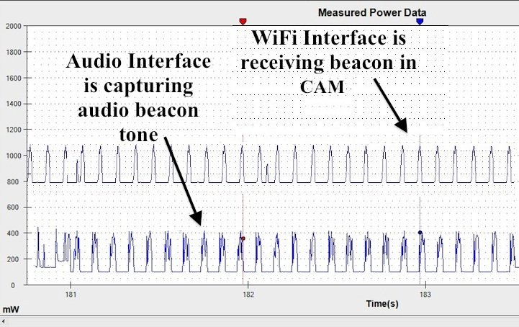
Power Consumption Comparison
Wi-Fi interface consumes three times more power than the
Audio interface.

Slide 15
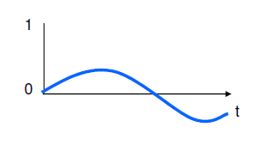
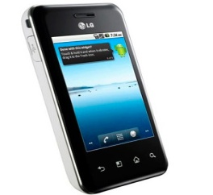
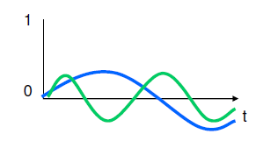
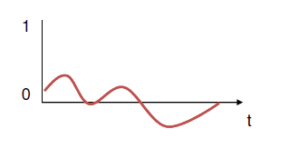
Audio Beacon Tone
Audio beacon is a combination of one or more high frequency(>=18kHz) sinusoidal audio signal.
Audio Beacon tone with single frequency.
f
AID =1 ( f1)
AID =2 (f2)
f+f2
Audio Beacon tone with f2 frequency signal added.
AID =3 (f3)

Slide 16
A2PSM: Design
In this project, we limit our scope to unicast transmission in Wi-Fi infrastructure mode.
The constraint in designing the A2PSM:
  The proposed PSM should cost less energy than the traditional Wi-Fi PSM.
  The audio interface needs to generate and receive the audio beacon within the Wi-Fi beacon period.
  A2PSM should support PSM for legacy devices.

Slide 17
A2PSM: Scheme
WiFi Beacon
Audio Beacon
Receiving Acoustic Beacon
Data for STA
PS-Poll
ACK
Beacon Interval Time
Data
AP's Wi-Fi Interface
AP's Audio Interface
Audio Sleeps
STA's audio Interface
STA's Wi-Fi Interface
Wi-Fi sleeps
Wi-Fi sleeps

Slide 18
Relative Position/Range
Propagation speed of the sound in air is relatively very
slow compare to the electromagnetic wave.
Beacon Interval Time
AP's Audio Interface
STA1 Audio Interface
STA1 is
nearer to AP
compare to
STA2
STA 2 Audio Interface
STAs at different distance from the AP receive the audio beacon at different time.
The STA needs to estimate the relative distance from the AP (Using relative ranging scheme) to awake the audio interface just before receiving the audio beacon.

Slide 19
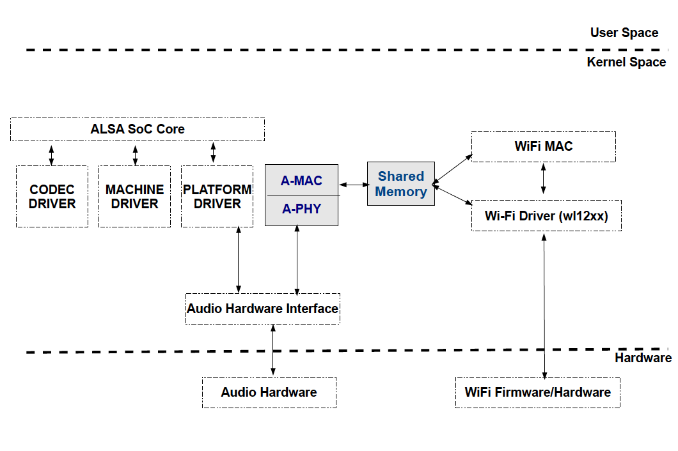
Implementation
A-PHY module in the AP only generates the audio beacon synchronized with the Wi-Fi Beacon
A-PHY module in the STA capture the audio

Slide 20
Implementation
A-MAC module in the AP communicate with the Wi-Fi MAC to define the frequency component in the audio beacon based on the STAs those have buffered data at AP.
A-MAC in the STA notifies the Wi-Fi MAC only when it detects the corresponding unique frequency component in the audio beacon tone.

Slide 21
Implementation
How long STA need to keep the audio interface awake to
capture the audio beacon?
Minimize the duration of keeping the audio interface awake at STA.
We tune the parameters in sound driver to limit duration of transmitting the audio beacon signal to 10ms from the AP.
The STA needs to keep the audio interface awake 10ms to detect the audio beacon, (which is identical to the period the Wi-Fi interface stays awake to receive a Wi-Fi beacon).

Slide 22
Implementation
How to minimize the miss-alignment between the transmission time of the audio beacon and the Wi-Fi beacon at the AP?
Requires fast interaction between the audio and the Wi-Fi interface.
We use a common shared memory and signals to interact between the Wi-Fi driver and the audio codec driver.

Slide 23
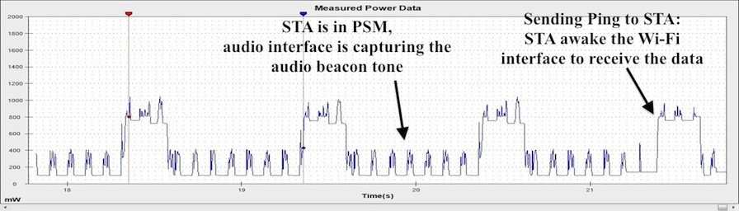
Experiment
We Implemented the A2PSM prototype on two Nokia N900 smartphones. One as AP, other as STA
We connect the STA with Monsoon Power Monitor to measure the energy consumption.
We are sending periodic ping command through the AP to the STA.
Above figure shows the proper operation of the A2PSM scheme

Slide 24
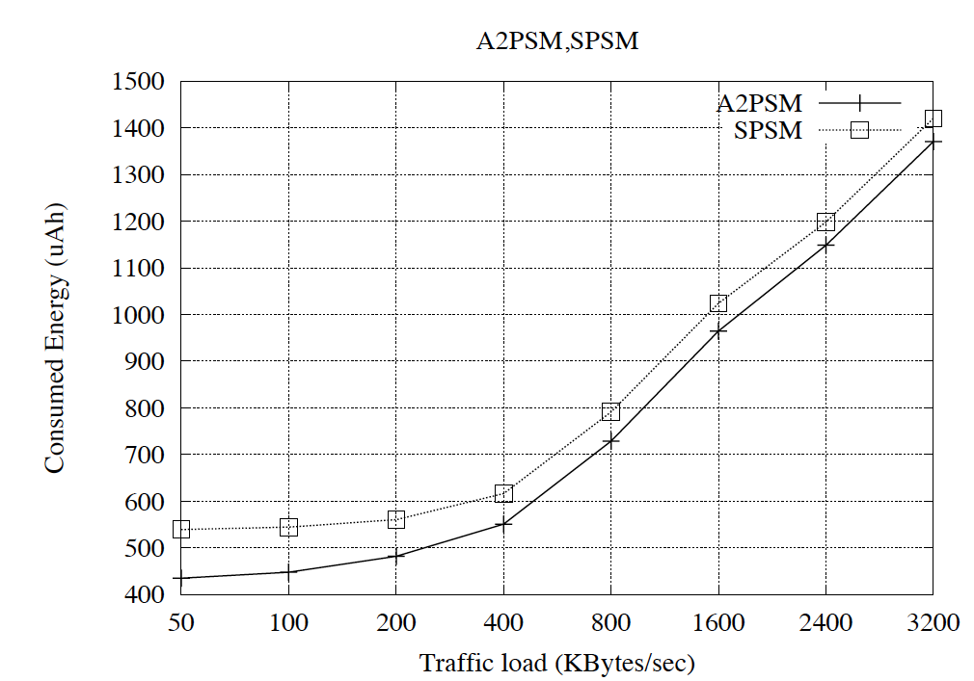
Evaluation
We used iperf tool to control the traffic load between the STA and the AP.
We replicate our experiment 10 times for different traffic load.
During the experiment we fix the distance between the AP and the STA to 3 meter.
We compare the power consumption between SPSM and A2PSM.
A2PSM can save up to 25% more power than the SPSM.

Slide 25
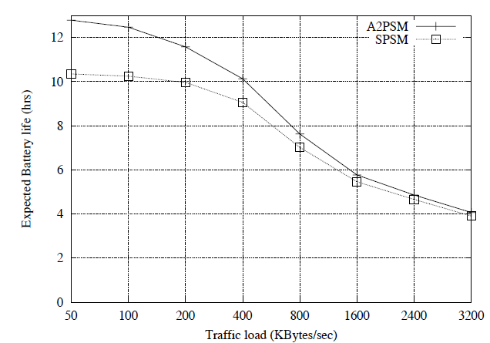
Evaluation
Expected battery life time for both power saving scheme under different traffic load.

Slide 26

What is ranging scheme?
RF-Beep
Estimate the distance from an anchor point
PerCom'13
Notes:
What we mean by a ranging scheme is a way to estimate the distance from an anchor point
In this project we design , develop and evaluate such ranging scheme for the smart devices. We named is RF-Beep

Slide 27

Applications
Customer:
right product
Seller:
Right customer
ADVERTISING
PerCom'13
Notes:
There can be many application of such ranging scheme.
Consider this practical scenario, where Marry went to grocery shop to buy cheese. But she is undecided what cheese product to buy. So she went near to the aisle where are all the cheese products are, to look for the right product. In such case wouldn’t it be nice, if she could get some advertising information about different cheese product based on the items they have on that day. So that she can choose based on her preference. In that case, product sellers can also get benefit by target, advertisement of their products to the right customer at right place and at time.
On the other hand, getting an irrelevant advertisement about a product that you are not looking for is really anoying. Just imagine your mailbox full of junk advertisement coupon that you never look for.
Now my point is, if you want to build a App for the user to provide such advertisement, you need to know the exact range of the user from that aisle.

Slide 28

Applications
MARKETING
PerCom'13
Notes:
Again normally a product in sale is always attractive, No matter what product you used to buy. And this sales in different products changes day to day. Like the previous scenario, such sell advertisement can be directly covey to the targeted customer in a more convenient way.
However, FYI, this cartoon is from one of the marketing website.

Slide 29

Applications
HEALTHCARE
PerCom'13
Notes:
Even in the area of Health care, In scenarios where nearest doctor can be informed based on patient’s condition at hospital.

Slide 30
Applications
Accurate localization
Face-to-face gamming applications.
Driver phone detection
And many more….
PerCom'13
Notes:
There are many other applications where high accuracy range estimation is applicable .

Slide 31

RF-Beep Ranging
Beacon device
Target Devices
Smart device that have RF and audio interface
Target device estimate relative distance to beacon device .
PerCom'13
Notes:
Lets discuss about the use case of the RF-Beep scheme.
Here we have two smart devices and both have RF and audio interface.
The device that work as anchor point we are calling that device as beacon device. And the device that wants to estimate distance from the beacon device, we are calling that device as target device.

Slide 32
How RF-Beep works?
Broadcast
RF Beacon
Beacon device
Target Device
RF Beacon is a Small RF Frame
PerCom'13
Notes:
Now the way RF-Beep Scheme works as follows,
First device beacon device broadcast a RF beacon, where RF beacon is a small RF frame
Then beacon device sends a Beep Sound, which is a high frequency sinusoidal acoustic signals with single frequency.
After receiving both the RF beacon and Beep sound target device calculate the distance to the beacon device

Slide 33
How RF-Beep works?
Beep
Sound
Beacon device
Target Device
Beep sound is a high frequency sinusoidal acoustic signal with a single frequency.
PerCom'13
Notes:
Now the way RF-Beep Scheme works as follows,
First device beacon device broadcast a RF beacon, where RF beacon is a small RF frame
Then beacon device sends a Beep Sound, which is a high frequency sinusoidal acoustic signals with single frequency.
After receiving both the RF beacon and Beep sound target device calculate the distance to the beacon device

Slide 34
How RF-Beep works?
TDoA technique that utilizes the relative speed between RF and Acoustic signal.
Beacon device
Target Device
Calculate Distance to device ‘A’
PerCom'13
Notes:
Now the way RF-Beep Scheme works as follows,
First device beacon device broadcast a RF beacon, where RF beacon is a small RF frame
Then beacon device sends a Beep Sound, which is a high frequency sinusoidal acoustic signals with single frequency.
After receiving both the RF beacon and Beep sound target device calculate the distance to the beacon device

Slide 35
Features in RF-Beep
COTS Smart Device Usability
One-way sensing
Energy Efficient
Distributed
Beacon
device
Target
Device
Preserve
Privacy
PerCom'13
Notes:
As you seen in previous use case device ‘B’ can calculate the distance locally without making any collaboration with other devices.
Therefore RF-Base can be easily applicable for the use case of one to many.
In summary RF beep is one way sensing
Its energy efficient for target device because it does not get involved with any communication it just receive beacon and beep.
Its distributed it does not require any centralized collaboration
Since the target device calculate its distance locally, so it preserve the privacy of the target device.

Slide 36
One-to-many scenario
Target Devices
Beacon device
PerCom'13
Notes:
As you seen in previous use case device ‘B’ can calculate the distance locally without making any collaboration with other devices.
Therefore RF-Base can be easily applicable for the use case of one to many.
In summary RF beep is one way sensing
Its energy efficient for target device because it does not get involved with any communication it just receive beacon and beep.
Its distributed it does not require any centralized collaboration
Since the target device calculate its distance locally, so it preserve the privacy of the target device.

Slide 37
RF-Beep: Time events
t_{b1}
Timestamp at Beacon device
Timestamp at Target device
Time when beacon device puts the RF beacon into the transmission buffer to transmit
PerCom'13
Notes:
Here is the more details of the RF-Beep scheme.
We have two timeline for beacon device and target device. In this timeline we keep timestamp for different event.
The first timestamp is for the event when the beacon device put the RF beacon into the transmission buffer for RF driver.

Slide 38

RF-Beep: Time events
t_{b1}
t_{b2}
Timestamp at Beacon device
Timestamp at Target device
Time when beacon device’s RF hardware interrupts for successfully transmitting RF beacon
PerCom'13
Notes:
The second timestamp is for the event, when the beacon device’s RF hardware interrupts for successfully transmitting RF beacon.

Slide 39
RF-Beep: Time events
t_{b1}
t_{b2}
Timestamp at Beacon device
f_{b1}
Timestamp at Target device
Time when target device’s RF hardware interrupts for successfully receiving the RF beacon
PerCom'13
Notes:
The next timestamp for event is when target device RF hardware interrupts for successfully receiving the RF beacon.

Slide 40

RF-Beep: Time events
t_{b1}
t_{b2}
Timestamp at Beacon device
f_{b1}
f_{a1}
Timestamp at Target device
Time when the target device’s microphone starts capturing the audio samples.
PerCom'13
Notes:
This is the timestamp when the target device starts capturing audio samples in the audio driver buffer

Slide 41
RF-Beep: Time events
t_{b1}
t_{b2}
t_{a1}
Timestamp at Beacon device
f_{b1}
f_{a1}
Timestamp at Target device
Time when beacon device’s starts writing beep sound into the audio hardware.
PerCom'13
Notes:
The next timestamp is when audio starts writing audio frames

Slide 42

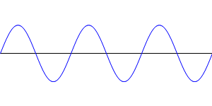
RF-Beep: Time events
t_{b1}
t_{b2}
t_{a1}
t_{a2}
Timestamp at Beacon device
f_{b1}
f_{a1}
Timestamp at Target device
Time when the beacon device’s speaker starts to generate the Beep sound.
PerCom'13

Slide 43
RF-Beep: Time events
t_{b1}
t_{b2}
t_{a1}
t_{a2}
Timestamp at Beacon device
f_{b1}
f_{a1}
f_{a2}
Timestamp at Target device
Time when the target device starts receiving the beep sound from the beacon device.
PerCom'13

Slide 44
RF-Beep: Time events
t_{b2} and f_{b1} represents the same event on both timeline
t_{b1}
t_{b2}
t_{a1}
t_{a2}
Timestamp at Beacon device
f_{b1}
f_{a1}
f_{a2}
Timestamp at Target device
High propagation speed of the RF signal
Small length of the RF beacon
PerCom'13
Notes:
Now since the propagation speed of the RF signal is high and the small length of the RF beacon makes the timestamp t_{b2} and f_{b1} represents the same event on both timeline. Where tb2 is the timestamp of
Thus eliminates the time synchronization requirement.

Slide 45
Distance Calculation
∆t_{ab}
Timestamp at Beacon device
t_{b1}
t_{b2}
t_{a1}
t_{a2}
D = s_{a}.(∆f_{ab} -∆t_{ab})
∆f_{ab}
Timestamp at Target device
f_{b1}
f_{a1}
f_{a2}
D = s_{a}.(f_{a2}-t_{a2})
D = s_{a}.(f_{a2}-t_{a2} +t_{b2}-t_{b2})
D = s_{a}.((f_{a2}-f_{b1})-(t_{a2}-t_{b2}))
PerCom'13

Slide 46
Distance Calculation
∆t_{ab}
Can we fix it?
Timestamp at Beacon device
t_{b1}
t_{b2}
t_{a1}
t_{a2}
D = s_{a}.(∆f_{ab} -∆t_{ab})
∆f_{ab}
f_{a2}
Timestamp at Target device
f_{b1}
f_{a1}
∆f_{ab} is known to the target device
∆t_{ab} contains the time variability (red section) of emitting acoustic signal from speaker
PerCom'13

Slide 47
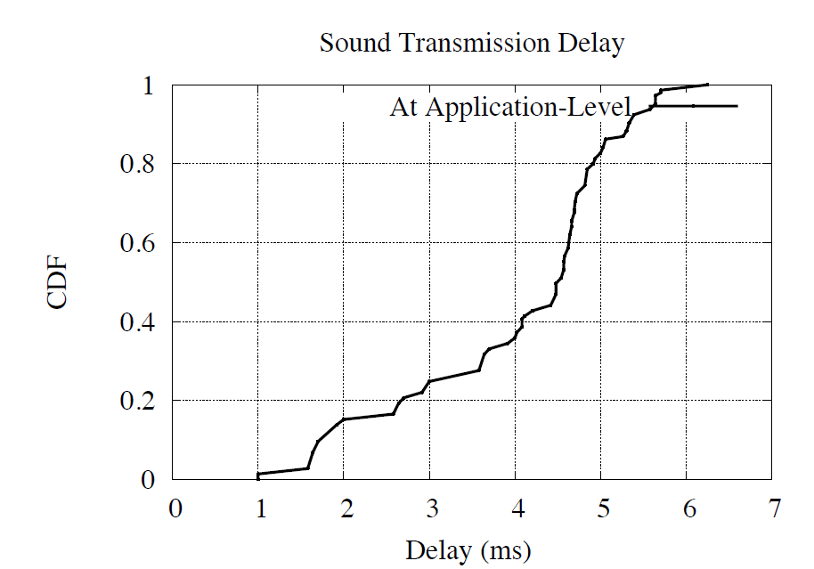
Challenge in Playing Beep
1 ms of error can lead up to 30 cm of error
Highly
variable
Transmit of acoustic Signal from Application space
Emission of acoustic signal
from the speaker
PerCom'13

Slide 48

Challenge in Playing Beep
Power up the playback stream
Data transfer between application to sound driver
DMA data transfer between sound driver to sound hardware
PerCom'13

Slide 49
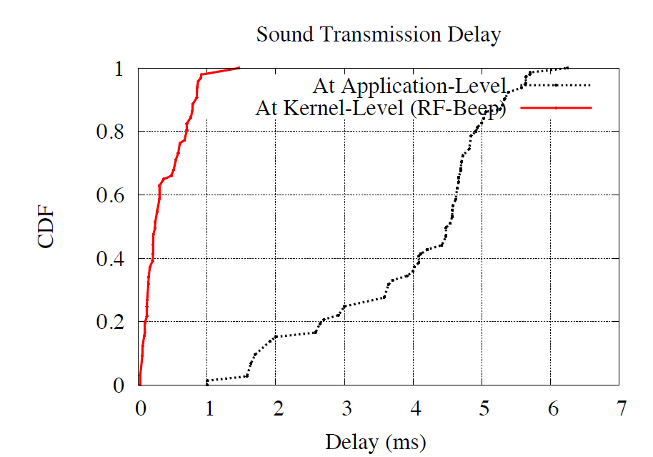
Challenge in Playing Beep
kernel
Which make ∆t_{ab} fixable
Delay comparison between transmitting beep sound from application space and kernel space
PerCom'13

Slide 50
Challenge in Capturing Beep
Timestamp at Beacon device
t_{b1}
t_{b2}
t_{a1}
t_{a2}
Timestamp at Target device
f_{b1}
f_{a1}
f_{a2}
(t_{a1} -t_{b2})-(f_{a1} -f_{b1} )>0
beacon device should not generate the Beep sound before the target device starts capturing
PerCom'13

Slide 51
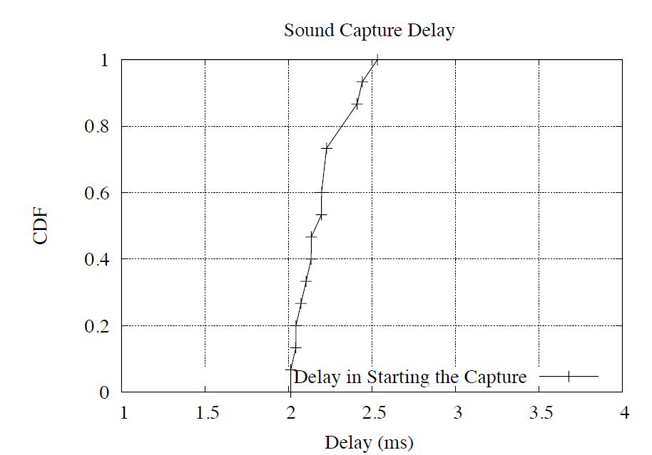
Challenge in Capturing Beep
μ = 2-2.5ms
Power up the capture stream
PerCom'13

Slide 52
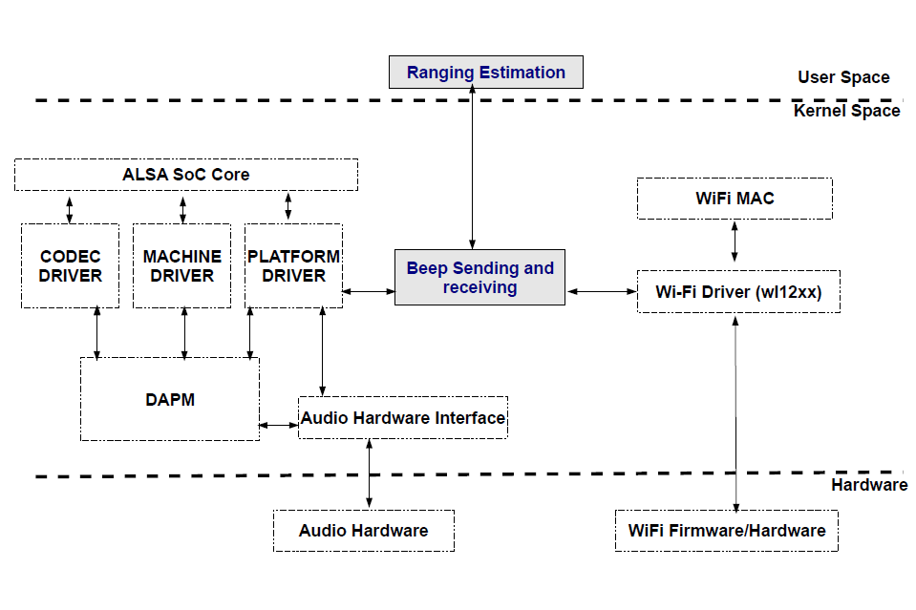
RF-Beep Architecture
Implemented
Module
PerCom'13

Slide 53
RF-Beep: Implementation
RF-Beep Architecture
Frequency 18kHz
∆t_{ab}= 5ms
Beep Signal Generation
PerCom'13

Slide 54
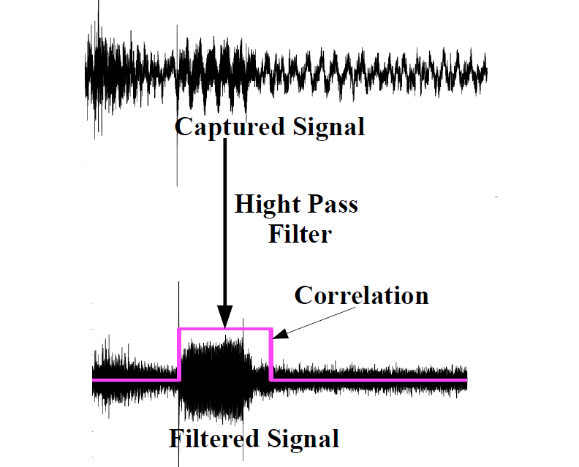
RF-Beep: Implementation
RF-Beep Architecture
Beep Signal Generation
Beep Signal Detection
PerCom'13

Slide 55
RF-Beep: Range Estimation
∆t_{ab}
Timestamp at Beacon device
t_{b1}
t_{b2}
t_{a1}
t_{a2}
D = s_{a}.(∆f_{ab} -∆t_{ab})
f_{a2}
Timestamp at Target device
f_{b1}
f_{a1}
∆f_{ab} =
μ
+
n_{ab}/f_{s}
n_{ab} , is the starting sampling # of the capture Beep sound f_{s} , sampling frequency.
PerCom'13

Slide 56
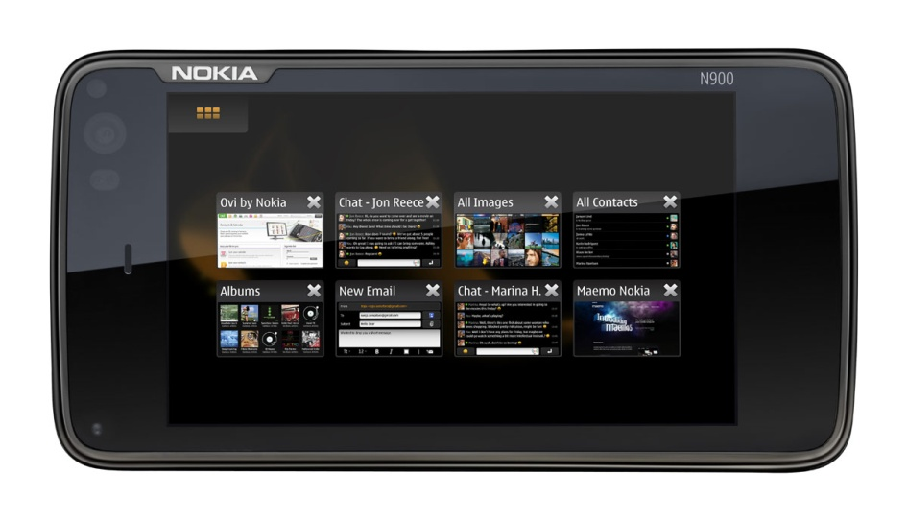
Experiment Equipment
We Implement RF-Beep in Nokia N900
Audio Interface is supported by ALSA SoC driver
WiFi Interface is supported by wl12xx driver
PerCom'13

Slide 57
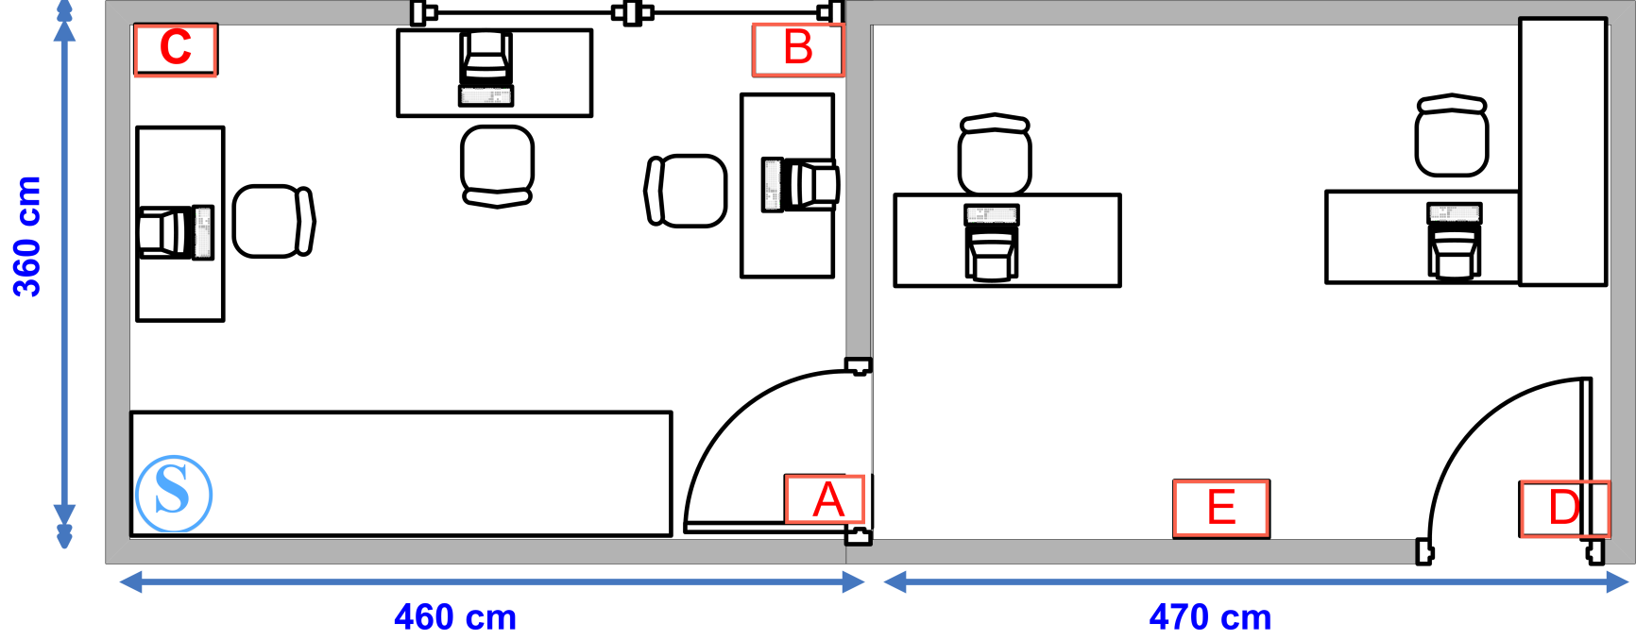
Experiment Scenarios
Indoor-quiet
Indoor-noisy
Outdoor-open space
PerCom'13

Slide 58
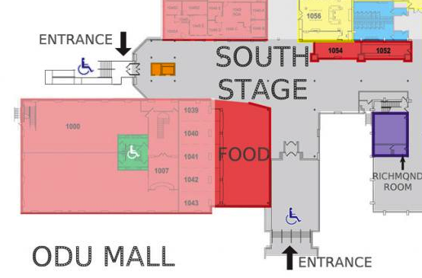
Experiment Scenarios
Indoor-quiet
Indoor-noisy
Outdoor-open space
PerCom'13

Slide 59
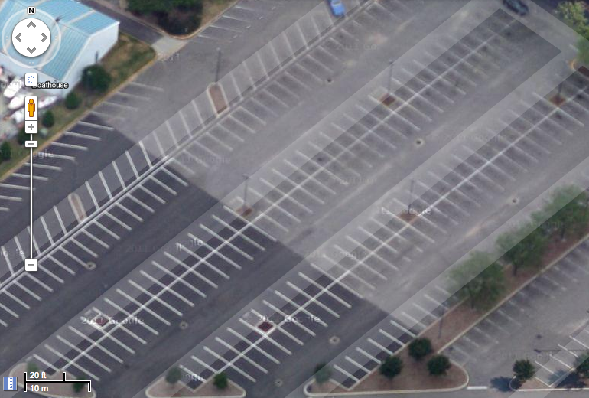
Experiment Scenarios
Indoor-quiet
Indoor-noisy
Outdoor-open space
PerCom'13

Slide 60
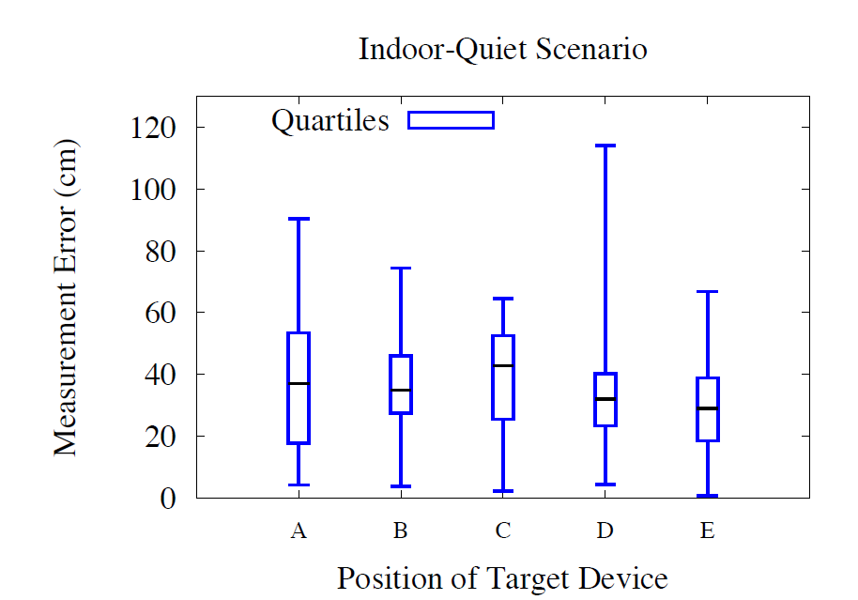
RF-Beep: Evaluation
Indoor-quiet
Indoor-noisy
Outdoor-open space
75% error less or equal to 50 cm
PerCom'13

Slide 61
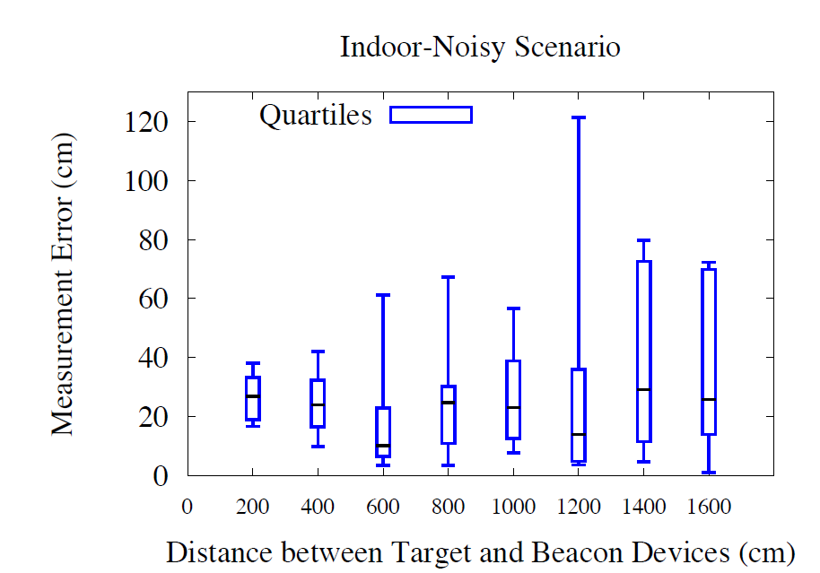
RF-Beep: Evaluation
Indoor-quiet
Indoor-noisy
Outdoor-open space
75% error less or equal to 40 cm up to 14meter
PerCom'13

Slide 62
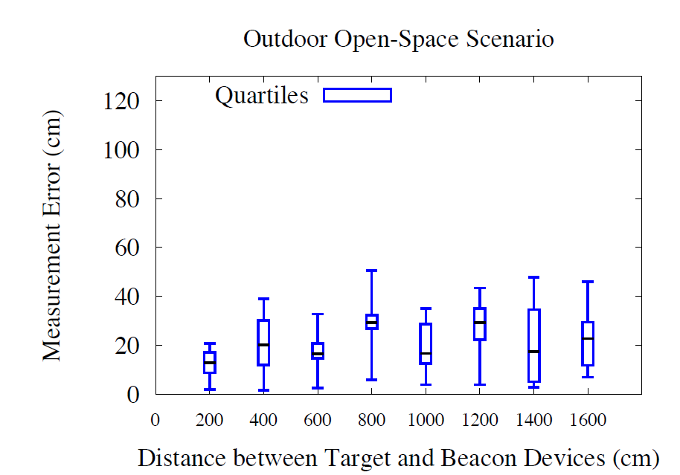
RF-Beep: Evaluation
Indoor-quiet
Indoor-noisy
Outdoor-open space
75% error less or equal 35 cm
PerCom'13

Slide 63
Conclusion
Ranging Scheme: RF-Beep
One way sensing scheme. (unlike Beep-Beep)
High accuracy.
Eliminates time synchronization requirement.
Smart devices usability. (unlike Cricket)
Local calculation.
Energy efficient.
Privacy preserving. (unlike Beep-Beep)
PerCom'13
Notes:
In this project, we design, implement and evaluate a ranging scheme Which we call RF-Beep.
This ranging scheme works for commercial off-the shelf smart device.
It utilizes the audio interface which is the microphone, speaker and the sound driver,
And the RF interface (in this case Wi-Fi) at the kernel spaces of the smart devices.
The reason we implement in kernel space so that we have better understanding about challenges of having

Slide 64

Contact Info
muddin@cs.odu.edu
http://www.cs.odu.edu/~muddin/
PerCom'13

